Slide 1
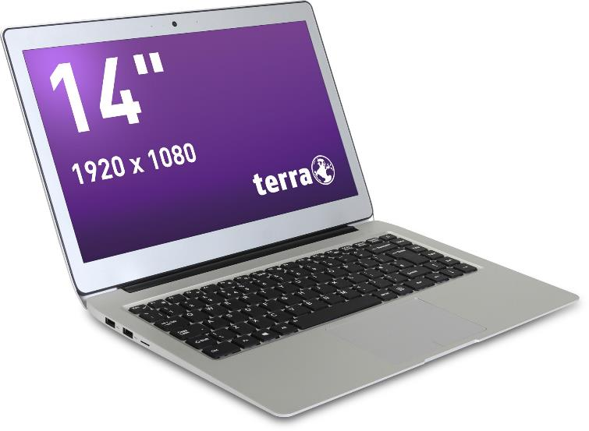
Service Manual
TERRA MOBILE 1460
TERRA MOBILE 1460P
TERRA MOBILE 1460Q

Slide 2


Contents
Service Notes
Remove the Bottom Case
LTE Module installation
Remove the Battery
Remove the CMOS Battery
Remove the SSD
Remove the WLAN Module
Remove the Mainboard
Remove the Touchpad
Remove the Top Case/ Keyboard
Remove the Hinge
Remove the LCD Display
Spare Parts
Feedback

Slide 3

SERVICE NOTES
Safety instructions
Work on a clean surface. Make sure that the housing can not be scratched.
Sort the screws and make sure that they are in the right place when reinstalling. Wrongly inserted screws can cause irreparable damage.
For all service work. Always disconnect the power supply and the battery connection to the mainboard.
Ensure you have sufficient ESD protection.
The WORTMANN AG accepts no liability for any damage caused when using this service manual.
Tools
Phillips screwdriver PH0
Phillips screwdriver PH1
Slotted screwdriver 2 mm
Plastic Slotted screwdriver 3mm
Duct tape
These repair instructions are for the TERRA MOBILE 1460P. The construction of the 1460 and 1460Q differs partially from this manual.

Slide 4
REMOVE THE
BOTTOM CASE
TERRA MOBILE 1460P
Difficulty: 

Slide 5
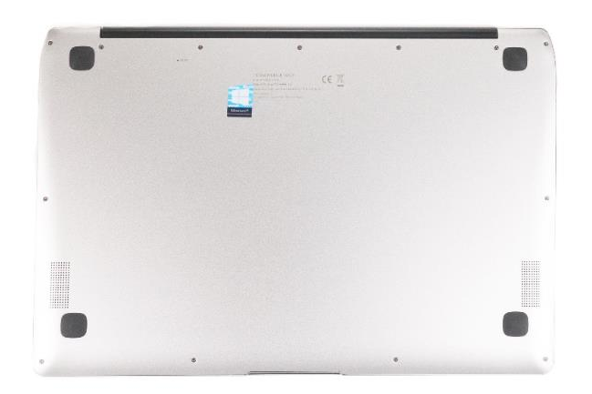
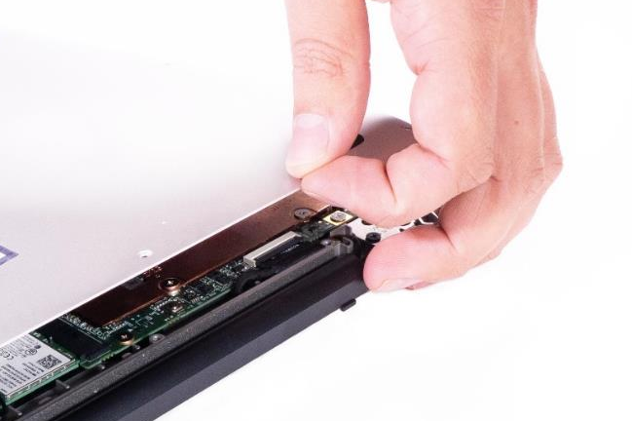
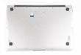

1. Step
Before you start, switch off the notebook! and remove the power supply.
Remove the 13 screws from the bottom case. (Fig.1).
Lift off the case cover. (Fig.2).
1
2

Slide 6
LTE MODULE INSTALLATION
TERRA MOBILE 1460P/Q
Difficulty: 

Slide 7
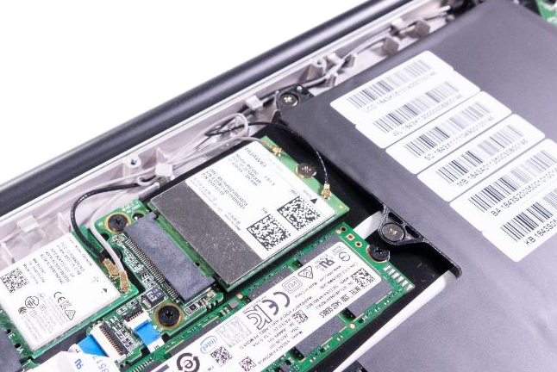
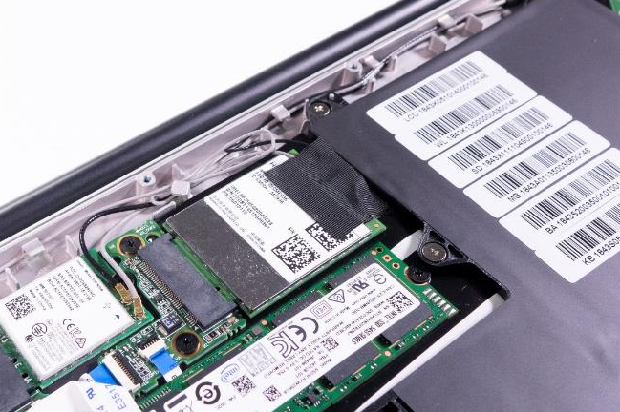
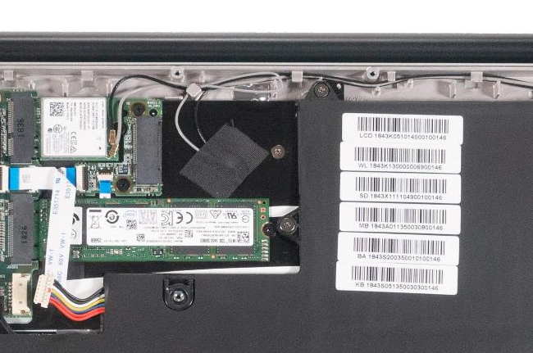
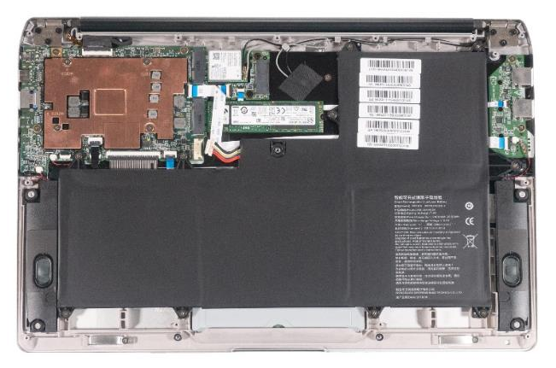




1. Step
AUX
Remove the Bottom Case
Disconnect the battery connection cable. (Fig.1).
Loosen the fixing screw and the black adhesive strips. (Fig. 2).
Insert the module and secure it again with the screw. Then carefully plug in the antenna connectors (black cable to Main, gray cable to AUX. (Fig.3).
Finally, secure the connectors with duct tape. (Fig.4).
Connect the battery cable. (Fig.1).
MAIN
1
2
3
4

Slide 8
REMOVE THE BATTERY
TERRA MOBILE 1460
Difficulty: 

Slide 9
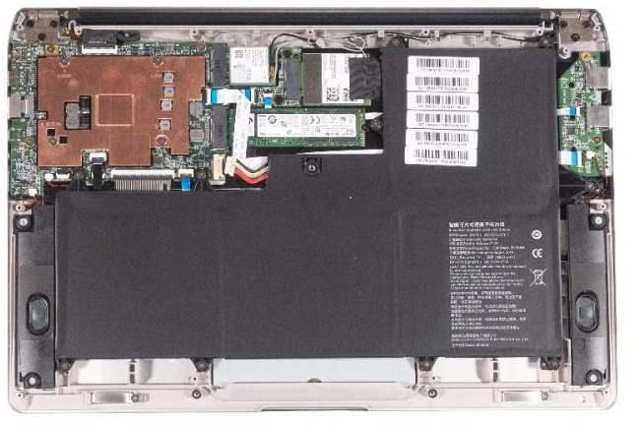
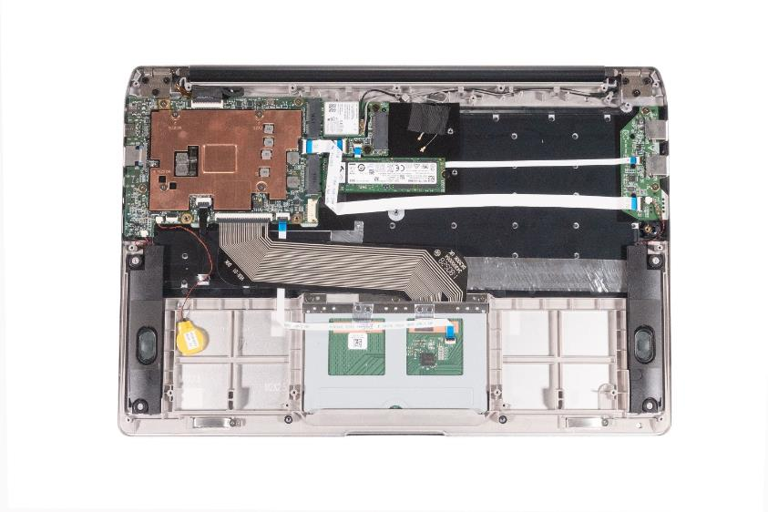
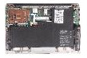
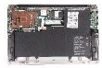
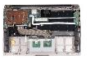
1. Step
Remove the Bottom Case
Disconnect the battery connection cable. (Fig.1).
Remove the 10 screws. (Fig.2).
The battery can now be easily removed by lifting it upwards.(Fig.3).
To install a battery, please proceed in the reverse order.
1
2
3

Slide 10
REMOVE THE
CMOS BATTERY
TERRA MOBILE 1460
Difficulty: 

Slide 11
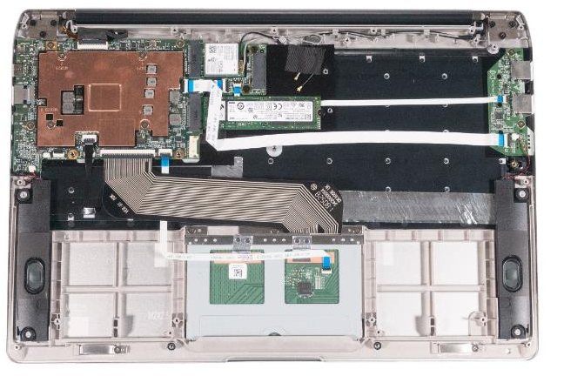
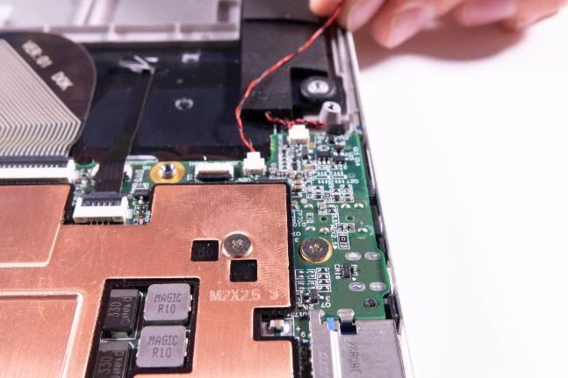



1. Step
Remove the Bottom Case
Remove the Battery
Now you can see the CMOS battery. (Fig.1).
Carefully remove the plug. (Fig.2).
Detach the CMOS battery from the housing. (Fig.3).
When installing, pay attention to the correct polarity of the plug. (Fig.2).
After inserting a new battery, the notebook will switch off twice during start-up! This is normal.Make sure you reset your BIOS/UEFI settings.
1
2
3

Slide 12
REMOVE THE SSD
TERRA MOBILE 1460
Difficulty: 

Slide 13
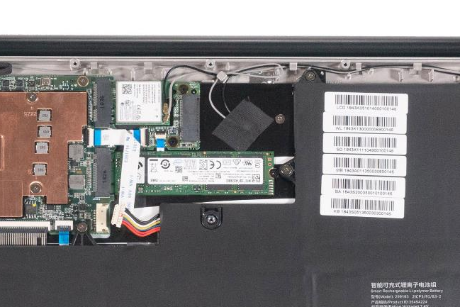
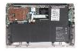

1. Step
Remove the Bottom Case
Disconnect the battery connection cable. (Fig.1).
Loosen the mounting screw. ( Fig.2) and then you can easily release the SSD from the slot.
To install an SSD, please proceed in the reverse order.
Terra MOBILE 1460 supports SATA SSDMOBILE. Terra MOBILE1460P/Q supports SATA & NVME SSD.
Connect the battery cable. (Fig.1).
1
2

Slide 14
REMOVE THE
WLAN MODULE
TERRA MOBILE 1460
Difficulty: 

Slide 15
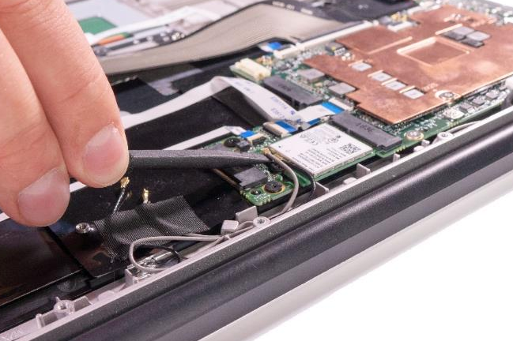

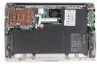
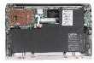

1. Step
Remove the Bottom Case
Disconnect the battery connection cable. (Fig.1).
Carefully loosen the two antenna connectors. (Fig.2 & 3) using the slotted plastic screwdriver 3mm.
Remove the screw.
When installing, please make sure that the antenna cables are connected as shown in the pictures.
1
2
3

Slide 16
REMOVE THE MAINBOARD
TERRA MOBILE 1460
Difficulty: 

Slide 17
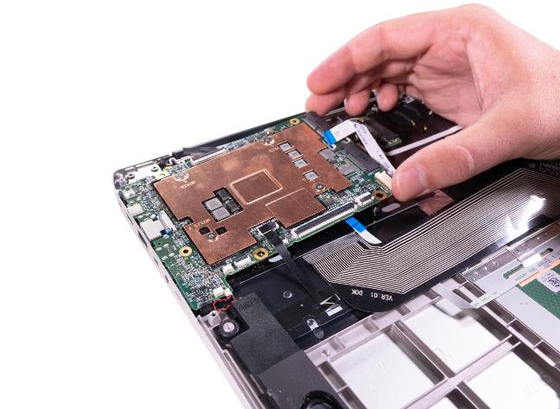
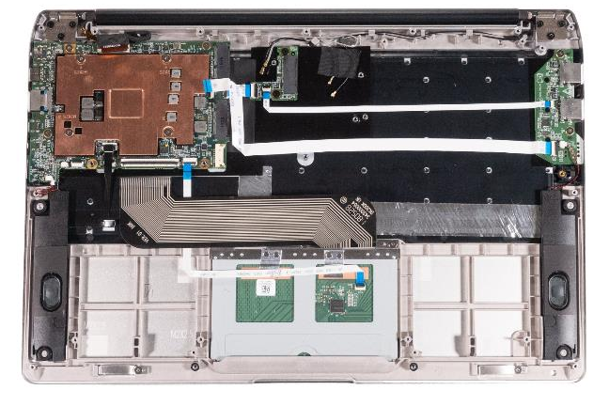
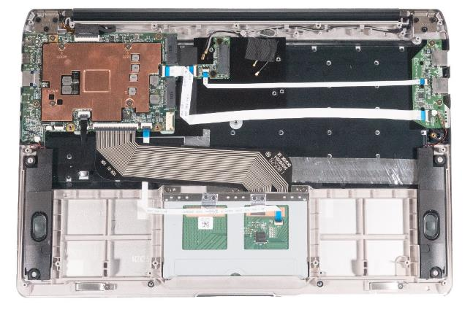



1. Step
Remove the Bottom Case
Remove the battery
Remove the SSD
Remove the WLAN Module
Disconnect all 7 connectors on the mainboard. (Fig.1).
Now remove the 3 screws from the mainboard. (Fig.2).
Now you can remove the mainboard.(Fig.3).
Heatsinks and foils should be transferred over, the thermal paste may have to be renewed.
1
2
3

Slide 18
REMOVE THE TOUCHPAD
TERRA MOBILE 1460
Difficulty: 

Slide 19
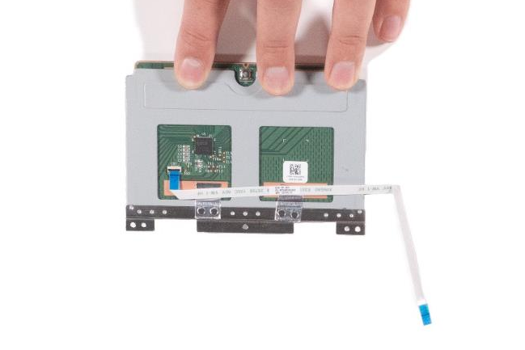
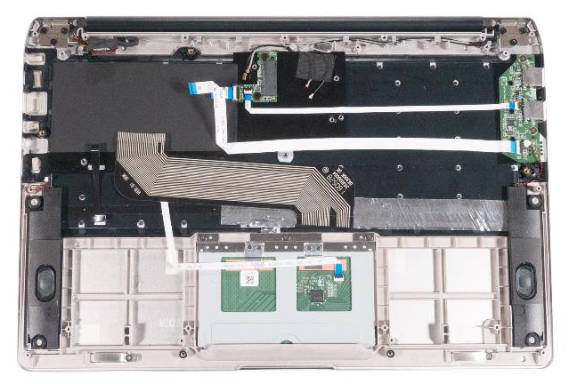
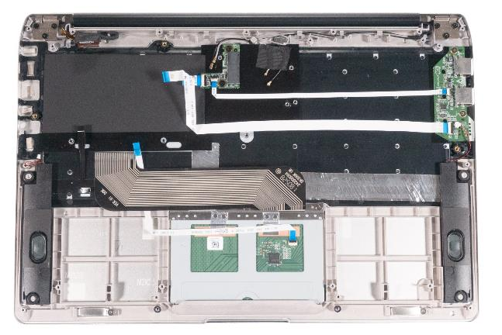

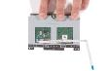
1. Step
Remove the Bottom Case
Remove the Battery
First you have to remove the black flat cable. (Fig.1) it covers the screws from the touchpad.
Now remove the 3 screws on the touchpad. (Fig.2).
Take the touchpad out of the housing.
Release the safety catch on the connector and remove the flat ribbon cable. (Fig.3).
1
2
3

Slide 20
REMOVE THE TOP CASE/ KEYBOARD
TERRA MOBILE 1460
Difficulty: 

Slide 21
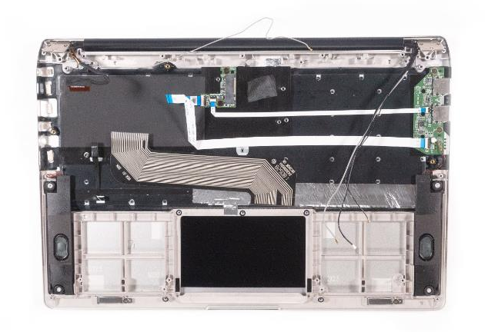
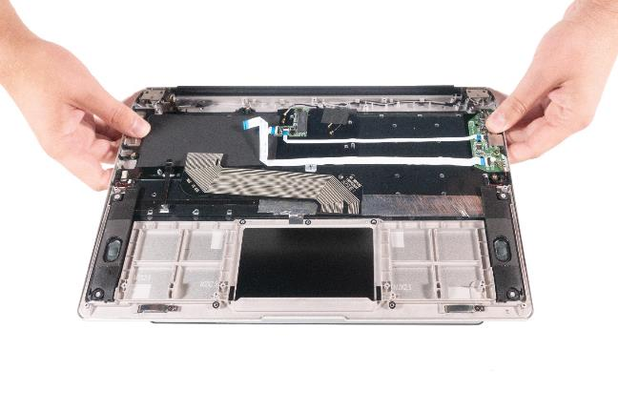
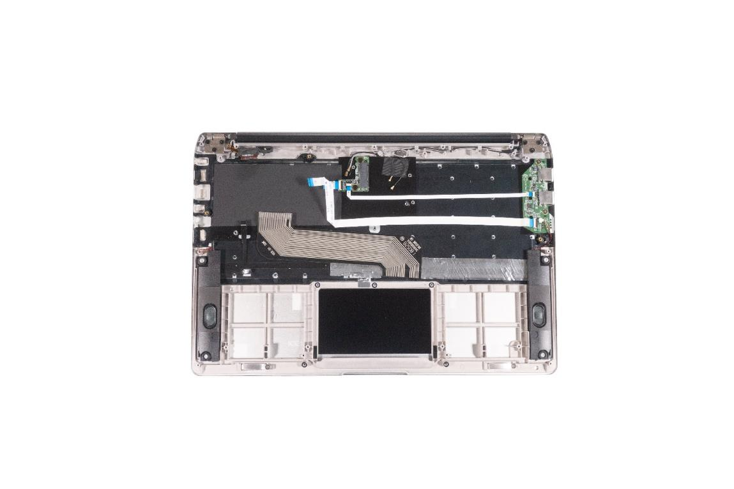
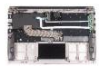


1. Step
Remove the Mainboard
Remove the Touchpad
Separate the top case from the LCD housing by removing 6 PH1 screws from the hinges. (Fig.1).
Flip open the display. (Fig.2).
Now carefully remove the antenna cable and the display cable that were previously behind the hinges. (Fig.3).
The cables cannot be completely removed until you have released the hinges. Do not remove the top case until you have disconnected the cables.
1
2
3

Slide 22
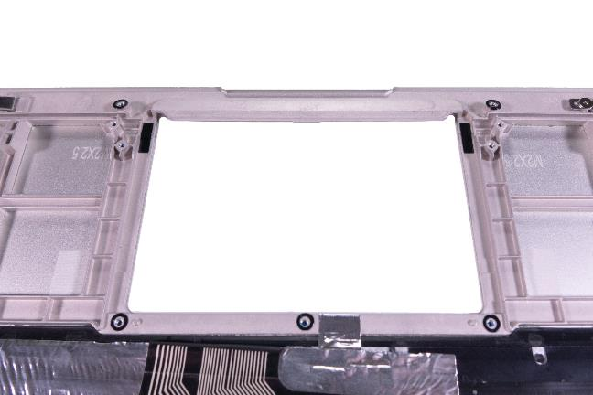
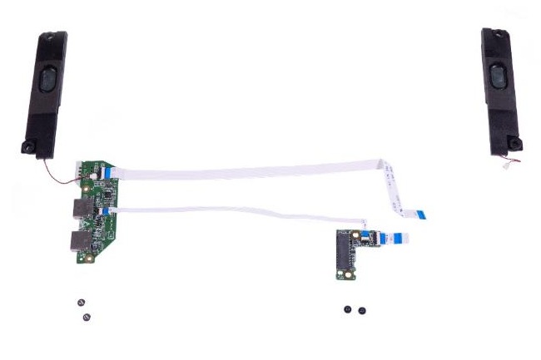
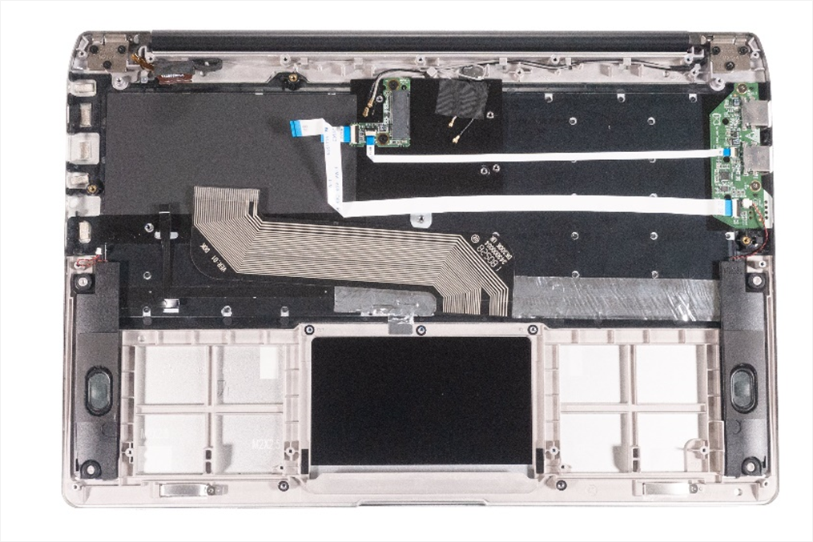
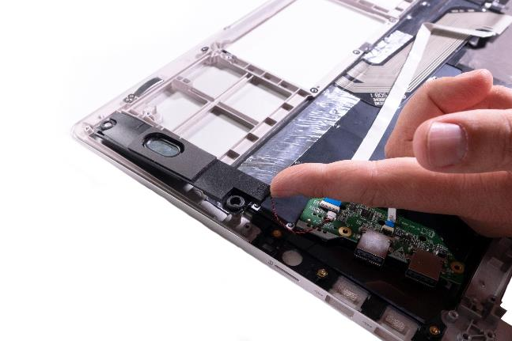
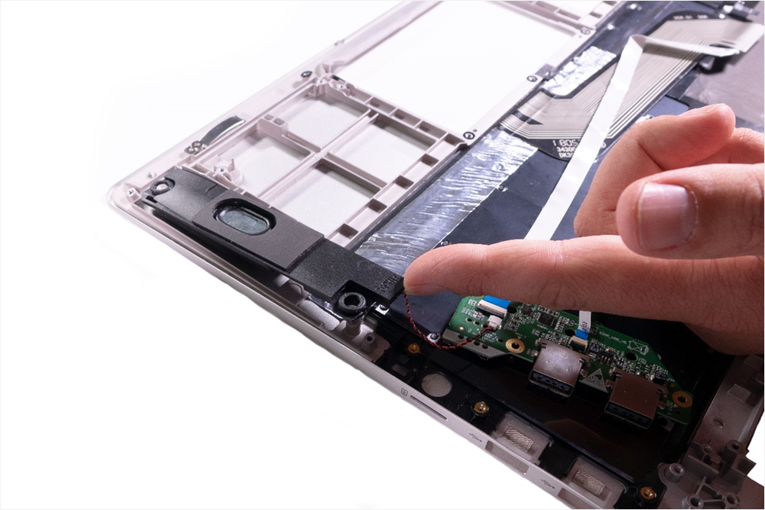

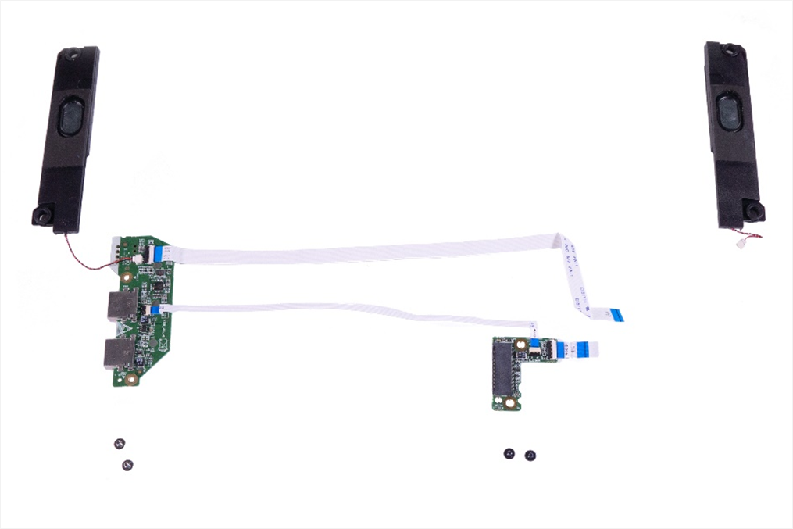
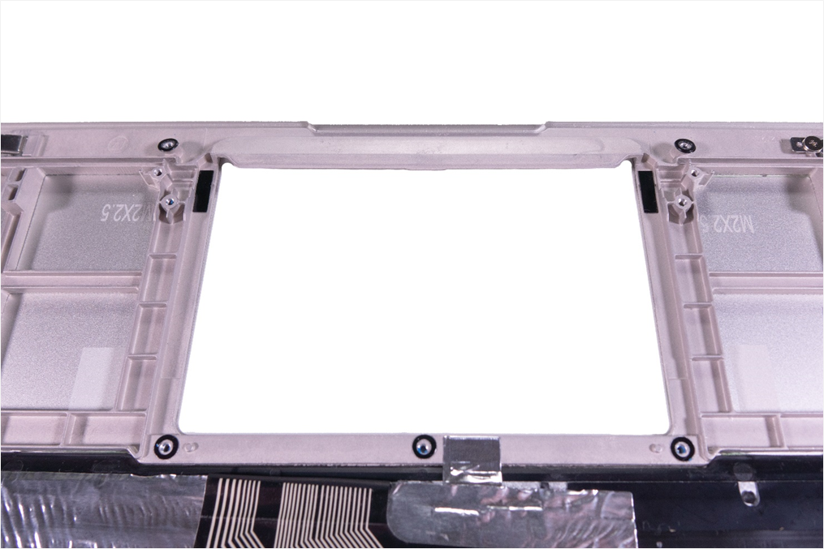
2. Step
Now remove the two speakers (Fig.1).The speakers are attached to the casing with adhesive tape. Remove them by lifting them up as shown in. (Fig.2).
Remove the USB board & the LTE board both have 2 screws. (Fig.3). To check, all the individual parts can be seen in. (Fig.4).
If necessary, take over the conductive connectors. (Fig.5).
Replace the adhesive on the flat ribbon cables as necessary.
To install a top case or keyboard, please proceed in the reverse order.
1
2
3
4
5

Slide 23
REMOVE THE HINGE
TERRA MOBILE 1460
Difficulty: 

Slide 24
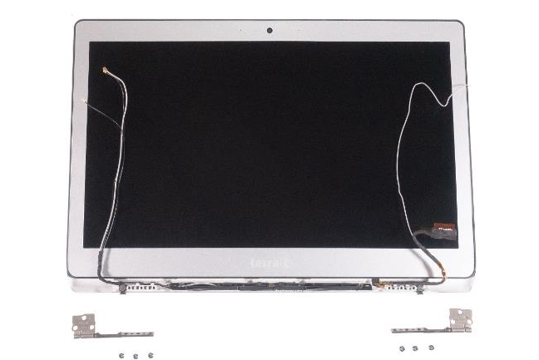
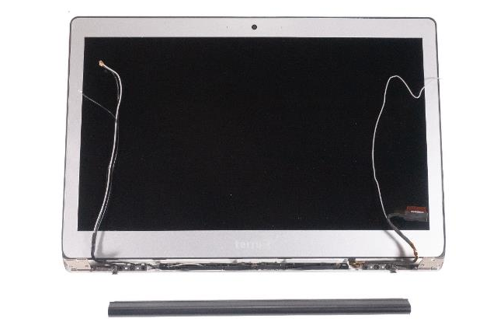
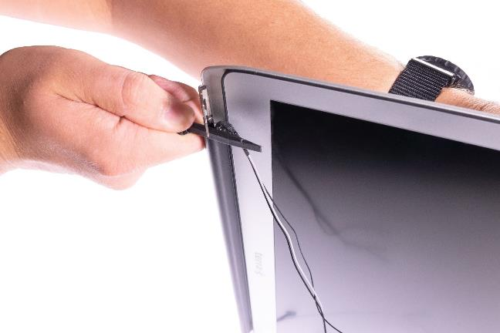
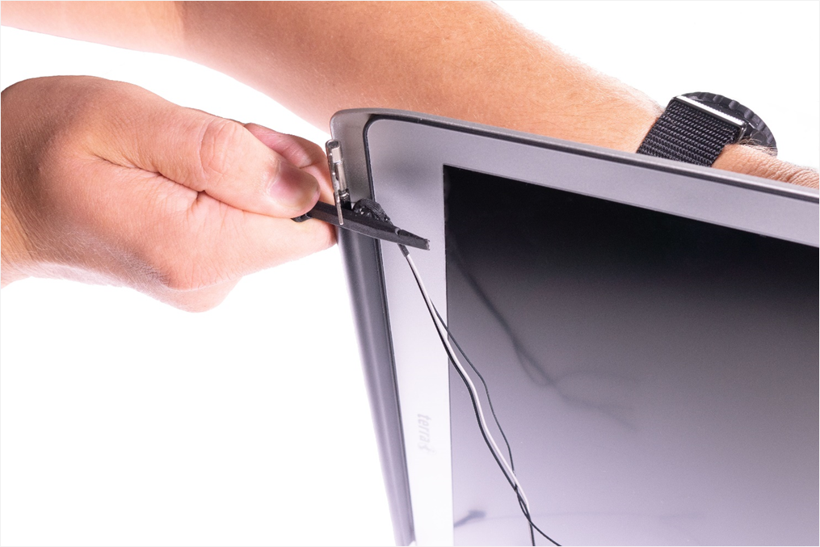
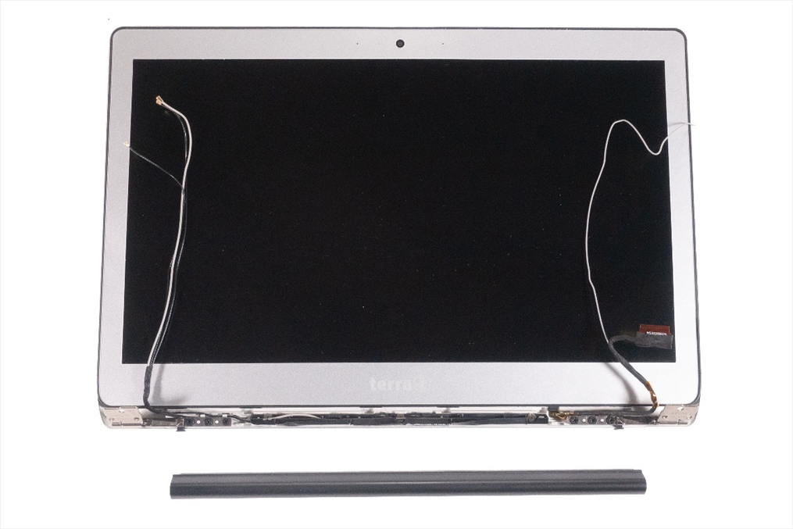
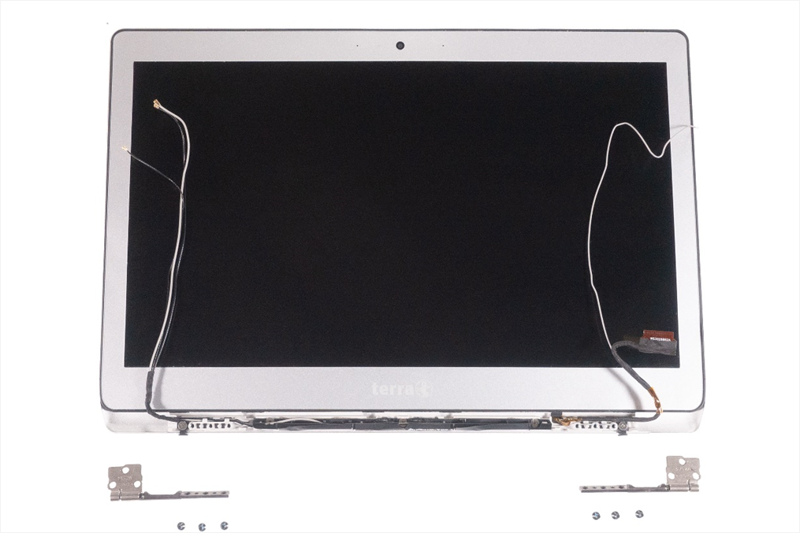
1. Step
Remove the Top Case
Place the display upright and press the hinge cover down slightly until you hear a clicking sound. (Fig.1).
Now you can remove the hinge cover.
Loosen the 6 hinge screws PH1(Fig.2).
To install new hinges, please proceed in the reverse order.
When installing, make sure that no cables are trapped or cramped.
1
2
3

Slide 25
REMOVE THE LCD DISPLAY
TERRA MOBILE 1460
Difficulty: 

Slide 26
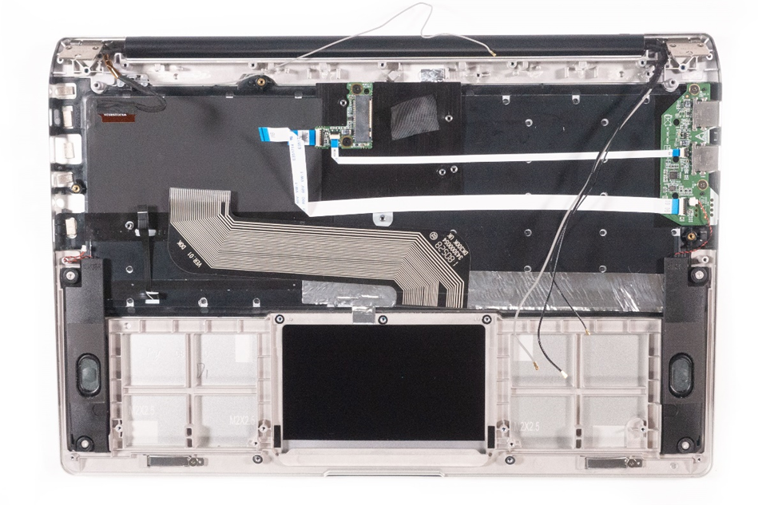
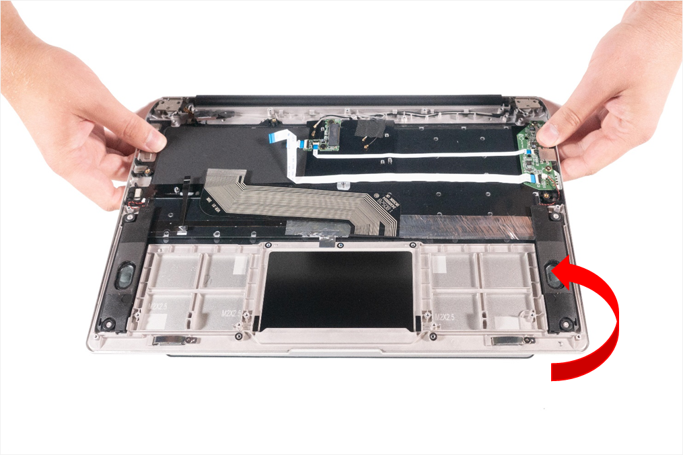
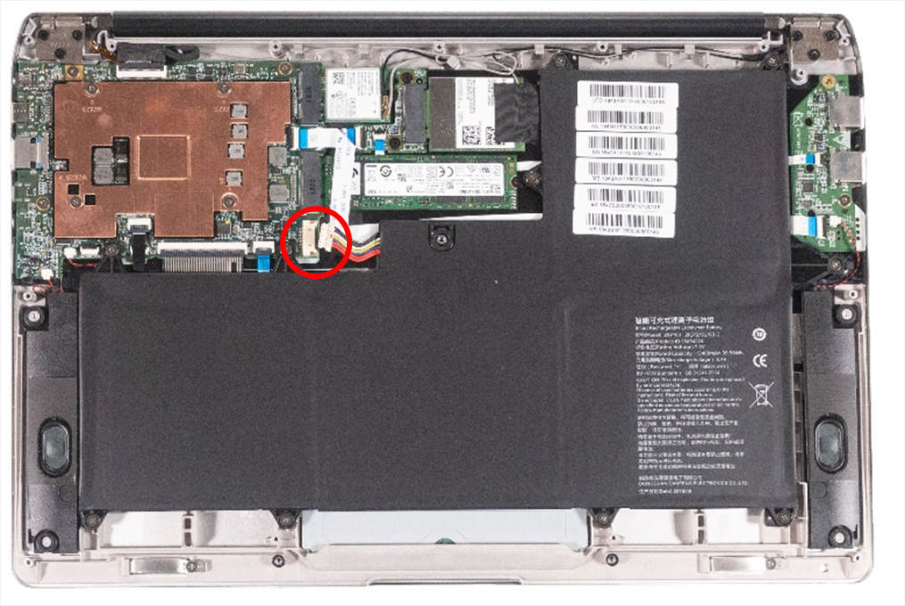
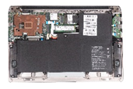
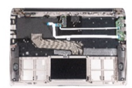

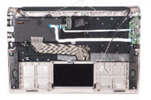
1. Step
Remove the Bottom Case
Disconnect the battery connection cable, or even better remove the battery completely from the case. (Fig.1).
Separate the top case from the LCD housing by removing 6 PH1 screws from the hinges. (Fig.2).
Flip open the display (Fig.3).
Now carefully remove the antenna cable and the display cable that were previously behind the hinges. (Fig.4).
Now you can begin to remove the LCD display from the top case.
The display and housing are a complete unit.
1
2
3
4

Slide 27
Spare Parts TERRA MOBILE 1460
Article number | Description
1480075 | Power supply 36W
1480079 | Battery 40Wh
E1080160 | Bottom Case (Cover D)
E1080098 | Display Full HD eDP 14.0" incl. Cover A & B
E1080099 | Foil for Touchpad
E1080104 | Mainboard (M3-7Y30)
E1080105 | Mainboard (i5-7Y54)
E1080297 | Hinge (L)
E1080298 | Hinge (R)
E1080159 | Hinge Cover
E1080096 | Speaker (L)
E1080097 | Speaker (R)
E1080263 | Top Case (Cover C) incl. Keyboard (DE)
E1080262 | Top Case (Cover C) incl. Keyboard (FR)
E1080100 | Touchpad
E1080106 | USB Board

Slide 28
Spare Parts TERRA MOBILE 1460P
Article number | Description
1480075 | Power supply 36W
1480079 | Battery 40Wh
E1080262 | Bottom Case (Cover D)
E1080325 | Display Full HD eDP 14.0" incl. Cover A & B
E1080099 | Foil for Touchpad
E1080261 | LTE Board
E1080278 | M.2 Screw für LTE & SSD
E1080259 | Mainboard (i5-8200Y)
E1080100 | Touchpad
E1080260 | USB Board
E1080297 | Hinge (L)
E1080298 | Hinge (R)
E1080159 | Hinge Cover
E1080096 | Speaker (L)
E1080097 | Speaker (R)
Article number | Description
E1080263 | Top Case (Cover C) incl. Keyboard (DE)
E1080264 | Top Case (Cover C) incl. Keyboard (CH)
E1080265 | Top Case (Cover C) incl. Keyboard (FR)
E1080266 | Top Case (Cover C) incl. Keyboard (US)
E1080513 | Top Case (Cover C) incl. Keyboard (UK)
E1ß80359 | LTE/WLAN Antenne

Slide 29
Spare Parts TERRA MOBILE 1460Q
Article number | Description
1480075 | Power supply 36W
1480079 | Battery 40Wh
E1080523 | Bottom Case (Cover D)
E1080515 | Display Full HD eDP 14.0" incl. Cover A & B
E1080099 | Foil for Touchpad
E1080261 | LTE Board
E1080278 | M.2 Screw für LTE & SSD
E1080471 | Mainboard (i5-10210Y)
E1080100 | Touchpad
E1080260 | USB Board
E1080297 | Hinge (L)
E1080298 | Hinge (R)
E1080159 | Hinge Cover
E1080096 | Speaker (L)
E1080097 | Speaker (R)
Article number | Description
E1080263 | Top Case (Cover C) incl. Keyboard (DE)
E1080264 | Top Case (Cover C) incl. Keyboard (CH)
E1080265 | Top Case (Cover C) incl. Keyboard (FR)
E1080266 | Top Case (Cover C) incl. Keyboard (US)
E1080513 | Top Case (Cover C) incl. Keyboard (UK)
E1ß80359 | LTE/WLAN Antenne

Slide 30
Do you have questions or suggestions?
Then send an e-mail to info@wortmann.de
We are looking forward to your feedback!

