Slide 1
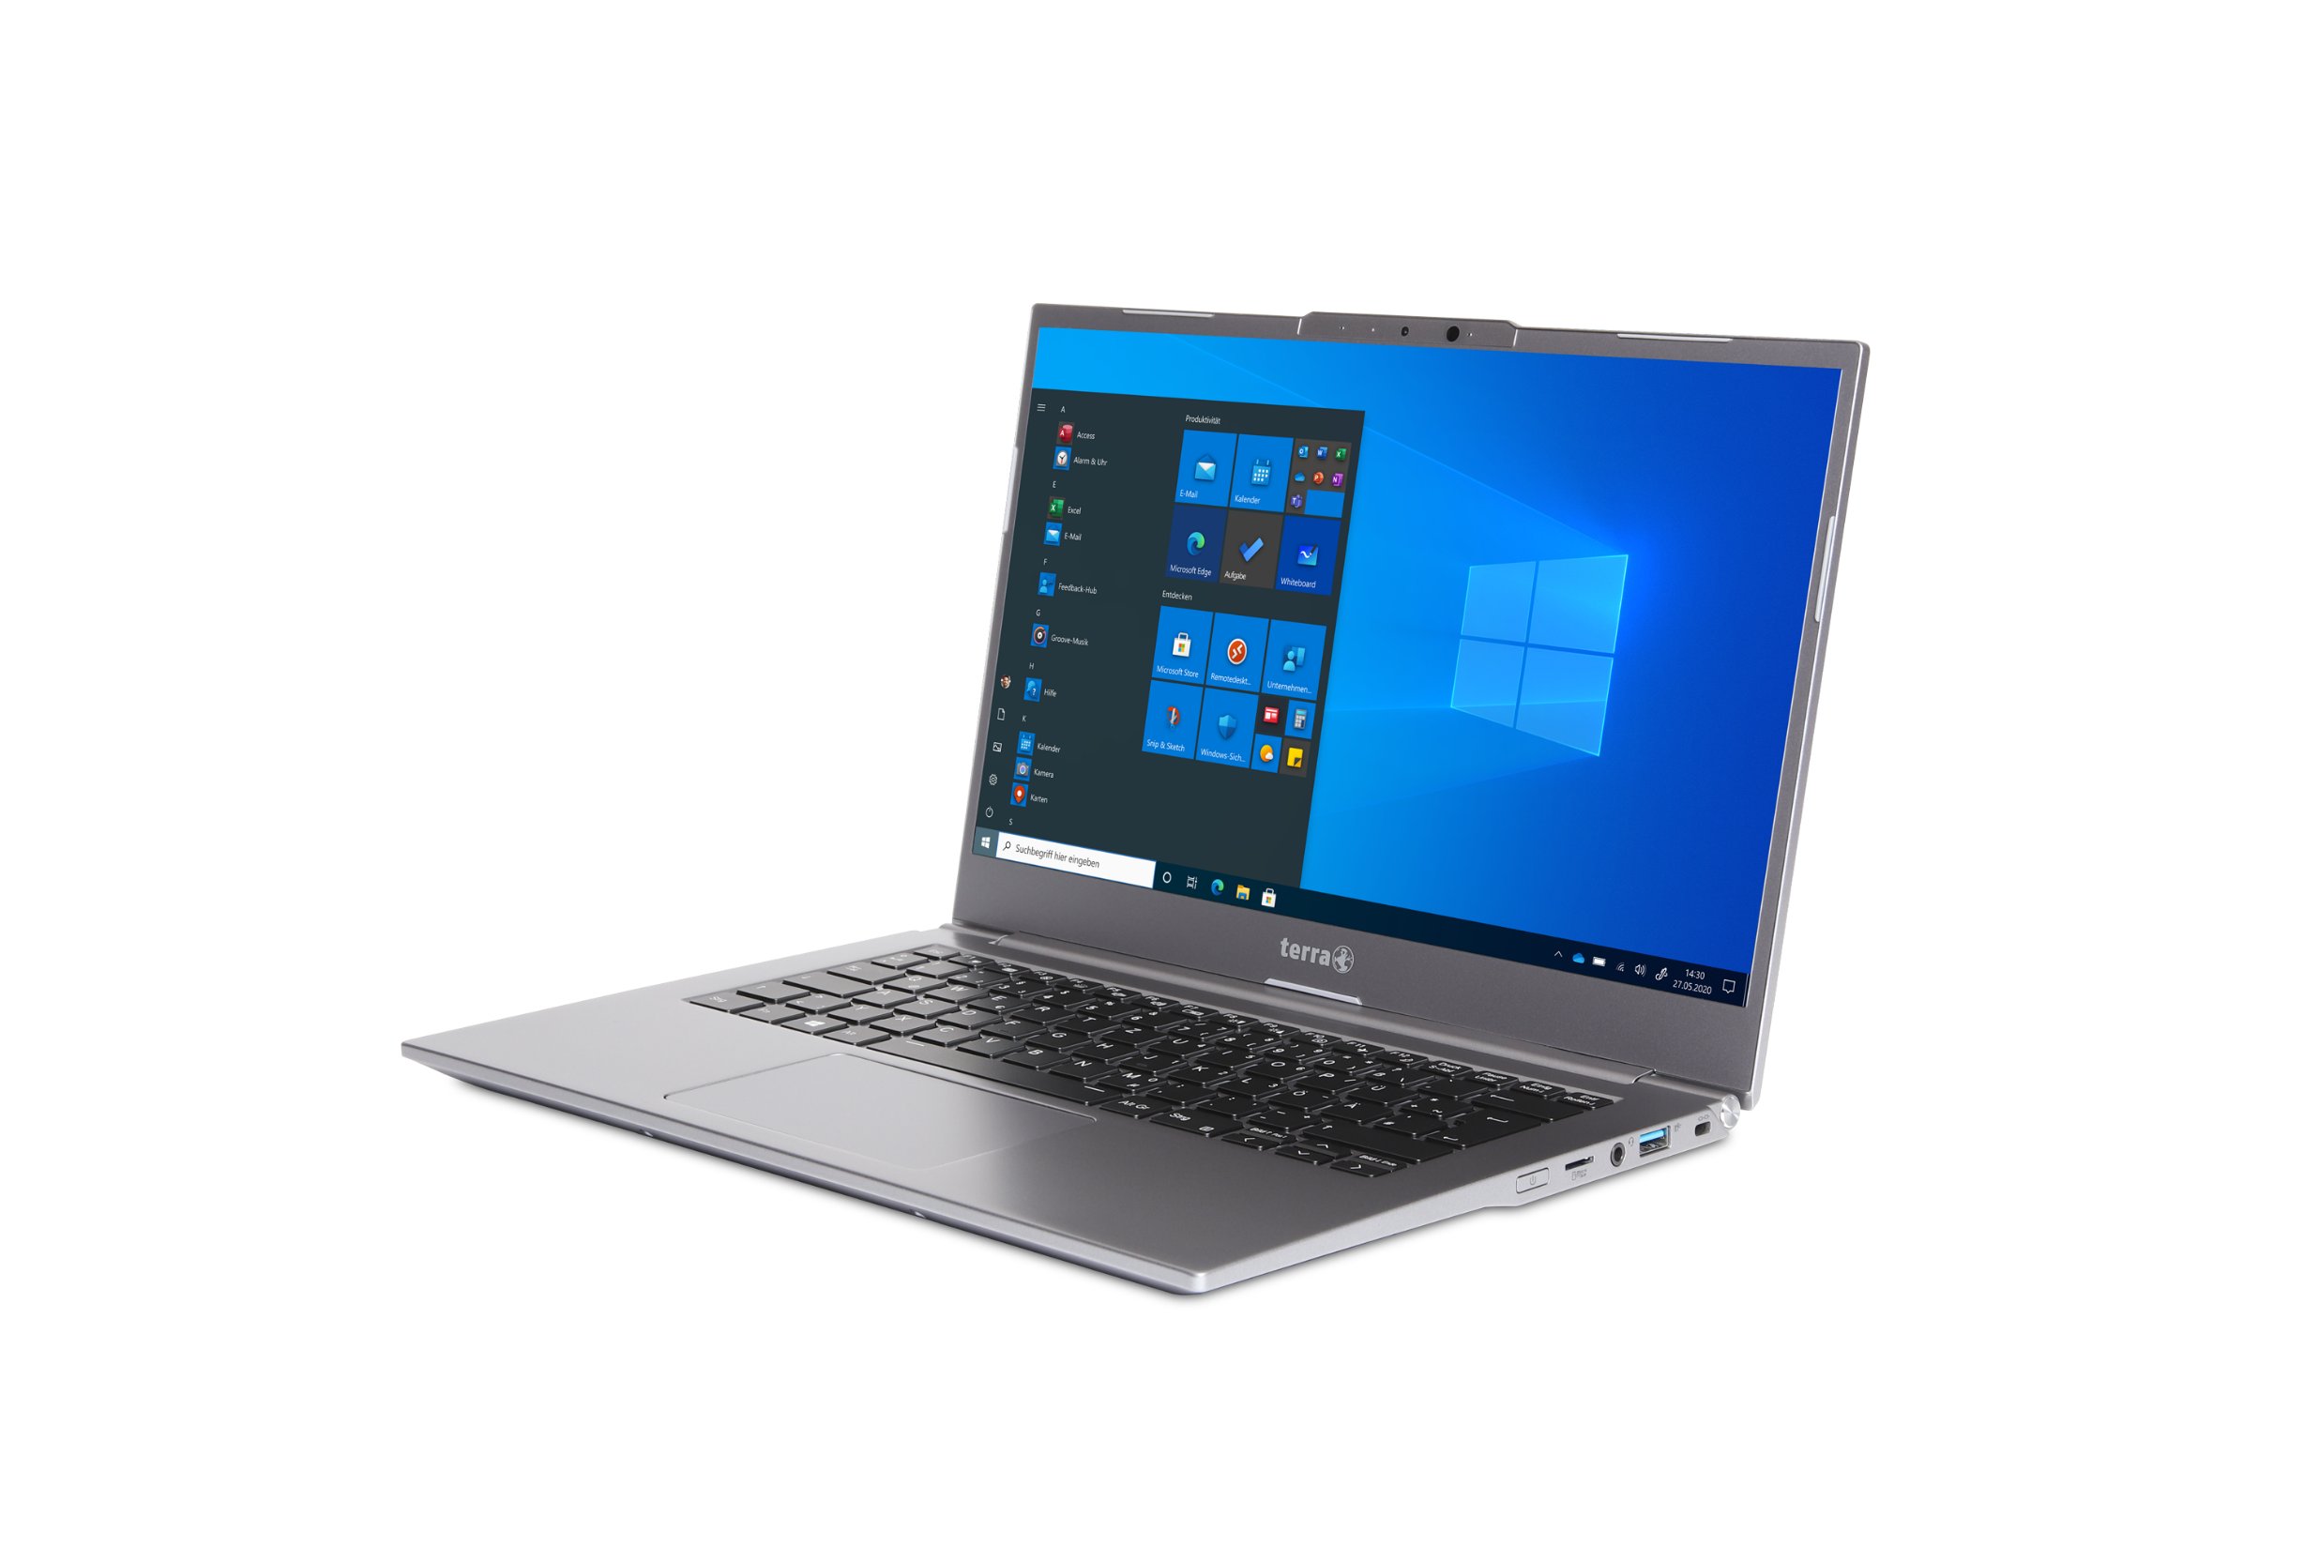
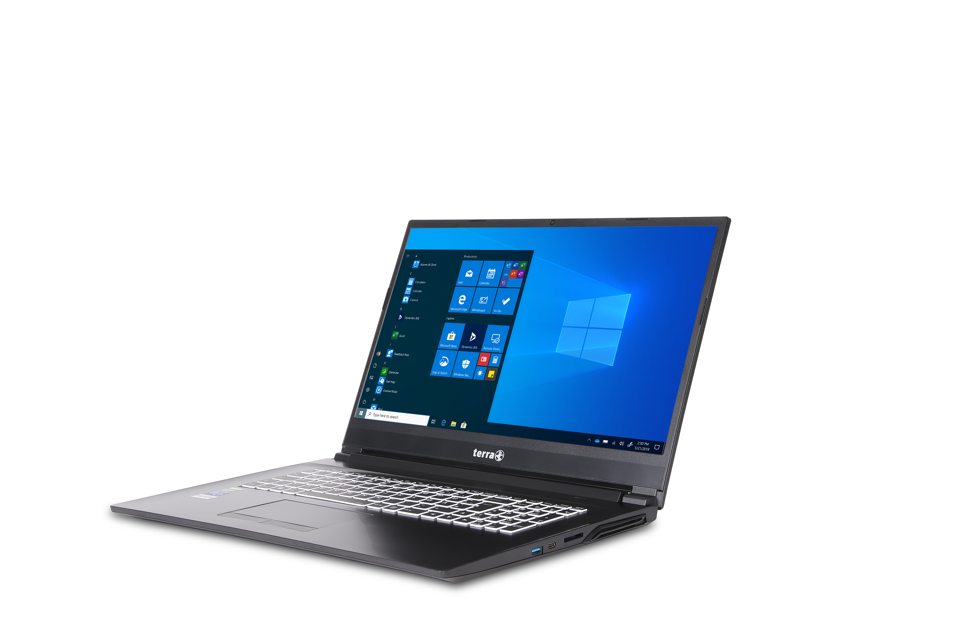
Service Manual
TERRA MOBILE 1470
TERRA MOBILE 1470T
TERRA MOBILE 1470U

Slide 2


Contents
Service Notes
Remove the Bottom Case
Remove the Battery
Remove the RAM
Remove the SSD
Remove the CMOS Battery
Remove the WLAN Module
LTE-Module installation
Remove the CPU Fan
Remove the Heatsink
Remove the Touchpad
Remove the Mainboard
Remove the Top Case
Remove the Webcam
Remove the LCD Hinge Cover
Remove the Hinge
Spare Parts

Slide 3
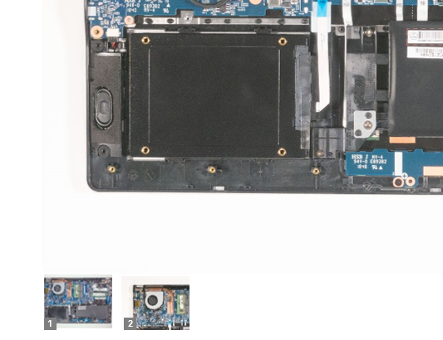
SERVICE NOTES
Safety instructions
Work on a clean surface. Make sure that the housing can not be scratched.
Sort the screws and make sure that they are in the right place when reinstalling. Wrongly inserted screws can cause irreparable damage.
For all service work. Always disconnect the power supply and the battery connection to the mainboard.
Ensure you have sufficient ESD protection.
The WORTMANN AG accepts no liability for any damage caused when using this service manual.
Tools
Phillips screwdriver PH0
Phillips screwdriver PH1
Slotted screwdriver 2 mm
Plastic Slotted screwdriver 3mm
Duct tape
Combination tool or long nose pliers
The photos in this repair manual show the TERRA MOBILE 1470. Deviations in the construction of the MOBILE 1470T and 1470U are shown separately....
Note
Click on the thumbnails to
view the pictures in full size.

Slide 4
REMOVE THE BOTTOM CASE
TERRA MOBILE 1470
Difficulty: 

Slide 5
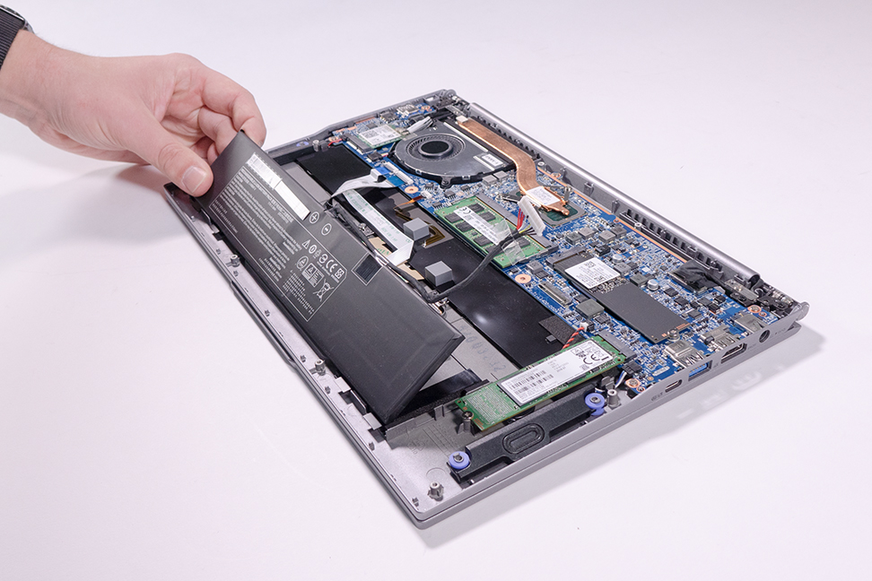
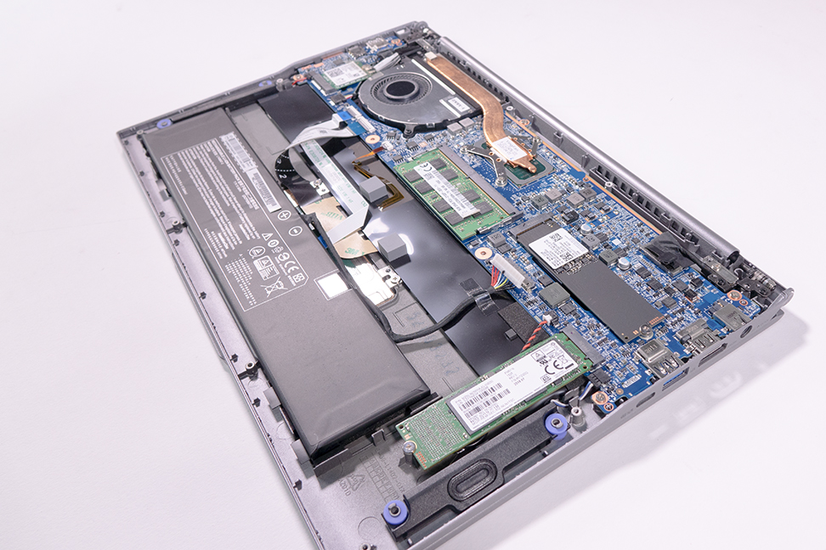
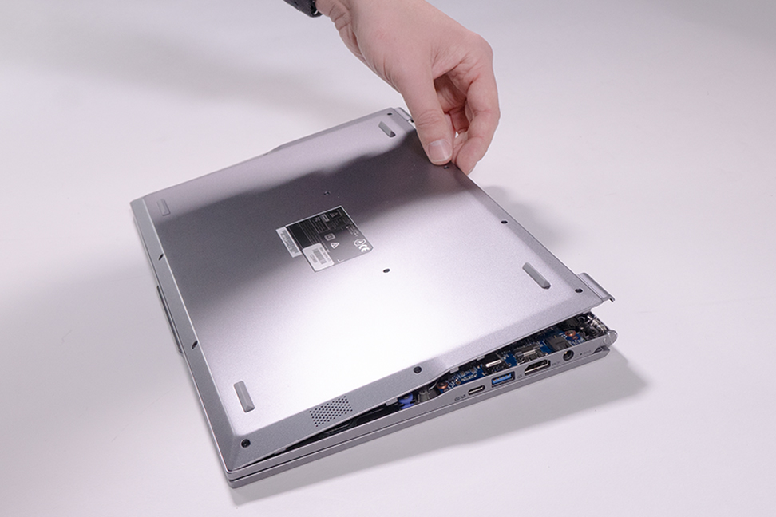
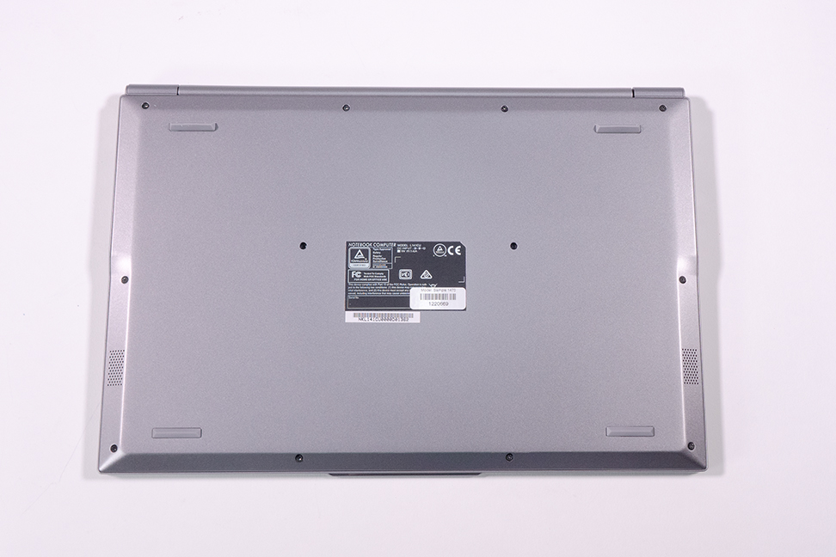
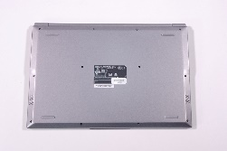
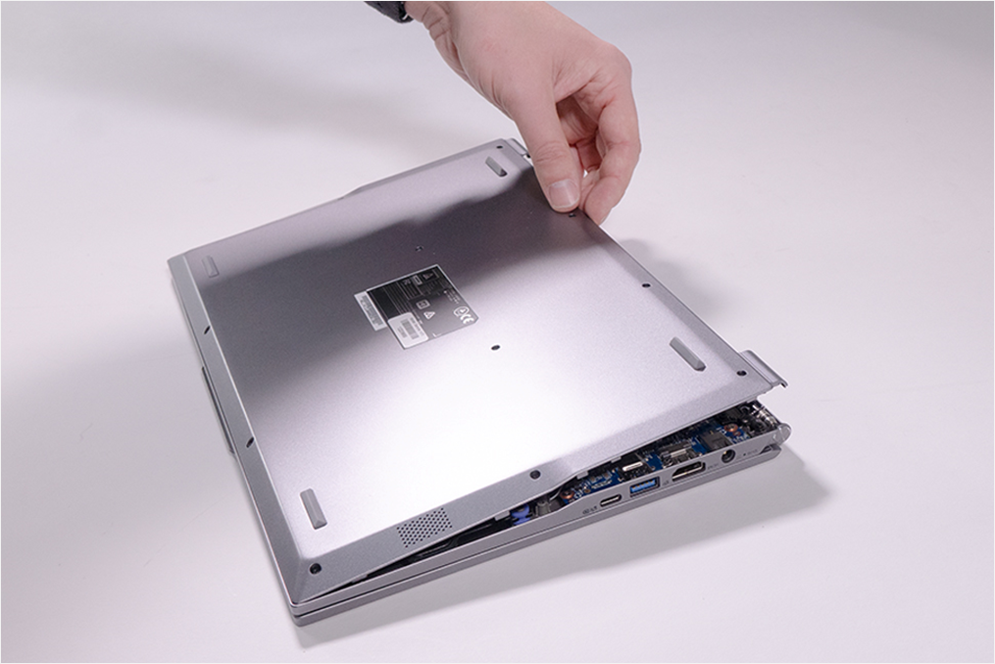
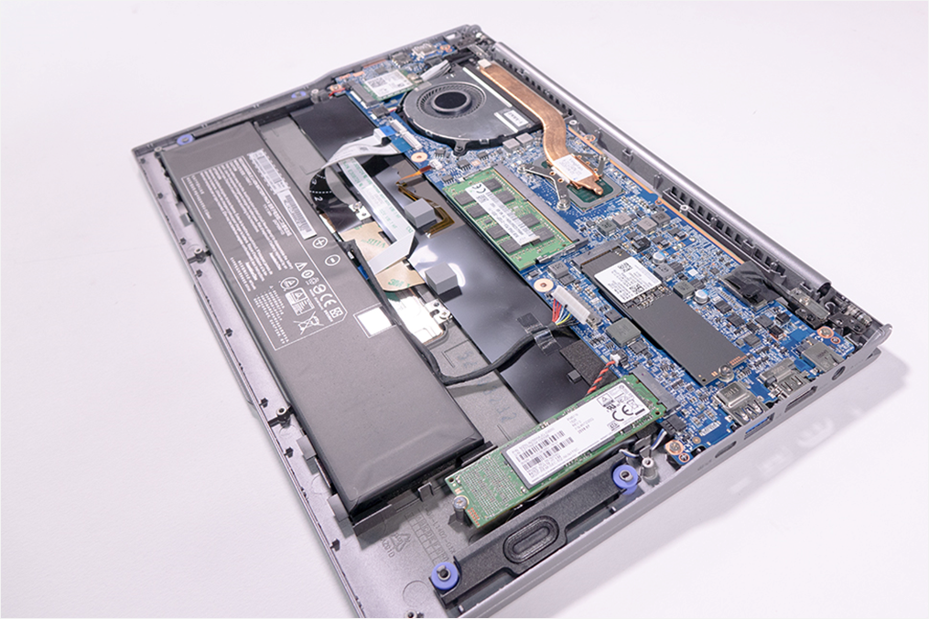
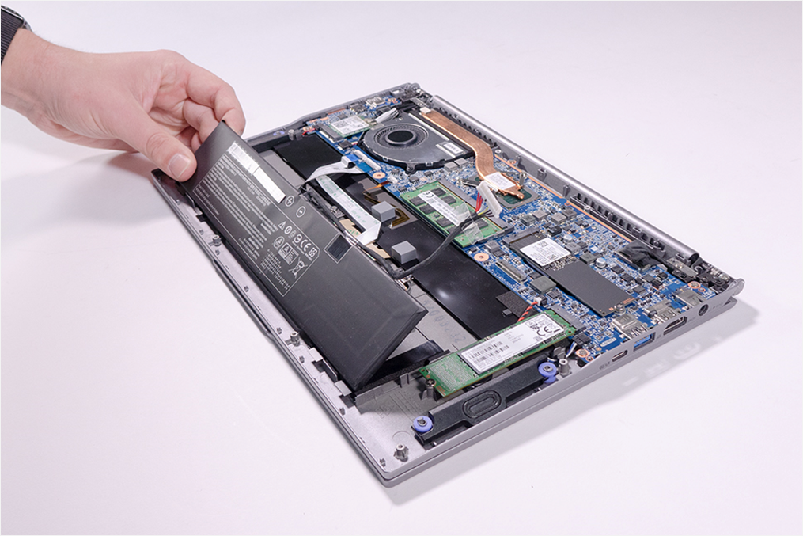
1. Step
4
11
12
2
Remove the 12 screws located on the bottom case. (Fig.1).
Remove the case by lifting it upwards. (Fig.2).
Attention: When assembling, pay attention to the assembly order of the screws. (Fig.1).
8
9
7
10
1
5
6
3
1
2
3
4
5

Slide 6
REMOVE THE BATTERY
TERRA MOBILE 1470
Difficulty: 

Slide 7
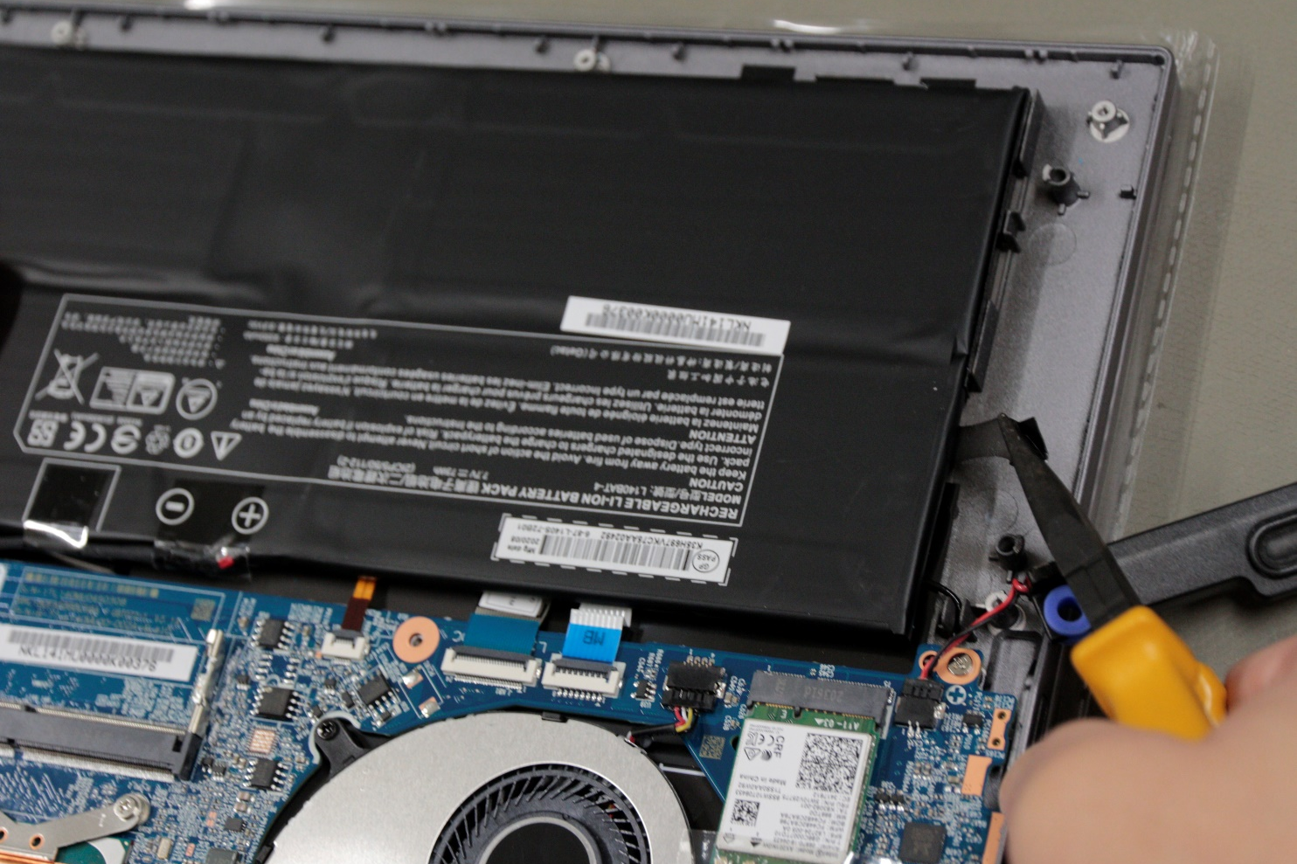
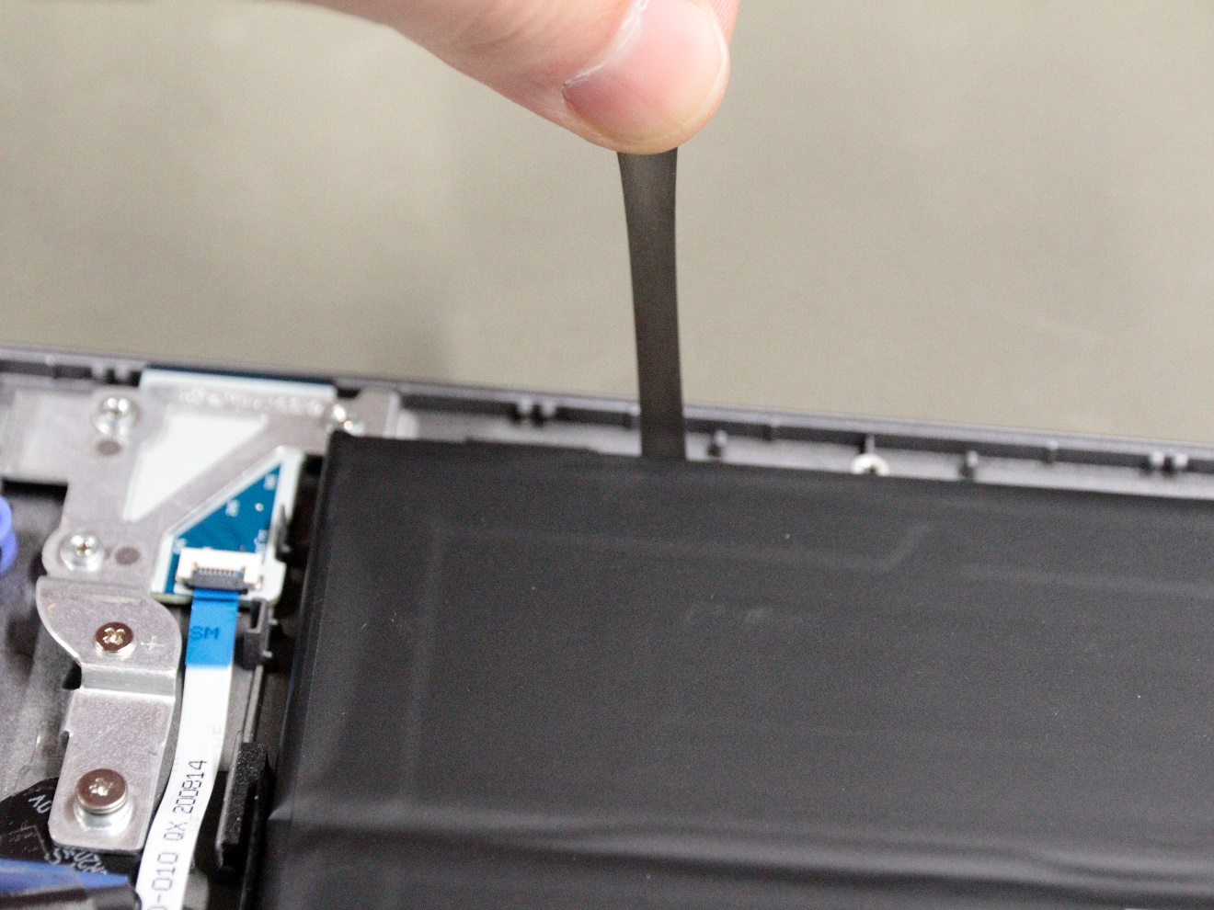
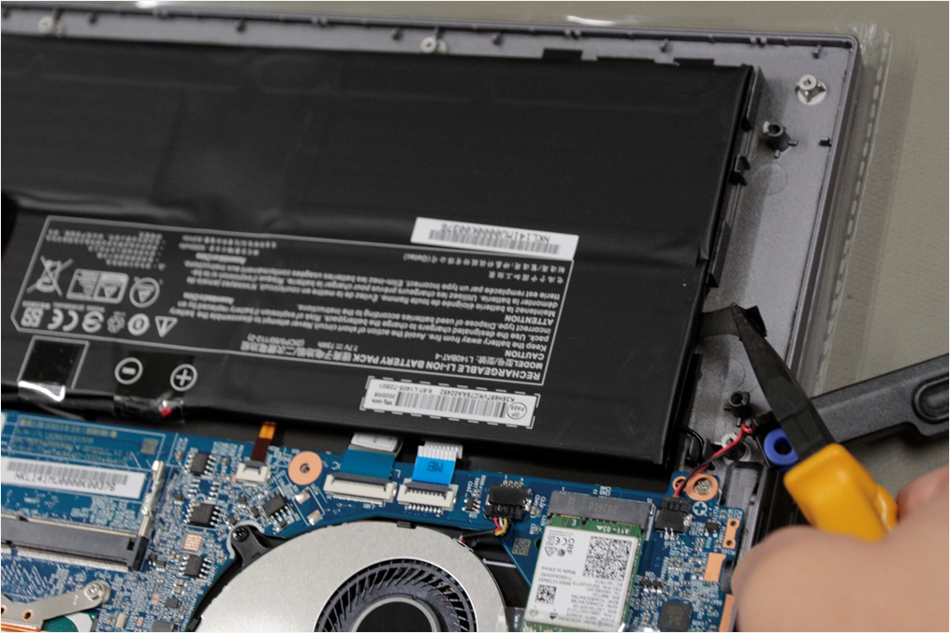
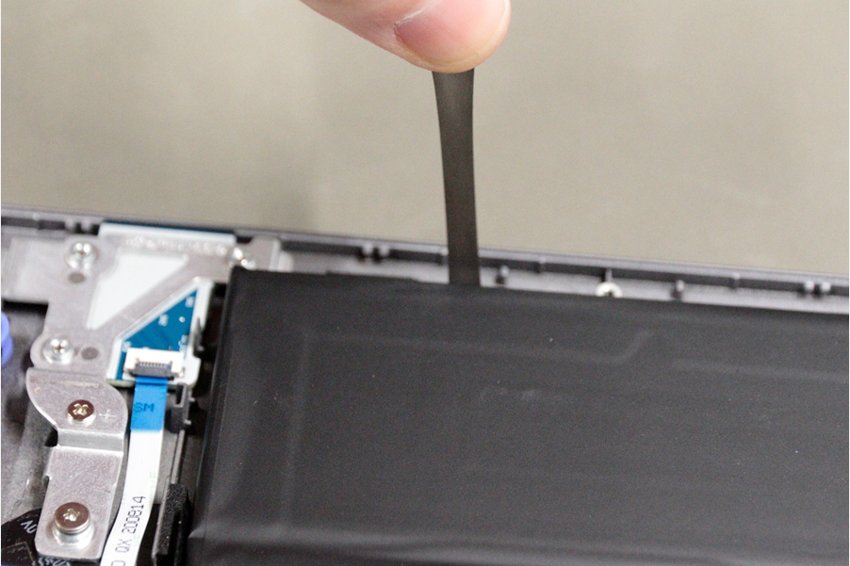
1. Step
Remove the Bottom Case
Disconnect the plug connection.(Fig.3).
MOBILE 1470T/U: Remove the LTE module and the right speaker. Remove 6 adhesive strips with the help of pliers. (Fig.1 & 2). Use 4pcs E1080590 to install a new battery.
MOBILE 1470: Remove the battery that is glued on to the housing by carefully applying pressure to the battery from below with a plastic spatula. (Fig. 4). Use 4pcs E1080589 to install a new battery.
1
2
3
4
5

Slide 8
REMOVE THE RAM
TERRA MOBILE 1470
Difficulty: 

Slide 9
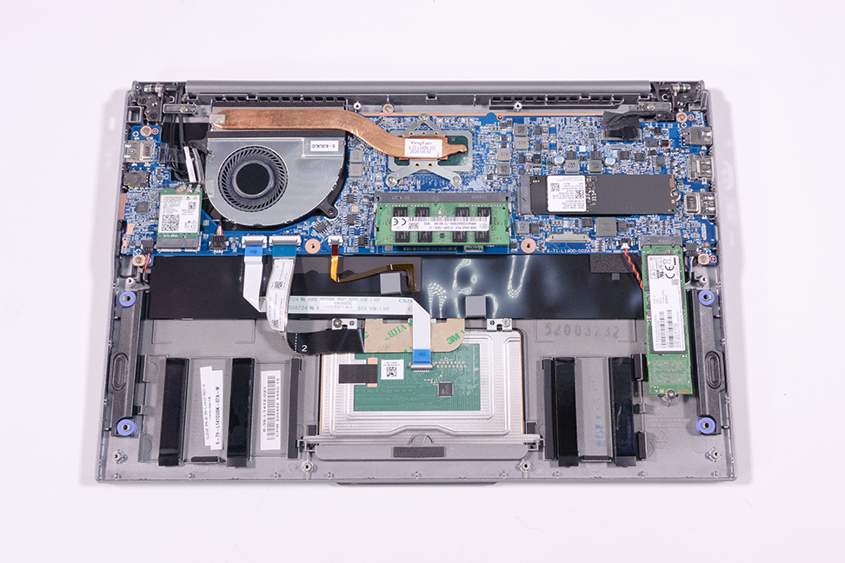
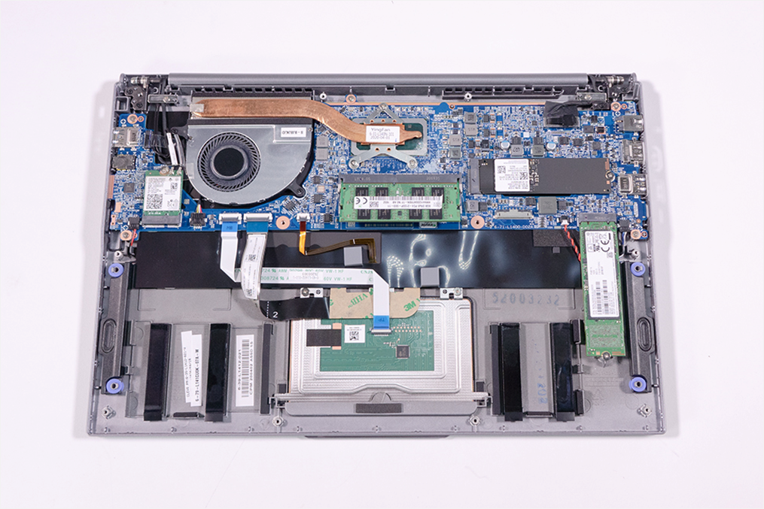
1. Step
Remove the Bottom Case
Slide the retaining clips outwards to release the RAM Module.
Now you can simply remove the memory.
Note: The notebook models 1470 and 1470T have 8GB onboard memory. This cannot be individually replaced.
1
2
3
4
5

Slide 10
REMOVE THE SSD
TERRA MOBILE 1470
Difficulty: 

Slide 11
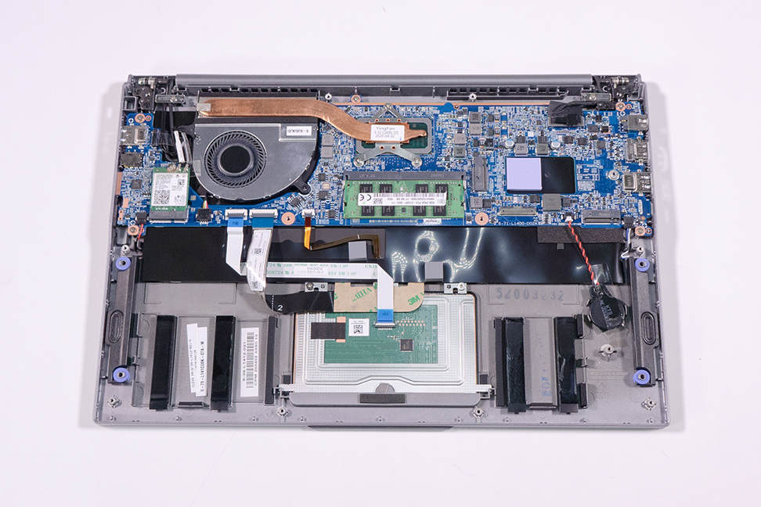
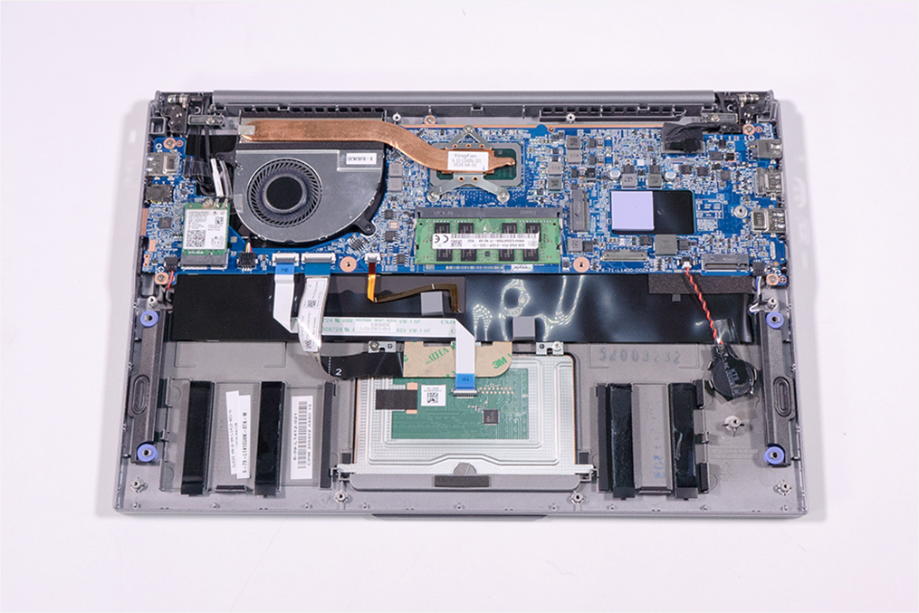
1. Step
Remove the Bottom Case
Loosen the screw on the SSD you want to replace. (Fig.1).
The upper connector is an M.2 2280 SATA/NVMe connector. The lower connector can only be fitted with a SATA SSD which is not available on the 1470T/U.
Now you can simply remove the desired SSD. (Fig.2).
To install the new SSDs, simply follow the steps in the reverse order.
The upper SSD has a heat conducting pad, which must be taken over when the SSD is replaced.
The SSD drive is not displayed in the UEFI menu when no OS is installed.
1
2
3
4
5

Slide 12
REMOVE THE
CMOS BATTERY
TERRA MOBILE 1470
Difficulty: 

Slide 13
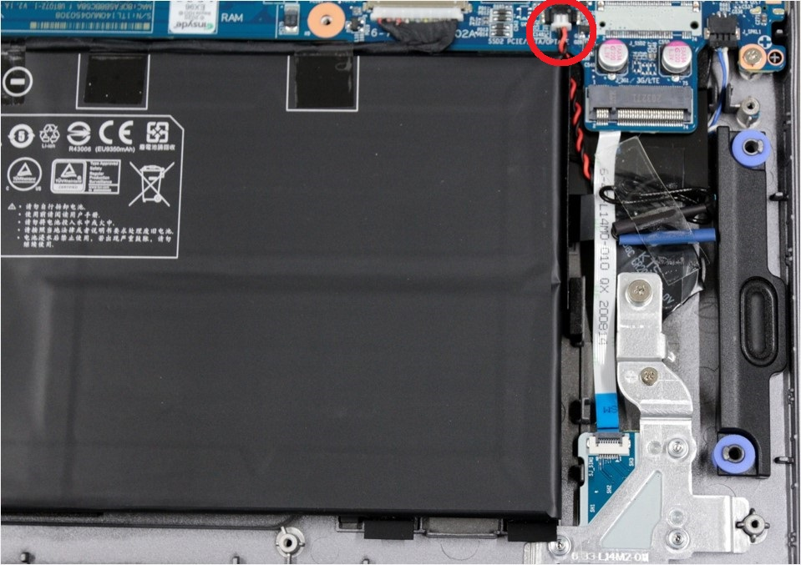
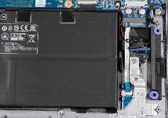
1. Step
Remove the Bottom Case
On the 1470, remove the lower SSD (Fig.1)
On the 1470T/U, remove the LTE module
Disconnect the connector. (Fig.2), then you can remove the battery.
To install the new battery, please proceed in the reverse order.
When replacing the battery, make you secure it with adhesive tape strips.
1
2
3
4
5

Slide 14
REMOVE THE
WLAN MODULE
TERRA MOBILE 1470
Difficulty: 

Slide 15
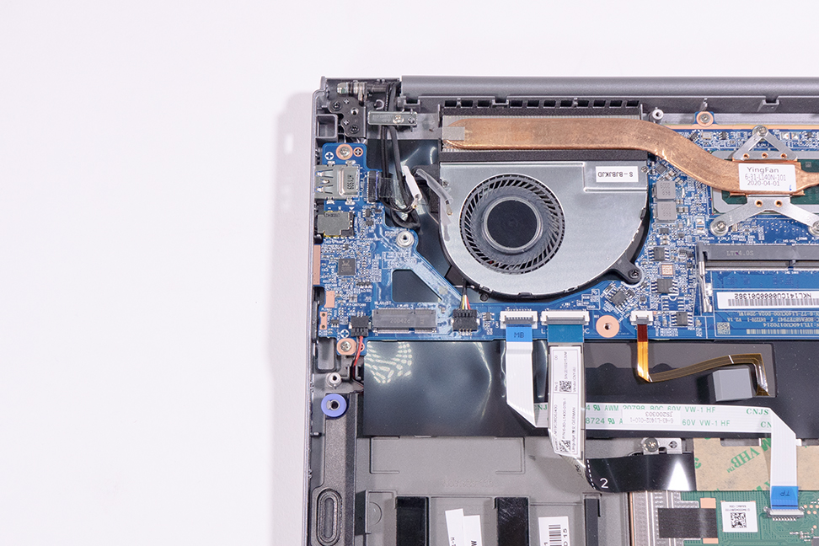
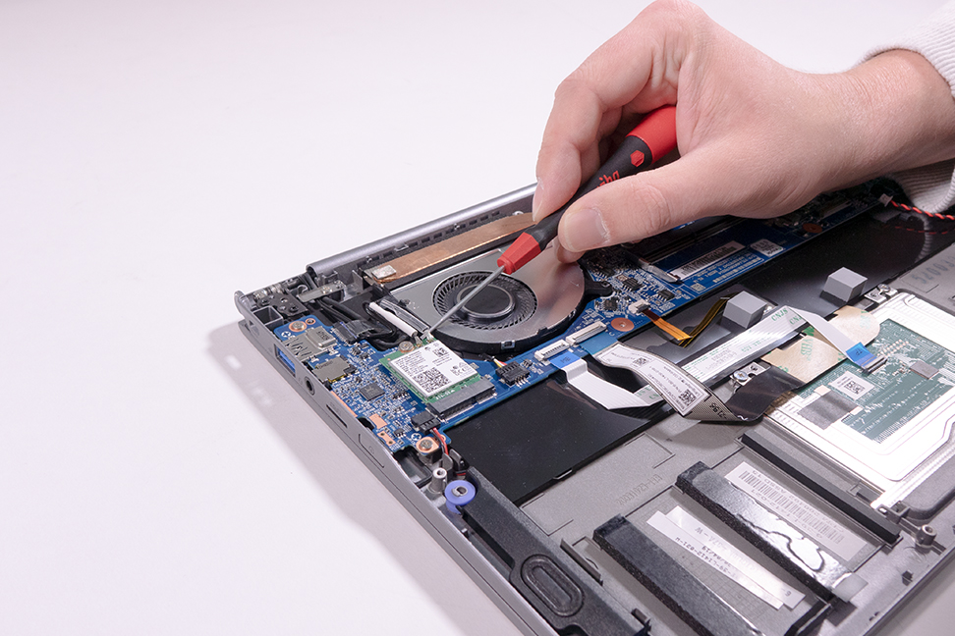
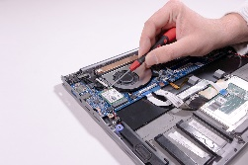
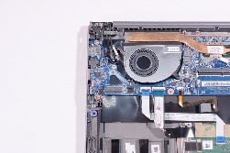
1. Step
Remove the Bottom Case
Carefully loosen the two cables and the screw. (Fig.1), then you can easily detach the module from the holder.
Please pay attention to the following during installation: The white cable to Main and the transparent cable to AUX.
1
2
3
4
5

Slide 16
LTE MODULE INSTALLATION
TERRA MOBILE 1470T/U
Difficulty: 

Slide 17
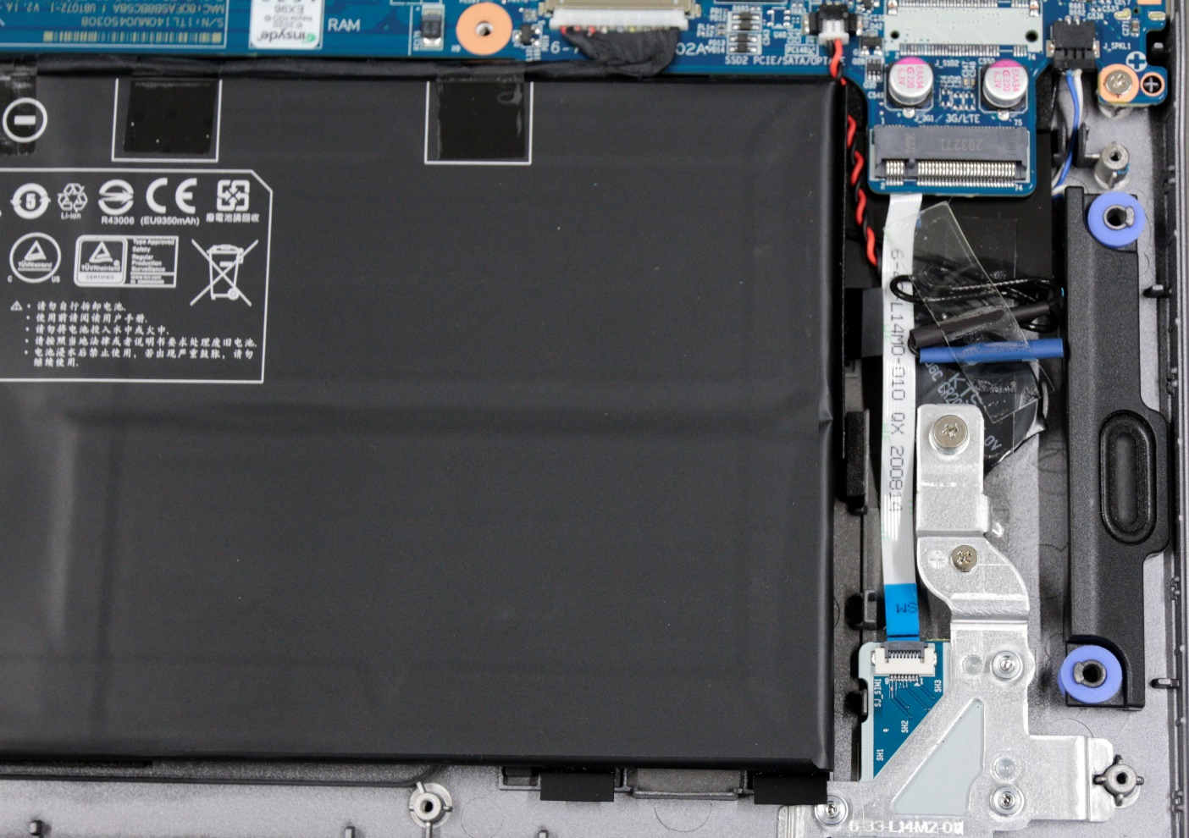
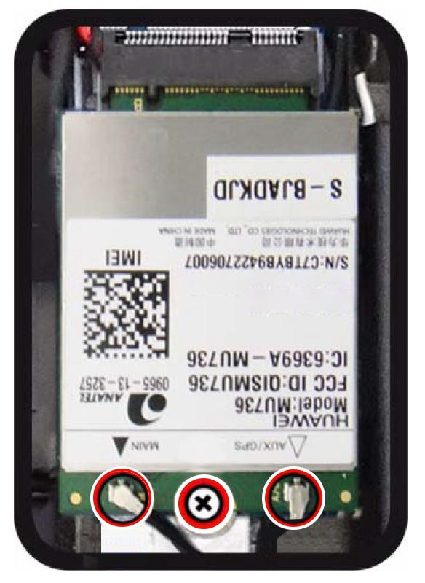
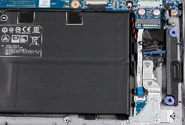
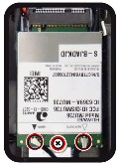
1. Step
Remove the Bottom Case
Carefully loosen the adhesive strip on the two black antenna cables. (Fig.1).
Secure the LTE module with a screw and carefully plug the connectors onto the sockets. (Fig.2).
When installing, please pay attention: The black cable to Main ,the blue cable to AUX.
1
2
3
4
5

Slide 18
REMOVE THE CPU FAN
TERRA MOBILE 1470
Difficulty: 

Slide 19
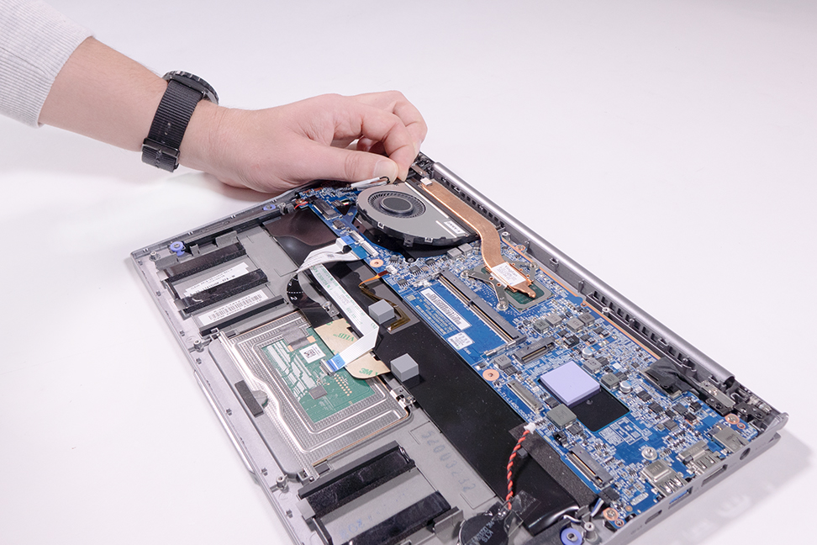
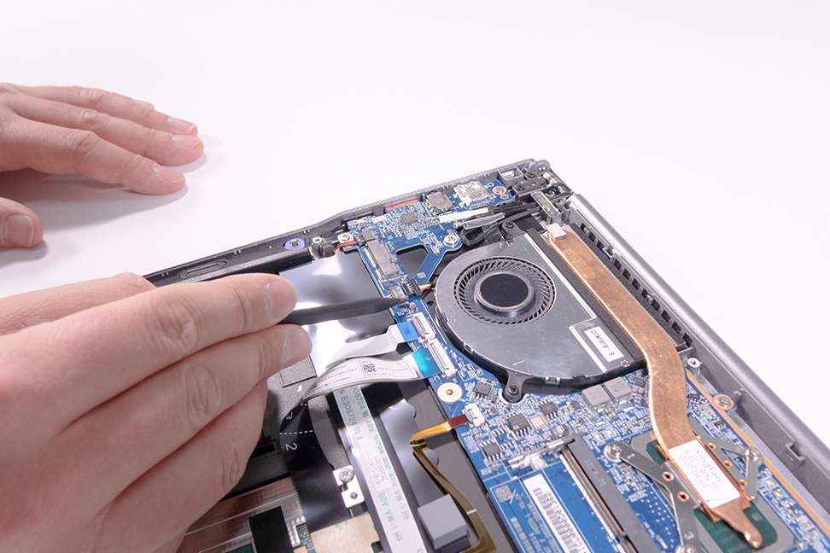

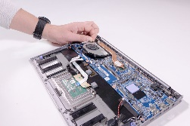
1. Step
Remove the Bottom Case
Loosen the two screws. (Fig.1).
Remove the fan. (Fig.2).
1
2
3
4
5

Slide 20
REMOVE THE HEATSINK
TERRA MOBILE 1470
Difficulty: 

Slide 21
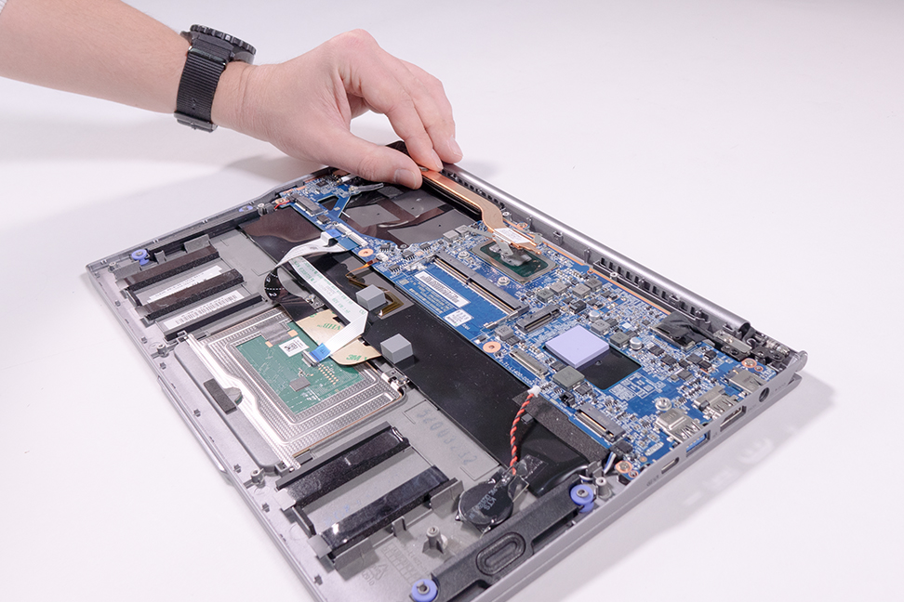
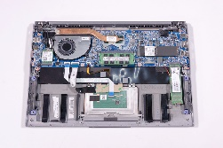

1. Step
Remove the Bottom Case.
Undo the 3 screws.
Remove the heatsink. (Fig.2).
Renew the thermal paste if necessary.
When reinstalling the heatsink, always start with the top screw.
1
2
3
4
5

Slide 22
REMOVE THE TOUCHPAD
TERRA MOBILE 1470
Difficulty: 

Slide 23
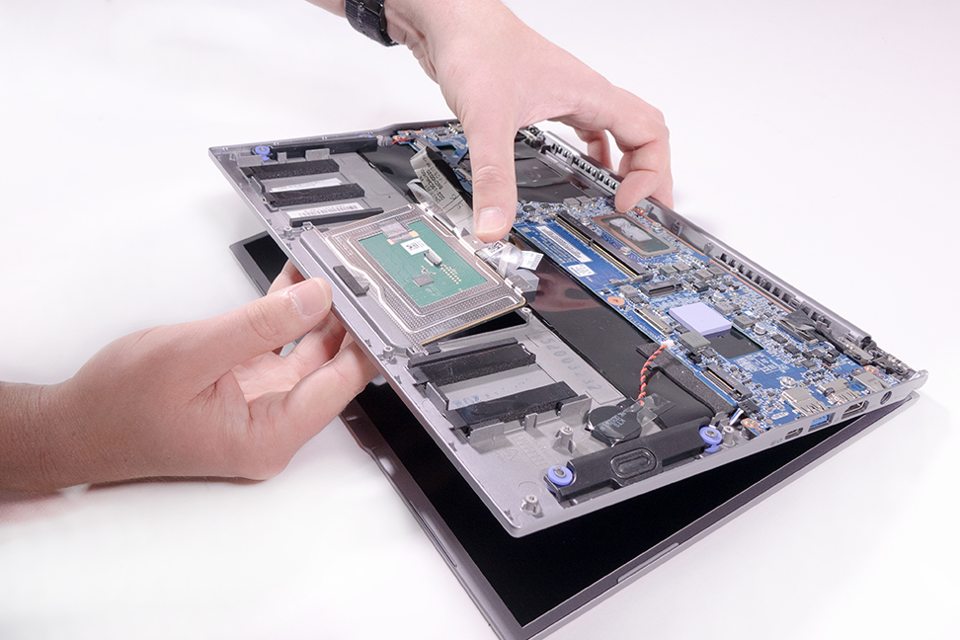
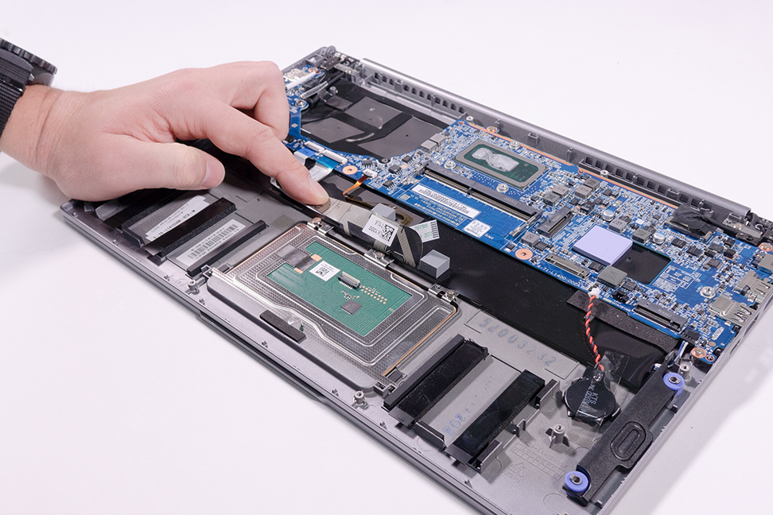
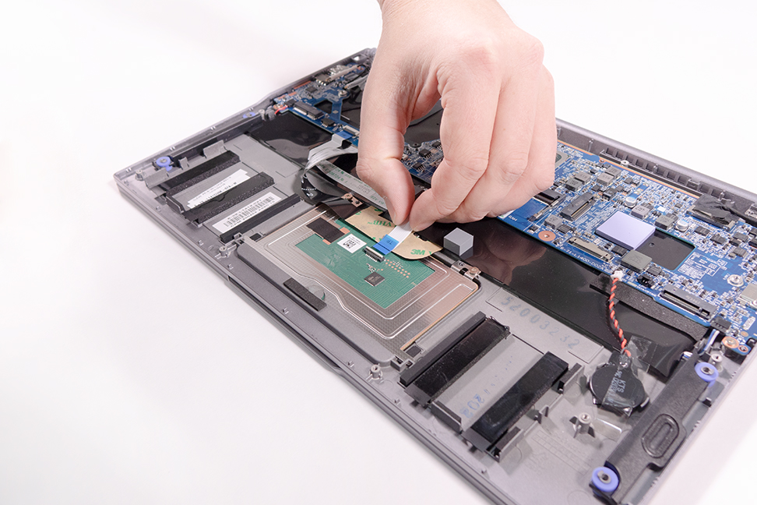

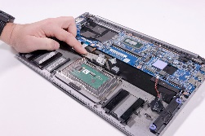

1. Step
Remove the Bottom Case.
Remove the Battery
Loosen the cable. (Fig.1).
Lift the cable upwards and loosen the 3 screws. (Fig.2).
Remove the touchpad. (Fig.3).
1
2
3
4
5

Slide 24
REMOVE THE MAINBOARD
TERRA MOBILE 1470
Difficulty: 

Slide 25
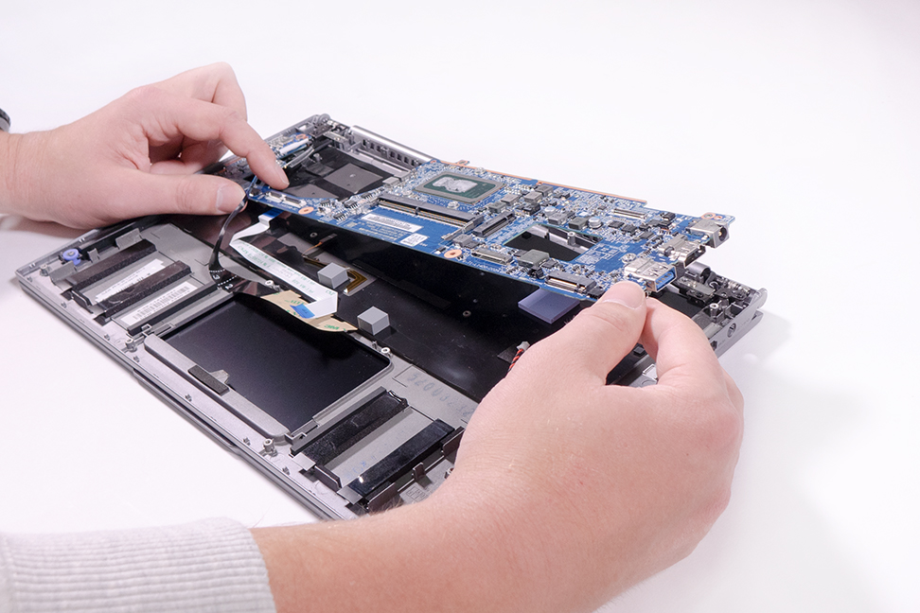
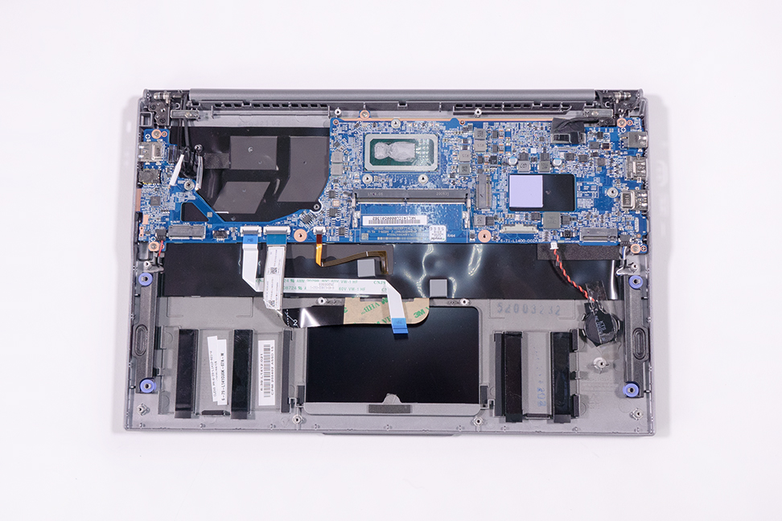
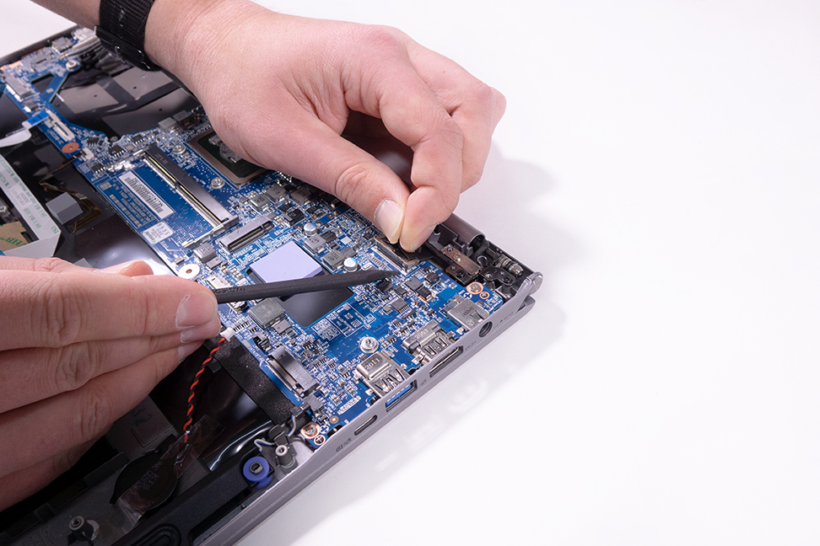
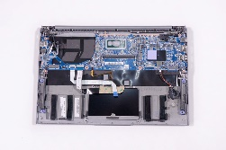
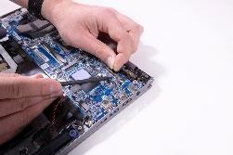

1. Step
Disconnect the battery connection cable
Remove the RAM
Remove the SSDs
Remove the LTE module from the 1470T/U
Loosen the CMOS battery cable
Remove the WLAN Module
Remove the CPU Fan
Remove the Heatsink
Disconnect 7 cable‘s. (Fig.1).
Use a plastic spatula on the LCD cable to help you. (Fig.2).
Loosen the 5 silver screws. ( Fig.3).
Carefully remove the mainboard. (Fig.4).
1
2
3
4
5

Slide 26
REMOVE THE TOP CASE
TERRA MOBILE 1470
Difficulty: 

Slide 27
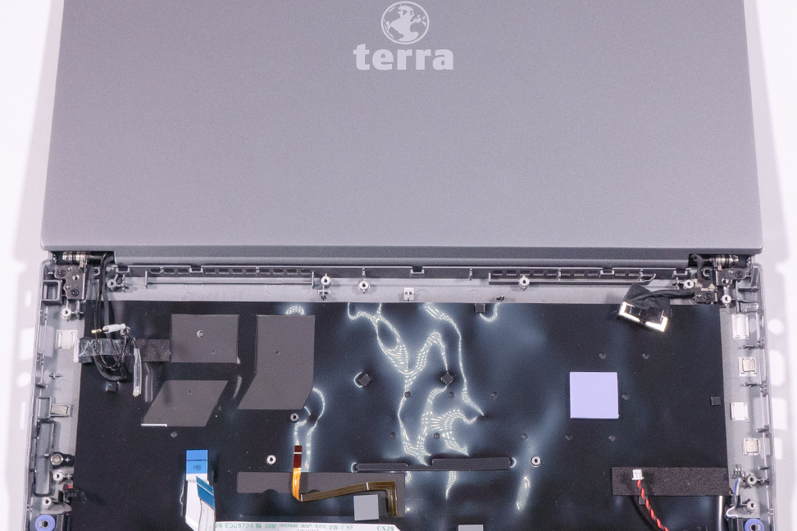
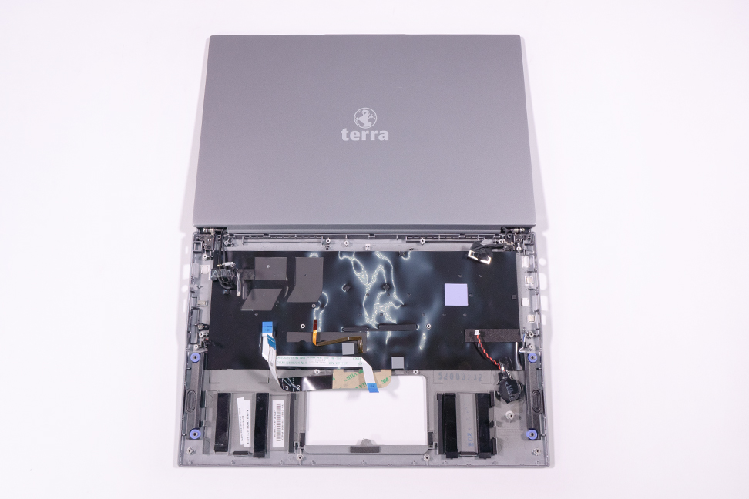
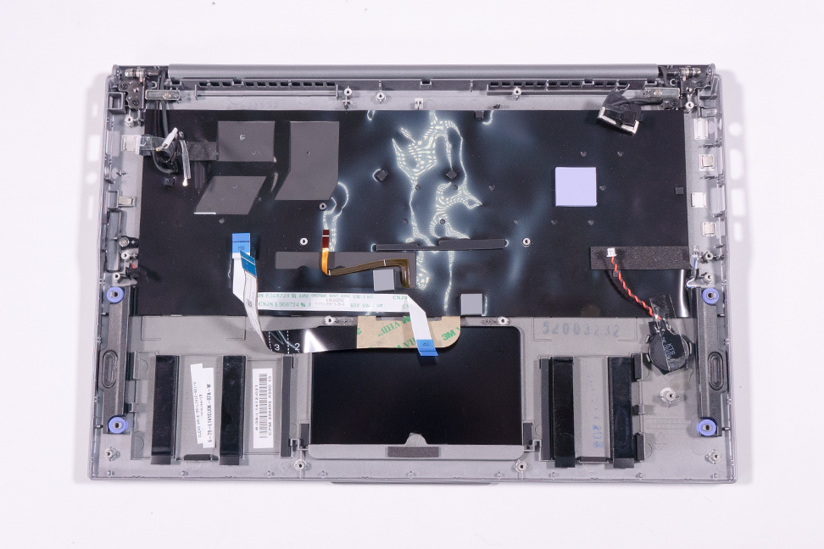
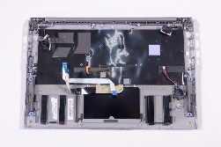
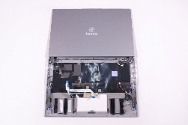

1. Step
Remove the Mainboard
Loudspeakers, CMOS battery, cooling pad SSD, possibly LTE module with SIM slot and the grey spacers must be transferd over. (Fig.1).
Remove one screw on the left and one on the right to loosen the guide rails. (Fig.2).
Open the display fully and place it down as shown in. (Fig.3).
Loosen 2 x 2 screws on the hinges. (Fig.4).
The display unit can now be removed
When installing, make sure that the screws are placed in the correct positions. (Fig.4).
1
2
3
4
5

Slide 28
REMOVE THE WEBCAM
TERRA MOBILE 1470
Difficulty: 

Slide 29
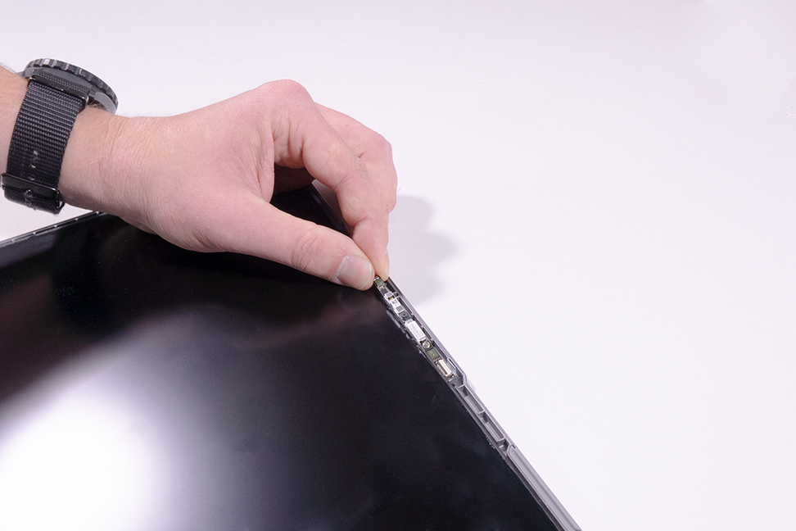
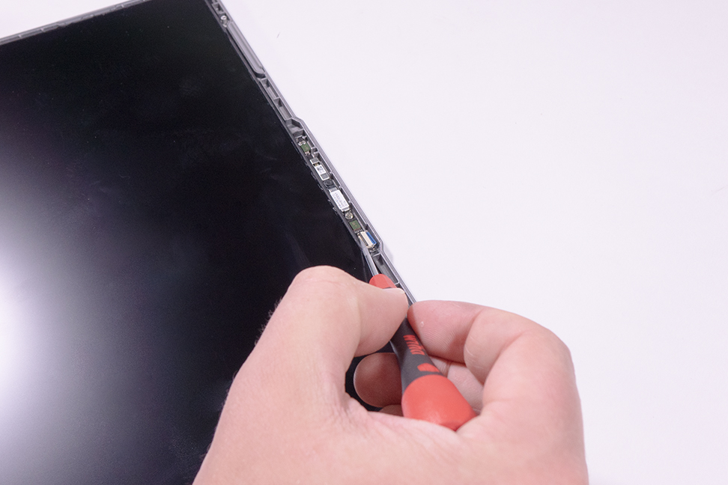






1. Step
Carefully loosen the front cover with a knife. (Fig.1 & 2).
The front cover must be replaced after removal.
Disconnect the flat ribbon cable on the webcam. (Fig.3).
Carefully lift the glued-in webcam out of the housing. (Fig.4).
1
2
3
4
5

Slide 30
REMOVE THE LCD
HINGE COVER
TERRA MOBILE 1470
Difficulty: 

Slide 31






1. Step
Carefully loosen the front cover with a knife. (Fig.1 & 2).
The front cover must be replaced after removal.
Undo the outer screw. (Fig.3).
Press into the 4 openings of the hinge cover latch (Fig.4) and remove it at a slight upward angle. (Fig.5).
1
2
3
4
5

Slide 32
REMOVE THE HINGE
TERRA MOBILE 1470
Difficulty: 

Slide 33


1. Step
Loosen LCD Hinge Cover
Loosen 3 screws on both sides. (Fig.1).
Pay attention to the cable routing.
1
2
3
4
5

Slide 34
Spare Parts TERRA MOBILE 1470
Article number | Description
1480179 | Power supply 65W
1480231 | Battery 36Wh
E1080589 | Battery Double Side Tape (46x5mm)
E1080459 | Bottom Case (Cover D)
E1080461 | Cable for Webcam
E1080456 | Cable Touchpad
E1080314 | CMOS Battery
E1080458 | CPU Fan
E1080464 | Hinge (L)
E1080465 | Hinge (R)
E1080466 | Hinge Cover
E1080467 | LCD Back Cover (Cover A)
E1080462 | LCD Cable
E1080460 | LCD Display 14" FHD (eDP)
Article number | Description
E1080327 | LCD Double Side Tape
E1080468 | LCD Front Cover (Cover B)
E1080537 | LCD Rubber Mobile 1470
E1080457 | Mainboard (i5-10210U /8GB)
E1080454 | Speaker (L)
E1080455 | Speaker (R)
E1080474 | Top Case with Keyboard (CH)
E1080473 | Top Case with Keyboard (DE)
E1080475 | Top Case with Keyboard (FR)
E1080591 | Top Case with Keyboard (US)
E1080597 | Touchpad
E1080463 | Webcam
E1080538 | WLAN Antenna AUX
E1080539 | WLAN Antenna Main

Slide 35
Spare Parts TERRA MOBILE 1470T
Article number | Description
1480179 | AC-Adapter 65W
E1080533 | Battery Rubber
E1080590 | Battery Double Side Tape (57x8mm)
1480231 | Battery 36Wh
1480195 | Battery 73Wh
E1080459 | Bottom Case (Cover D)
E1080461 | Cable for Webcam
E1080456 | Cable Touchpad
E1080314 | CMOS Battery
E1080458 | CPU Fan
E1080464 | Hinge (L)
E1080465 | Hinge (R)
E1080466 | Hinge Cover
E1080696 | LCD Back Cover (Cover A)
E1080462 | LCD Cable
E1080460 | LCD Display 14" FHD (eDP)
Article number | Description
E1080327 | LCD Double Side Tape
E1080468 | LCD Front Cover (Cover B)
E1080536 | Mainboard (i5-1135G7 /8GB)
E1080535 | SIM Card Board
E1080534 | SIM Card Bracket
E1080454 | Speaker (L)
E1080455 | Speaker (R)
E1080541 | Top Case with Keyboard (CH)
E1080543 | Top Case with Keyboard (DE)
E1080542 | Top Case with Keyboard (FR)
E1080592 | Top Case with Keyboard (US)
E1080597 | Touchpad
E1080463 | Webcam
E1080540 | WLAN/LTE Antenna

Slide 36
Spare Parts TERRA MOBILE 1470U
Article number | Description
1480179 | AC-Adapter 65W
E1080533 | Battery Rubber
E1080590 | Battery Double Side Tape (57x8mm)
1480195 | Battery 73Wh
E1080459 | Bottom Case (Cover D)
E1080461 | Cable for Webcam
E1080456 | Cable Touchpad
E1080314 | CMOS Battery
E1080458 | CPU Fan
E1080464 | Hinge (L)
E1080465 | Hinge (R)
E1080700 | Hinge Cover
E1080696 | LCD Back Cover (Cover A)
E1080462 | LCD Cable
E1080460 | LCD Display 14" FHD (eDP)
Article number | Description
E1080327 | LCD Double Side Tape
E1080468 | LCD Front Cover (Cover B)
E1080698 | Mainboard (i5-1235U)
E1080699 | SIM Card Board
E1080534 | SIM Card Bracket
E1080454 | Speaker (L)
E1080455 | Speaker (R)
E1080541 | Top Case with Keyboard (CH)
E1080543 | Top Case with Keyboard (DE)
E1080542 | Top Case with Keyboard (FR)
E1080592 | Top Case with Keyboard (US)
E1080597 | Touchpad
E1080463 | Webcam
E1080540 | WLAN/LTE Antenna

