Slide 1
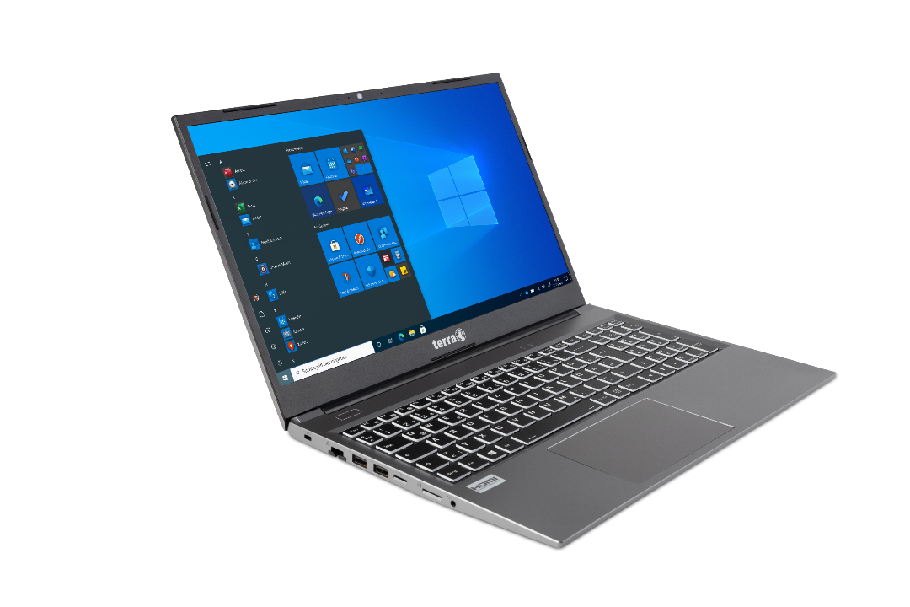
Service Manual
TERRA MOBILE 1500

Slide 2

Contents
Service Notes
Remove the Bottom Case
Remove the Battery
Remove the M.2 SSD
Remove the 2.5“ SSD
Remove the RAM
LTE Module installation
Remove the WLAN Module
Remove the CMOS Battery
Remove the CPU Fan / Heatsink
Remove the Keyboard
Remove the Mainboard
Remove the Top Case
Remove the Camera
Remove the LCD Panel
Remove the Back Cover

Slide 3
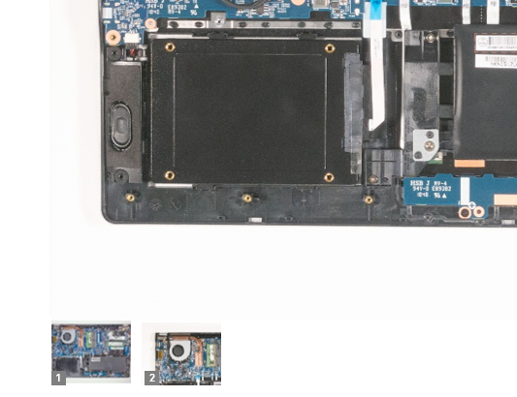
SERVICE NOTES
Safety instructions
Work on a clean surface. Make sure that the housing can not be scratched.
Sort the screws and make sure that they are in the right place when reinstalling. Wrongly inserted screws can cause irreparable damage.
For all service work. Always disconnect the power supply and the battery connection to the mainboard.
Ensure you have sufficient ESD protection.
The WORTMANN AG accepts no liability for any damage caused when using this service manual.
Tools
Phillips screwdriver PH0
Phillips screwdriver PH1
Slotted screwdriver 2 mm
Plastic Slotted screwdriver 3mm
Duct tape
Protective cloth
Note
Click on the thumbnails to
view the images in full size

Slide 4
REMOVE THE BOTTOM CASE
TERRA MOBILE 1500
Difficulty: 

Slide 5
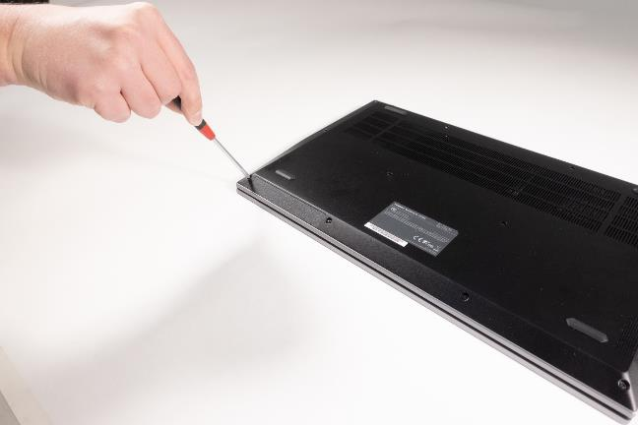
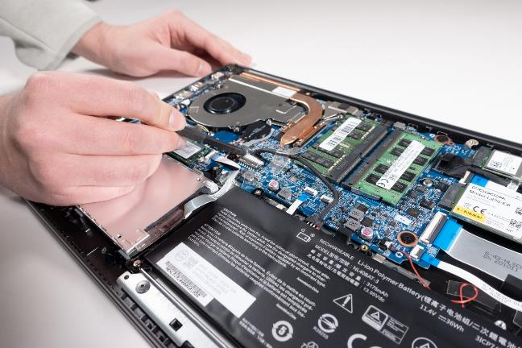
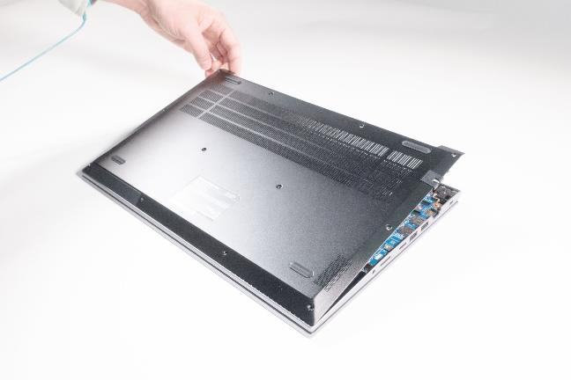
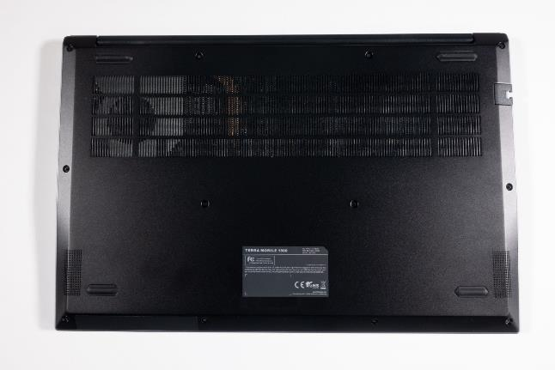





1. Step
Before you start, turn off the Notebook! and remove the power supply.
Remove the 8 screws (M2x5/PH1). (Fig.1).
Unscrew 4 front screws (M2x5/PH1) . The screws are angled approx. 35° outwards. (Fig.2).
Lift up and remove the bottom case. (Fig.3).
For all other tasks, disconnect the cable connection between the battery and the mainboard. (Fig.4).
1
2
3
4

Slide 6
REMOVE THE BATTERY
TERRA MOBILE 1500
Difficulty: 

Slide 7
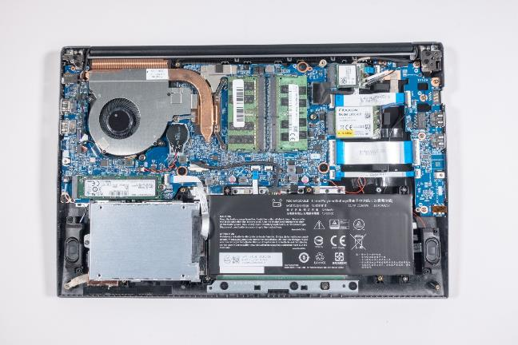


1. Step
Before you start, switch off the notebook! and remove the power supply.
Remove the Bottom Case
Disconnect the cable to the mainboard. (Fig.1).
Remove the 4 screws (M2x4) (Fig.2).
1
2
3
4

Slide 8
REMOVE THE M.2 SSD
TERRA MOBILE 1500
Difficulty: 

Slide 9
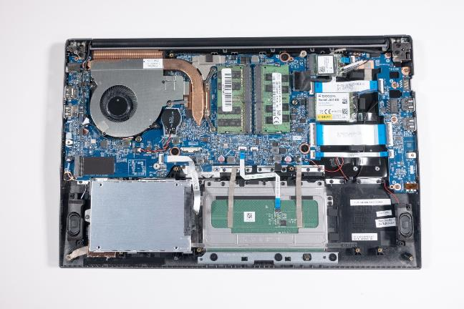
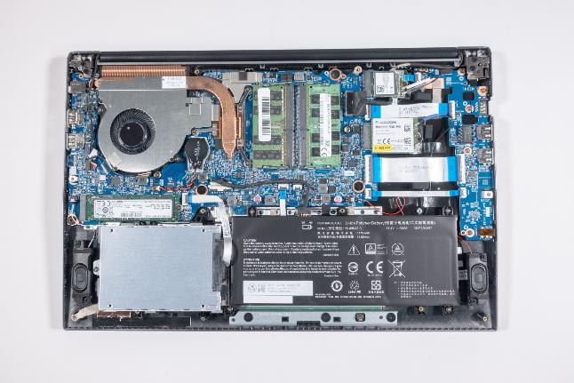

1. Step
Before you start, switch off the Notebook! and remove the power supply.
Remove the Bottom Case
Disconnect the cable from the battery
Undo the screw (M2x2/PH0) and then remove the M.2 SSD. (Fig.1).
The cooling pad below the SSD has to be transferd over. (Fig.2).
M.2 NVMe SSD’s are not displayed in the boot manager if no (OS) operating system is installed.
1
2
3
4

Slide 10
REMOVE THE 2.5“ SSD
TERRA MOBILE 1500
Difficulty: 

Slide 11
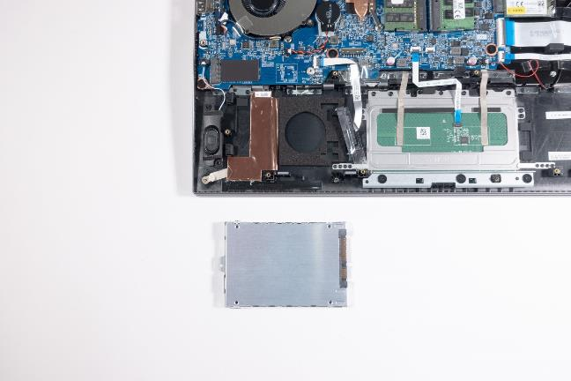

1. Step
Before you start, switch off the notebook! and remove the power supply.
Remove the Bottom Case
Disconnect the cable from the battery
Undo the screw (M2x4/PH0) and remove the SSD/HDD from the connector. (Fig.1).
The mounting frame should be fitted to the new SSD. (Fig.2).
1
2
3
4

Slide 12
REMOVE THE RAM
TERRA MOBILE 1500
Difficulty: 

Slide 13
1. Step
Before you start, switch off the notebook! and remove the power supply.
Remove the Bottom Case
Disconnect the cable from the battery
Push the metal retaining clips outwards at the same time to release the RAM module.
1
2
3
4

Slide 14
LTE MODULE INSTALLATION
TERRA MOBILE 1500
Difficulty: 

Slide 15
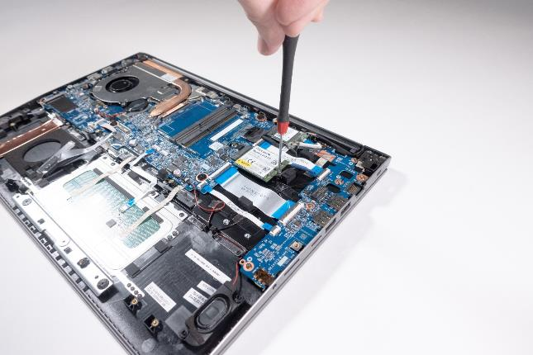

1. Step
Before you start, switch off the notebook! and remove the power supply.
Remove the Bottom Case
Disconnect the cable from the battery
Secure the LTE module with the screw (M2x2) provided with the accessories.
Attach the antenna connectors. The Black cable on MAIN, and the blue cable on AUX.
After installation, secure the adapters with adhesive strips.
1
2
3
4

Slide 16
REMOVE THE
WLAN MODULE
TERRA MOBILE 1500
Difficulty: 

Slide 17
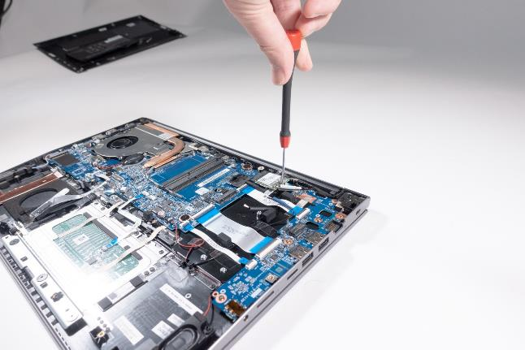

1. Step
Before you start, switch off the notebook! and remove the power supply.
Remove the Bottom Case
Disconnect the cable from the battery
Remove one screw (M2x3/PH0).
Remove the module and replace it.
Note: The white cable on MAIN, and the transparent cable on AUX.
After installation, secure the adapters with adhesive strips.
1
2
3
4

Slide 18
REMOVE THE
CMOS BATTERY
TERRA MOBILE 1500
Difficulty: 

Slide 19
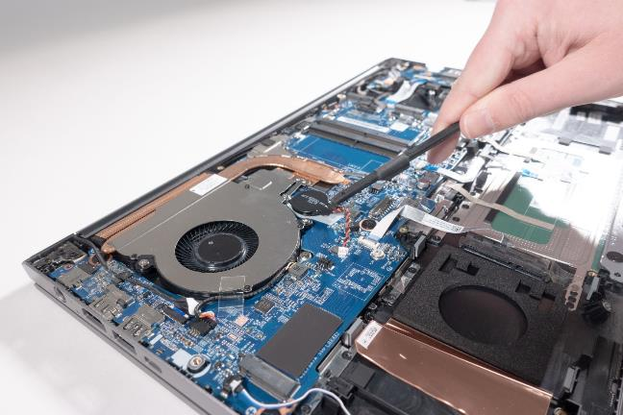
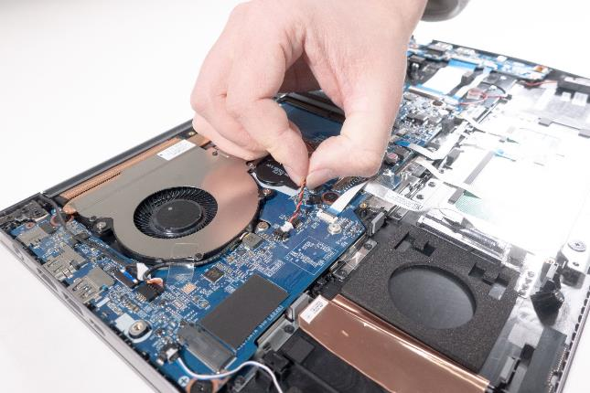


1. Step
Before you start, switch off the notebook! and remove the power supply.
Remove the Bottom Case
Disconnect the cable from the battery
Disconnect the cable by pulling on the plug and not the cable. (Fig.1).
The battery is glued on and must be carefully removed from the mainboard. (Fig.2).
The adhesive must be replaced in after re-installing.
1
2
3
4

Slide 20
REMOVE THE CPU FAN / HEATSINK
TERRA MOBILE 1500
Difficulty: 

Slide 21
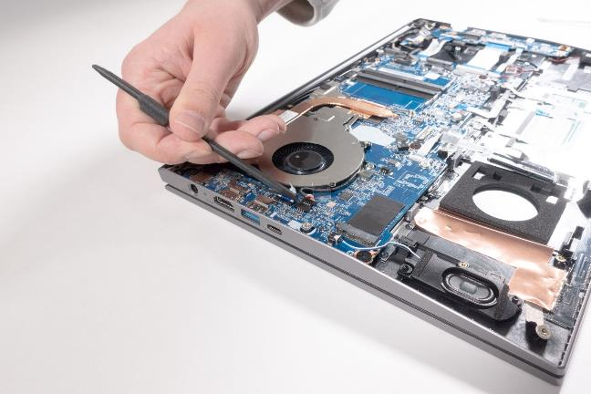
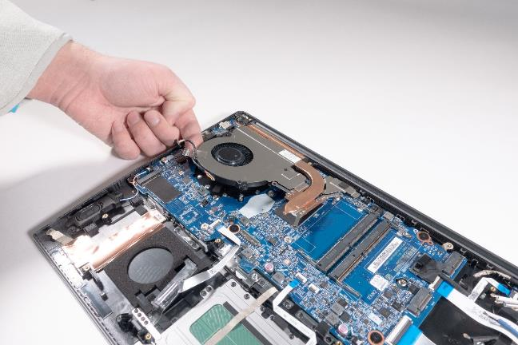
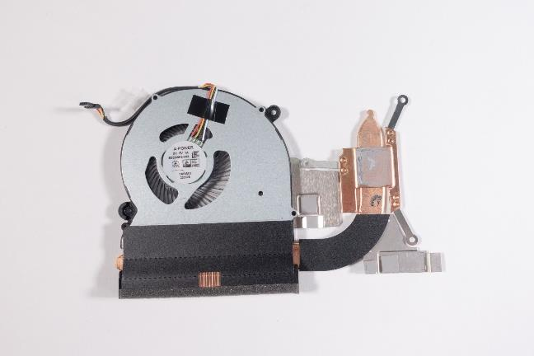



1. Step
Before you start, switch off the notebook! and remove the power supply.
Remove the Bottom Case
Disconnect the cable from the battery
Remove 3 screws (M2x3/PH1) and 2 screws (M2x4/PH1). (Fig.1).
Disconnect the cable by pulling on the plug and not on the cable. (Fig.2).
Now you can remove the fan and heatsink. (Fig.3).
The 4 Heat conducting pads must be transferred with the heatsink (Fig.4).
Renew the thermal paste for the CPU if necessary. (Fig.4.
1
2
3
4

Slide 22
REMOVE THE KEYBOARD
TERRA MOBILE 1500
Difficulty: 

Slide 23
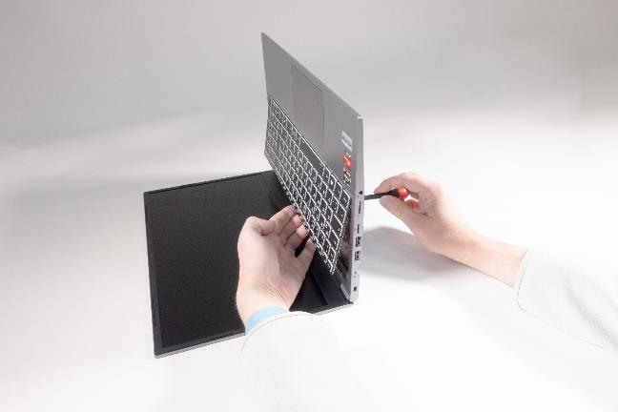
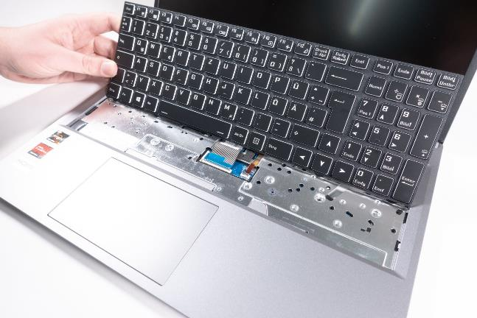


1. Step
Before you start, switch off the notebook! and remove the power supply.
Remove the Bottom Case
Disconnect the cable from the battery
Remove the two marked screws (M2x4). (Fig.1).
Use a screwdriver to carefully push out the keyboard. Hold the keyboard with one hand so that it does not fall down (Fig.2).
Disconnect the two keyboard flat ribbon cables from the locking sockets. (Fig.3).
1
2
3
4

Slide 24
REMOVE THE MAINBOARD
TERRA MOBILE 1500
Difficulty: 

Slide 25
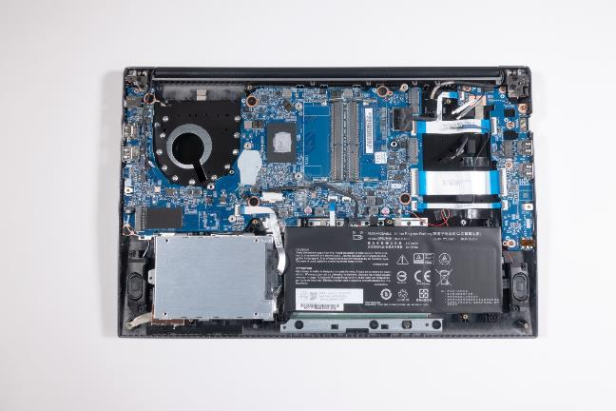

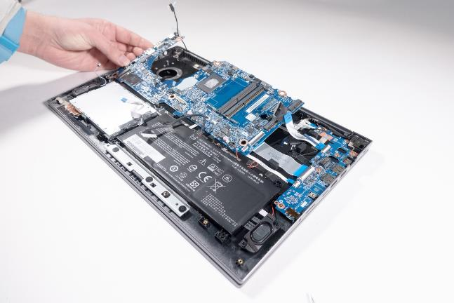
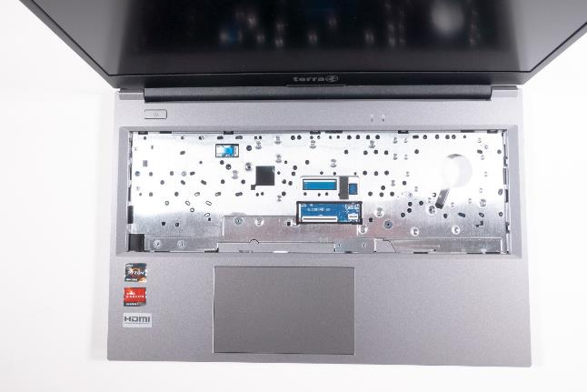



1. Step
Before you start, switch off the notebook! and remove the power supply.
Remove the keyboard
Remove the heatsink
Remove the RAM, M.2 SSD, WLAN module and, if necessary, the LTE module.
Disconnect the ribbon cable below the keyboard. (Fig.1).
10 Cables need to be disconnected from the mainboard. (Fig.2).
6 screws (black, M2x2/PH0) hold the mainboard. (Fig.3).
Now the mainboard can be removed upwards. (Fig.4).
1
2
3
4

Slide 26
REMOVE THE TOP CASE
TERRA MOBILE 1500
Difficulty: 

Slide 27
1. Step
Before you start, switch off the notebook! and remove the power supply.
Remove the battery
Remove the 2.5“ SSD
Remove the Mainboard

Slide 28
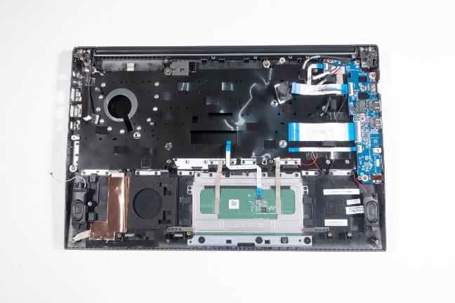



2. Step
Transfer the two speakers, the touchpad frame, audio/USB board, power board, an LTE antenna, and 5 cables. (Fig.1).
Undo 4 screws on the audio/USB board .(Fig.2).
Undo 3 screws from the power board (Fig.3).
Undo 3 screws from the touchpad frame. (Fig.4).
1
2
3
4

Slide 29
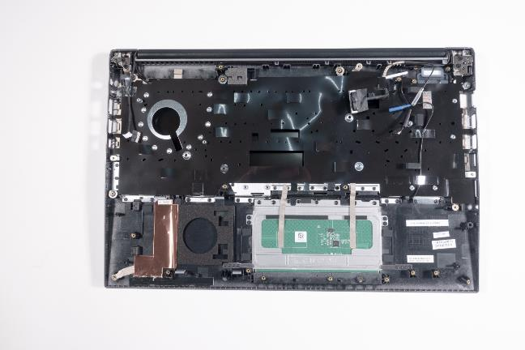
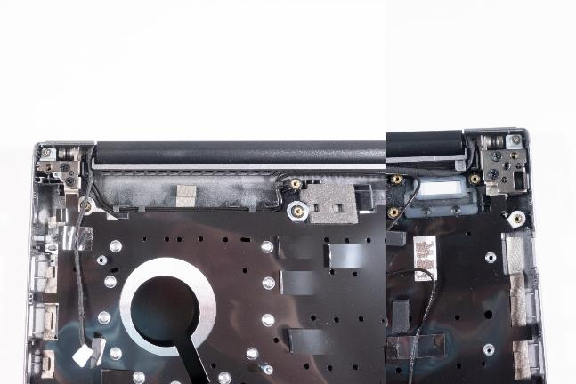
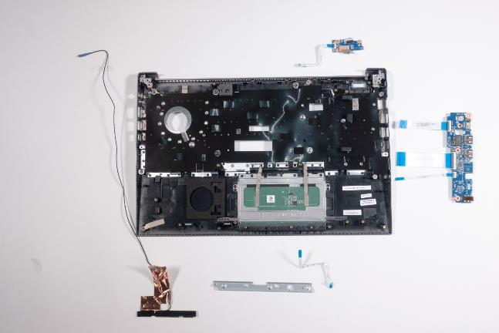





3. Step
Disconnect the cable. (Fig.1).
Remove the LTE antenna. (Fig.2).
Undo 2 screws (M2.5x5) on both hinges. (Fig.3).
Note: Please pay attention to the correct position during installation.
1
2
3
4

Slide 30
REMOVE THE CAMERA
TERRA MOBILE 1500
Difficulty: 

Slide 31
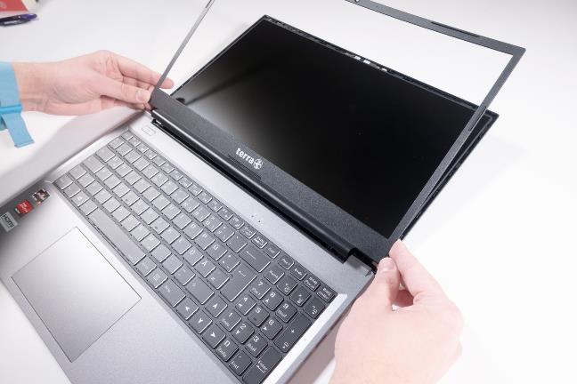
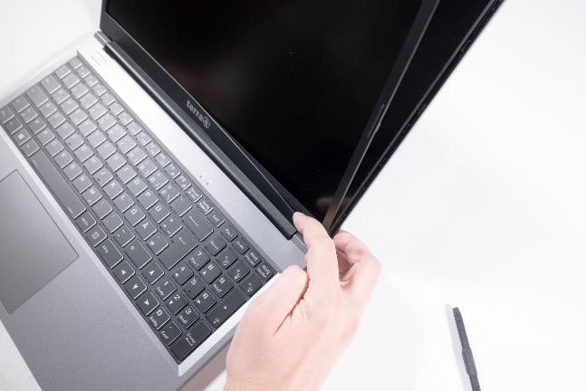
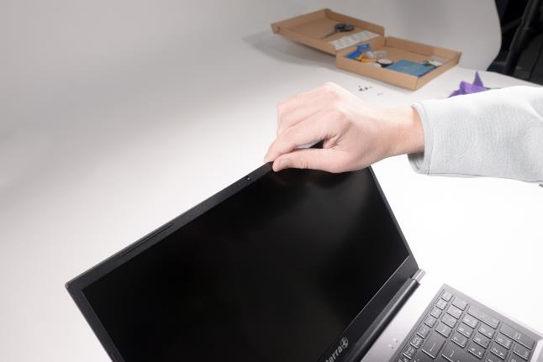



1. Step
Before you start, switch off the notebook! and remove the power supply.
First you have to loosen the front cover. (Fig.1).
If you are only replacing the camera, it is only necessary to remove the front cover in the upper area.
Note: Work slowly, the front cover is very fragile.
1
2
3
4

Slide 32
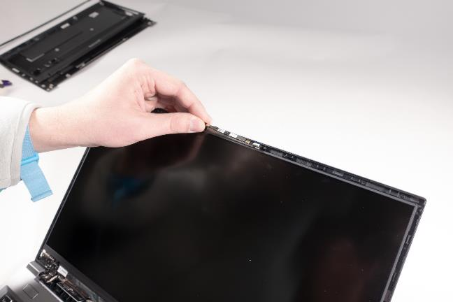
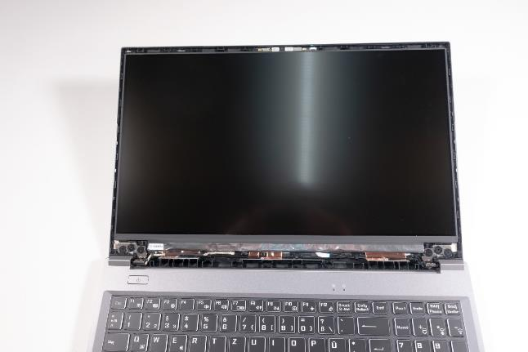


2. Step
The camera is Glued in place and connected with a flat ribbon cable.
Carefully remove the camera from the housing. (Fig.2).
Disconnect the flat ribbon cable.
1
2
3
4

Slide 33
REMOVE THE LCD PANEL
TERRA MOBILE 1500
Diffculity: 

Slide 34
1. Step
Before you start, switch off the notebook! and remove the power supply.
The first thing you need to do is to remove the front cover. (Fig.1).
Starting at the top, then the sides and finally the bottom area. (Fig.2).
Note: Work slowly, the front cover is very fragile. (Fig.3).
Note: The cover is glued in the lower area. The double-sided adhesive tape must be renewed during installation.
1
2
3
4

Slide 35
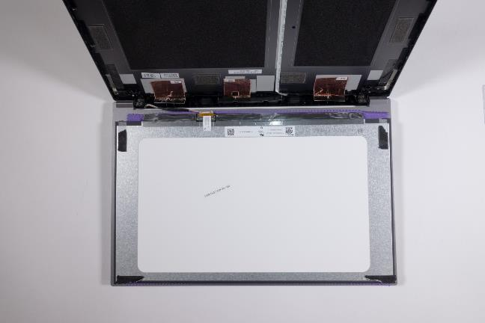
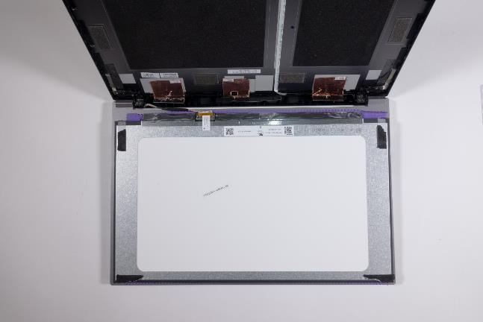
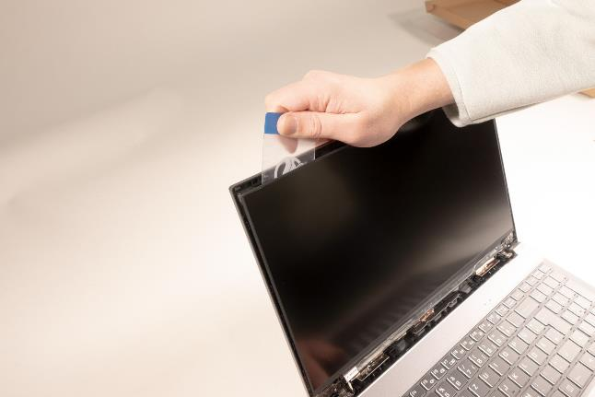


2. Step
Note: The display is attached with 4 adhesive strips.
Use a flat spatula to loosen the adhesive strips behind the display. (Fig.1).
Place the supplied protective cloth on the keyboard so that you can place the display on it. (Fig.2).
Disconnect the LCD cable from the panel. (Fig.3)
1
2
3
4

Slide 36
REMOVE THE BACK COVER
TERRA MOBILE 1500
Difficulty: 

Slide 37
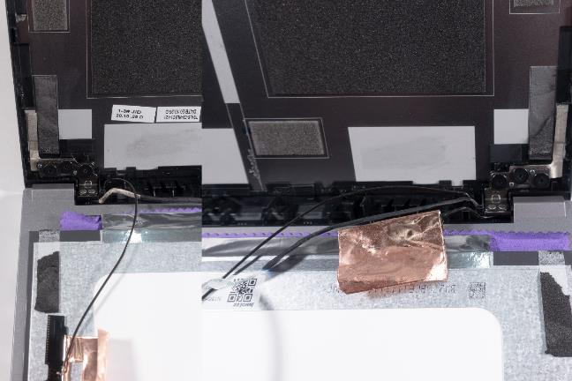
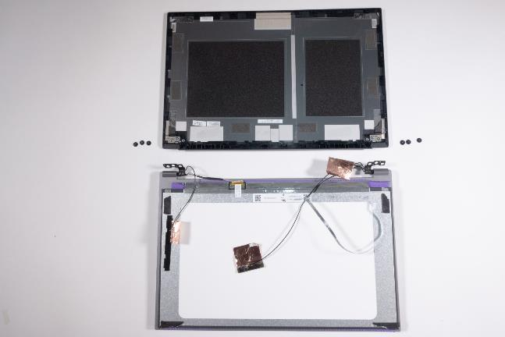
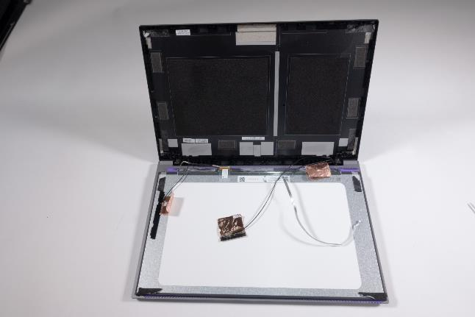



1. Step
Remove the Camera
Remove the LCD Panel
Disconnect the webcam cable, two WLAN antennas and one LTE antenna. (Fig.1).
Unscrew 3 screws (black, M2.5x2.5/PH1) from the hinges. (Fig.2).
Now the back cover can be removed to the rear. (Fig.3).
1
2
3
4

Slide 38
SPARE PARTS
TERRA MOBILE 1500

Slide 39
Spare Parts TERRA MOBILE 1500
Article number | Description
1480486 | Power supply 65W EU
E1080549 | Antenna LTE (1)
E1080548 | Antenna LTE (2)
1480236 | Battery 36Wh
E1080551 | Bottom Case
E1080314 | CMOS Battery
E1080554 | CPU Fan
E1080186 | HDD Bracket
E1080550 | HDD Cable
E1080557 | Hinge (L)
E1080558 | Hinge (R)
1480221 | Keyboard Multi-Colour [CH]
1480219 | Keyboard Multi-Colour [DE]
1480220 | Keyboard Multi-Colour [FR]
1480224 | Keyboard Multi-Colour [UK]
1480222 | Keyboard Multi-Colour [US]
E1080556 | LCD Back Cover (Cover A)
Article number | Description
E1080560 | LCD Cable
E1080436 | LCD Display 15.6" FHD (eDP)
E1080555 | LCD Front Cover (Cover B)
E1080552 | Mainboard (Ryzen 5-4500U)
E1080642 | Mainboard (Ryzen 5-5500U)
E1080545 | Power Switch
E1080516 | Screw M2x5mm Nylok for Bottom Case
E1080546 | Speaker (L)
E1080547 | Speaker (R)
E1080553 | Thermal Pad for M.2 SDD
E1080544 | Top Case (Cover C) incl. Touchpad
E1080559 | Webcam
E1080561 | Webcam cable
E1080594 | Multi I/O Board Realtek
E1080625 | Multi I/O Board O²Micro

