Slide 1
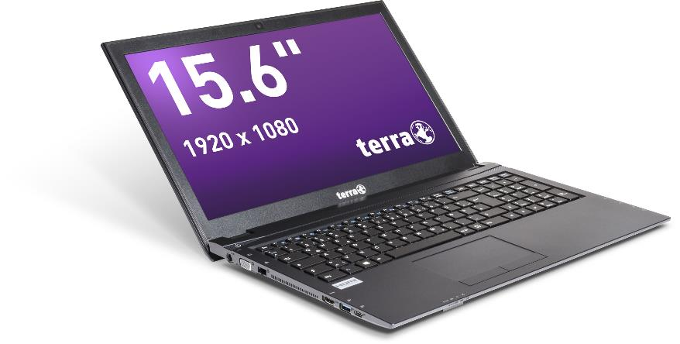
Service Manual
TERRA MOBILE 1515V
(1515, 1515A, 1715, 1715A, 1715V)

Slide 2


Contents
Service Notes
Remove the Keyboard
Remove the Bottom Case
Remove the RAM
Remove the ODD
Remove the M.2 SSD
Remove the HDD
Spare Parts
Remove the WLAN Module
Remove the CMOS Battery
LTE Module installation
Remove the Fan
Remove the Mainboard
Remove the Top Case
Remove the LCD Display

Slide 3

SERVICE NOTES
Safety instructions
Work on a clean surface. Make sure that the housing can not be scratched.
Sort the screws and make sure that they are in the right place when reinstalling. Wrongly inserted screws can cause irreparable damage.
For all service work. Always disconnect the power supply and the battery connection to the mainboard.
Ensure you have sufficient ESD protection.
The WORTMANN AG accepts no liability for any damage caused when using this service manual.
Tools
Phillips screwdriver PH0
Phillips screwdriver PH1
Slotted screwdriver 2 mm
Plastic Slotted screwdriver 3mm
Duct tape
The pictures in this manual show the 1515V model. To a large extent, this manual also applies to the 1515, 1515A, 1715, 1715A and 1715V models.

Slide 4
REMOVE THE KEYBOARD
TERRA MOBILE 1515
Difficulty: 

Slide 5
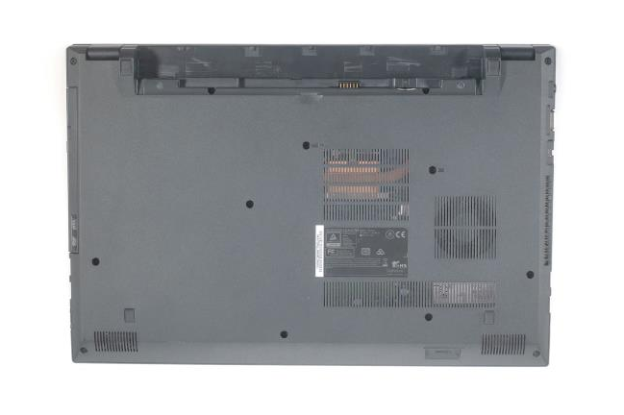

1. Step
Before you start, switch off the notebook! and remove the power supply.
Remove the battery.
Remove the two screws from the bottom case.
1

Slide 6
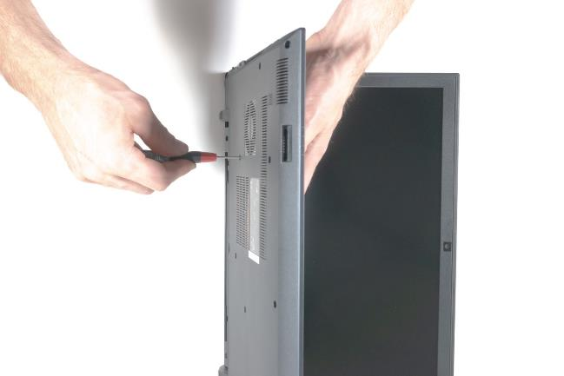

2. Step
Open the notebook and place the display on a flat surface.
Hold the keyboard with one hand to prevent it from falling.
Now insert a screwdriver into the hole and push the keyboard out.
1

Slide 7
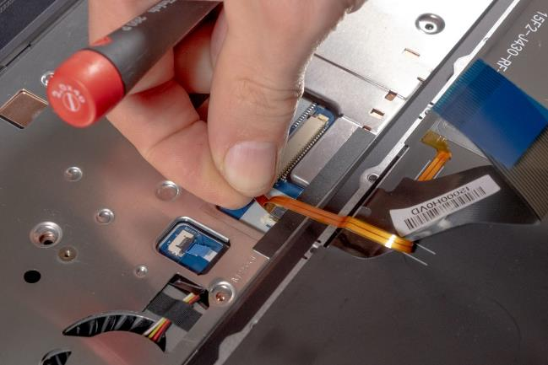
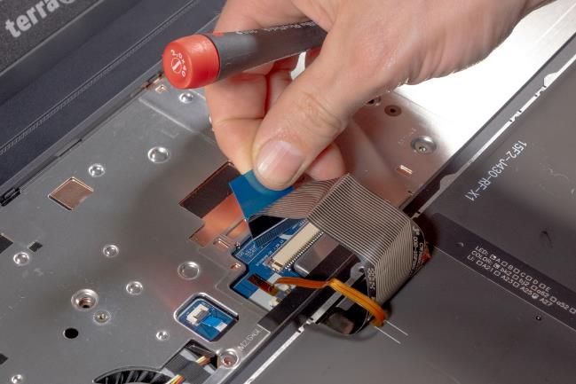
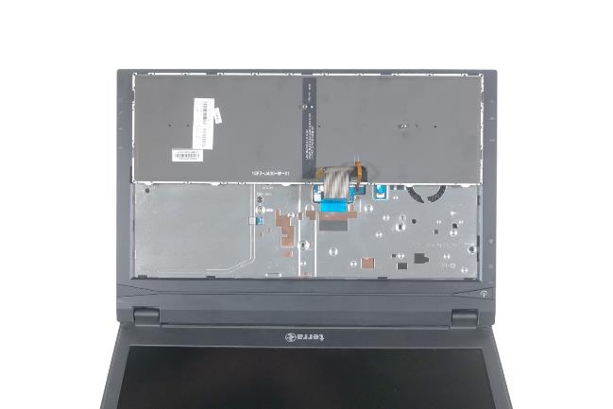



3. Step
Put the notebook down normally.
Carefully fold down the keyboard.
Be careful not to damage the keyboard flat ribbon cable!
Disconnect the two keyboard flat ribbon cables from the sockets. (Fig.2 & 3).
Carefully remove the keyboard.
To install the keyboard, proceed in the reverse order.
1
2
3

Slide 8
REMOVE THE
BOTTOM CASE
TERRA MOBILE 1515
Difficulty: 

Slide 9
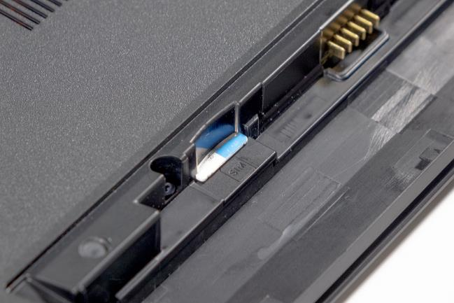
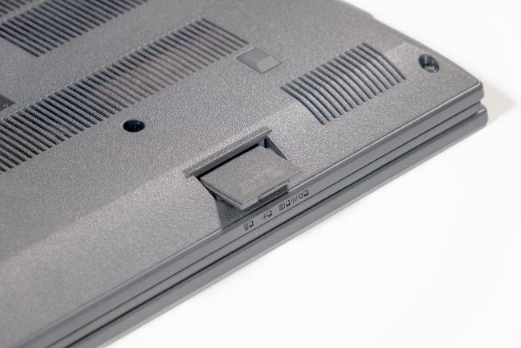
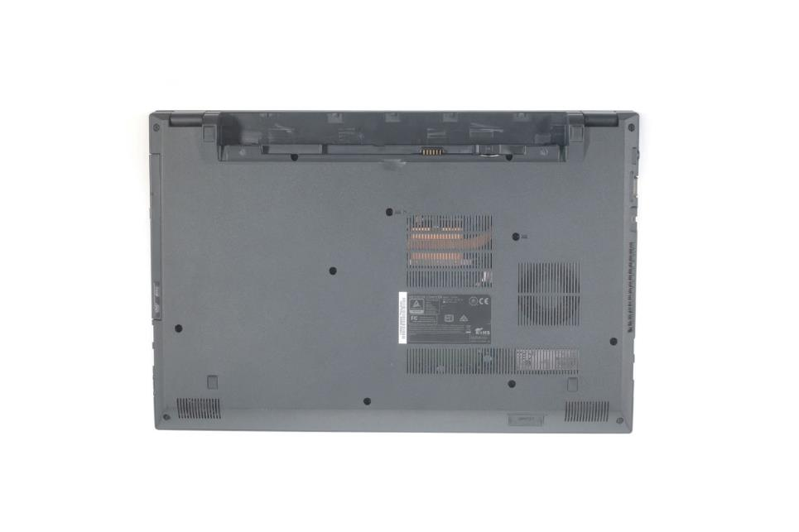


1. Step
Please note that SIM and SD cards may be installed!
Remove the SD-Card. (Fig.2).
Remove the SIM-Card. (Fig.3).
Remove the Keyboard
1
2
3

Slide 10
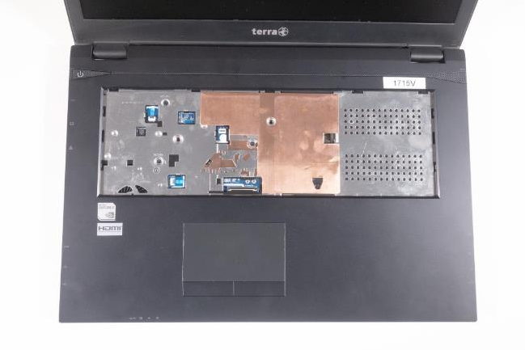
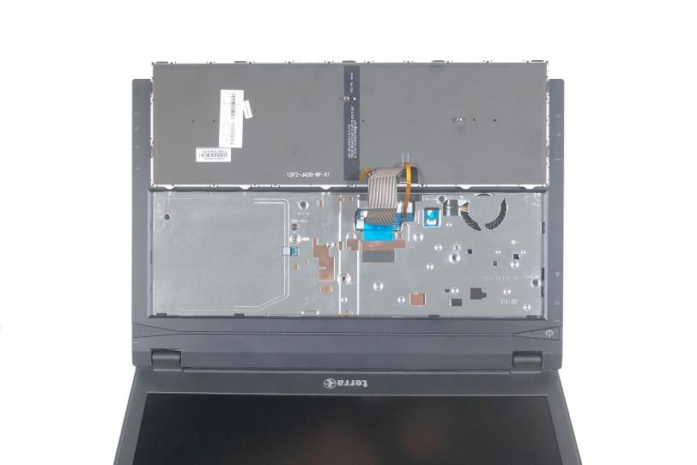


2. Step
Mobile 1515. (Fig.1): Unscrew the three marked screws located under the keyboard.
Mobile 1715. (Fig.2): Unscrew the four screws located under the keyboard.
1
2

Slide 11

3. Step
Remove the screws from the Bottom Case.
MOBILE 1515 = 11 screws PH1.
MOBILE 1715 = 13 screws PH1.
The ODD screw in the middle is. thinner than the other enclosure screws!
1

Slide 12
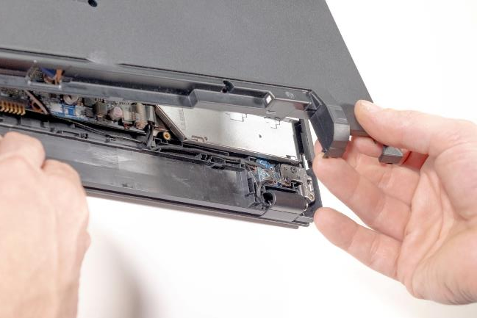
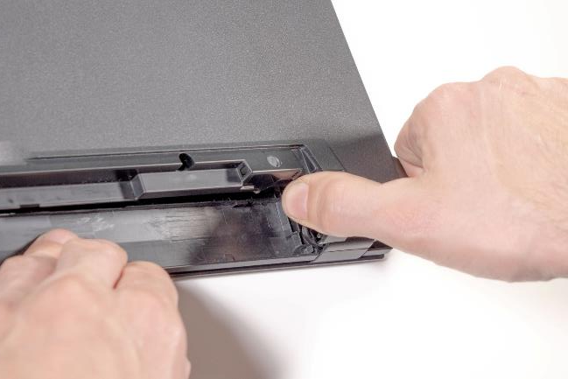


4. Step
Carefully lift the bottom case in the direction of the arrow and remove it. (Fig.2).
1
2

Slide 13
REMOVE THE RAM
TERRA MOBILE 1515
Difficulty: 

Slide 14
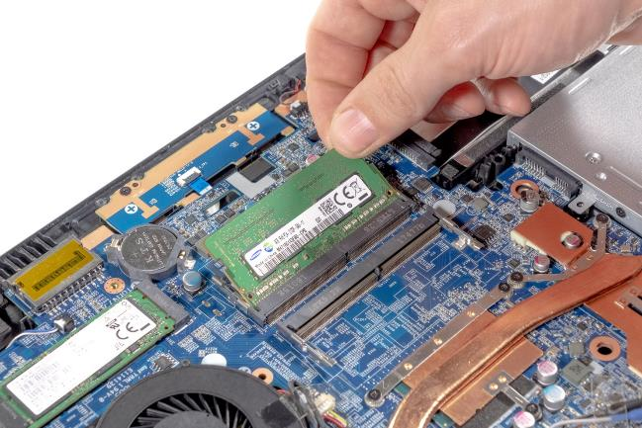
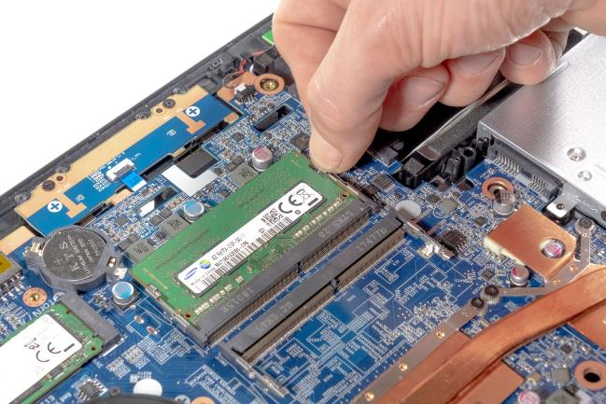
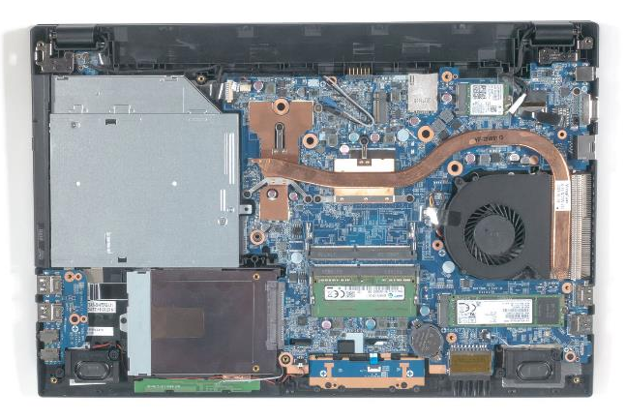



1. Step
Remove the Keyboard
Remove the Bottom Case
Now you can see the RAM Module.
Slide the metal retaining clips outwards to loosen the RAM. (Fig.2).
Now you can simply remove the memory. (Fig.3).
To install RAM, please proceed in the reverse order.
Make sure you use the same slot. Otherwise, problems can occur.
1
2
3

Slide 15
REMOVE THE ODD
TERRA MOBILE 1515
Difficulty: 

Slide 16
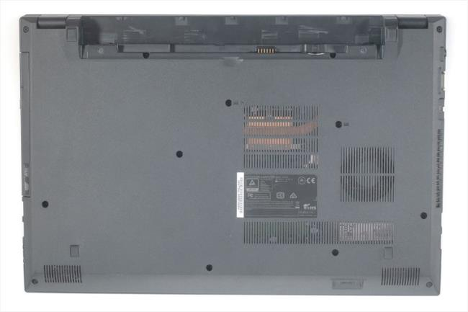

1. Step
Loosen the marked screw.
Pull the drive out of the housing in the direction of the arrow. (It is helpful to open the drive beforehand).
When replacing the drive, the bezel and the mounting bracket have to be transferred.
1
2

Slide 17
REMOVE THE M.2 SSD
TERRA MOBILE 1515
Difficulty: 

Slide 18
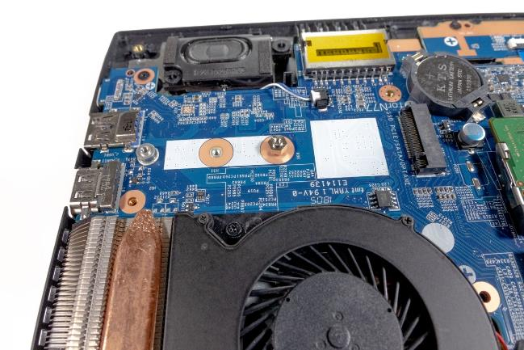
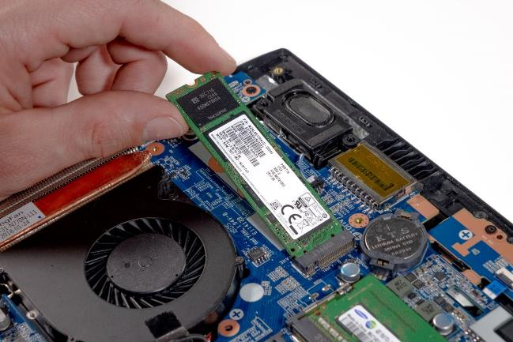
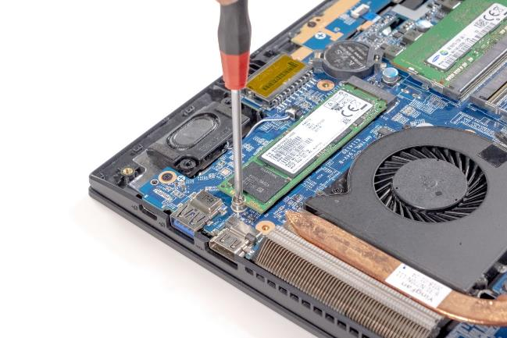
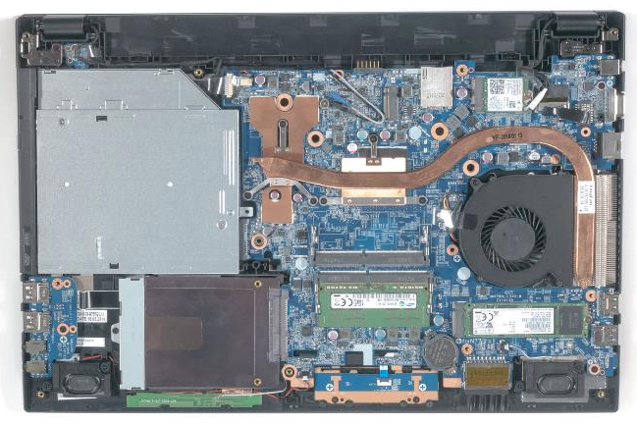



1. Step
Remove the Keyboard
Remove the Bottom Case
Now you can see the M.2 SSD. (Fig.1).
Loosen the screw. (Fig.2).
Pull out the M.2 SSD module as shown. (Fig.3).
To install a M.2 SSD, please proceed in the reverse order.
M.2 SSD modules of different lengths can be installed. Use the M.2 adapter from the enclosed accessories when using shorter M.2 modules. (Fig.4).
The models 1515A and 1715A only support SATA modules.
1
2
3
4

Slide 19
REMOVE THE HDD
TERRA MOBILE 1515
Difficulty: 

Slide 20
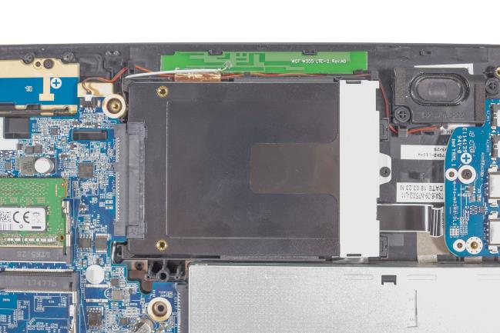


1. Step
Remove the keyboard
Remove the Bottom Case
Now you can see the HDD. (Fig.1).
Loosen the screw and pull the hard drive out of the bay in the direction of the arrow. (Fig.2).
To install a HDD, please proceed in the reverse order.
New HDDs come without written data. Before swapping, make sure that the data you want to keep is backed up.
The 2.5 inch replacement hard disk can not be higher than 7.0 mm.
1
2

Slide 21
REMOVE THE
WLAN MODULE
TERRA MOBILE 1515
Difficulty: 

Slide 22
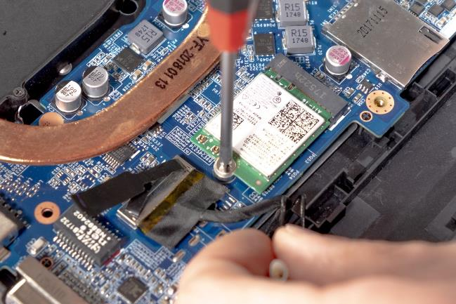
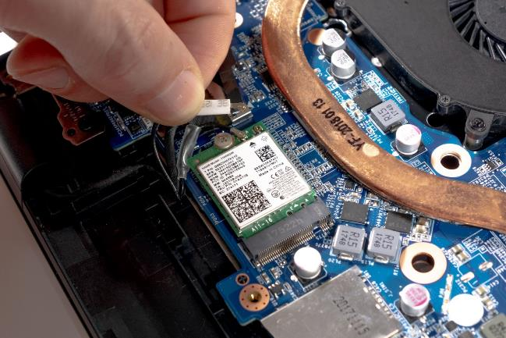
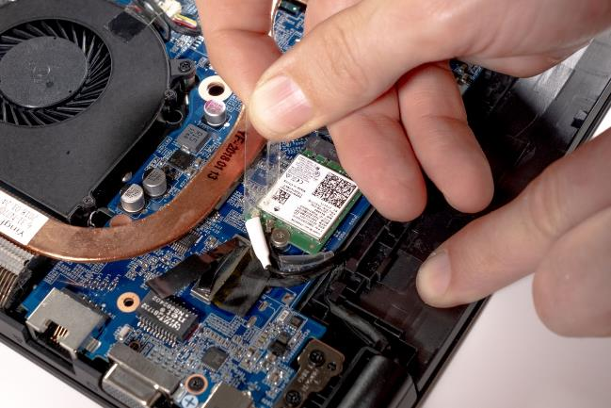




1. Step
Remove the Keyboard
Remove the Bottom Case
Now you can see the WLAN Module.
Detach the adhesive strips without disconnecting the antenna cables from the module. (Fig.2).
Disconnect the antenna cables from the module. (Fig.3).
Unscrew the marked screw. (Fig.4).
1
2
3
4

Slide 23
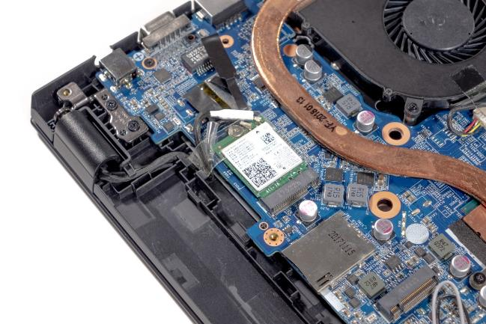

2. Step
Now you can remove the module.
If you want to replace the mainboard, it is not necessary to disconnect the antenna cables. The adhesive strip must be present.
To install a WLAN module, please proceed in the reverse order.
1

Slide 24
REMOVE THE
CMOS BATTERY
TERRA MOBILE 1515
Difficulty: 

Slide 25
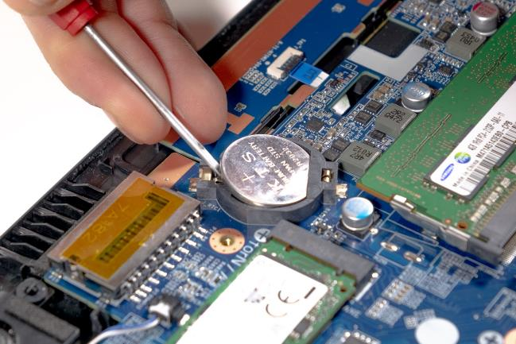

1. Step
Remove the Keyboard
Remove the Bottom Case
Now you can see the CMOS battery
Carefully lever the battery out of the holder with a screwdriver. (Fig.2).
Install a new 3V lithium battery, type CR2032.
1
2

Slide 26
LTE MODULE
INSTALLATION
TERRA MOBILE 1515
Difficulty: 

Slide 27

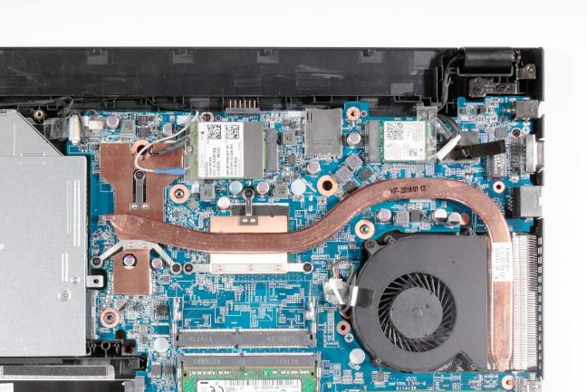
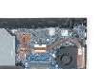
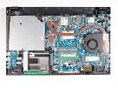
1. Step
Remove the Keyboard
Remove the Bottom Case
The M.2 socket for the LTE module is now accessible.
Loosen the screw. (Fig.2).
Insert the LTE module into the slot as shown in the picture and secure it with the screw.
Carefully push the antenna plugs into the sockets of the module until they snap into place.
Secure the connector with the transparent foil.
After the housing has been refitted, you can insert the SIM card. The SIM slot is located in the battery compartment. (Fig.4).
1
2
3
4

Slide 28
REMOVE THE FAN
TERRA MOBILE 1515
Difficulty: 

Slide 29
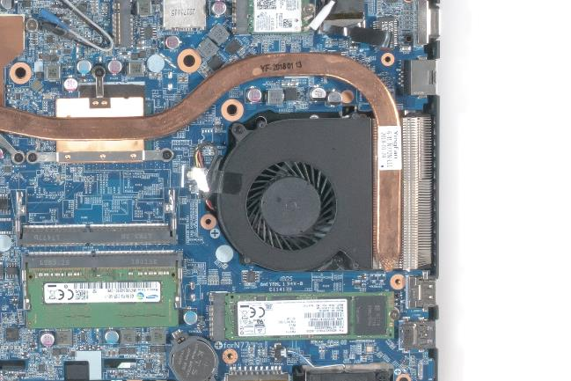
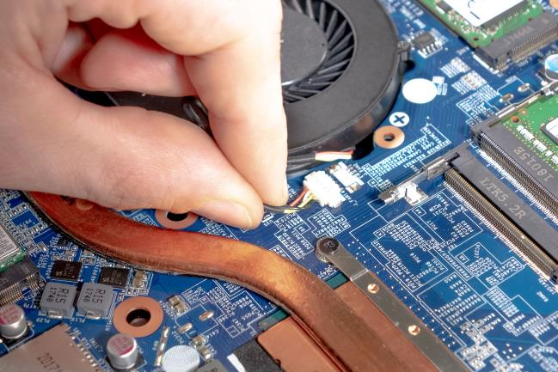


1. Step
Remove the Keyboard
Remove the Bottom Case
Now you can see the fan.
Remove the adhesive strip and keep it for the installation of the replacement fan.
Now carefully pull the plug out of the holder. (Fig.2).
Unscrew the two marked screws. (Fig.3).
Now you can lift the fan out with ease.
To install a fan, please proceed in the reverse order.
1
2
3

Slide 30
REMOVE THE MAINBOARD
TERRA MOBILE 1515
Difficulty: 

Slide 31
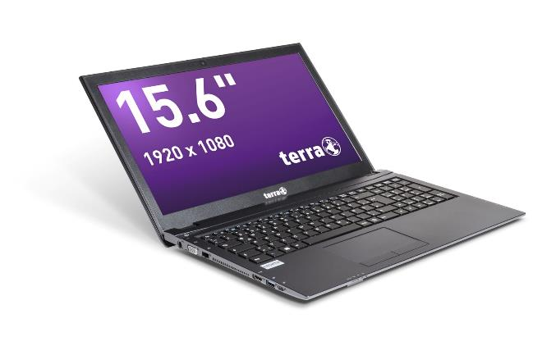

1. Step
Before you start, switch off the notebook! And remove the power supply.
Remove the Keyboard
Remove the Bottom Case
Remove the HDD
Remove the M.2 SSD
Remove the RAM
Remove the Fan
Remove the WLAN Module
1

Slide 32




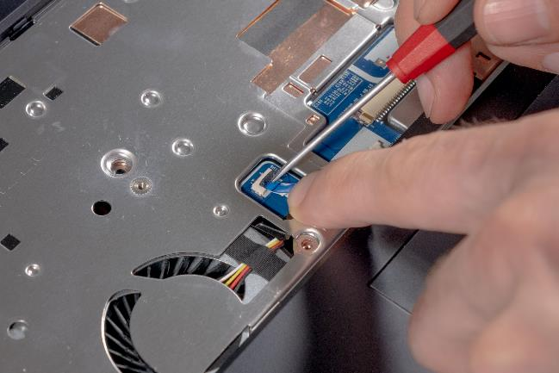

2. Step
Before continuing, please check that all the previous steps have been carried out.
First disconnect the two cables on the front from the mainboard that were previously covered by the keyboard by lifting up the locking device (black) and carefully pulling the tabs of the cables.
1
2
3
4
5

Slide 33
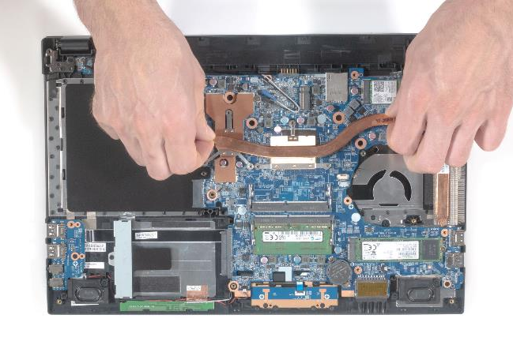
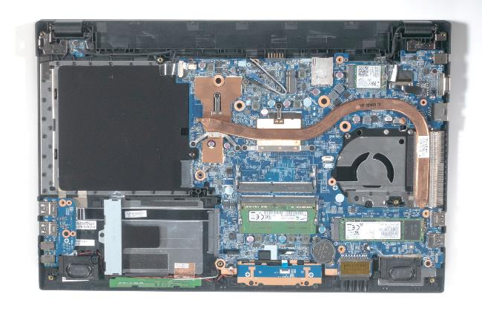


3. Step
The MOBILE 1515V is shown here. The MOBILE 1515 and MOBILE 1715 series differ slightly from each other here.
Remove the six marked screws from the heatsink. (Fig.1).
Now the heatsink can be lifted off the mainboard. (Fig.2).
To install a heatsink, please proceed in the reverse order.
1
2
3
4
5

Slide 34
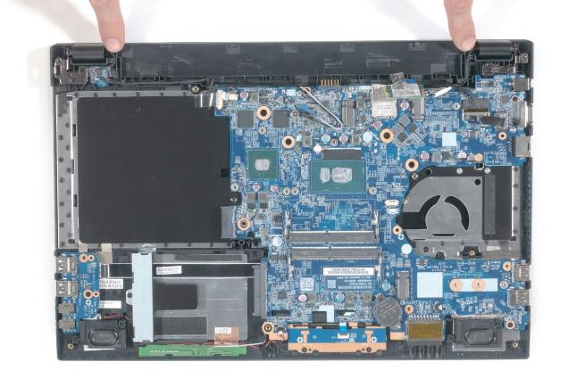
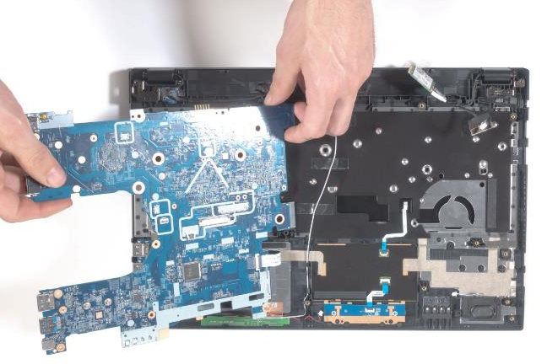
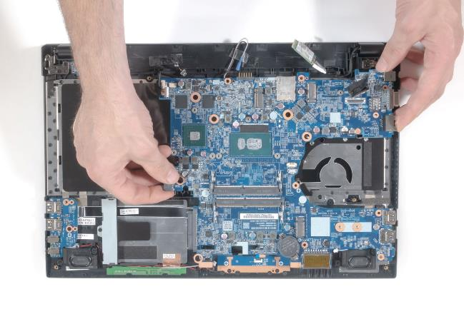




4. Step
Now you have to carefully pull a total of four plugs out of the holders (Fig. 1).The two antenna cables are only glued on. Please reuse the adhesive tape.
Remove the three screws.( Fig.2).
Pay particular attention to the cable routing. It helps to document the initial state of your device with additional photos.
Lift the mainboard slightly.(Fig.3).
Remove the hidden flat ribbon cable on the back of the mainboard.(Fig.4).
To install a mainboard, please proceed in the reverse order.
Please transfer the adhesive foil for fixing the cables from the old mainboard.
1
2
3
3
4
5

Slide 35
REMOVE THE TOP CASE
TERRA MOBILE 1515
Difficulty: 

Slide 36
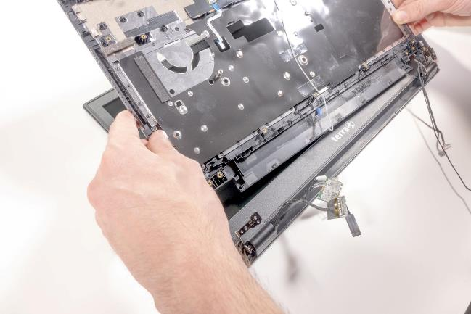
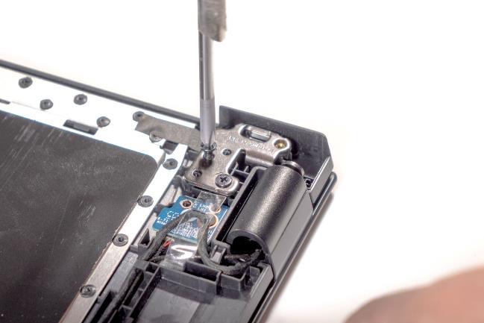
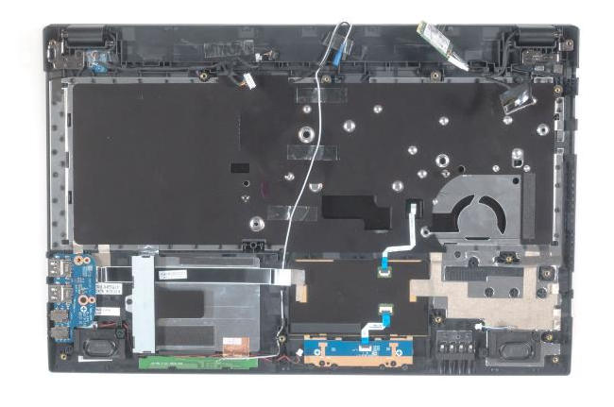



1. Step
Remove the mainboard
Before continuing, please check that all the previous steps have been carried out.
Remove the circuit board, cables and speakers. (Fig.1).
Remove the screws from the hinges. (Fig.2).
When you carefully flip open the case, the hinges should release so that you can remove the top case. (Fig.3).
To install a top case, please proceed in the reverse order.
Pay attention to the correct cable routing, the correct cable marking and the screws on the hinges. Improper handling can result in irreparable damage.
1
2
3
4
5

Slide 37
REMOVE THE LCD DISPLAY
TERRA MOBILE 1515
Difficulty: 

Slide 38
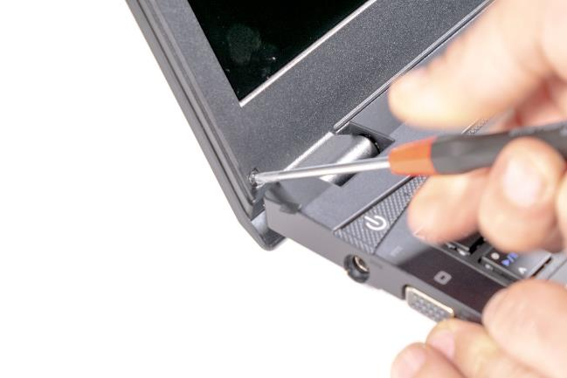
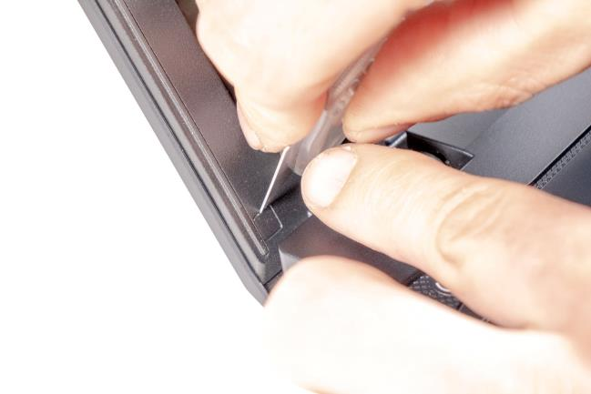


1. Step
Before you start, switch off the notebook! And remove the power supply and battery.
Carefully remove the screw covers. (Fig.1). These are delicate and should be reused after replacing the display.
Remove the screws. (Fig.2).
1
2
3
4
5

Slide 39
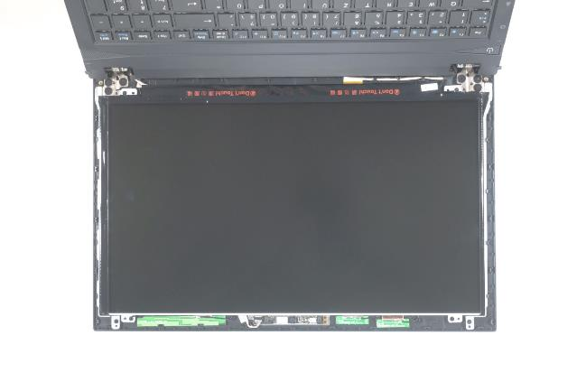
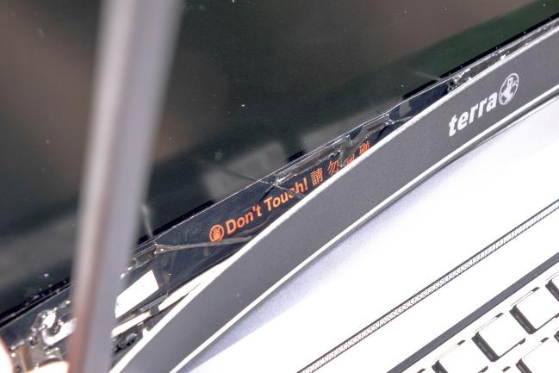
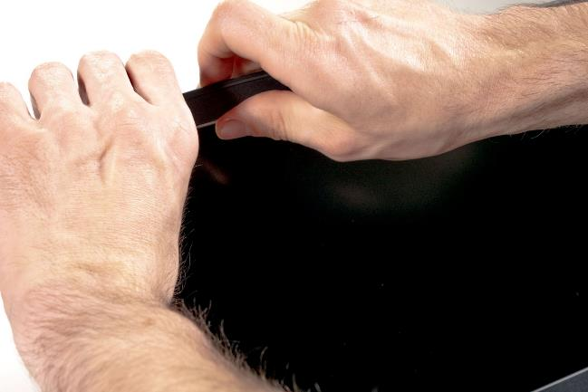
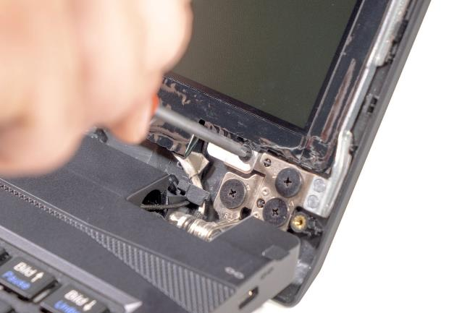
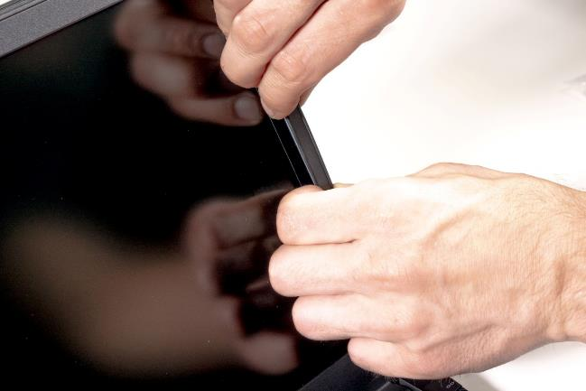




2. Step
Now remove the front cover, starting on the top right corner (Fig. 1) working your way round anti-clockwise. (Fig.2). so that the bottom gets done last.
Be careful not to damage the foil. (Fig.3).
Remove the four screws. (Fig.4).
1
2
3
4
5

Slide 40
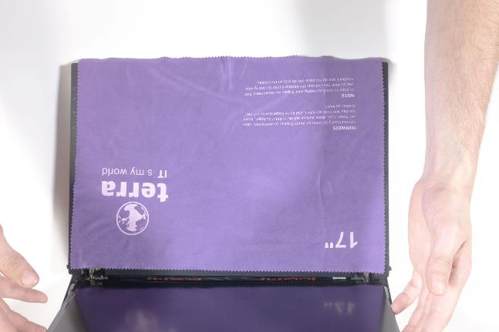







3. Step
Use the supplied protective cloth as shown (Fig. 1) Remove the LCD panel from the front and place it down. (Fig.2).
Remove the LCD cable, paying attention to the adhesive foil. (Fig.3).
Now you can remove the LCD panel.
To install an LCD display, please proceed in the reverse order.
If necessary, additionally fix the cable to the LCD panel with duct tape. Replace the double-sided adhesive tape on the LCD front cover.
1
2
3
4
5

Slide 41
Spare parts lists
Mobile 1515
Mobile 1515A
Mobile 1515V
Mobile 1715
Mobile 1715A
Mobile 1715V

Slide 42
Spare parts TERRA Mobile 1515
Article number | Description
1480074 | Battery 44Wh
1481175 | Power supply 40W EU
1480043 | Keyboard [German]
E1080093 | Antenna LTE (LTE1)
E1080081 | Antenna LTE (LTE2)
E1080082 | Audio Board
E1080217 | Audio Board WU
E1080084 | Bottom Case (Cover D)
E1080216 | Bottom Case (Cover D) WU
E1080092 | Cable for Webcam
E1080078 | Click Board
E1082852 | CPU Fan 3-pin
E1080191 | CPU Fan 4-pin (PWM)
E1080218 | DC port (single socket)
E1080086 | Display 15.6" FHD (eDP)
E1080079 | Hall Sensor Board
E1080186 | HDD Bracket
E1080087 | Hinge (L)
E1080091 | Hinge (R)
Article number | Description
E1080272 | LAN Cover
E1080088 | LCD Back Cover (Cover A)
E1080090 | LCD Cable (eDP)
E1080085 | LCD Front Cover (Cover B)
E1080089 | LCD Rubber
E1080173 | LID Switch Board
E1080358 | Mainboard (i3-7020U)
E1080158 | Mainboard WU (i3-7100U)
E1080333 | Mainboard (i3-8130U)
E1080083 | Mainboard WU (i5-7200U)
E1080334 | Mainboard WU (i5-8250U)
E1080094 | ODD Bezel Set
E1080076 | Speaker (L)
E1080080 | Speaker (R)
E1080066 | Top Case (Cover C)
E1080077 | Touchpad

Slide 43
Spare parts TERRA Mobile 1515A
Article number | Description
1481175 | Power supply 40W (EU)
1480074 | Battery 44Wh
1480043 | Keyboard [German]
E1080093 | Antenna LTE (LTE1)
E1080081 | Antenna LTE (LTE2)
E1080234 | Audio Board
E1080236 | Bottom Case (Cover D)
E1080092 | Cable for Webcam
E1080078 | Click Board
E1083605 | CPU Fan
E1080218 | DC port (single socket)
E1080086 | Display 15.6" FHD (eDP)
E1080079 | Hall Sensor
E1080186 | HDD Bracket
E1080087 | Hinge (L)
E1080091 | Hinge (R)
E1080272 | LAN Cover
Article number | Description
E1080088 | LCD Back Cover (Cover A)
E1080090 | LCD Cable (eDP)
E1080085 | LCD Front Cover (Cover B)
E1080089 | LCD Rubber
E1080173 | LID Switch Board
E1080235 | Mainboard (N5000)
E1080094 | ODD Bezel Set
E1080076 | Speaker (L)
E1080080 | Speaker (R)
E1080233 | Top Case (Cover C)
E1080077 | Touchpad

Slide 44
Spare parts TERRA Mobile 1515V
Article number | Description
1480074 | Battery 44Wh
1480486 | Power supply 65W (EU)
1480043 | Keyboard [German]
E1080093 | Antenna LTE (LTE1)
E1080081 | Antenna LTE (LTE2)
E1080217 | Audio Board
E1080216 | Bottom Case (Cover D)
E1080092 | Cable for Webcam
E1080078 | Click Board
E1080191 | CPU Fan 4-pin (PWM)
E1080086 | Display 15.6" FHD (eDP/nonGl.)
E1080079 | Hall Sensor
E1080186 | HDD Bracket
E1080087 | Hinge (L)
E1080091 | Hinge (R)
E1080272 | LAN Cover
E1080088 | LCD Back Cover (Cover A)
Article number | Description
E1080090 | LCD Cable (eDP)
E1080085 | LCD Front Cover (Cover B)
E1080089 | LCD Rubber
E1080173 | LID Switch Board
E1080270 | Mainboard (i5-7200U/MX150)
E1080238 | Mainboard (i5-8250U/MX150)
E1080331 | Mainboard (i5-8250U/MX250)
E1080094 | ODD Bezel Set
E1080076 | Speaker (L)
E1080080 | Speaker (R)
E1080215 | Top Case (Cover C)
E1080077 | Touchpad

Slide 45
Spare parts TERRA Mobile 1715
Article number | Description
1480074 | Battery 44Wh
1481175 | Power supply 40W (EU)
1480043 | Keyboard [German]
E1080335 | Antenna LTE (LTE1)
E1080081 | Antenna LTE (LTE2)
E1080174 | Audio Board
E1080171 | Battery Transfer Board
E1080179 | Bottom Case (Cover D)
E1080184 | Cable for Webcam
E1080172 | Click Board
E1083605 | CPU Fan 3-pin
E1080191 | CPU Fan 4-pin (PWM)
E1080218 | DC port (single socket)
E1080192 | Display 17.3" FHD (eDP/nonGl.)
E1080193 | Display 17.3" HD+ (eDP/nonGl.)
E1080186 | HDD Bracket
E1080181 | Hinge (L)
E1080182 | Hinge (R)
E1080183 | LCD Back Cover (Cover A)
Article number | Description
E1080185 | LCD Cable (eDP)
E1080180 | LCD Front Cover (Cover B)
E1080089 | LCD Rubber
E1080173 | LID Switch Board
E1080175 | Mainboard (i3-7100U) V2.1A
E1080267 | Mainboard (i3-7100U) V3.1
E1080332 | Mainboard (i3-8130U) V3.0
E1080269 | Mainboard (i5-7200U) V3.1
E1080176 | Mainboard (i5-8250U) V2.1A
E1080268 | Mainboard (i5-8250U) V3.1
E1080177 | ODD Bridge Board
E1080169 | Power Switch Board
E1080178 | SATA Board
E1080170 | SIM Card Board
E1080196 | Speaker (L)
E1080197 | Speaker (R)
E1080168 | Top Case (Cover C)
E1080077 | Touchpad

Slide 46
Spare parts TERRA Mobile 1715A
Article number | Description
1480074 | Battery 44Wh
1481175 | Power supply 40W
1480043 | Keyboard [German]
E1080335 | Antenna LTE (LTE1)
E1080081 | Antenna LTE(LTE2)
E1080174 | Audio Board
E1080171 | Battery Transfer Board
E1080214 | Bottom Case (Cover D)
E1080184 | Cable for Webcam
E1080172 | Click Board
E1083605 | CPU Fan 3-pin
E1080191 | CPU Fan 4-pin (PWM)
E1080218 | DC port (single socket)
E1080192 | Display 17.3" FHD (eDP/nonGl.)
E1080193 | Display 17.3" HD+ (eDP/nonGl.)
E1080186 | HDD Bracket
E1080181 | Hinge (L)
Article number | Description
E1080182 | Hinge (R)
E1080183 | LCD Back Cover (Cover A)
E1080185 | LCD Cable (eDP)
E1080180 | LCD Front Cover (Cover B)
E1080089 | LCD Rubber
E1080173 | LID Switch Board
E1080213 | Mainboard (N5000)
E1080177 | ODD Bridge Board
E1080169 | Power Switch Board
E1080178 | SATA Board
E1080170 | SIM Card Board
E1080196 | Speaker (L)
E1080197 | Speaker (R)
E1080212 | Top Case (Cover C)
E1080077 | Touchpad

Slide 47
Spare parts TERRA Mobile 1715V
Article number | Description
1480074 | Battery 44Wh
1480486 | Power supply 65W (EU)
1480043 | Keyboard [German]
E1080335 | Antenna LTE (LTE1)
E1080081 | Antenna LTE (LTE2)
E1080174 | Audio Board
E1080171 | Battery Transfer Board
E1080232 | Bottom Case (Cover D)
E1080184 | Cable for Webcam
E1080172 | Click Board
E1080191 | CPU Fan 4-pin (PWM)
E1080192 | Display 17.3" FHD (eDP/nonGl.)
E1080186 | HDD Bracket
E1080181 | Hinge (L)
E1080182 | Hinge (R)
E1080183 | LCD Back Cover (Cover A)
E1080185 | LCD Cable (eDP)
Article number | Description
E1080180 | LCD Front Cover (Cover B)
E1080089 | LCD Rubber
E1080173 | LID Switch Board
E1080271 | Mainboard (i5-7200U/MX150)
E1080189 | Mainboard (i5-8250U/MX150)
E1080329 | Mainboard (i5-8250U/MX250)
E1080190 | Mainboard (i7-8550U/MX150)
E1080330 | Mainboard (i7-8550U/MX250)
E1080177 | ODD Bridge Board
E1080169 | Power Switch Board
E1080178 | SATA Board
E1080170 | SIM Card Board
E1080196 | Speaker (L)
E1080197 | Speaker (R)
E1080231 | Top Case (Cover C)
E1080077 | Touchpad

Slide 48
Do you have questions or suggestions?
Then send an e-mail to info@wortmann.de
We are looking forward to your feedback!

