Slide 1
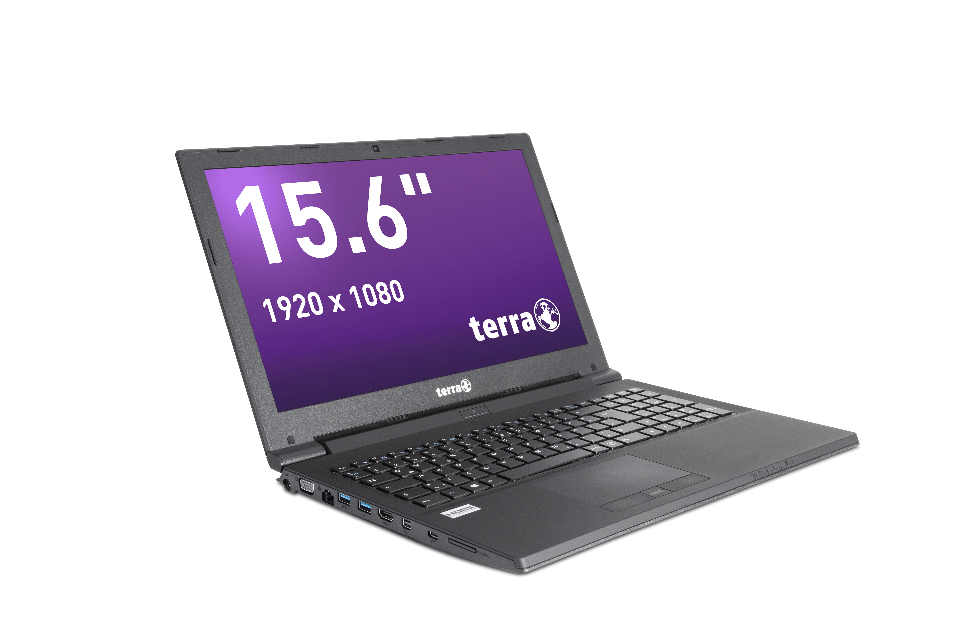
Service Manual
TERRA MOBILE 1542
TERRA MOBILE 1542K
TERRA MOBILE 1543

Slide 2


Contents
Service Notes
Remove the Service Cover
Remove the ODD
Remove the HDD /SSD
Remove the M.2 SSD
Remove the RAM
Remove the CPU Fan / Heatsink
Remove the CPU
Remove the CMOS-Battery
Remove the Keyboard
LTE Module installation
Remove the WLAN Module
Remove the Mainboard
Remove the Top Case
Remove the LCD Display
Remove the Bottom Case
Remove the LCD Back Cover
Spare Parts 1543/1542/1542K

Slide 3

SERVICE NOTES
Safety instructions
Work on a clean surface. Make sure that the housing can not be scratched.
Sort the screws and make sure that they are in the right place when reinstalling. Wrongly inserted screws can cause irreparable damage.
For all service work. Always disconnect the power supply and the battery connection to the mainboard.
Ensure you have sufficient ESD protection.
The WORTMANN AG accepts no liability for any damage caused when using this service manual.
Tools
Phillips screwdriver PH0
Phillips screwdriver PH1
Slotted screwdriver 2 mm
Plastic Slotted screwdriver 3mm
Duct tape
These repair instructions are for the TERRA MOBILE 1543. The construction of the 1542 differs partially from these instructions.
Use the buttons below the images to take a closer look at the steps involved.

Slide 4
SERVICE COVER
TERRA MOBILE 1543
Difficulty: 

Slide 5
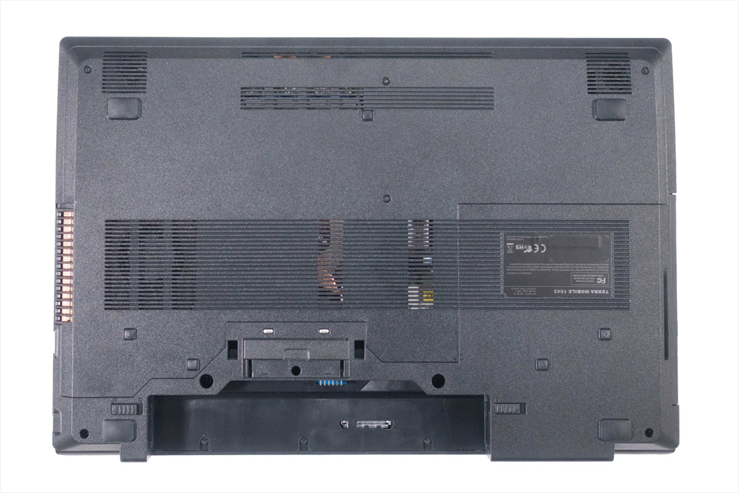
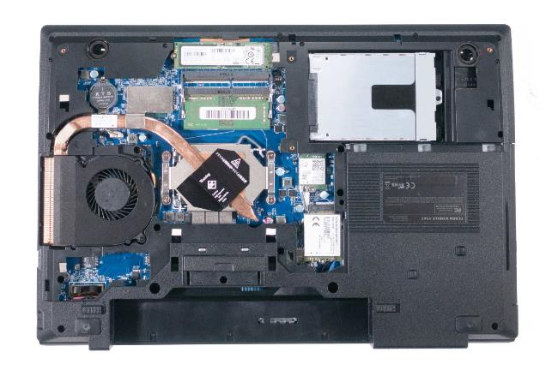
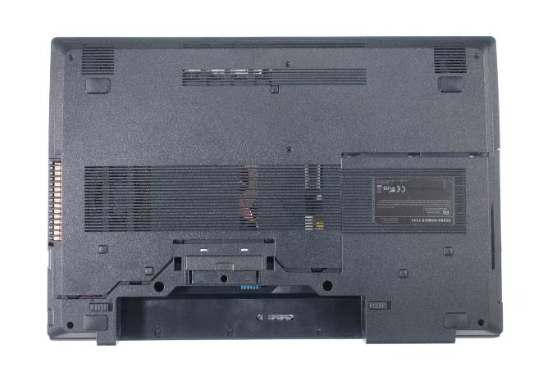
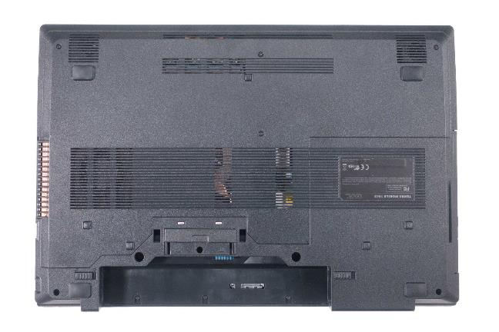



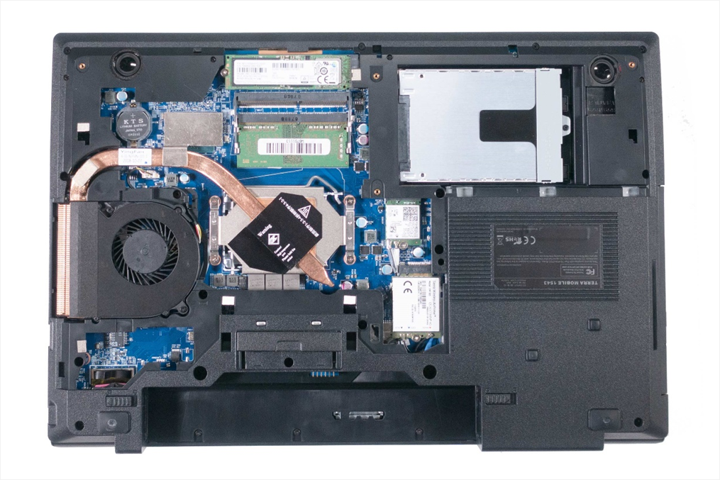
1. Step
First remove the battery. To do this, press the latches outward. (Fig.1) and simultaneously push the battery backwards.
Remove the 4 marked screws. (Fig.2).
Slide the cover in the direction of the arrows. (Fig. 3).
Now you can remove the cover. (Fig.4).
To install a service cover, please proceed in the reverse order.
1
2
3
4

Slide 6
REMOVE THE ODD
TERRA MOBILE 1543
Difficulty: 

Slide 7
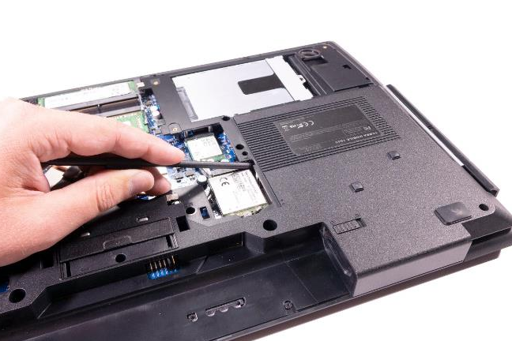

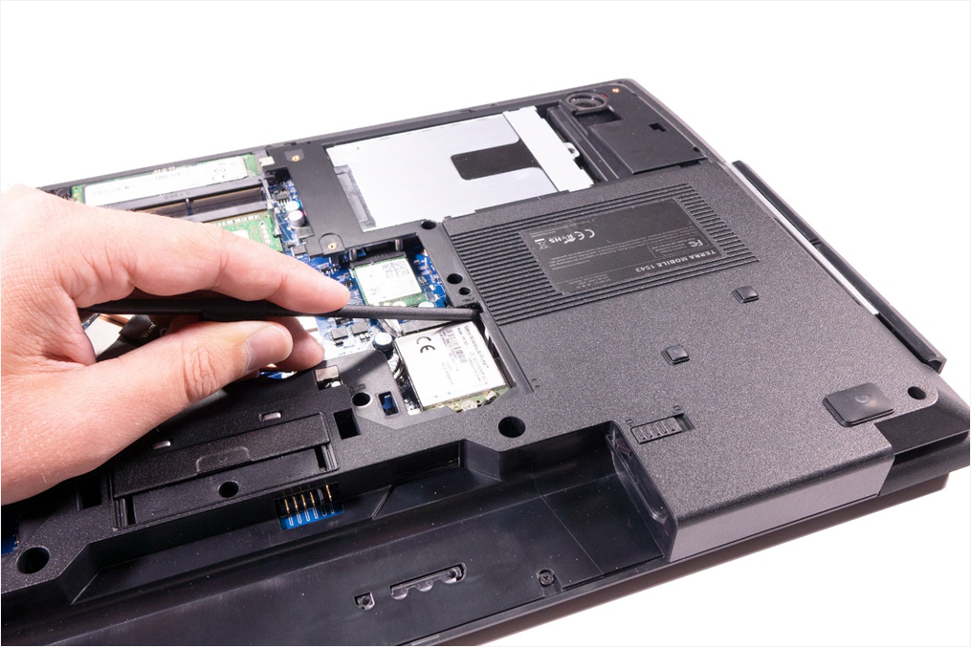
1. Step
Remove the service cover
Loosen the marked screw, which is located under the larger opening. (Fig. 1).
Push the drive out. (Fig. 2).
1
2

Slide 8
REMOVE THE 2,5“ HDD/SSD
TERRA MOBILE 1543
Difficulty: 

Slide 9
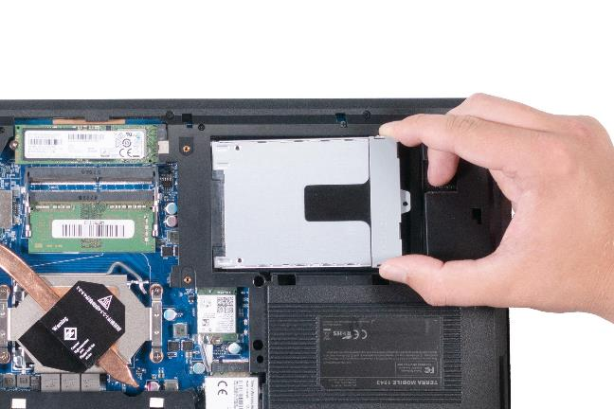
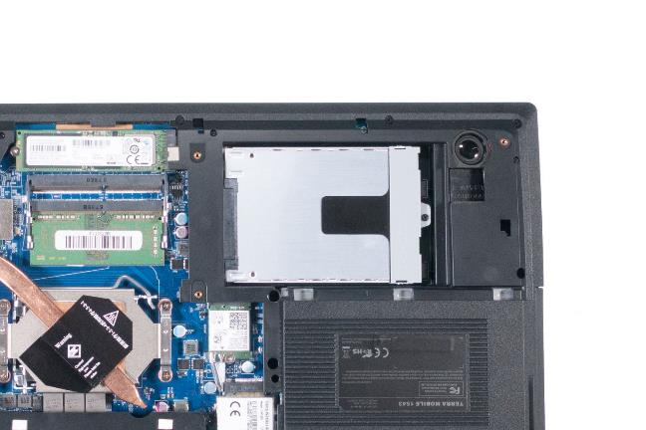
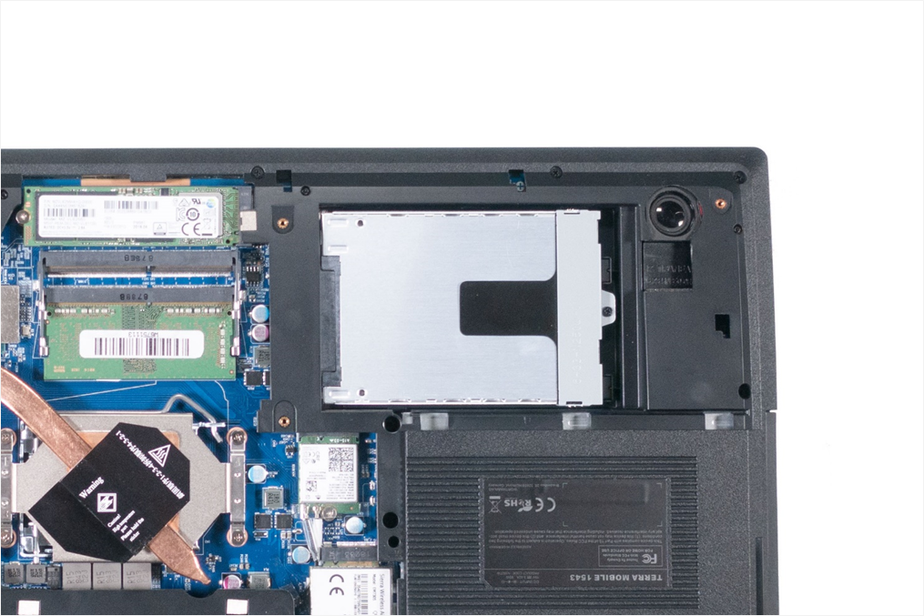
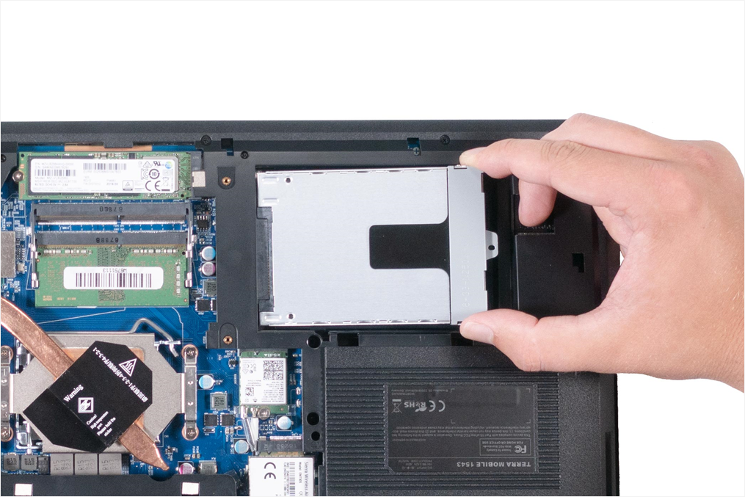
1. Step
Remove the service cover
Now you can see the HDD. ( Fig.1).
Loosen the scre. (Fig.2).
Lift the hard disk slightly and remove it in the direction of the arrow.(Fig.3).
To install a HDD, please proceed in the reverse order.
1
2
3

Slide 10
REMOVE THE M.2 SSD
TERRA MOBILE 1543
Difficulty: 

Slide 11
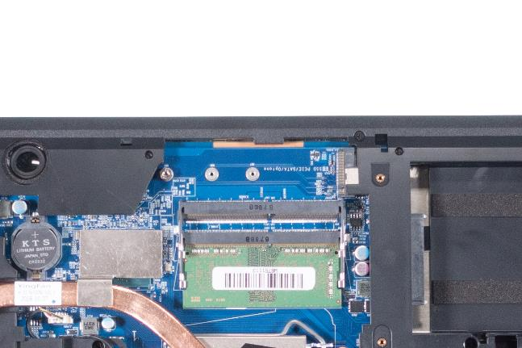
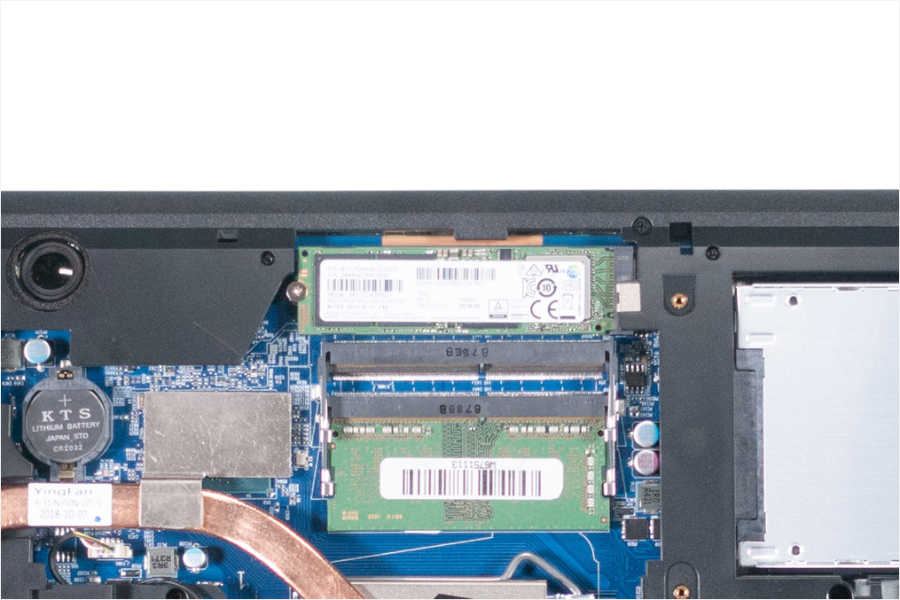
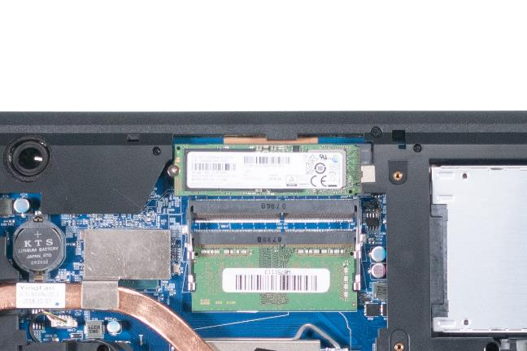

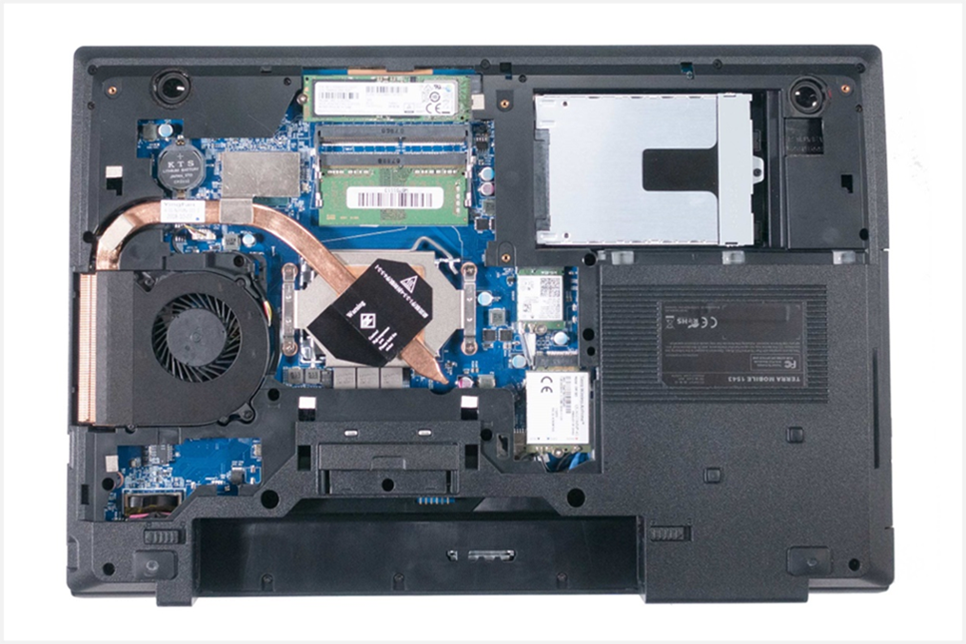
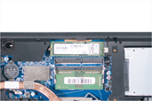
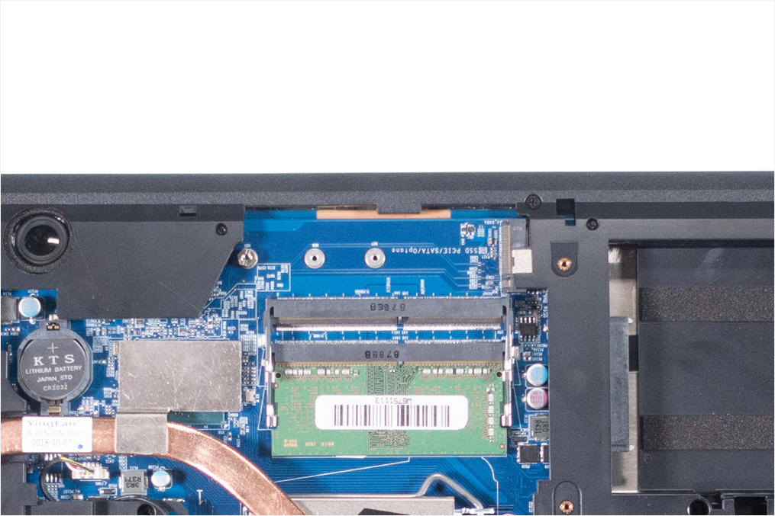
1. Step
Remove the service cover
Now you can see the M.2 SSD. (Fig.1)
Remove the marked screw. (Fig. 2).
Then lift the SSD slightly and remove it in the direction of the arrow .(Fig.3).
To install an M.2 SSD, please proceed in the reverse order
M.2 SSDs with a different form factors can also be installed. ( Fig.4).
1
2
3
4

Slide 12
REMOVE THE RAM
TERRA MOBILE 1543
Difficulty: 

Slide 13
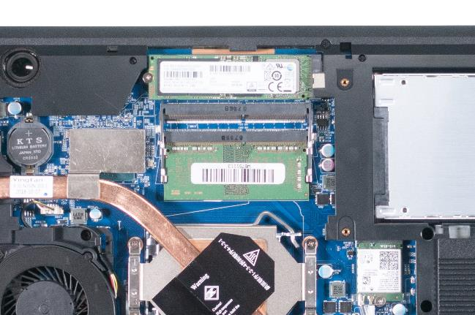

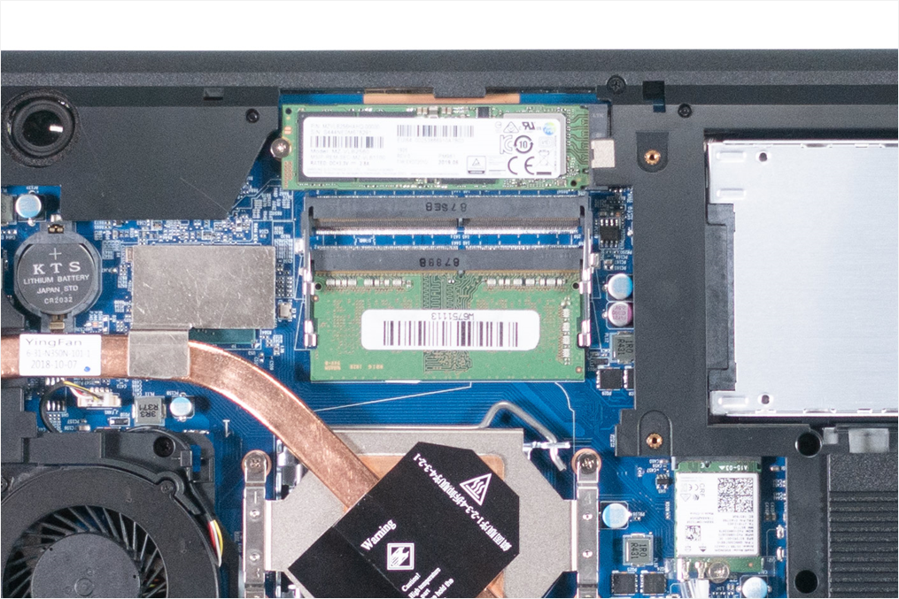
1. Step
Remove the service cover
Now you can see the RAM. (Fig.1)
RAM: Push the metal retaining clips outwards to release the RAM. (Fig.2).
To install a RAM, please proceed in the reverse order
Note that RAM slot 1 (lower socket) must always be allocated first.
1
2

Slide 14
REMOVE THE CPU FAN / HEATSINK
TERRA MOBILE 1543
Difficulty: 

Slide 15
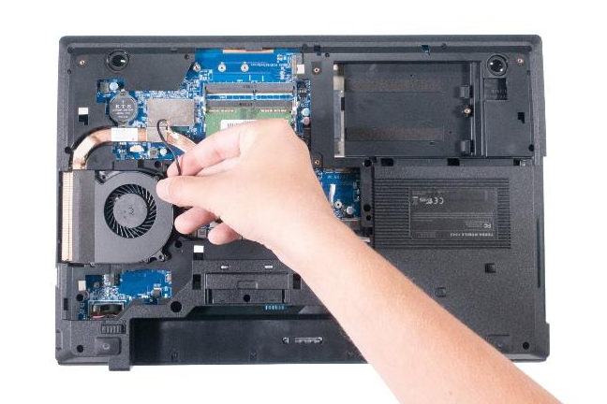
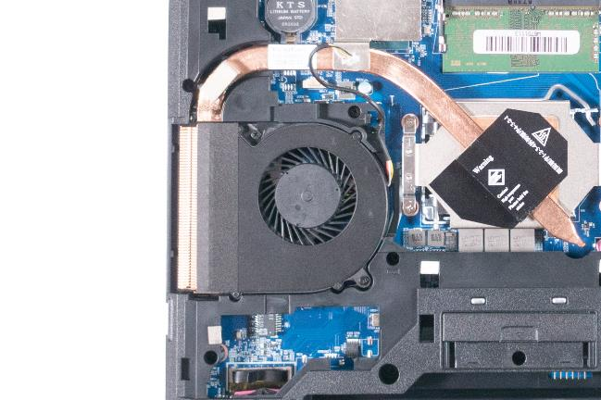
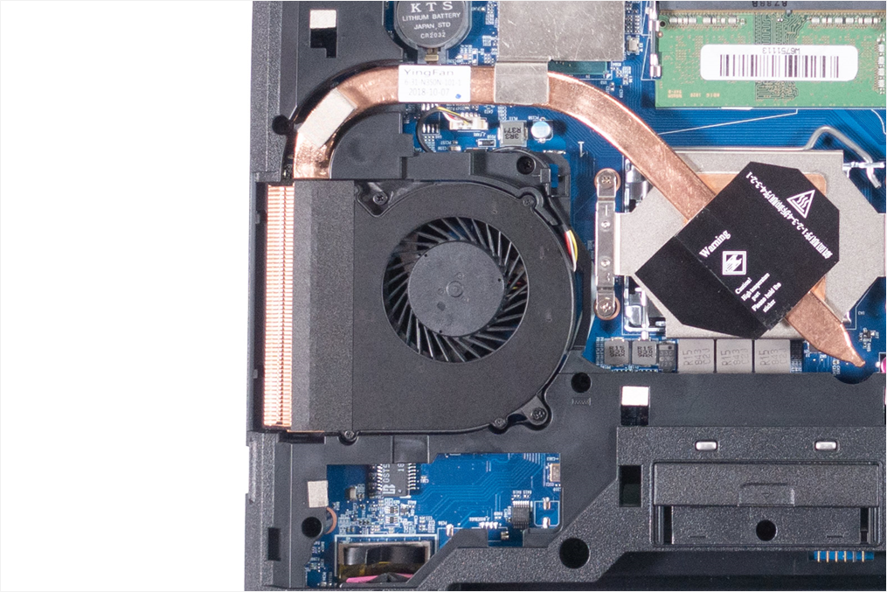

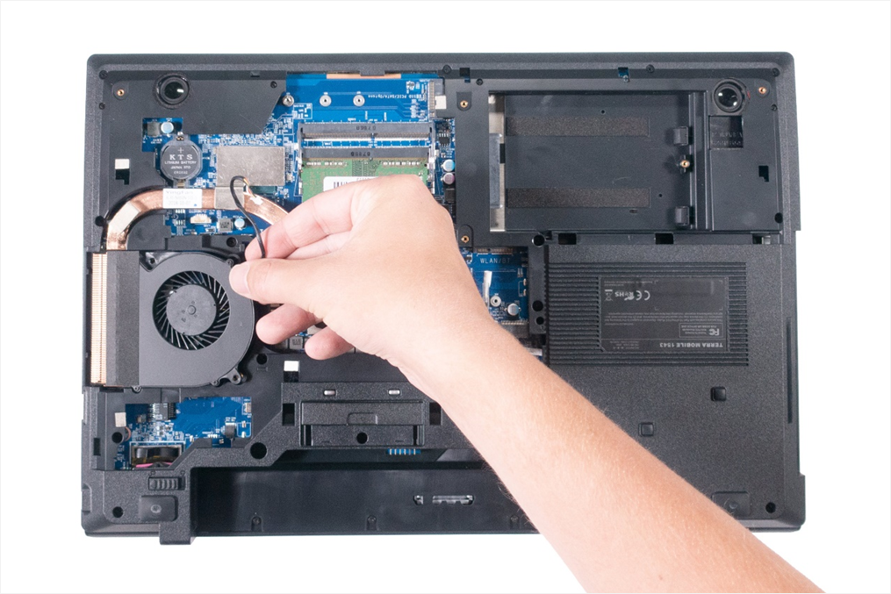
1. Step
Remove the service cover
Now you can see the fan. (Fig.1).
Disconnect the plug. (Fig.2).
Remove both marked screws of the fan (Fig.3)
Remove fan upwards. (Fig.4).
1
2
3
4

Slide 16
REMOVE THE CPU
TERRA MOBILE 1543
Difficulty: 

Slide 17
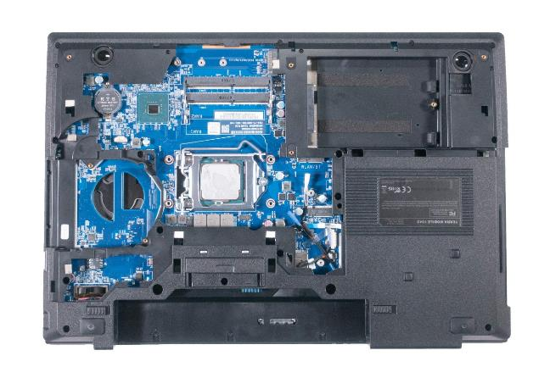
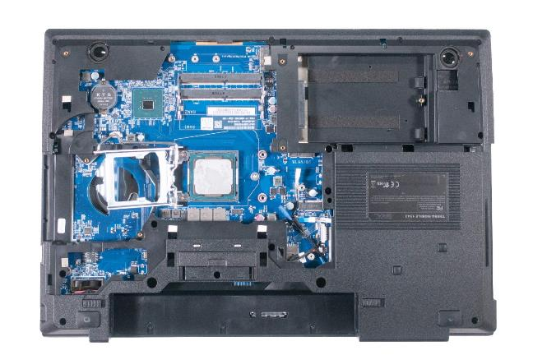
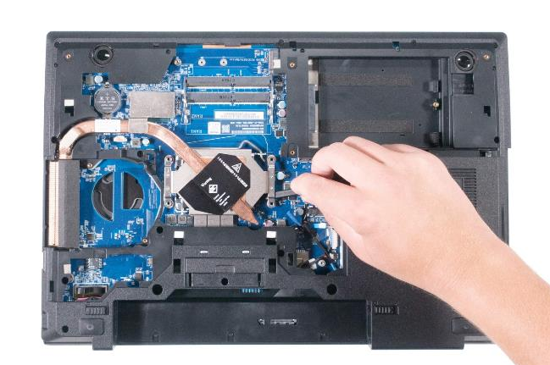
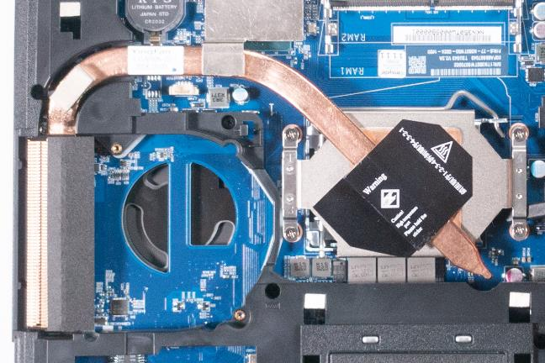
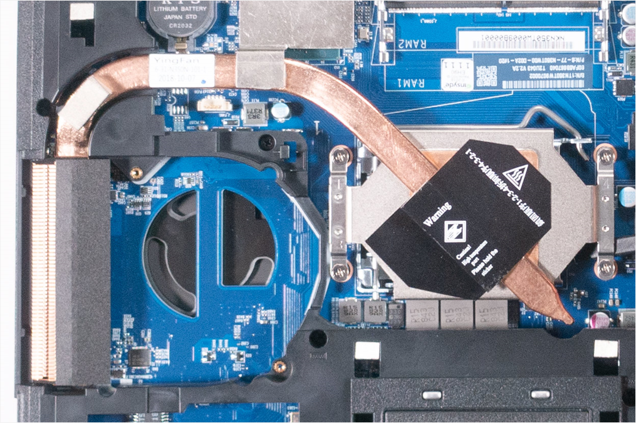
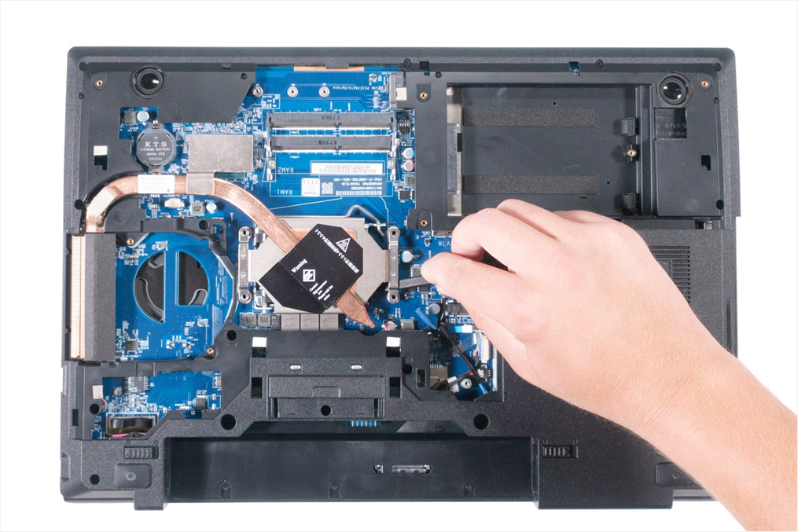
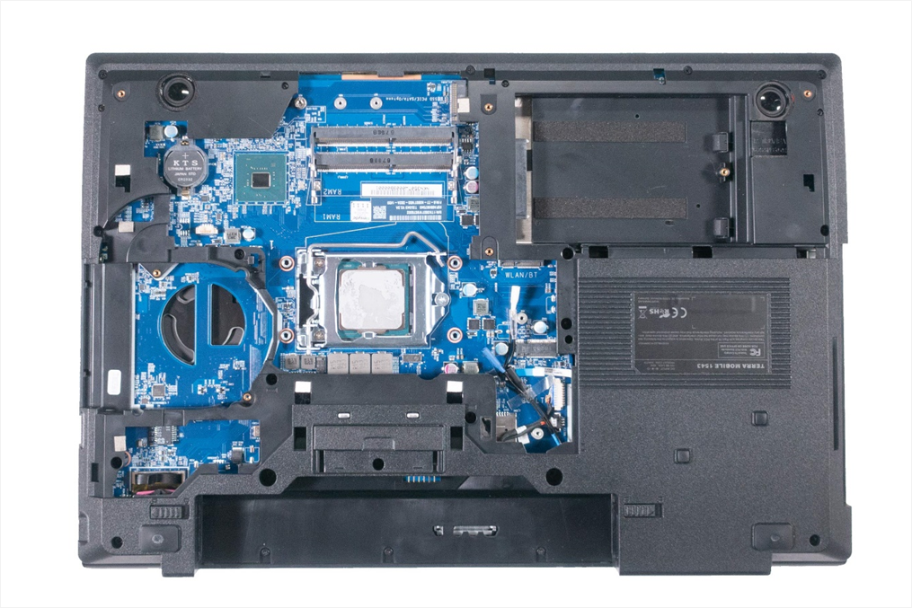
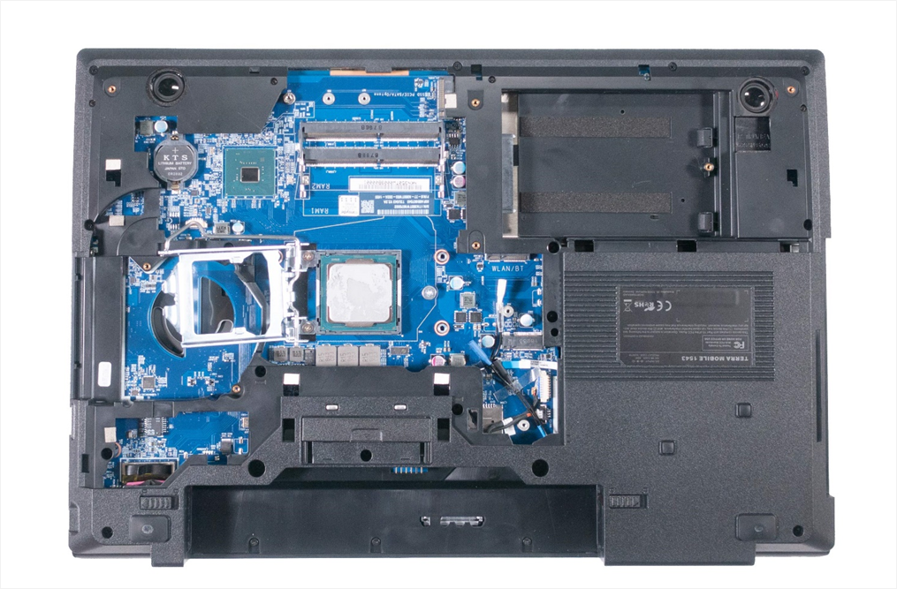
1. Step
Remove the service cover
It’s not absolutely necessary to remove the fan, as these components are not installed together
loosen the four marked screws of the heatsink .(Fig.1).
Lift the heatsink upwards. (Fig. 2).
Open the CPU socket and carefully remove the CPU.(Fig.3 & 4).
When you install the new CPU make sure you pay attention to the markings on the CPU and the socket.
When transporting a defective mainboard, the CPU socket must be covered with a cap to prevent damage.
1
2
3
4

Slide 18
REMOVE THE
CMOS BATTERY
TERRA MOBILE 1543
Difficulty: 

Slide 19
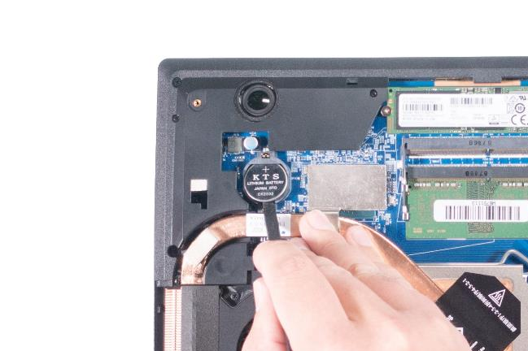
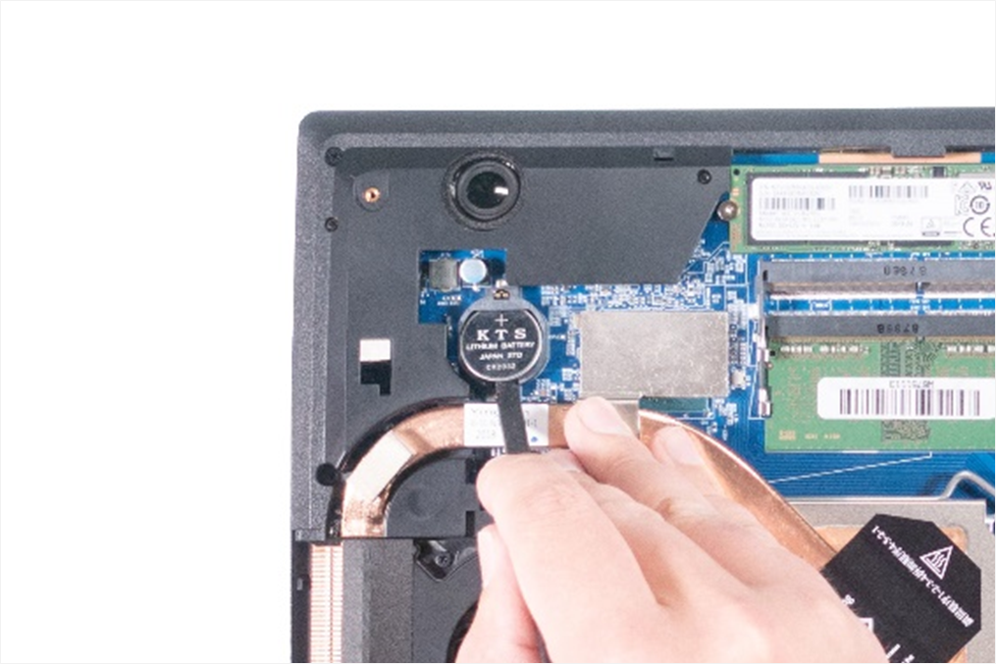
1. Step
Remove the service cover
Now you can see the battery. (Fig.1).
Carefully remove the CMOS battery (CR2032) from the socket. (Fig.2).
1
2

Slide 20
REMOVE THE KEYBOARD
TERRA MOBILE 1543
Difficulty: 

Slide 21
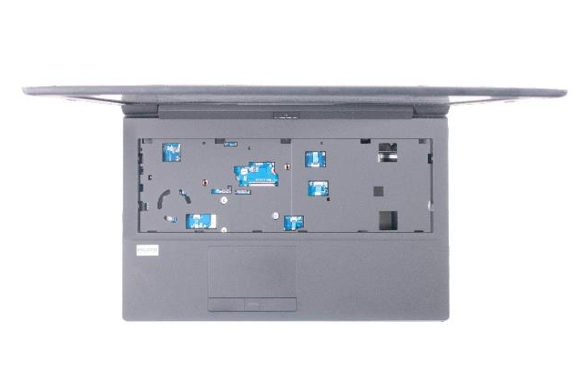
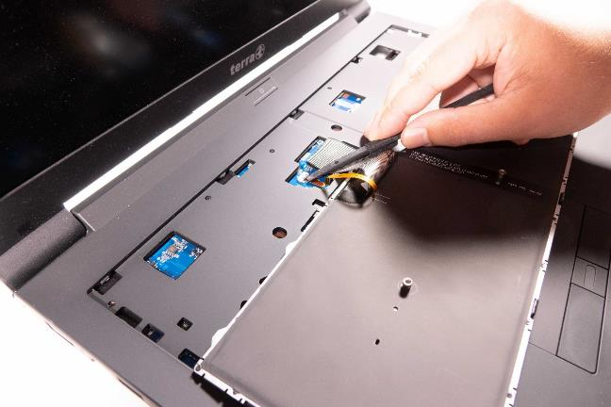
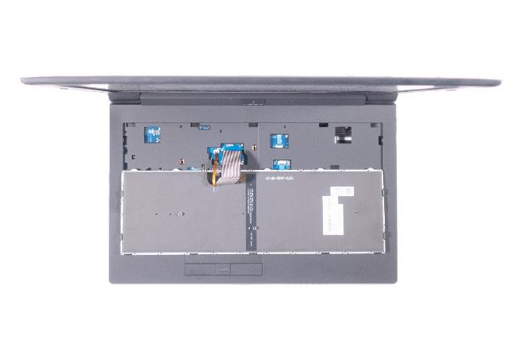
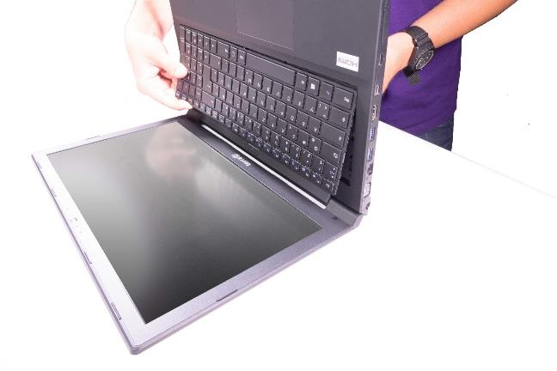

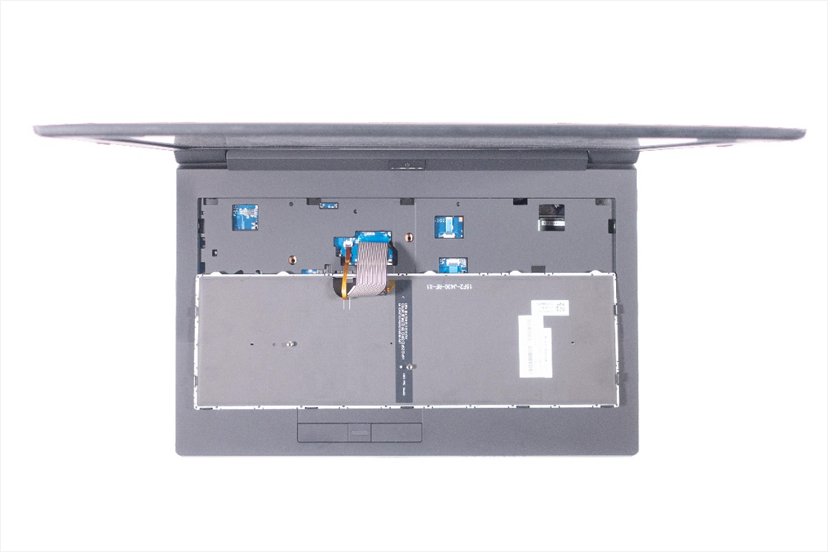

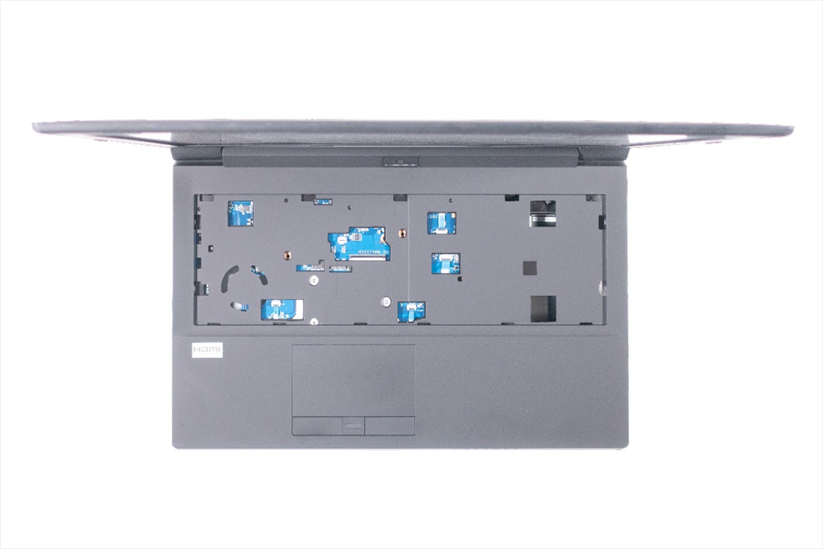
1. Step
Remove the service cover
Remove the two marked screws. (Fig.1).
Flip open the notebook display by 90°, press lightly into the screw hole with the screwdriver and hold the keyboard at the same time. (Fig.2).
Place the keyboard upside down on the notebook case .( Fig.3).
Disconnect the two flat ribbon cables. (Fig.4)
Now you can remove the keyboard. (Fig.5).
1
2
3
4
5

Slide 22
LTE MODULE INSTALLATION
TERRA MOBILE 1543
Difficulty: 

Slide 23
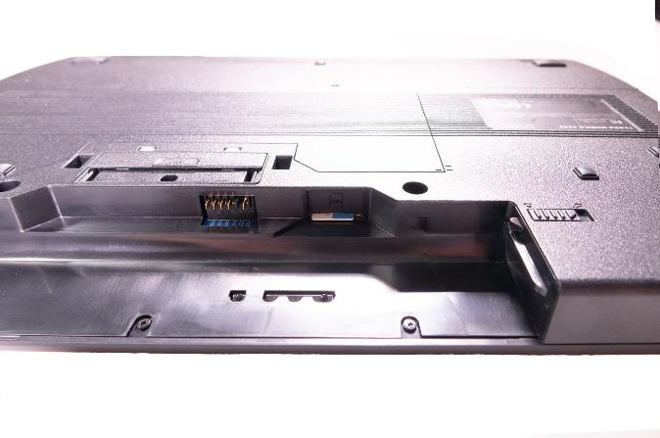
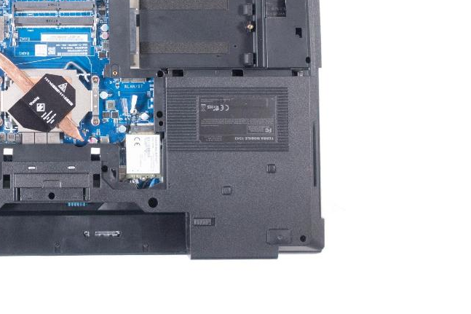
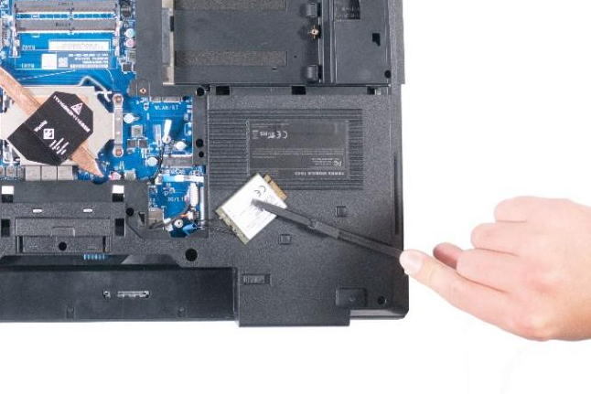
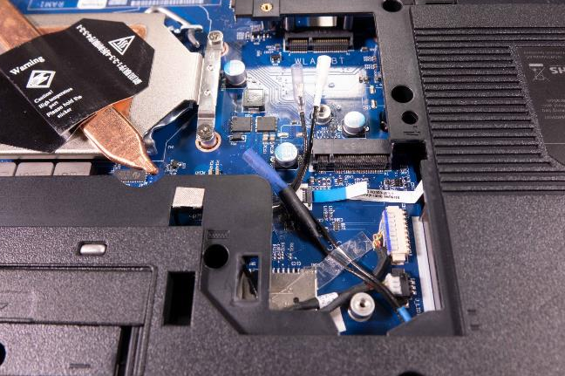
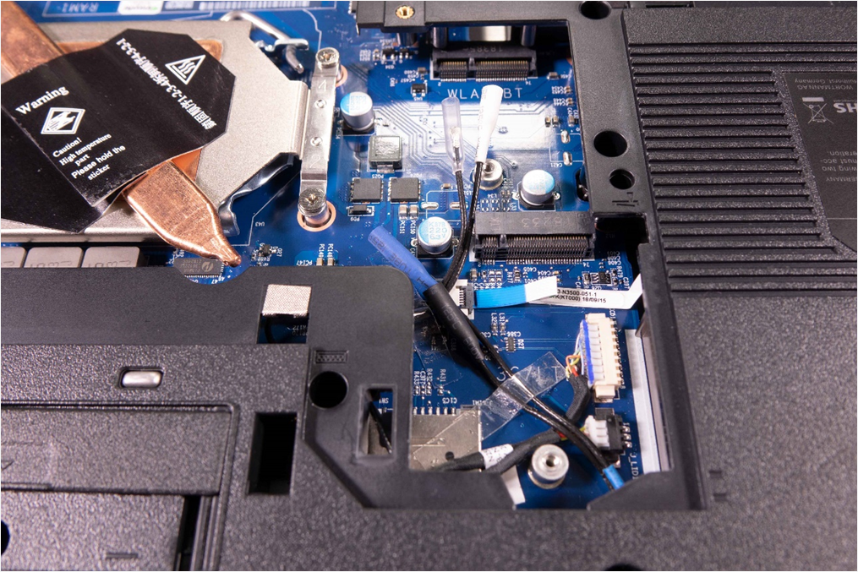
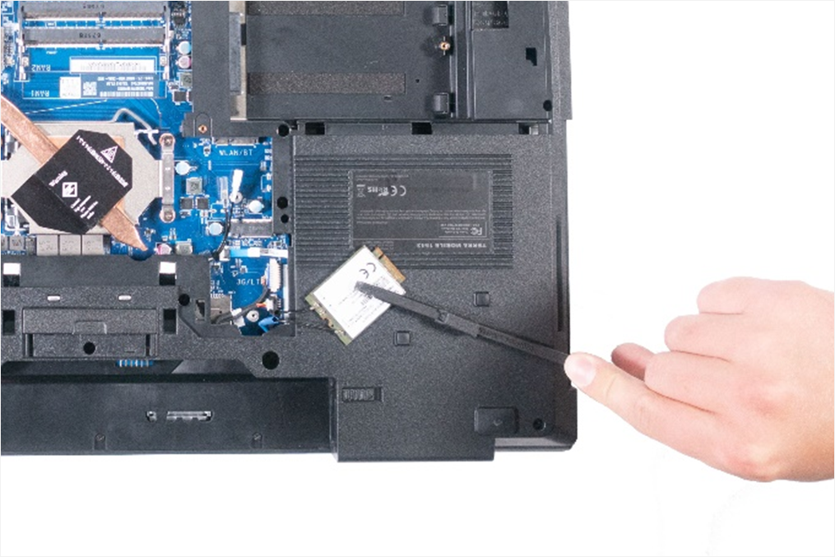
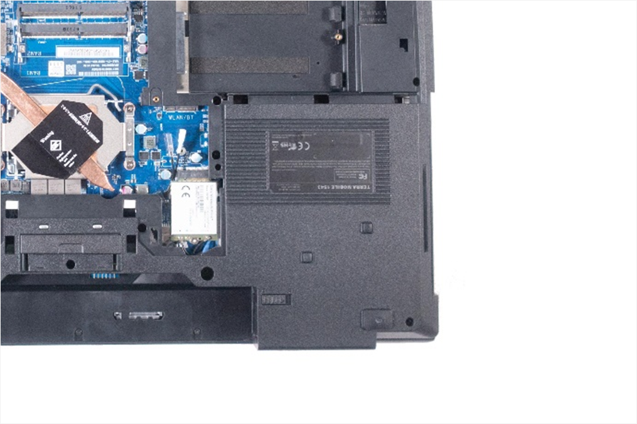
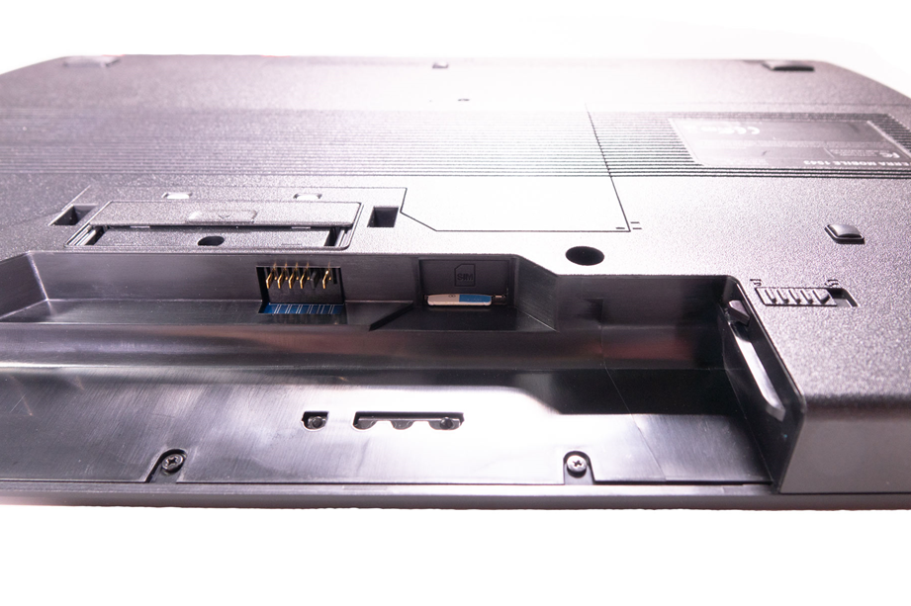
1. Step
Remove the service cover
Remove the transparent adhesive strip and slide the cover on the connectors in the direction of the arrow. (Fig.1).
Connect the antenna connectors to the LTE module ( Fig.2): Blue = Main, Black = AUX).
Place the LTE module in the M.2 socket and secure it with the screw. (Fig.3).
Insert the SIM card. (Fig.4).
To remove the LTE module, please proceed in the reverse order.
1
2
3
4

Slide 24
REMOVE THE
WLAN MODULE
TERRA MOBILE 1543
Difficulty

Slide 25
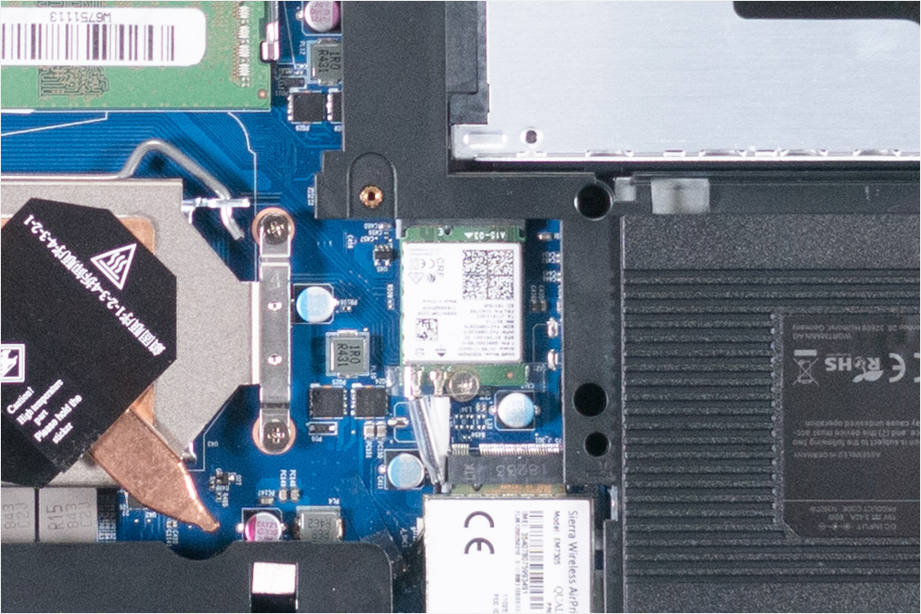
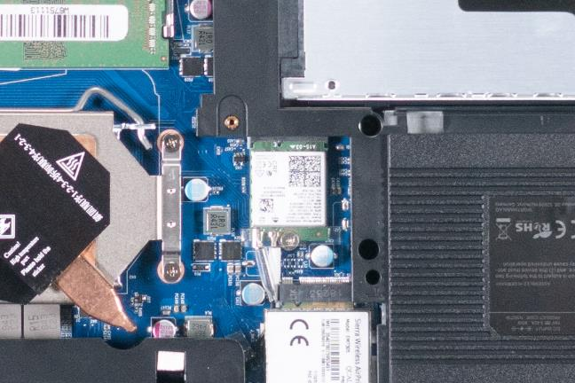
1. Step
Remove the service cover
Now you can see the WLAN module. (Fig.1)
Remove the transparent adhesive strip, remove the two connectors and loosen the fastening screw.(Fig.2).
Remove the module in the direction of the arrow. (Fig.3).
When installing, please make sure that the antenna cables are connected as shown in the picture. (White = Main, Transparent = AUX)
1
2
3

Slide 26
REMOVE THE TOP CASE
TERRA MOBILE 1543
Difficulty: 

Slide 27






1. Step
Remove the service cover
Remove the keyboard
Disconnect 4 flat ribbon cables. (Fig.1).
Remove the 3 screws in the battery compartment. (Fig.2).
Remove the 14 screws in the bottom case. (Fig.3).
The top case should now be separated from the bottom case. (Fig.4).
1
2
3
4

Slide 28






2. Step
Remove and take over the LED Board, Clickboard, Fingerprint Sensor, Power Button Board as well as the LTE Antenna with all cables. (Fig.1 & 2).
Note: The touchpad cannot be taken over.
LTE antenna cable to be directed to the mainboard during installation. (Fig.3).
1
2
3

Slide 29
REMOVE THE MAINBOARD
TERRA MOBILE 1543
Difficulty: 

Slide 30
1. Step
Remove the service cover
Remove the WLAN Module
Remove the if needed,the LTE Module
Remove the CPU
Remove the M.2 SSD
Remove the 2,5“ HDD
Remove the RAM
Remove the DVD
Remove the Keyboard
Remove the Top Case

Slide 31







2. Step
Remove SIM card and SD card if necessary
Disconnect the 4 cables. (Fig.1).
Disconnect the speaker cables and the cable from the audio board. (Fig.2).
Now unscrew the 6 screws on the mainboard. (Fig.3).
You can now remove the mainboard. (Fig.4).
Transfer the heatsink pad of the chipset to the new mainboard.
1
2
3
4

Slide 32
REMOVE THE LCD DISPLAY
TERRA MOBILE 1543
Difficulty: 

Slide 33








1. Step
Remove the screw covers and loosen the screws located below them. (Fig.1).
Remove the bezel (LCD Front Cover). (Fig.2).
Loosen the 4 screws from the display. (Fig.3).
Place a protective cloth on the keyboard, then remove the display, then remove the display cable. (Fig.4).
When assembling, make sure that the frame snaps into place at all points and is flush with the display. Replace the adhesive tape on the display if necessary.
1
2
3
4

Slide 34
REMOVE THE
BOTTOM CASE
TERRA MOBILE 1543
Difficulty: 

Slide 35


1. Step
Remove the Mainboard
Remove the speakers, audio board, LED board, and smart card reader .(Fig.1).
Note: Pay attention to the different screws sizes
Now remove the cables that lead to the display. When installing, the same cable routing method should be used.
1

Slide 36
REMOVE THE
LCD BACK COVER
TERRA MOBILE 1543
Difficulty: 

Slide 37







1. Step
Remove the LCD Display
Detach the antennas with the cables from the housing. (Fig.1).
Then disconnect the webcam and the associated cable. (Fig.2).
Loosen 2 screws at the bottom and one black screw at the top per hinge. (Fig.3).
Now you can remove the LCD Back Cover. (Fig.4).
When installing, please pay attention to the correct cable routing
1
2
3
4

Slide 38
Spare Parts TERRA MOBILE 1543
Article number | Description
1480486 | Power supply 65W
1480024 | Battery 62Wh
1480095 | Keyboard Backlit [CH]
1481250 | Keyboard Backlit [DE]
1480070 | Keyboard Backlit [ES]
1480093 | Keyboard Backlit [FR]
1480097 | Keyboard Backlit [UK]
1480096 | Keyboard Backlit [US]
E1083595 | Antenna LTE/3G
E1080344 | Audio Board
E1080345 | Bottom Case (Cover D)
E1080092 | Cable for Webcam
E1080348 | Click Board
E1083606 | CPU Cover
E1080191 | CPU Fan (PWM)
E1080228 | Display Mobile 15.6" FHD (eDP)
E1080349 | Fingerprint Board
E1083607 | HDD Bracket
E1083611 | Heatsink Mobile
E1080354 | Mainboard
Article number | Description
E1083616 | Hinge (L)
E1083617 | Hinge (R)
E1083615 | LCD Back Cover (Cover A)
E1080229 | LCD Cable (eDP)
E1083614 | LCD Front Cover (Cover B)
E1083281 | LCD Rubber
E1080350 | LED Board
E1080346 | LID Switch Board
E1083621 | ODD Bezel Set
E1080352 | Power Switch Board
E1080347 | Smart Card Board
E1083599 | Smart Card Reader
E1083608 | Smart Card Reader Rubber
E1083602 | Speaker (L)
E1083603 | Speaker (R)
E1083612 | Thermal Pad 10x10mm
E1083613 | Thermal Pad 35x35mm
E1080351 | Top Case (Cover C)
E1083569 | Touchpad
E1083598 | Touchpad Mylar
E1080343 | Webcam

Slide 39
Spare Parts TERRA MOBILE 1542/1542K
Article number | Description
E1083616 | Hinge (L)
E1083617 | Hinge (R)
E1083615 | LCD Back Cover (Cover A)
E1080229 | LCD Cable 1542K (eDP)
E1083620 | LCD Cable 1542/1542K (LVDS)
E1083614 | LCD Front Cover (Cover B)
E1083281 | LCD Rubber
E1083596 | LED Board
E1083601 | LID Switch Board
E1083621 | ODD Bezel Set
E1083594 | Power Switch Board
E1083600 | Smart Card Board
E1083599 | Smart Card Reader
E1083608 | Smart Card Reader Rubber
E1083602 | Speaker (L)
E1083603 | Speaker (R)
E1083612 | Thermal Pad 10x10mm
E1083613 | Thermal Pad 35x35mm
E1083593 | Top Case (Cover C)
E1083569 | Touchpad
E1083598 | Touchpad Mylar
E1080343 | Webcam
Article number | Description
1480486 | Power supply 65W
1480024 | Battery 62Wh
1480095 | Keyboard Backlit [CH]
1481250 | Keyboard Backlit [DE]
1480070 | Keyboard Backlit [ES]
1480093 | Keyboard Backlit [FR]
1480097 | Keyboard Backlit [UK]
1480096 | Keyboard Backlit [US]
E1083595 | Antenna LTE/3G
E1083609 | Audio Board
E1083604 | Bottom Case (Cover D)
E1080092 | Cable for Webcam
E1083597 | Click Board & Fingerprint
E1083606 | CPU Cover
E1083605 | CPU Fan 3Pol
E1080031 | Display Mobile 15.6" FHD (LVDS)
E1080228 | Display Mobile 15.6" FHD (eDP)
E1083607 | HDD Bracket
E1083611 | Heatsink Mobile
E1083610 | Mainboard 1542 /1542K (LVDS)
E1080230 | Mainboard 1542K (eDP)

Slide 40
Do you have questions or suggestions?
Then send an e-mail to info@wortmann.de
We are looking forward to your feedback!

