Slide 1
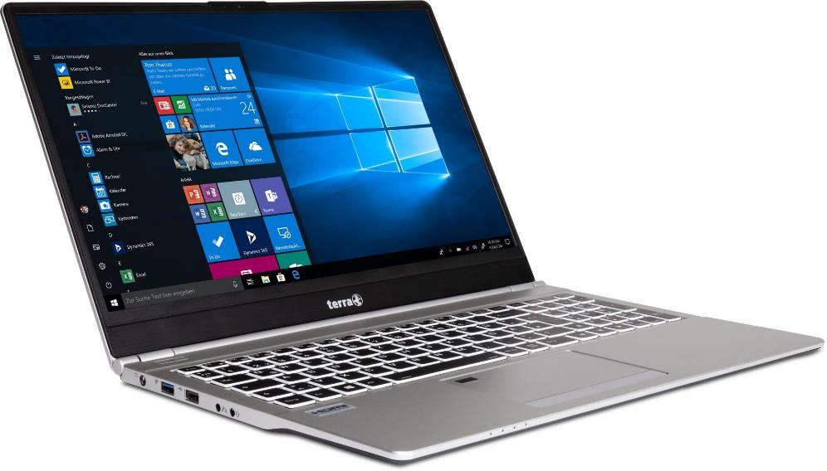
Service Manual
TERRA MOBILE 1550

Slide 2


Contents
Service Notes
Keyboard
Battery
HDD
M.2 SSD
RAM
Fan
WLAN Module
CMOS Battery
Mainboard
Top Case
LCD Display
LCD Back Cover
Spare Parts

Slide 3
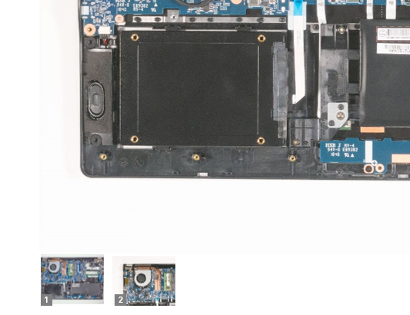
SERVICE NOTES
Safety instructions
Work on a clean surface. Make sure that the housing can not be scratched.
Sort the screws and make sure that they are in the right place when reinstalling. Wrongly inserted screws can cause irreparable damage.
For all service work. Always disconnect the power supply and the battery connection to the mainboard.
Ensure you have sufficient ESD protection.
The WORTMANN AG accepts no liability for any damage caused by the use of this service manual.
Tools
Phillips screwdriver PH0
Phillips screwdriver PH1
Slotted screwdriver 2 mm
Plastic Slotted screwdriver 3mm
Fabric tape
Protective cloth
Note
Click on the thumbnails to
view the images in full size

Slide 4
KEYBOARD
TERRA MOBILE 1550
Difficulty: 

Slide 5
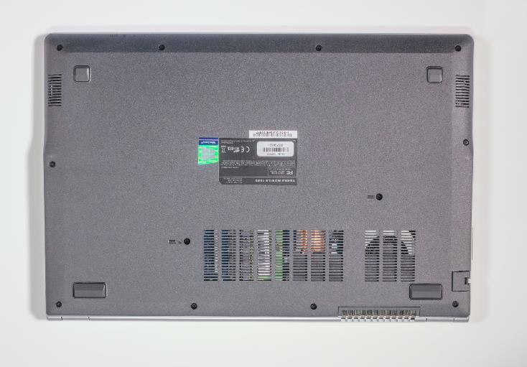

1. Step
Before you start, switch off the notebook! and remove the power supply.
Remove the two screws from the bottom case

Slide 6
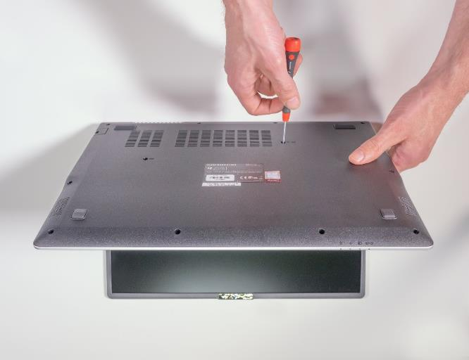
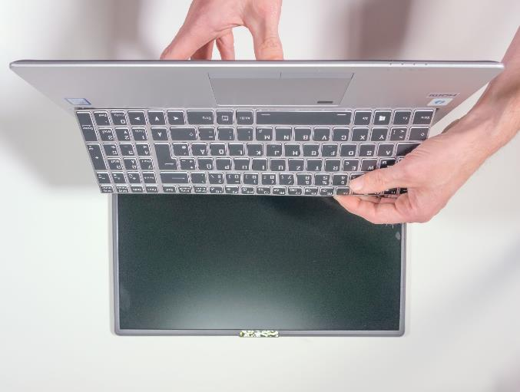


2. Step
Open the notebook and place the display on a flat surface
Hold the keyboard firmly with one hand to make sure it does not fall
Now place a screwdriver in the hole and push the keyboard out.
1
2

Slide 7
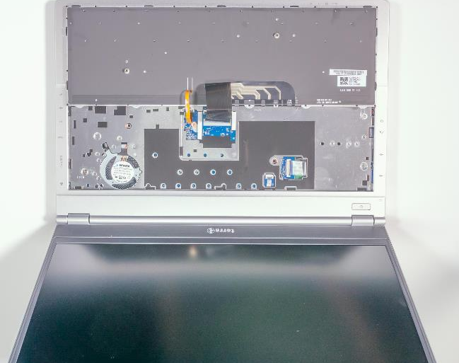
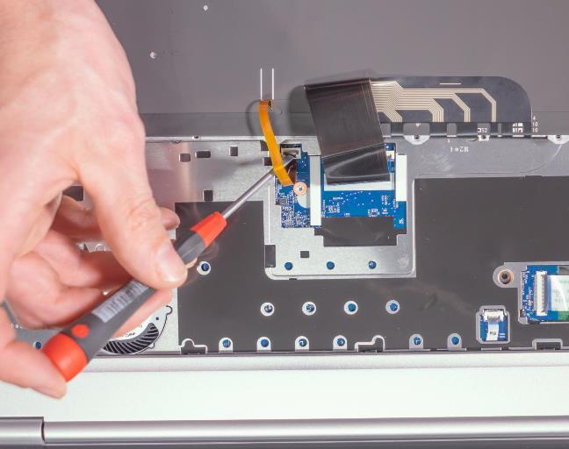


3. Step
Put down the notebook normally
Carefully fold down the keyboard
Be careful not to damage the keyboard ribbon cable!
Disconnect the two keyboard ribbon cables from the locking sockets
Carefully remove the keyboard
To install the keyboard, work in the reverse order
1
2

Slide 8
BATTERY
TERRA MOBILE 1550
Difficulty: 

Slide 9
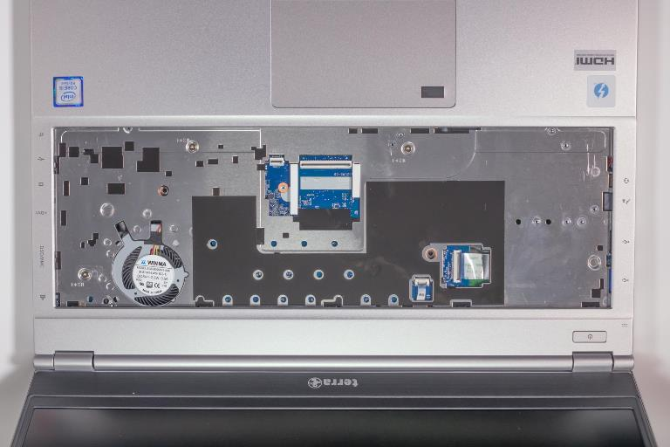
1. Step
Before you start, switch off the notebook! And remove the power supply.
Remove the keyboard
Unscrew the three screws where the keyboard used to be.

Slide 10
2. Step
Remove the ten screws on the back

Slide 11
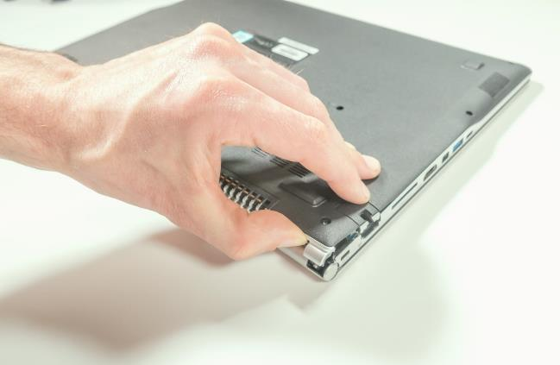
3. Step
Carefully lift the lower casing in the direction of the arrow and remove it

Slide 12
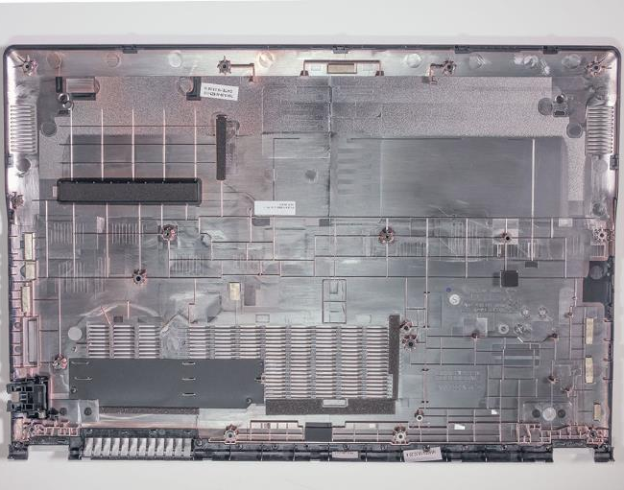
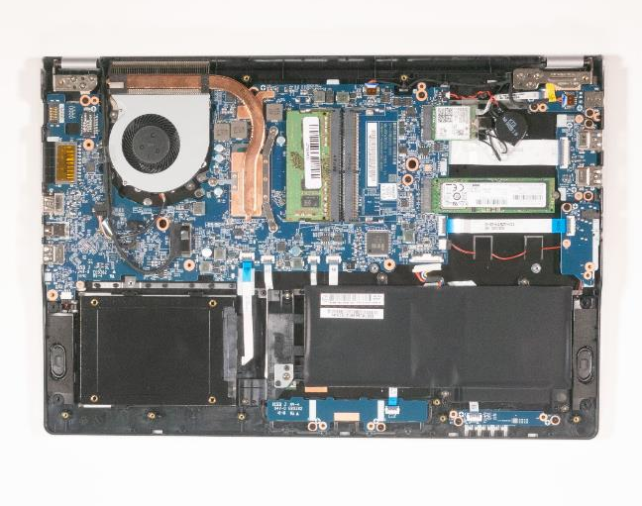


4. Step
The battery is now visible
Make sure that the foam rubber is attached to the inside of the lower casing
This is only important if a 2.5" hard disk is also installed
1
2

Slide 13
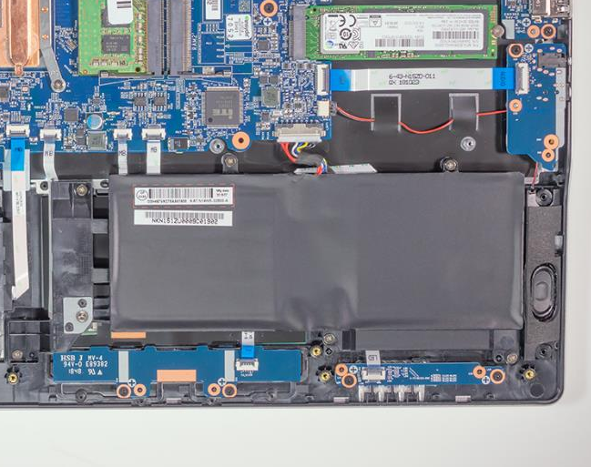
5. Step
Carefully remove the cable from the mainboard
When done, unscrew the six screws

Slide 14
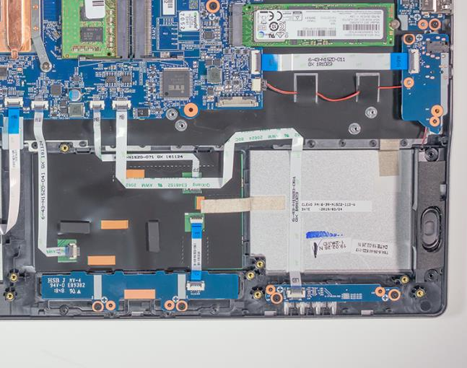
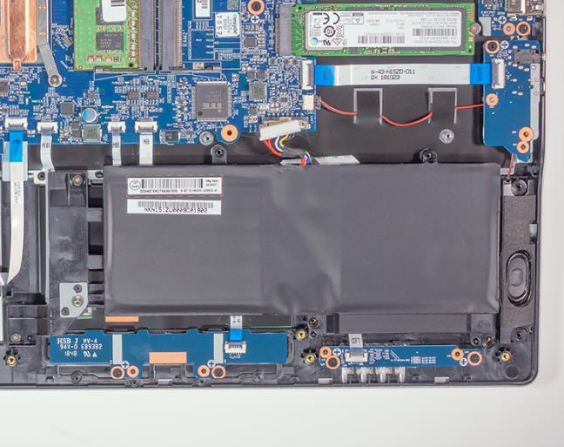


6. Step
Lift the battery out of the computer
To install the battery, proceed in the reverse order
1
2

Slide 15
HARD DISK
TERRA MOBILE 1550
Difficulty: 

Slide 16

1. Step
Before you start, switch off the notebook! And remove the power supply.
Remove the keyboard
Remove the battery: In some circumstances, it may be sufficient to disconnect the power cable from the mainboard without removing the entire battery.

Slide 17
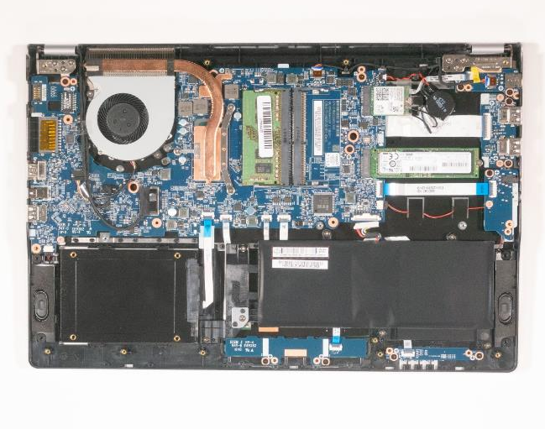

2. Step
The hard disk is now visible
Make sure that the foam rubber is attached to the inside of the lower casing
1
2

Slide 18
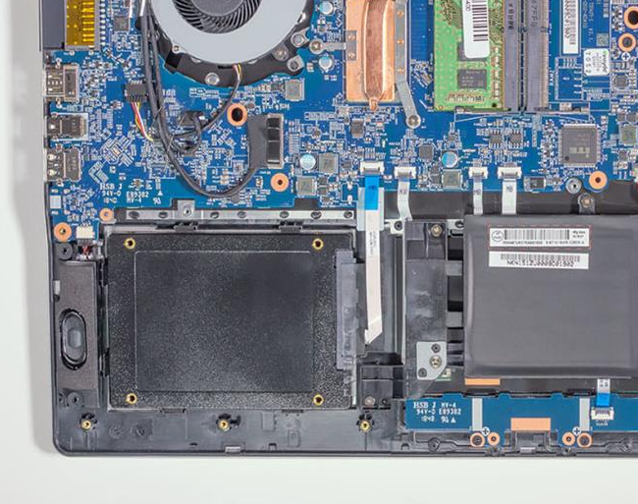
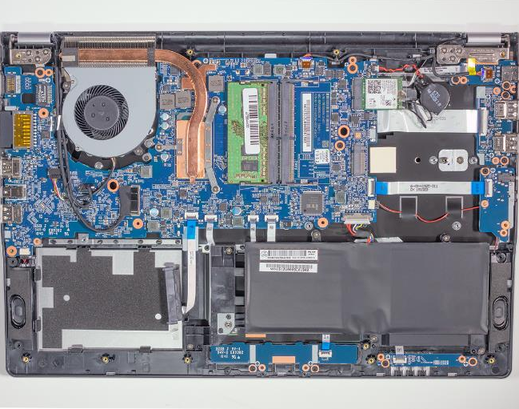


3. Step
Carefully remove the cable from the hard disk
Lift the hard drive out of the bay
To install a hard disk, please proceed in the reverse order
New HDDs are empty. Before swapping, make sure that your data is backed up.
The 2.5 inch replacement hard disk must not be higher than 7.0 mm
1
2

Slide 19
M.2 SSD
TERRA MOBILE 1550
Difficulty: 

Slide 20
1. Step
Before you start, switch off the notebook! And remove the power supply.
Remove the keyboard
Remove the battery: In some circumstances, it may be sufficient to disconnect the power cable from the mainboard without removing the entire battery.

Slide 21
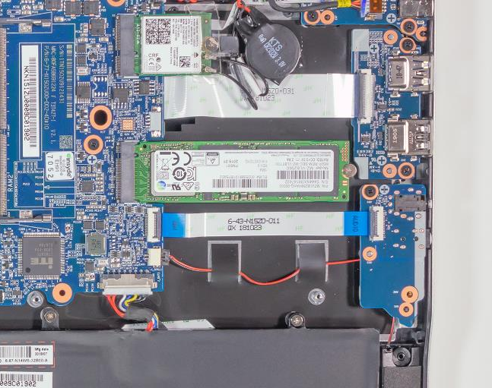

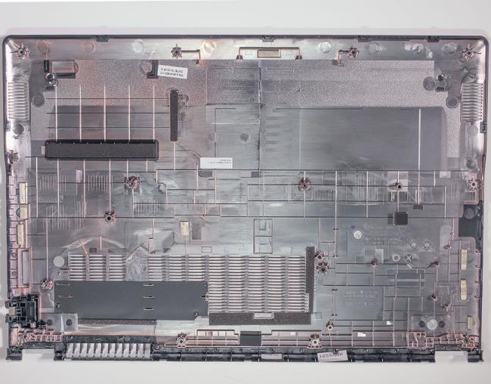


2. Step
The M.2 SSD is now visible
Loosen the screw
Pull out the M.2 SSD module as illustrated
1
2

Slide 22
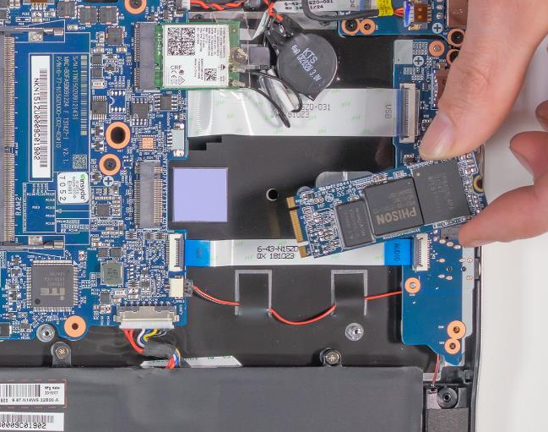
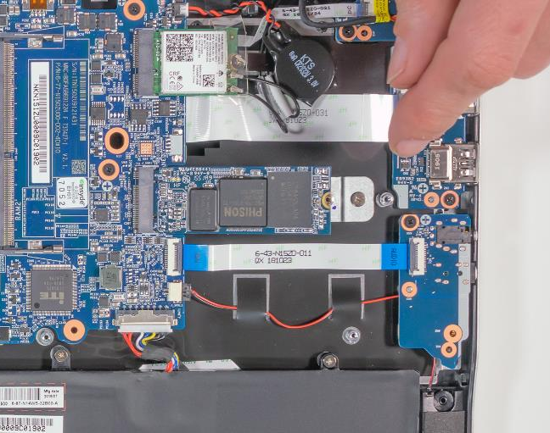


3. Step
To install a hard disk, please proceed in the reverse order
M.2 SSD modules of different lengths can be installed. Use the M.2 adapter from the enclosed accessories when using short M.2 modules. See picture 2
1
2

Slide 23
RAM
TERRA MOBILE 1550
Difficulty: 

Slide 24

1. Step
Before you start, switch off the notebook! And remove the power supply.
Remove the keyboard
Remove the battery: In some circumstances, it may be sufficient to disconnect the power cable from the mainboard without removing the entire battery.

Slide 25
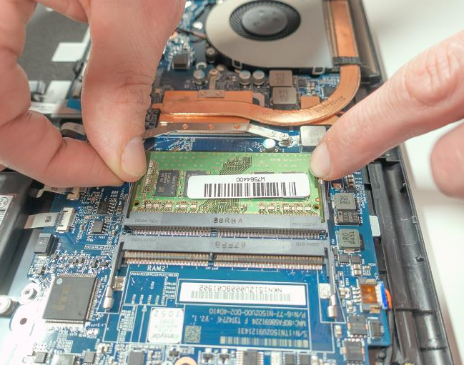


2. Step
The computer RAM is now visible
Push the metal retaining clips outwards at the same time to release the RAM module
Now you can simply remove it
To install RAM, please proceed in reverse order
Make sure to use the same slot, otherwise you may have problems starting up the unit
1
2

Slide 26
CPU FAN
TERRA MOBILE 1550
Difficulty: 

Slide 27
1. Step
Before you start, switch off the notebook! And remove the power supply.
Remove the keyboard
Remove the battery :In some circumstances, it may be sufficient to disconnect the power cable from the mainboard without removing the entire battery.

Slide 28
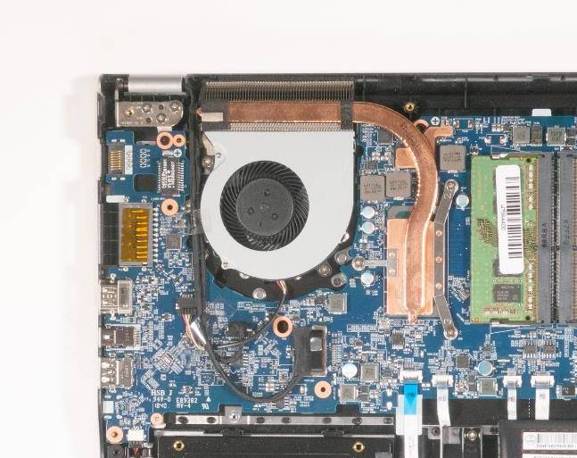

2. Step
The fan is now visible
Remove the two adhesive strips and keep them for the installation of the replacement fan
Carefully pull the plug out of the holder. See picture 2
Unscrew the two marked screws
1
2

Slide 29
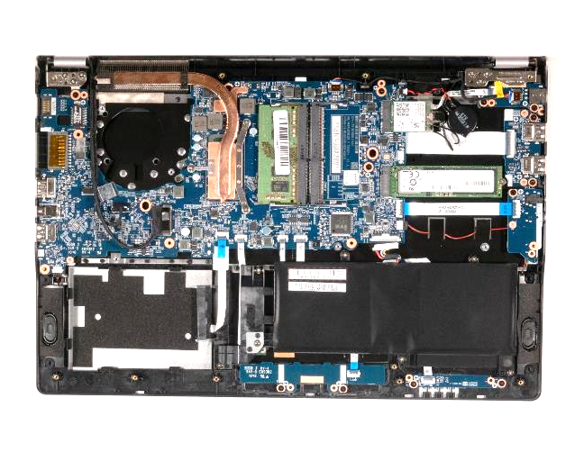
3. Step
The fan can now be removed.
To install a fan, please proceed in reverse order

Slide 30
WLAN MODULE
TERRA MOBILE 1550
Difficulty: 

Slide 31
1. Schritt
Before you start, switch off the notebook! And remove the power supply.
Remove the keyboard
Remove the battery : In some circumstances, it may be sufficient to disconnect the power cable from the mainboard without removing the entire battery.

Slide 32
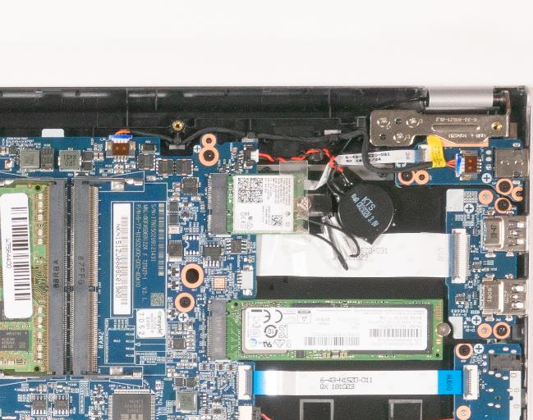


2. Step
The WLAN module is now visible
Peel off the adhesive strip without disconnecting the antenna cables from the module
Unscrew the marked screw
Now you can easily detach the module from the socket
1
2

Slide 33
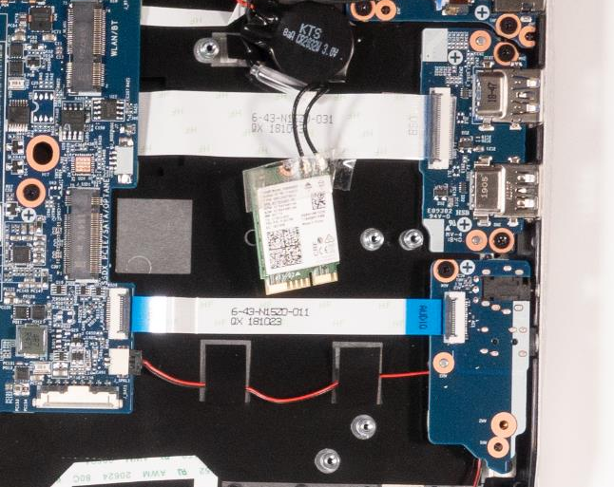
3. Step
Now you can disconnect the antenna cables
If you want to replace the mainboard, it is not necessary to disconnect the antenna cables. The adhesive strip must be present.
To install a WLAN module, please proceed in reverse order

Slide 34
CMOS BATTERY
TERRA MOBILE 1550
Difficulty: 

Slide 35
1. Step
Before you start, switch off the notebook! And remove the power supply.
Remove the keyboard
Remove the battery : In some circumstances, it may be sufficient to disconnect the power cable from the mainboard without removing the entire battery.

Slide 36
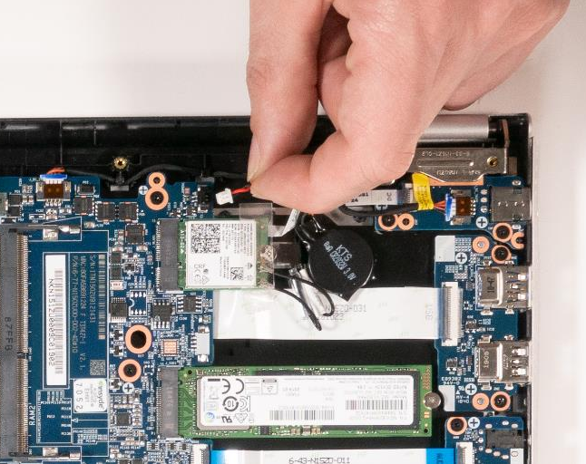

2. Step
The CMOS battery is now visible.
Carefully pull the plug out of the holder.
The battery is glued on and can be released carefully with a little more force
The battery cable is fitted to the housing with a small hook. The battery itself is glued on. When you change the battery, make sure both are secured again.
To install a battery, please proceed in reverse order.
1
2

Slide 37
MAINBOARD
TERRA MOBILE 1550
Difficulty: 

Slide 38
1. Step
Before you start, switch off the notebook! And remove the power supply.
Remove the Keyboard
Remove the Battery
Remove the Hard Disk
Remove the M.2 SSD
Remove the RAM
Remove the Fan
Remove the WLAN Module

Slide 39

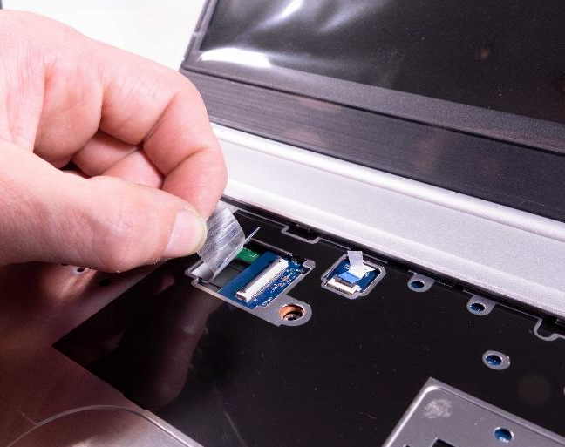

2. Step
Before continuing, please check that all the previous steps have been carried out.
First disconnect the two cables on the front from the mainboard that were previously covered by the keyboard by carefully pulling the tabs
1
2

Slide 40
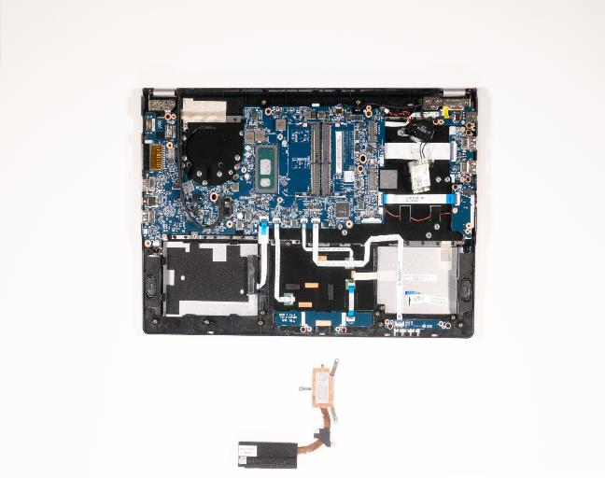
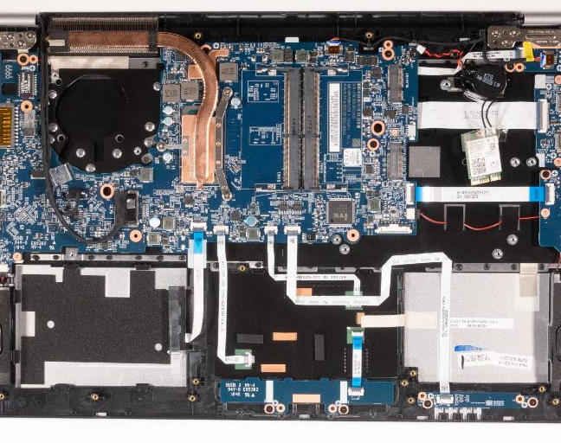


3. Step
Now remove the three marked screws from the cooler
Now the cooler can be lifted off the mainboard
1
2

Slide 41
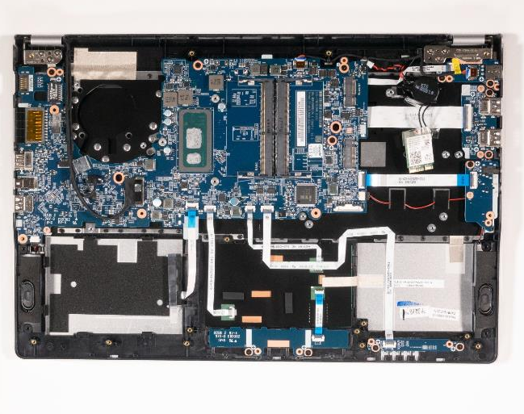
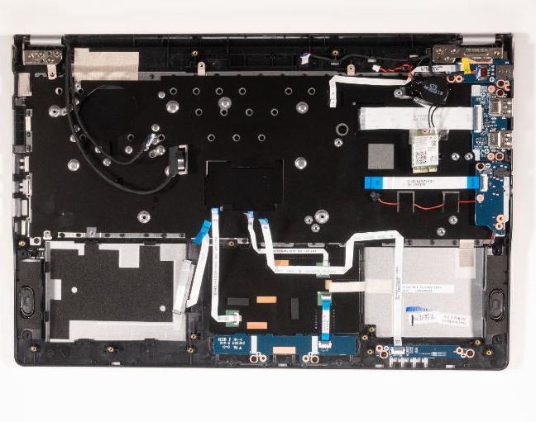



4. Step
Now you have to carefully pull a total of eleven cables out of their holders
Please pay particular attention to the cable routing. It helps to document the initial state of your device with additional photos.
Remove the 4 fixing screws from the mainboard.
Now you should be able to lift out the mainboard quite easily
To install a mainboard, please proceed in reverse order
Transfer missing rubber covers, ESD foils etc. to the new MB.
The new mainboard must be brought up to date with a BIOS update. Go to https://www.wortmann.de/ to find BIOS updates.
1
2
3

Slide 42
TOP CASE
TERRA MOBILE 1550
Difficulty: 

Slide 43
1. Step
Before you start, switch off the notebook! And remove the power supply.
Remove Mainboard

Slide 44
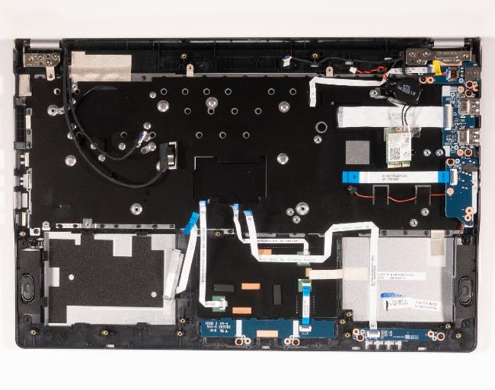
2. Step
Remove the circuit boards, cables and speakers
Now you have to remove the three screws on each hinge.

Slide 45
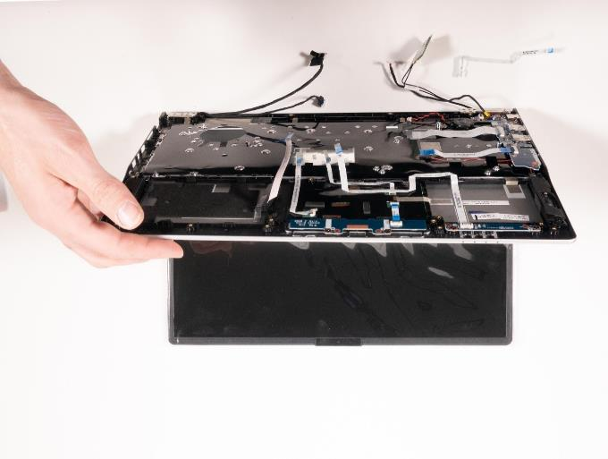
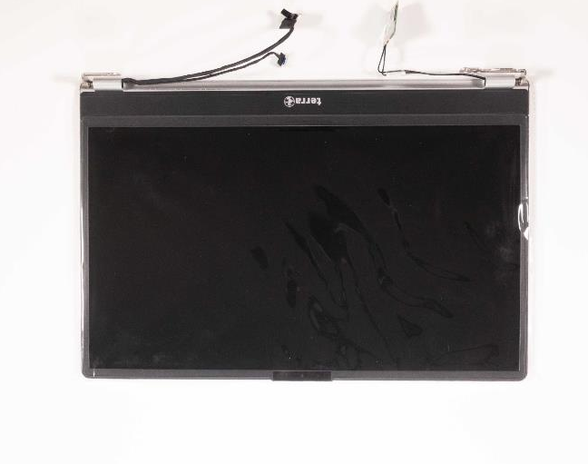


3. Step
Once the screws have been removed, now flip up the back about 90 degrees as shown
The hinges release automatically and you can now remove the top case without any problems.
To install a Top Case, please proceed in reverse order
Pay attention to the correct cable routing, the correct cable marking and the screws on the hinges. Improper handling can result in irreparable damage.
1
2

Slide 46
LCD DISPLAY
TERRA MOBILE 1550
Difficulty: 

Slide 47
1. Step
Before you start, switch off the notebook! And remove the power supply.
Remove the keyboard
Remove the battery: In some circumstances, it may be sufficient to disconnect the power cable from the mainboard without removing the entire battery.

Slide 48
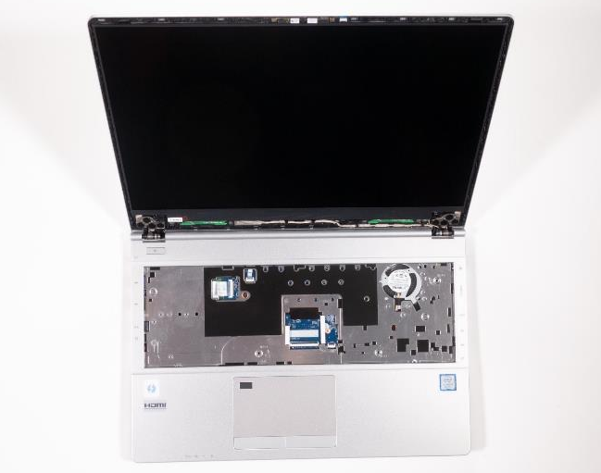
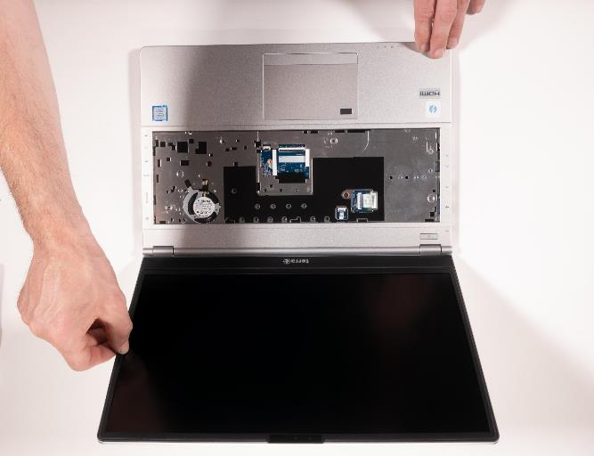


2. Step
Place the notebook down as shown in the photo
Carefully remove the front cover from the LCD by pulling it out with your hands.
Start on the left or right and work your way around it. The bottom side is glued and should be loosened at the end.
Now you can remove the camera
Remove any loose adhesive residues on the front cover
1
2

Slide 49
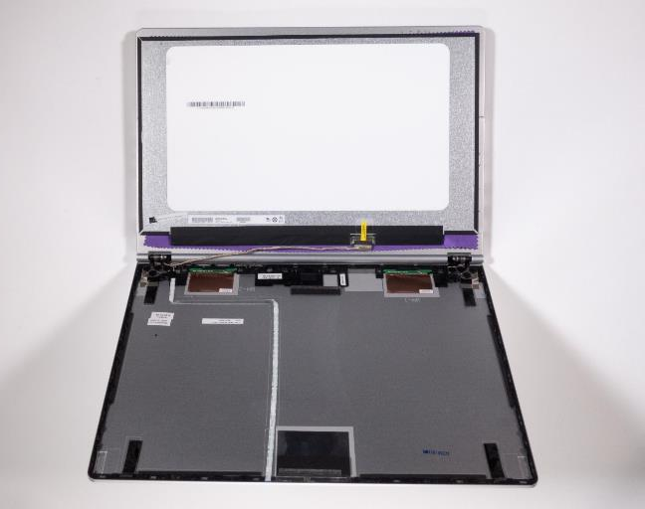
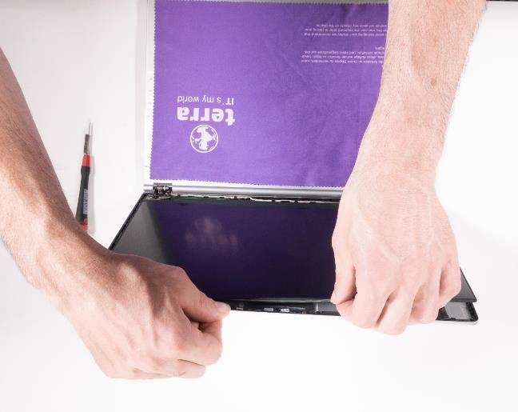


3. Step
At this point at the very latest, you should look for a soft surface, e.g. as shown in the picture, to make sure that the display panel or notebook housing is not scratched.
Now carefully loosen the panel with your hands, starting at the top
The panel is glued to the back cover in six places. See picture 2
If bent too much, the LCD panel can break and splinter very easily
1
2

Slide 50
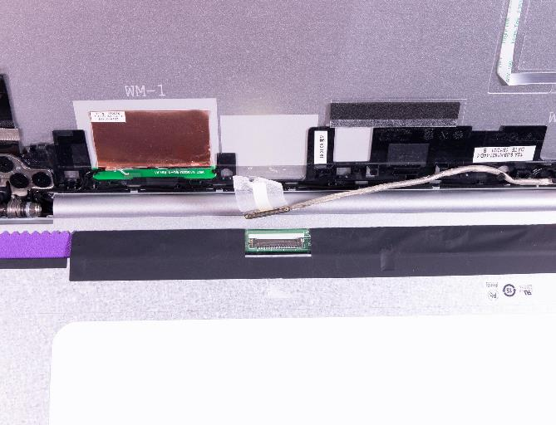

4. Step
To remove the LCD display, you should disconnect the LCD cable.
Fix the LCD cable properly after replacing the panel. If necessary, secure it additionally with thin fabric tape.
1
2

Slide 51
LCD BACK COVER
TERRA MOBILE 1550
Difficulty: 

Slide 52
1. Step
Before you start, switch off the notebook! And remove the power supply.
Remove the LCD display

Slide 53
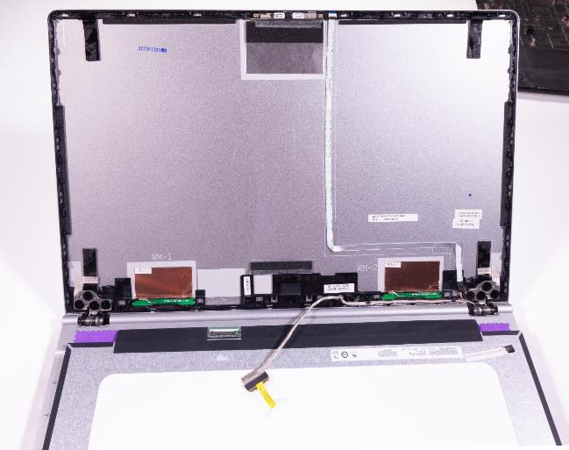
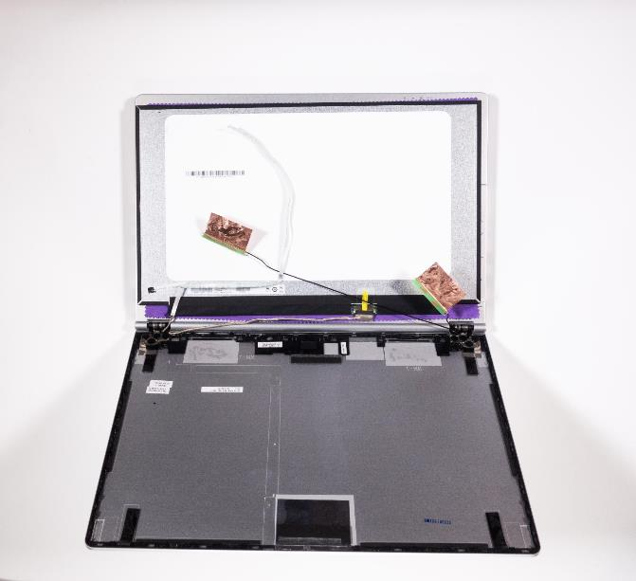


2. Step
The following steps should be carried out with a high degree of caution.
Remove the camera cable and the WLAN antennas.
1
2

Slide 54
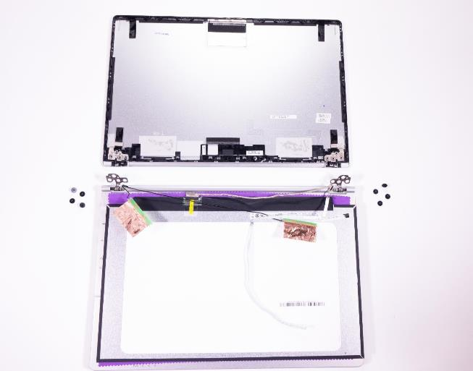

3. Step
When replacing, it is imperative that you observe the correct cable routing on the hinges , take photos if necessary.
Loosen the screws on the hinges
Pull the cover backwards
1
2

Slide 55
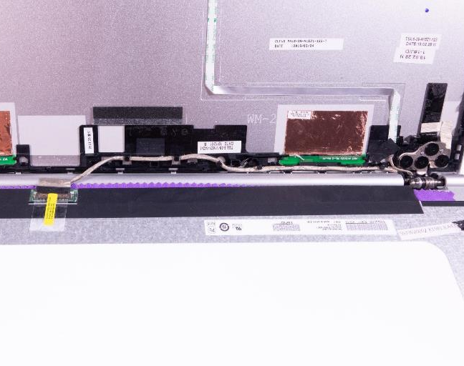
4. Step
To install a back cover, please proceed in reverse order
The following instructions should be observed:
Observe correct cable routing on the hinges
Place the camera cable according to the marking
Antenna and LCD cables must be laid precisely
Install the LCD front cover: Replace double-sided adhesive tape on the housing part if damaged; check gap dimensions.

Slide 56
SPARE PARTS
TERRA MOBILE 1550

Slide 57
Spare Parts TERRA MOBILE 1550
Article number | Description
E1080315 | Mainboard (i5-8265U)
E1080316 | Mainboard (i7-8565U)
E1080510 | Mainboard (i5-10210U)
E1080511 | Mainboard (i7-10510U)
E1080317 | SD Card Dummy
E1080318 | Bottom Case (Cover D)
E1080319 | LCD Front Cover (Cover B)
E1080320 | LCD Back Cover (Cover A)
E1080321 | Hinge/Scharnier (L )
E1080322 | Hinge/Scharnier (R )
E1080323 | LCD Cable
E1080324 | LCD Display 15.6" FHD (eDP)
E1080384 | LCD Display 15.6“ incl. Housing
E1080326 | CCD Lens
E1080327 | LCD Double Side Tape
E1080385 | Cable Set (9 cables, no LCD cable)
E1080386 | Screw Set
E1080516 | Screw M2x5mm Nylok for Bottom Case
E1080312 | Touchpad
E1080313 | Battery Holder
E1080314 | CMOS Battery
Article number | Description
1480486 | Power supply 65W EU
1480136 | Battery 36Wh
E1080301 | Top Case (Cover C)
E1080302 | USB Board
E1080303 | Power Switch Board
E1080304 | Audio Board
E1080305 | Touchpad Mylar (Foil)
E1080306 | Speaker (L)
E1080307 | Speaker (R)
E1080308 | HDD Cable
E1080309 | LED Board
E1080310 | CPU Fan
E1080311 | Click Board
1480226 | Keyboard Multi-Color light [FR]
1480227 | Keyboard Multi-Color light [CH]
1480228 | Keyboard Multi-Color light [US]
1480229 | Keyboard Multi-Color light [UK]
1480235 | Keyboard Multi-Color light [BE]
1480226 | Keyboard Multi-Color light [FR]
1480129 | Keyboard Multi-Color light [GER]

