Slide 1
Service Manual
TERRA MOBILE 1551
TERRA MOBILE 1551P

Slide 2

Contents
Service Notes
Remove the Keyboard
Remove the Bottom Case
Remove the Battery
Remove the M.2 SSD
Remove the WLAN Module
Remove the CMOS Battery
Remove the CPU Fan / Heatsink
Remove the Mainboard
Remove the Touchpad
Remove the Top Case
Remove the LCD Panel
Remove the Camera
Spare Parts

Slide 3
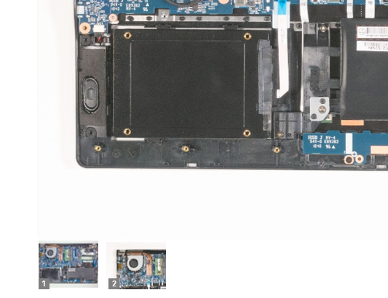
SERVICE NOTES
Safety instructions
Work on a clean surface. Make sure that the housing can not be scratched.
Sort the screws and make sure that they are in the right place when reinstalling. Wrongly inserted screws can cause irreparable damage.
For all service work. Always disconnect the power supply and the battery connection to the mainboard.
Ensure you have sufficient ESD protection.
The WORTMANN AG accepts no liability for any damage caused when using this service manual.
Tools
Phillips screwdriver PH0
Phillips screwdriver PH1
Slotted screwdriver 2 mm
Plastic Slotted screwdriver 3mm
Duct tape
Long nose pliers
Thermal paste
Note
Click on the thumbnails to
view the images in full size

Slide 4
REMOVE THE KEYBOARD
TERRA MOBILE 1551
Difficulty: 

Slide 5
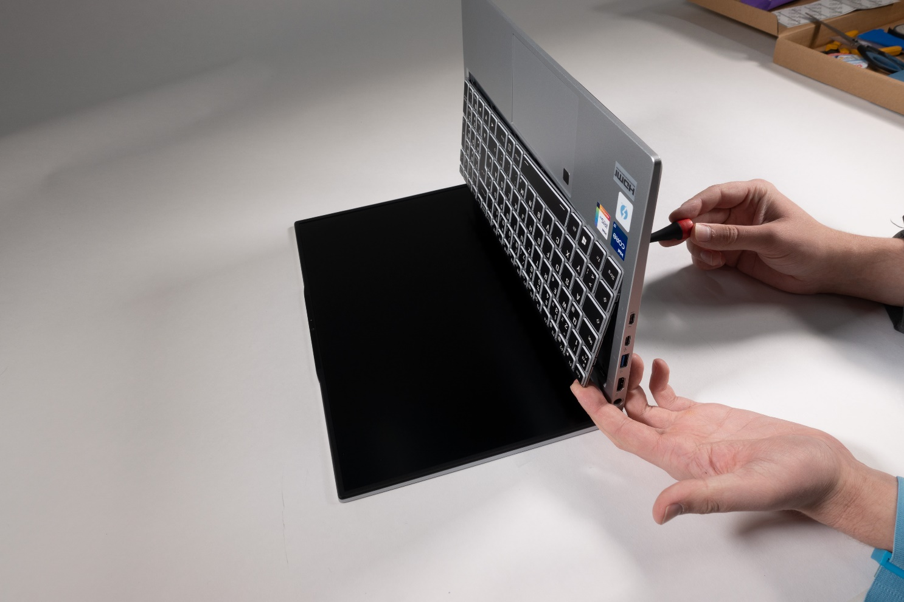
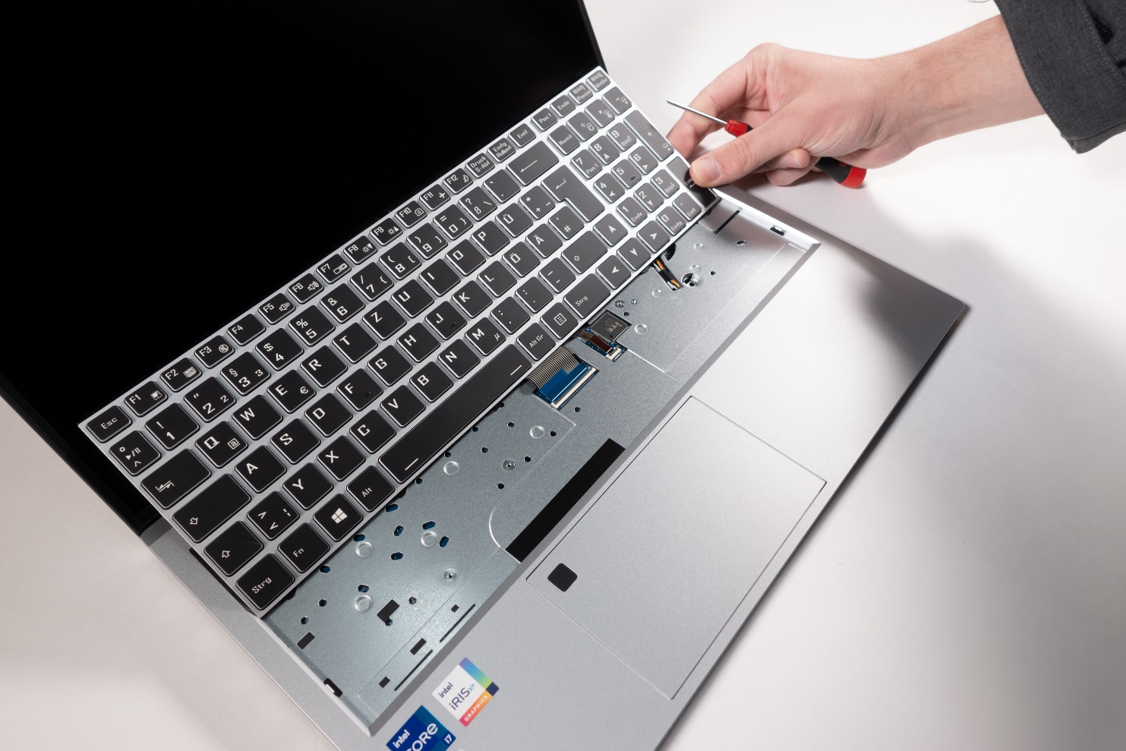
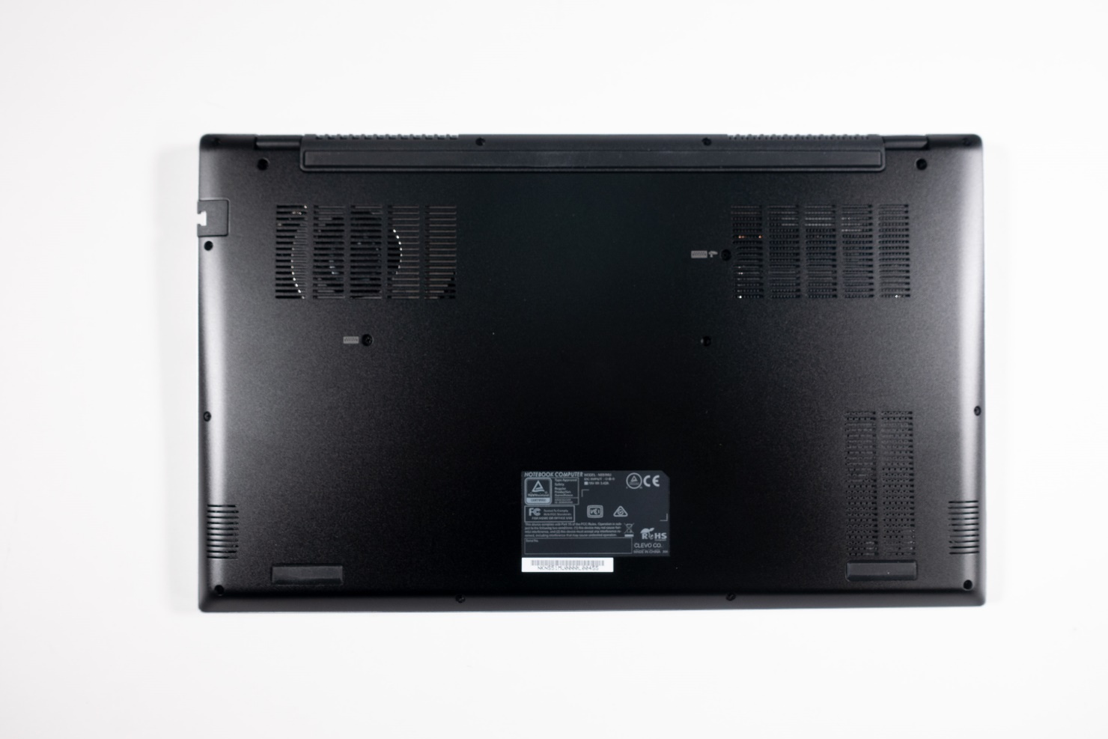
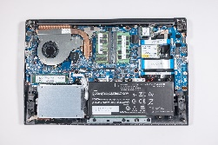
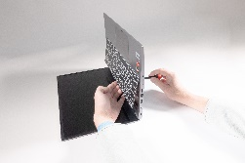
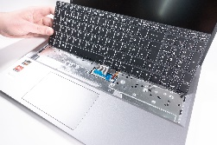

1. Step
Before you start,turn off the Notebook! and remove the power supply
Remove 2 screws (M2.5x6/PH1).(Fig.1).
Push out the keyboard with the screwdriver and prevent it from falling down with your free hand. (Fig. 2)
Disconnect both flat ribbon cables. (Fig.3)
1
2
3

Slide 6
REMOVE THE
BOTTOM CASE
TERRA MOBILE 1551
Difficulty: 

Slide 7
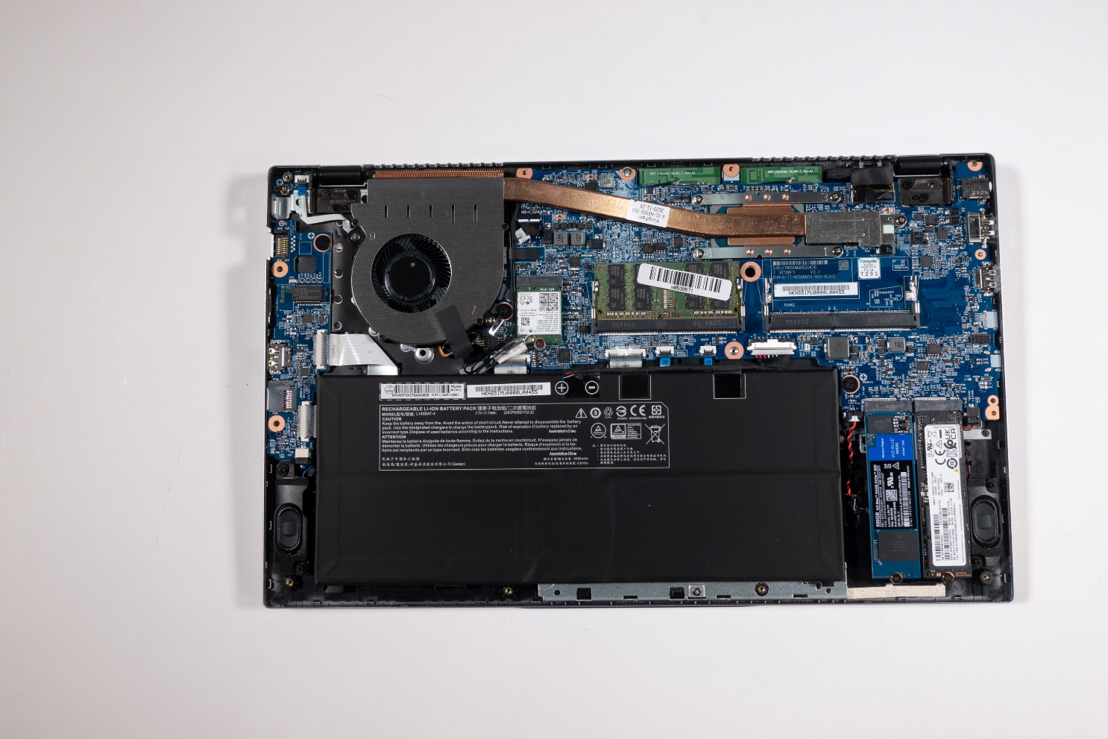

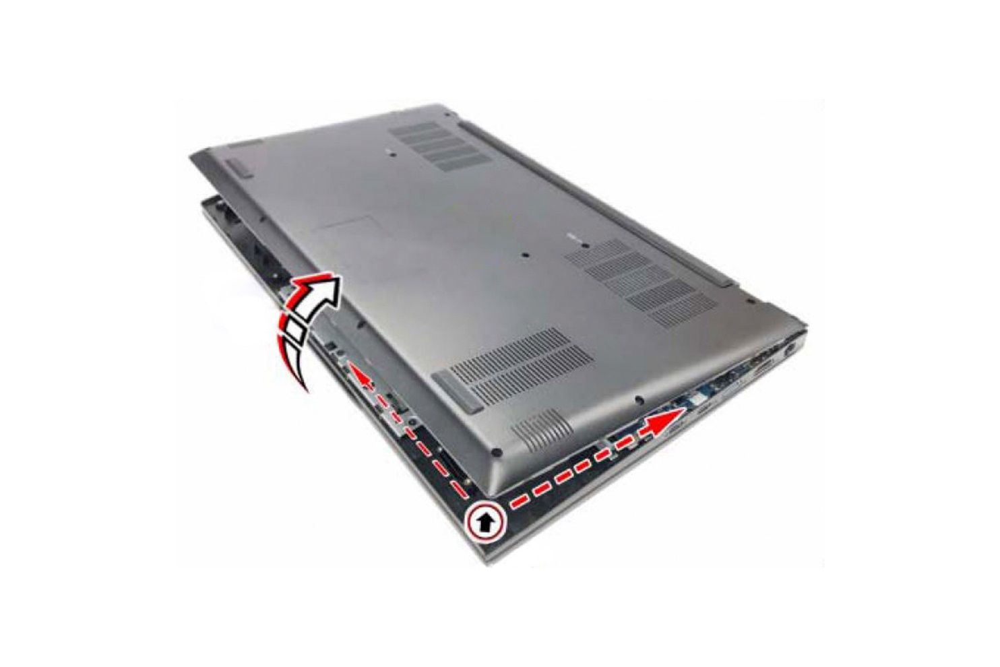
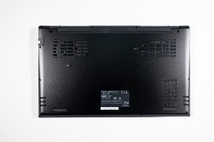
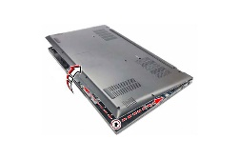
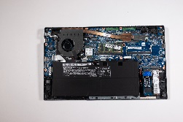
1. Step
Before you start,turn off the Notebook! and remove the power supply
Remove 12 screws (M2x5/PH1) (Fig.1).
Remove 4 screws (M2.5x6/PH1) on the hinges and on the keyboard (Fig.2).
Lift the bottom case and remove it. (Fig. 3)
For all other tasks, disconnect the cable connection between the battery and the mainboard (Fig. 4).
1
2
3
4

Slide 8
REMOVE THE BATTERY
TERRA MOBILE 1551
Difficulty: 

Slide 9
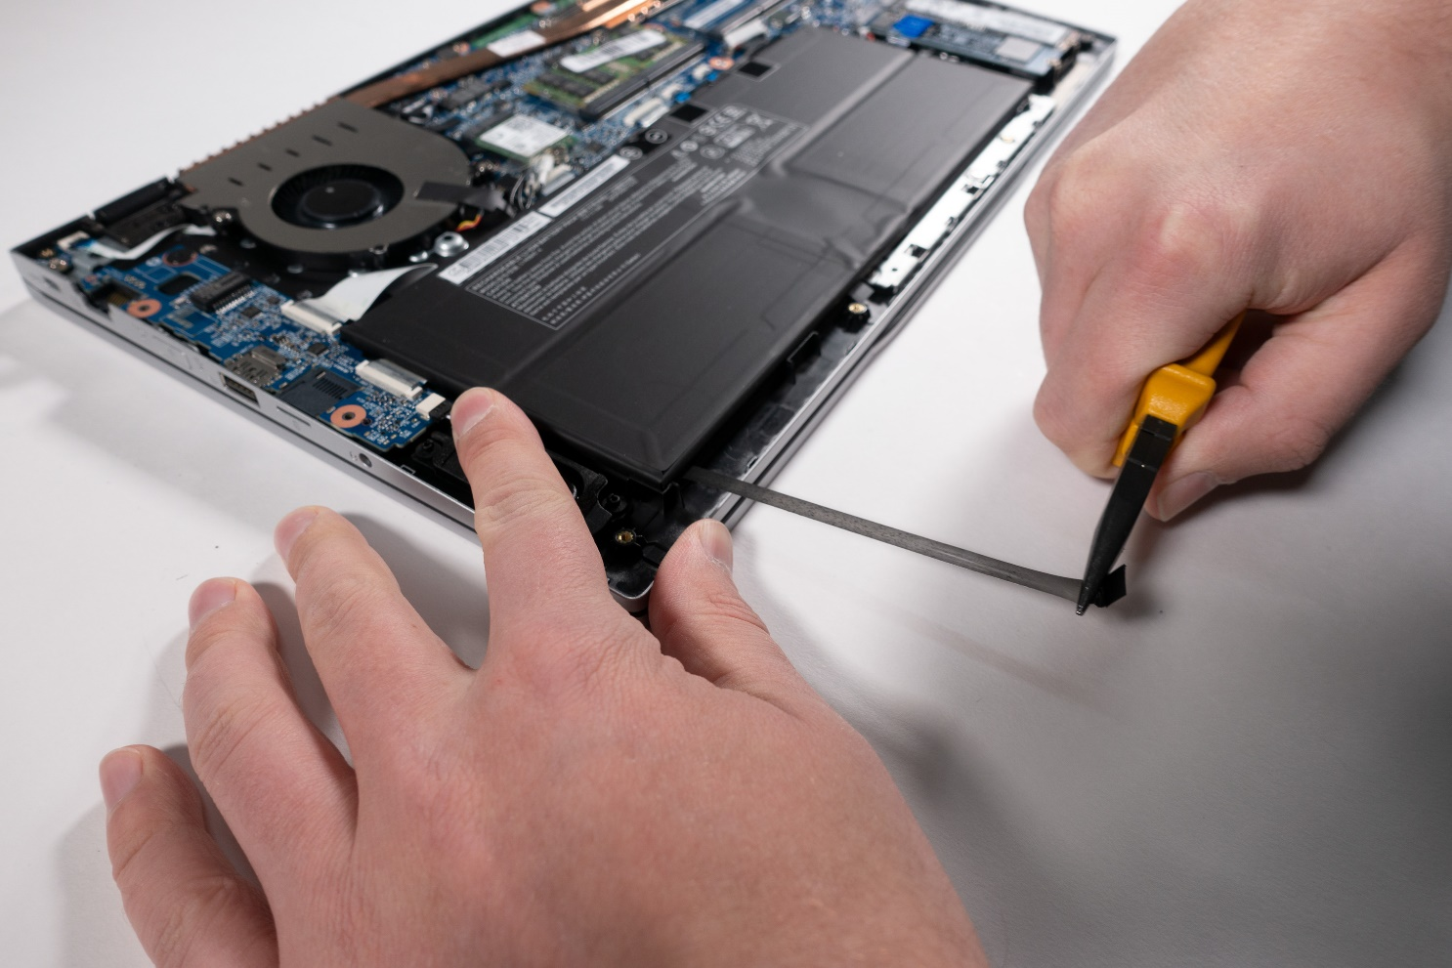
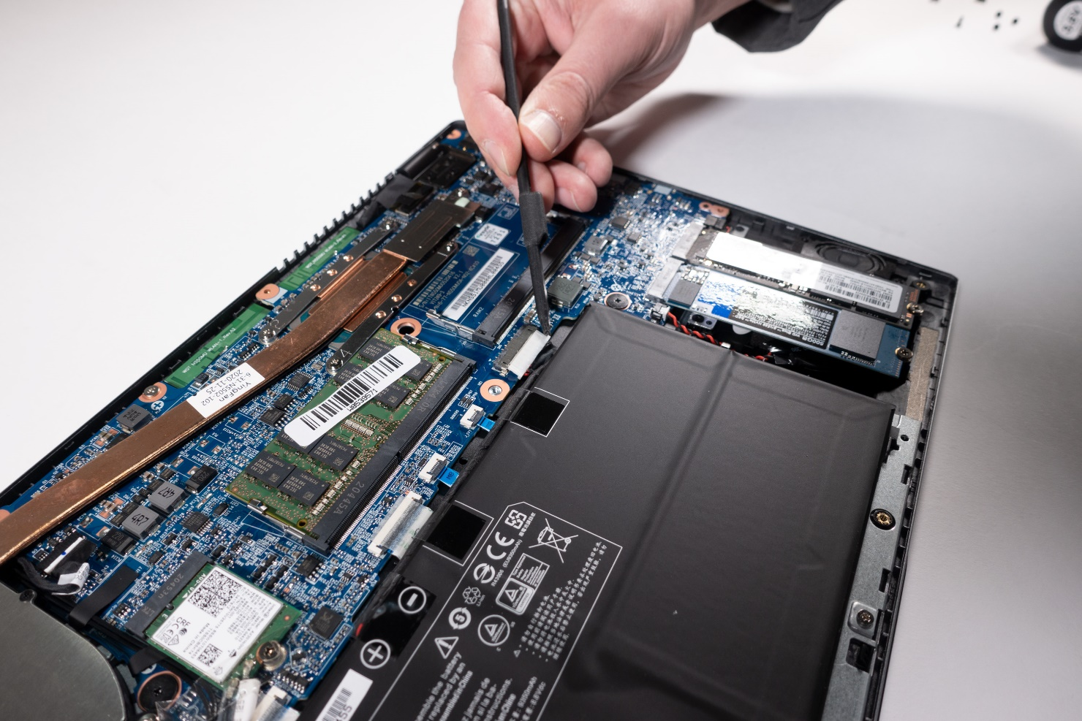


1. Step
Before you start,turn off the Notebook! and remove the power supply
Remove the Bottom Case
Disconnect the cable to the mainboard. (Fig.1)
Remove 3 adhesive strips using pliers, then you can remove the battery. (Fig.2)
1
2

Slide 10
REMOVE THE M.2 SSD
TERRA MOBILE 1551
Difficulty: 

Slide 11
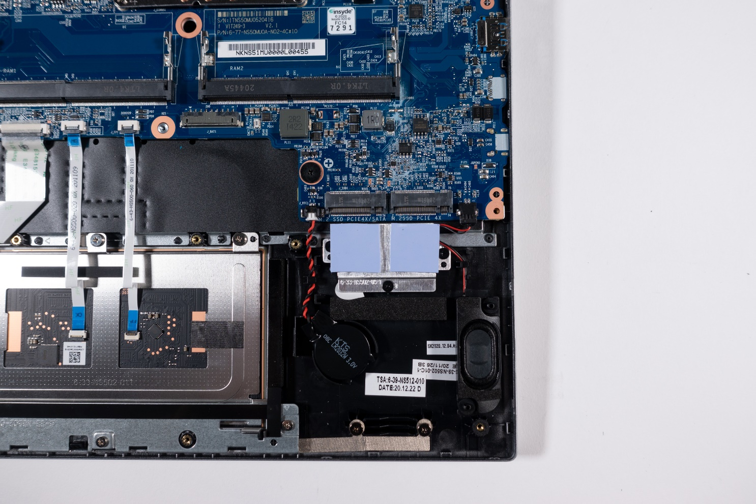
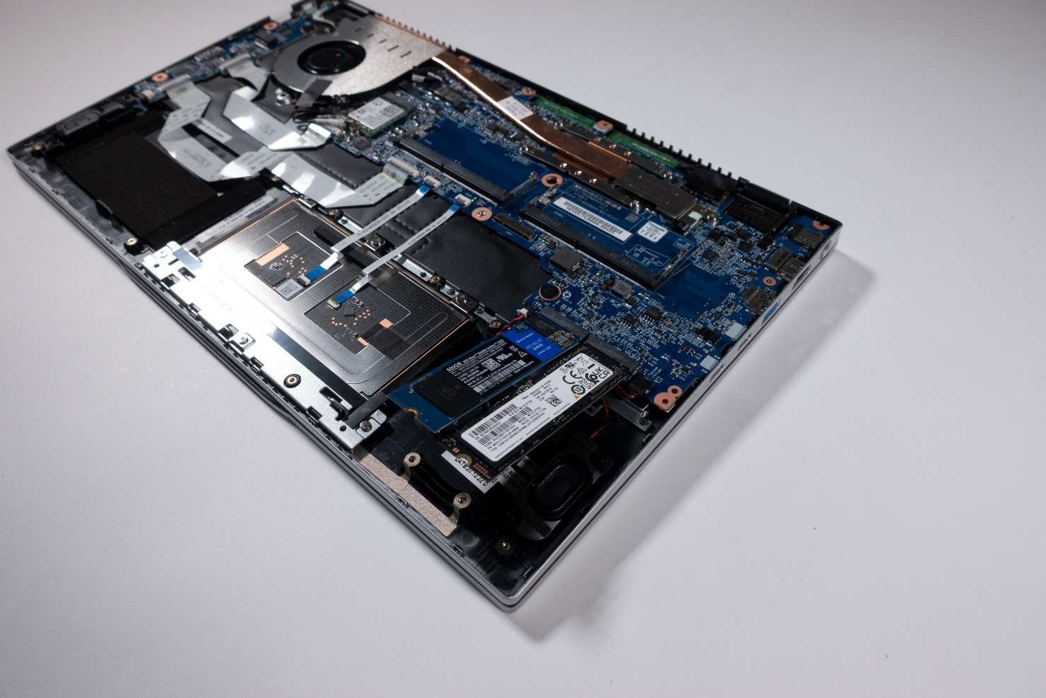

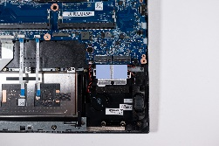
1. Step
Before you start,turn off the Notebook! and remove the power supply
Remove the Bottom Case
Disconnect the cable from the battery
Unscrew one of the two fastening screws (M2x3/PH0) (Fig. 1).
The M.2 slot on the left supports SATA and NVMe (PCIe 3x4) 2280
The M.2 slot on the right supports NVMe (PCIe 4x4) 2280
The cooling pads underneath the SSD must remain intact (Fig. 2).
M.2 NVMe SSD’s will not be displayed in the boot manager if no operating system is installed!
1
2

Slide 12
REMOVE THE
WLAN MODULE
TERRA MOBILE 1551
Difficulty: 

Slide 13
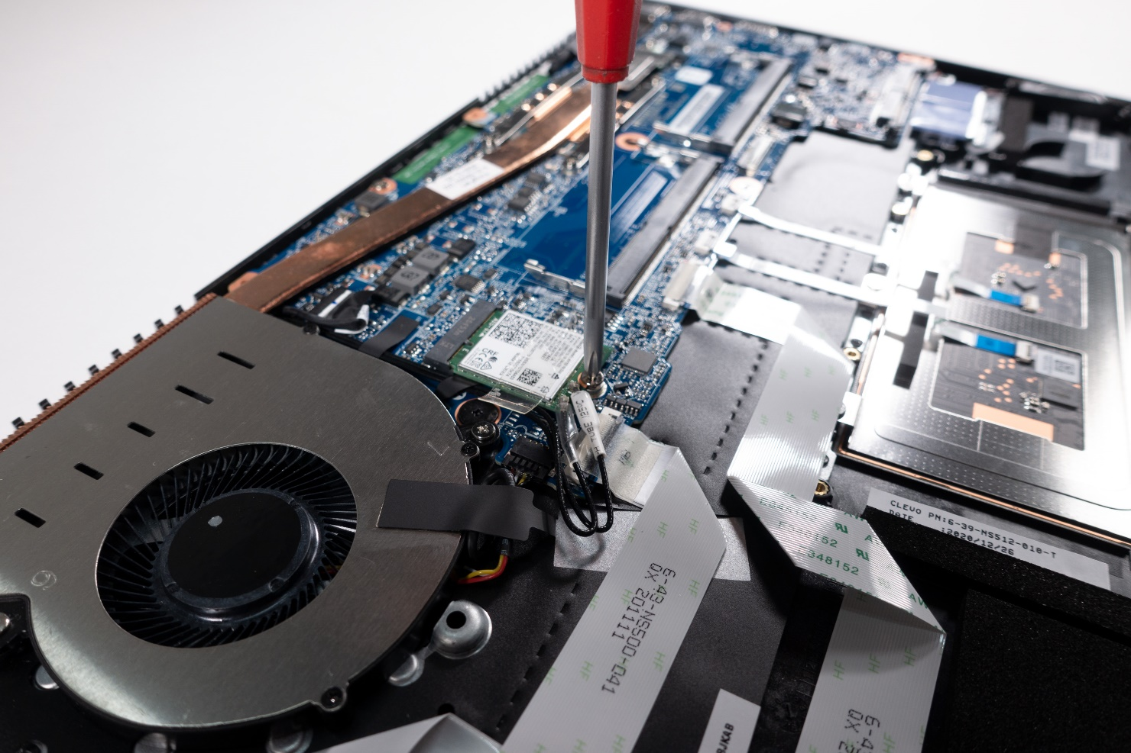

1. Step
Before you start,turn off the Notebook! and remove the power supply
Remove the Bottom Case
Disconnect the cable from the battery
Remove the fastening screw (M2x3/PH0) and take out the WLAN module (Fig. 1).
Note: Connect the white cable is MAIN,the transparent cable is AUX
After installation, secure the adapters with adhesive strips!
1

Slide 14
REMOVE THE
CMOS BATTERY
TERRA MOBILE 1551
Difficulty: 

Slide 15
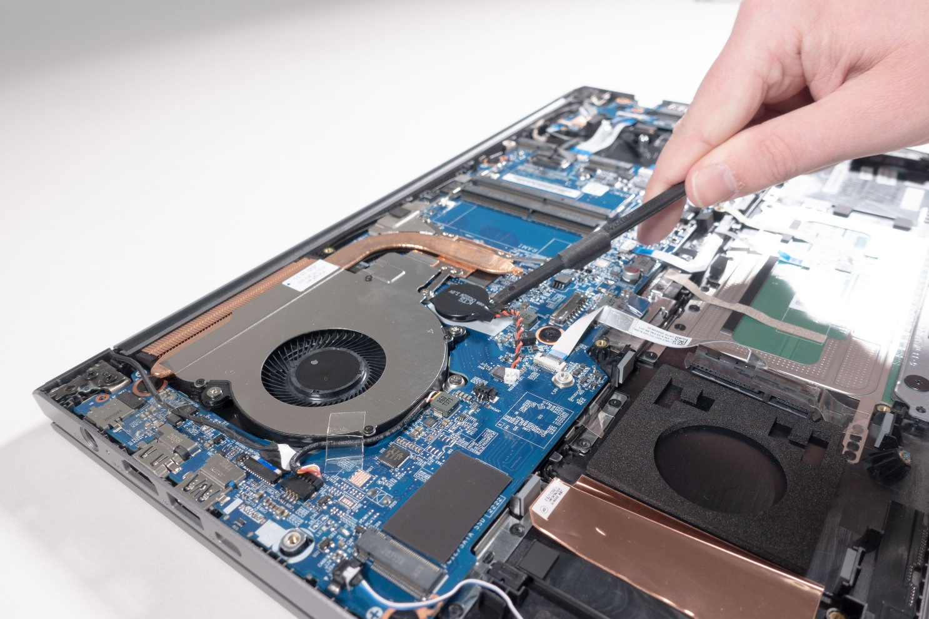
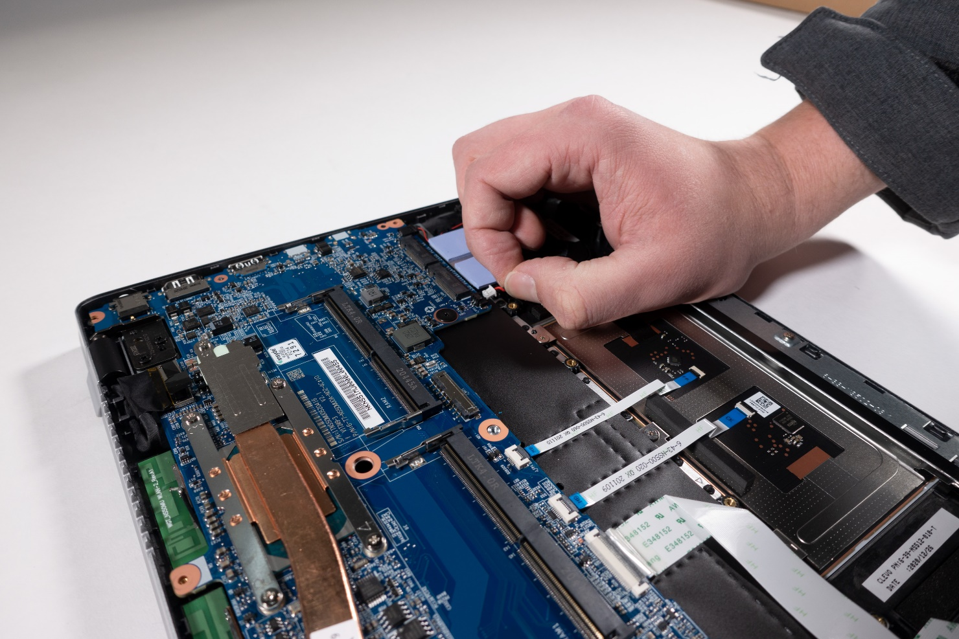

1. Step
Before you start,turn off the Notebook! and remove the power supply
Remove the Bottom Case
Disconnect the cable by pulling on the plug and not on the cable! (Fig.1)
The battery is glued on. The adhesive pad must be replaced for reassembly
If the CMOS battery was removed, an error message will be displayed during booting. Date, time and other settings have to be adjusted in BIOS/ UEFI again.
1
2

Slide 16
REMOVE THE CPU
FAN / HEATSINK
TERRA MOBILE 1551
Difficulty: 

Slide 17
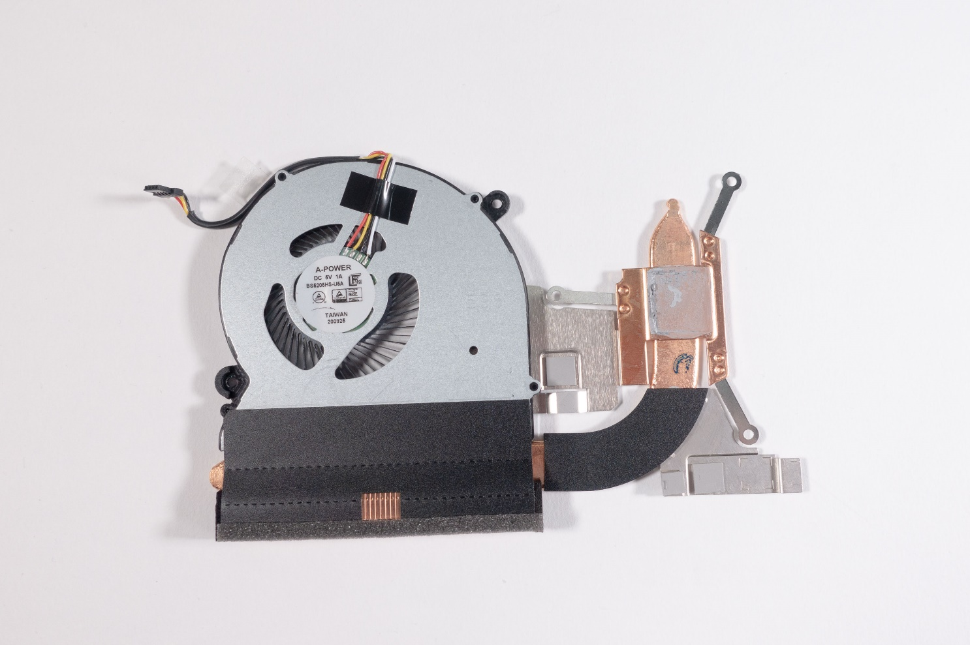
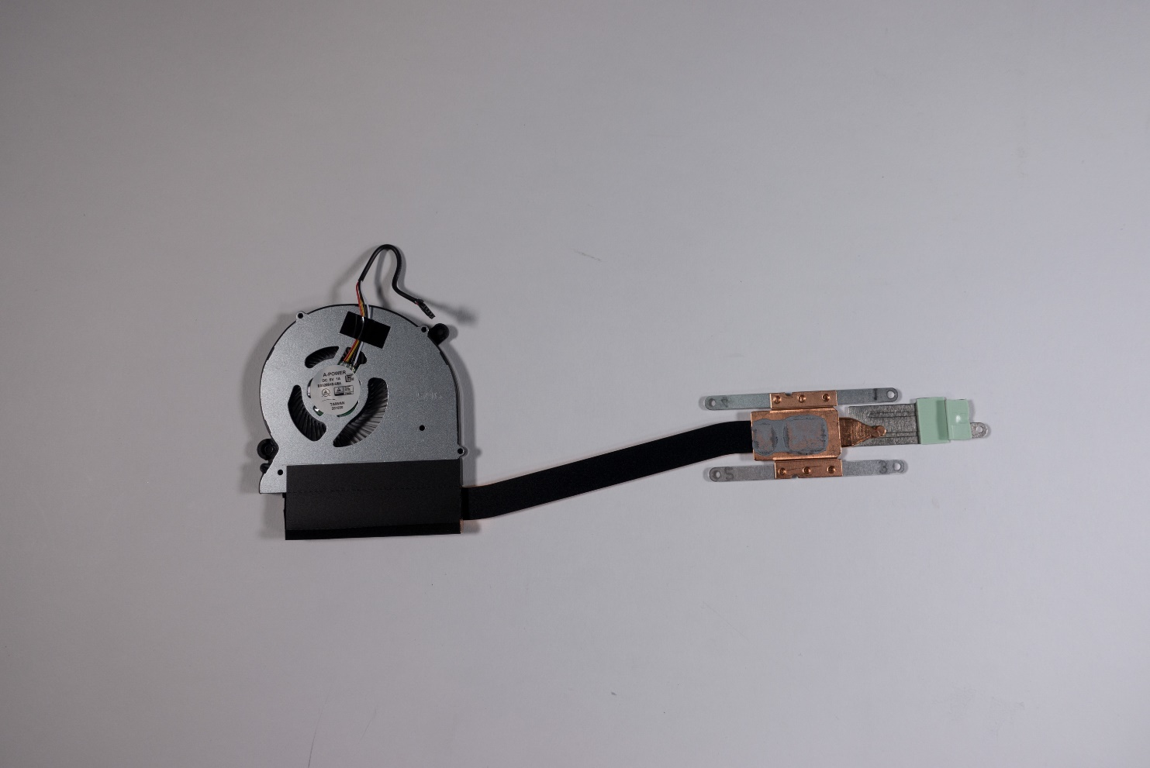
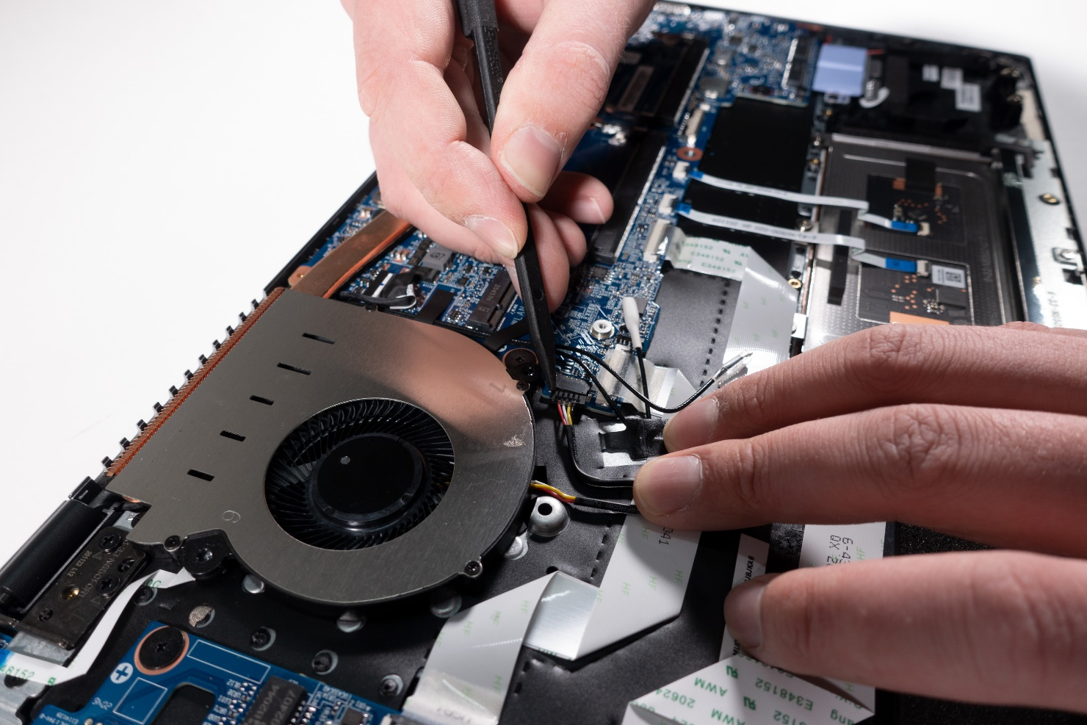

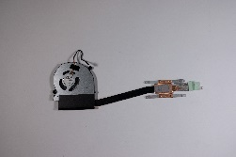
1. Step
Before you start,turn off the Notebook! and remove the power supply
Remove the Bottom Case
Disconnect the cable from the battery
First loosen the black tab above the cable, then the plug (Fig.1).
7 screws (M2x4/PH1) have to be removed (Fig.2).
2 Heat conducting pads need to be transferred (Fig.3).
Renew the thermal paste for the CPU if necessary.
1
2
3
4

Slide 18
REMOVE THE MAINBOARD
TERRA MOBILE 1551
Difficulty: 

Slide 19
1. Step
Before you start,turn off the Notebook! and remove the power supply
Remove the Bottom Case
Remove the Keyboard
Remove the M.2 SSD
Remove the WLAN Module
Remove the CPU Fan / Heatsink

Slide 20
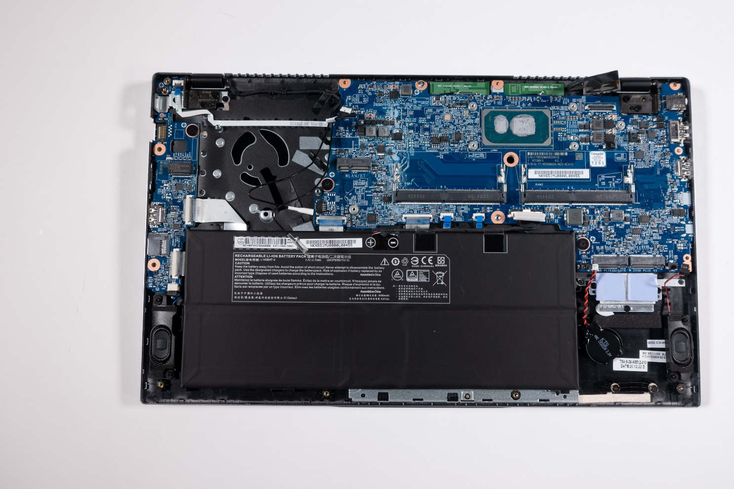
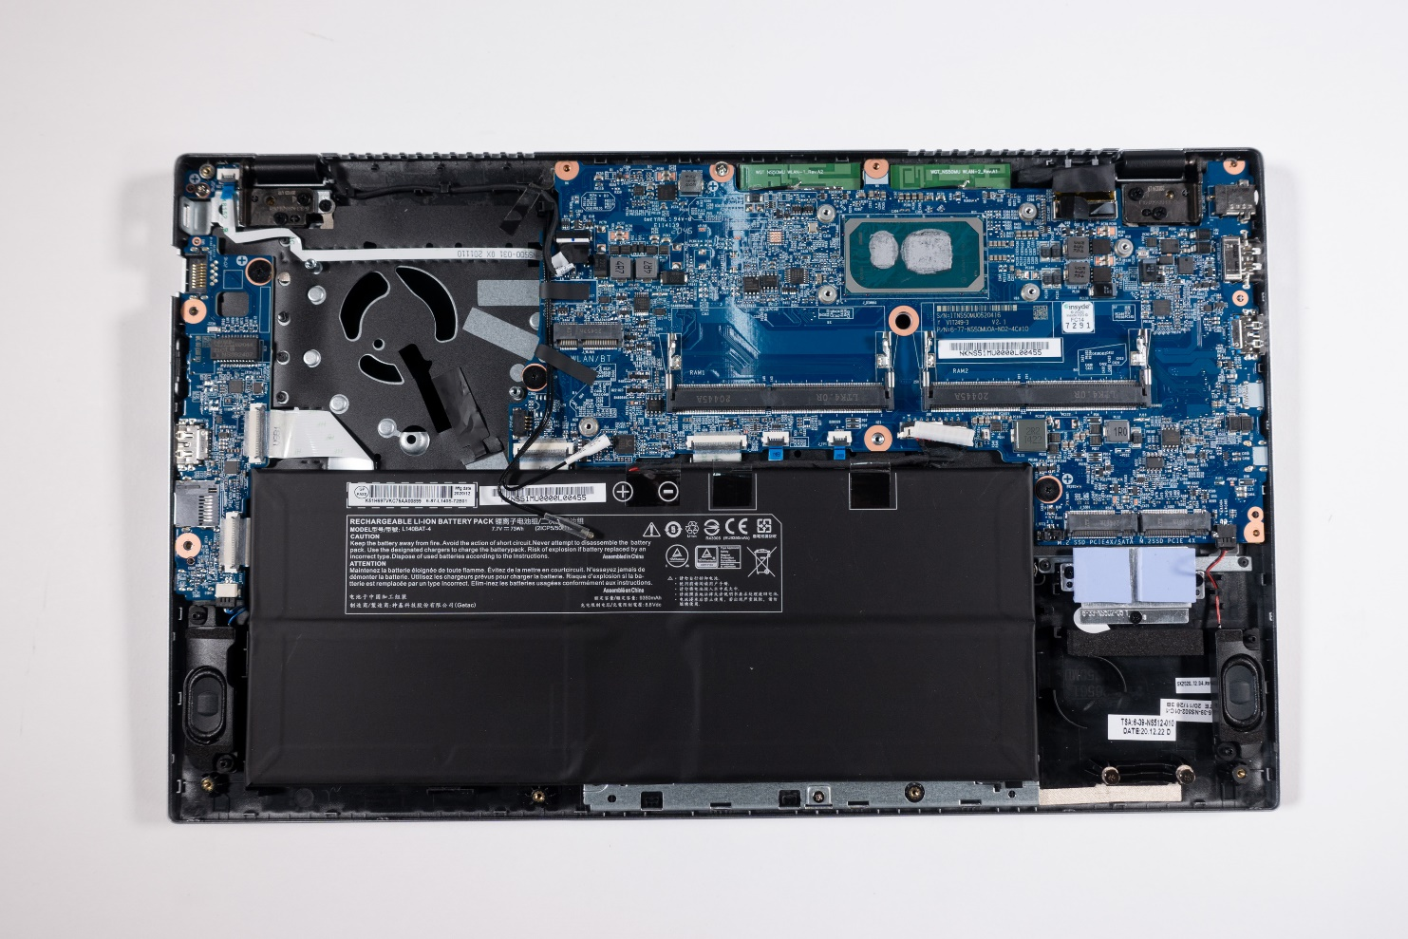
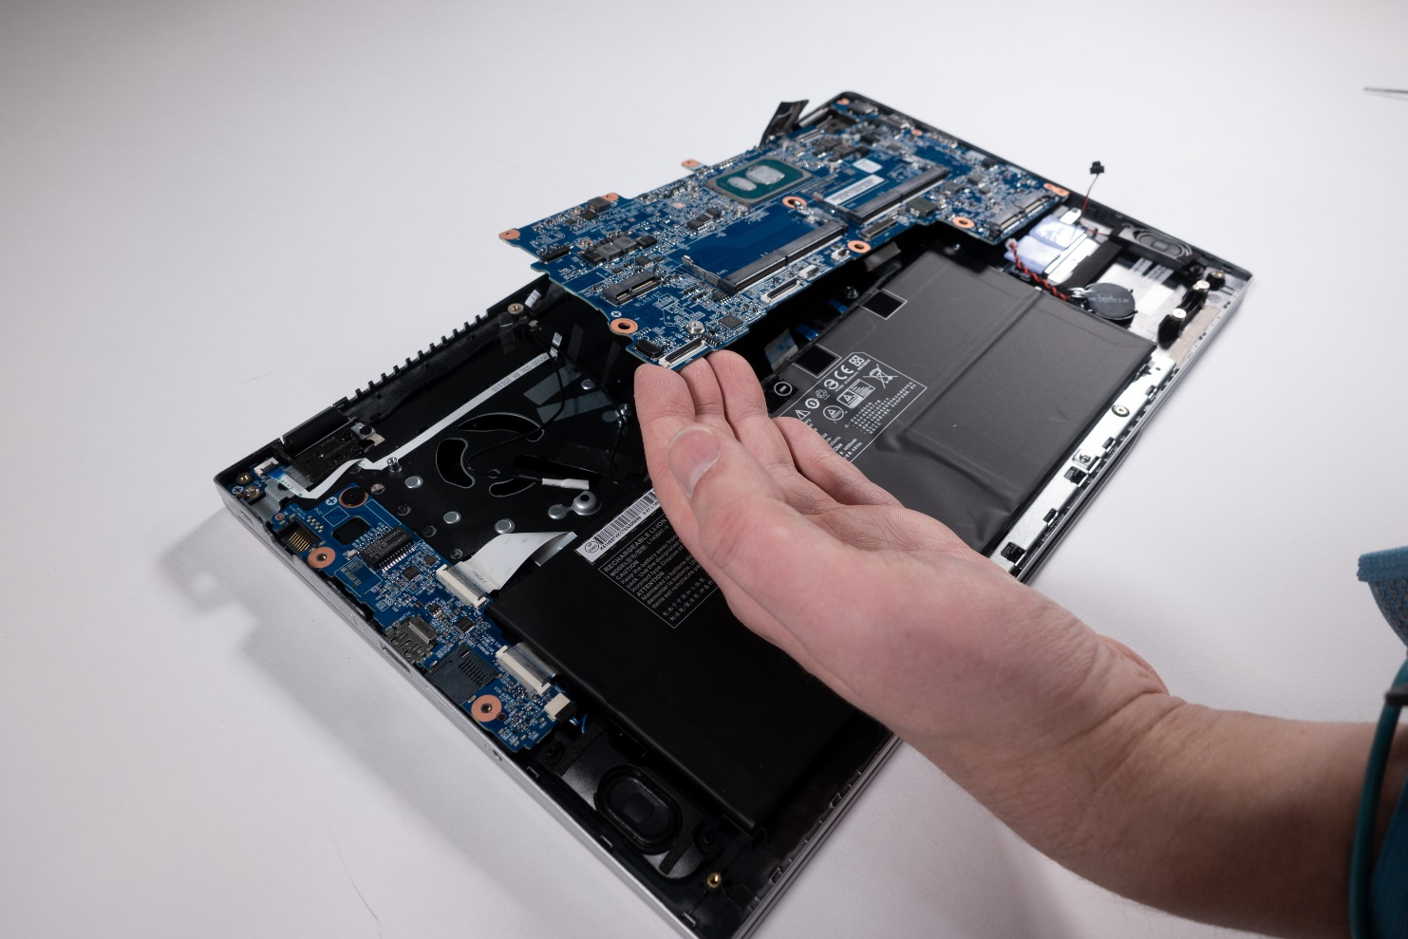
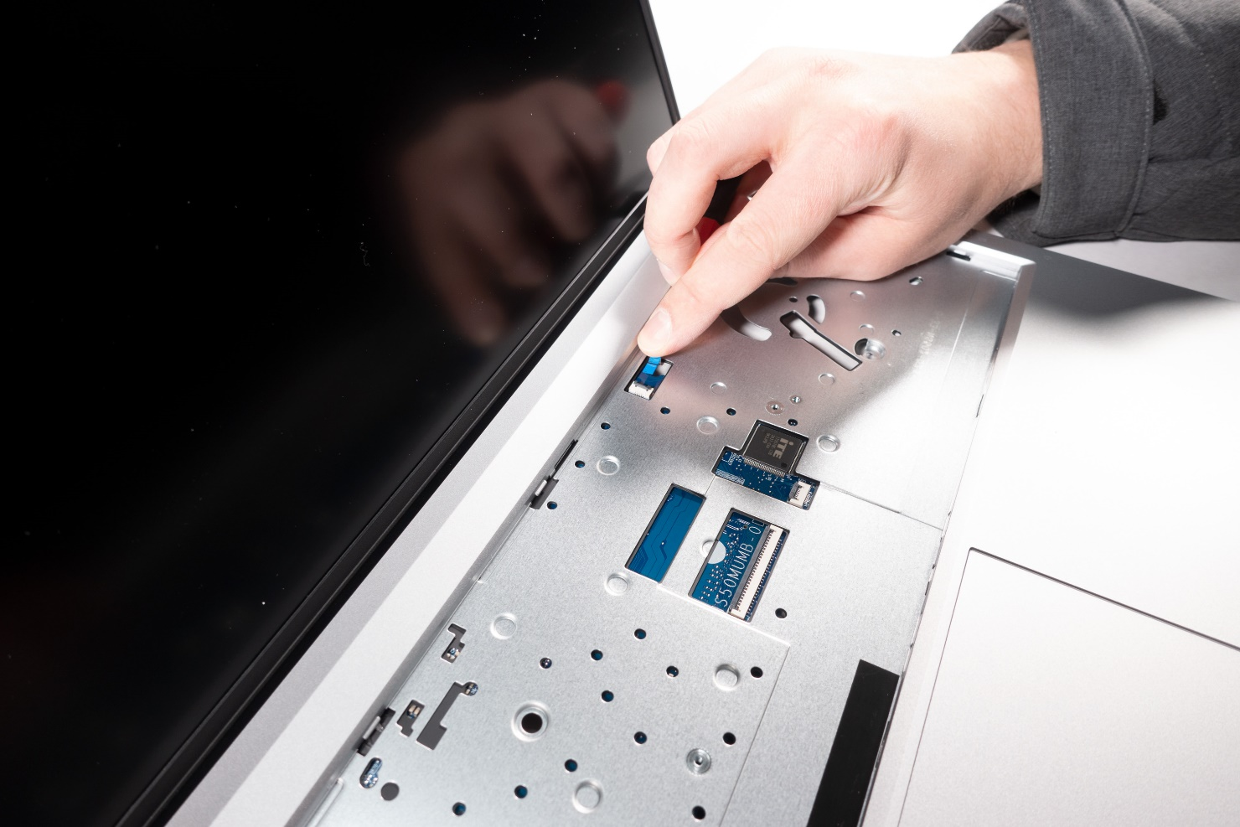

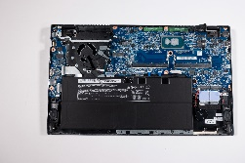
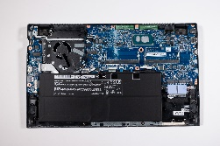

2. Step
Disconnect the ribbon cable below the keyboard (Fig. 1).
Disconnect 9 cables from the mainboard (Fig. 2).
Disconnect the antenna cable from the mainboard (Fig. 3).
Loosen two black (M2x2) and one silver (M2x4)screw on the mainboard. They are marked on the board with crosses (Fig. 4).
Now you can remove the mainboard upwards (Fig. 5).
1
2
3
4
5

Slide 21
REMOVE THE TOUCHPAD
TERRA MOBILE 1551
Difficulty: 

Slide 22
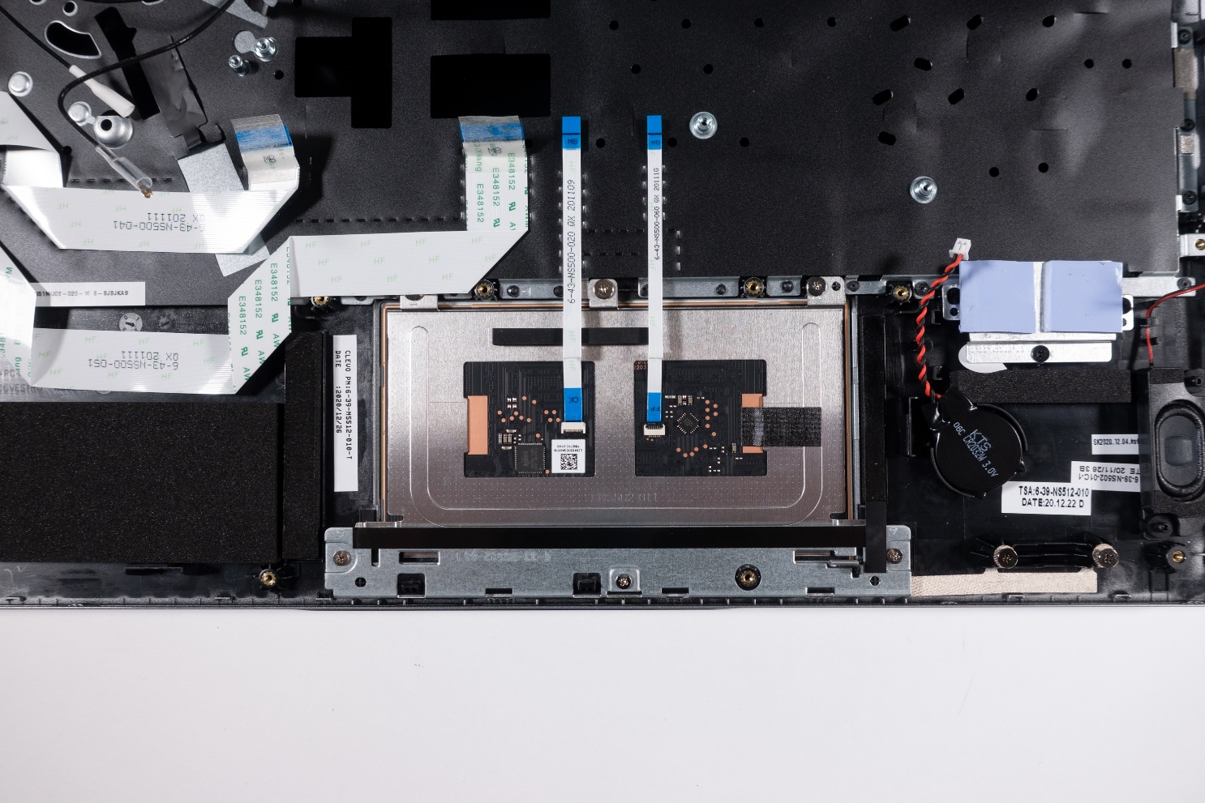
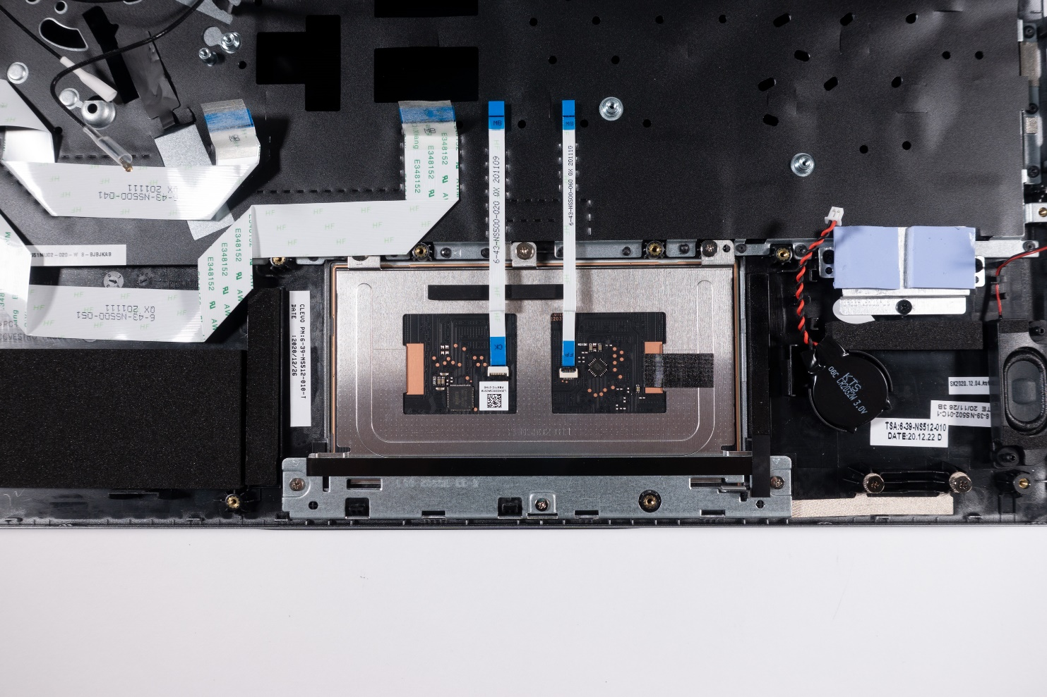
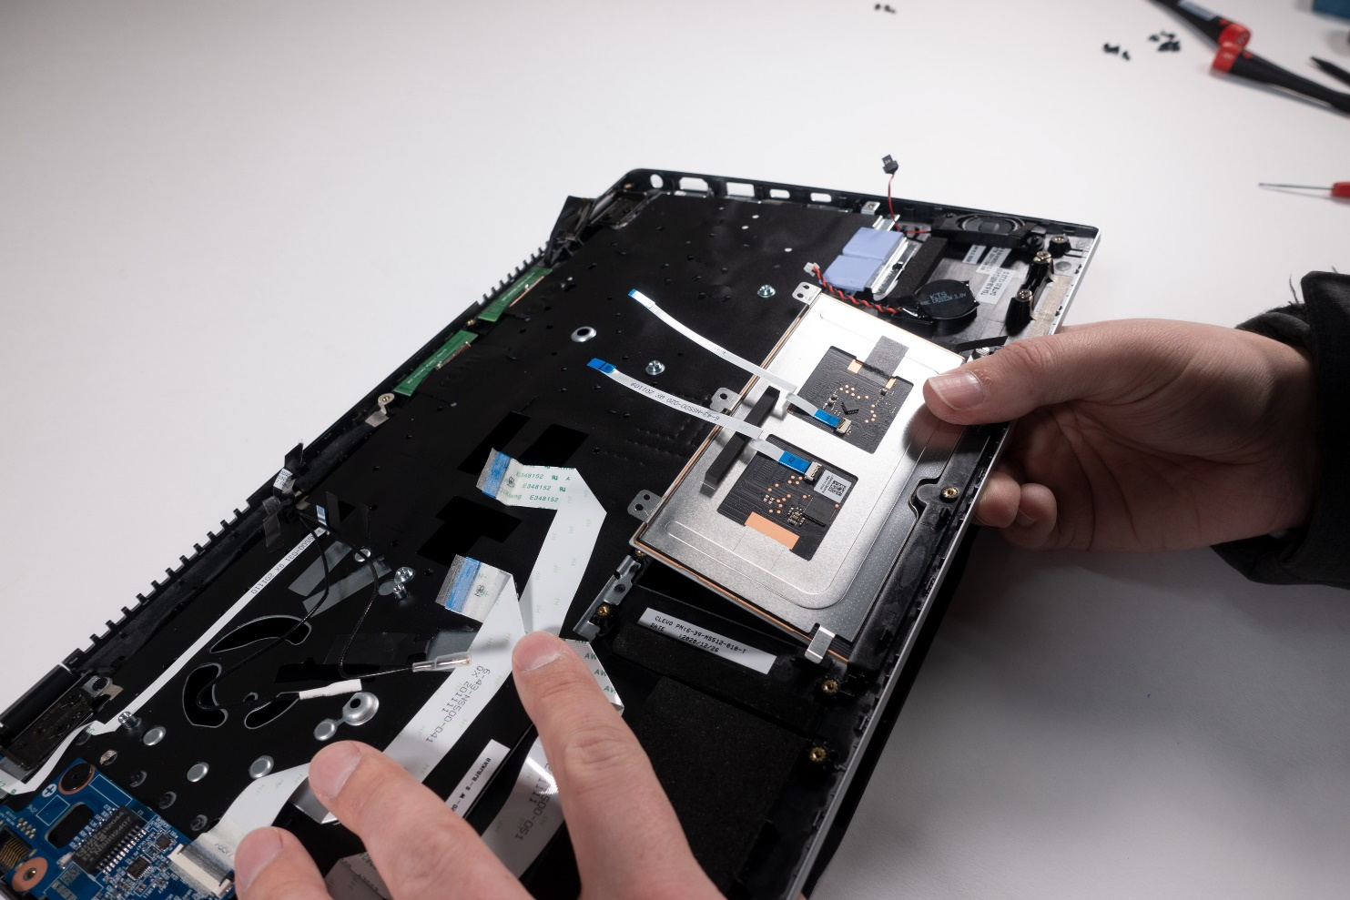
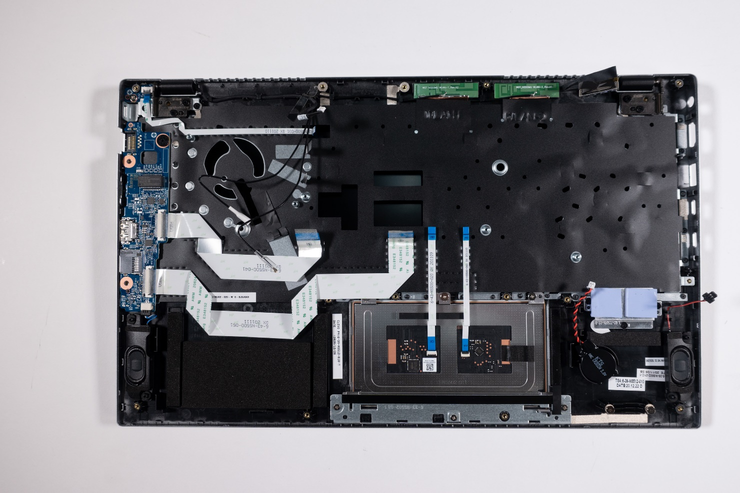
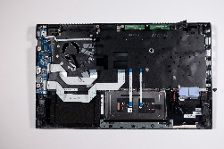
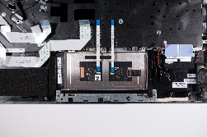

1. Step
Before you start,turn off the Notebook! and remove the power supply
Remove the Bottom Case
Remove the battery
The mainboard does not need to be removed
Disconnect two flat ribbon cables (Fig.1).
Remove three screws from the frame (Fig. 2).
Three screws on the top case must be removed (Fig. 3).
The touchpad can now be removed (Fig. 4).
1
2
3
4

Slide 23
REMOVE THE TOP CASE
TERRA MOBILE 1551
Difficulty: 

Slide 24
1. Step
Before you start,turn off the Notebook! and remove the power supply
Remove the battery
Remove the mainboard
Remove the touchpad

Slide 25
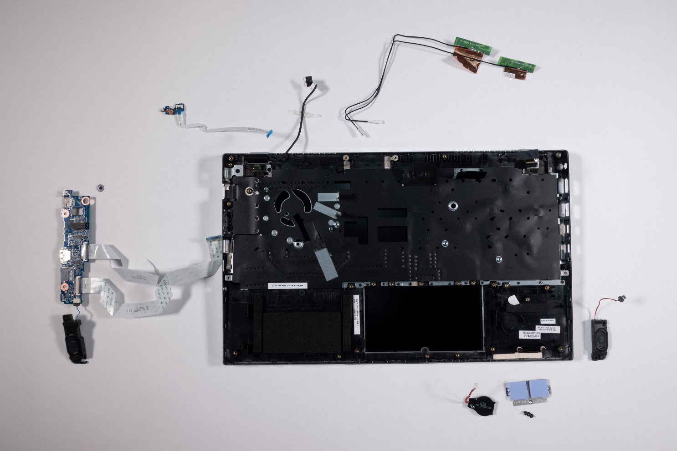
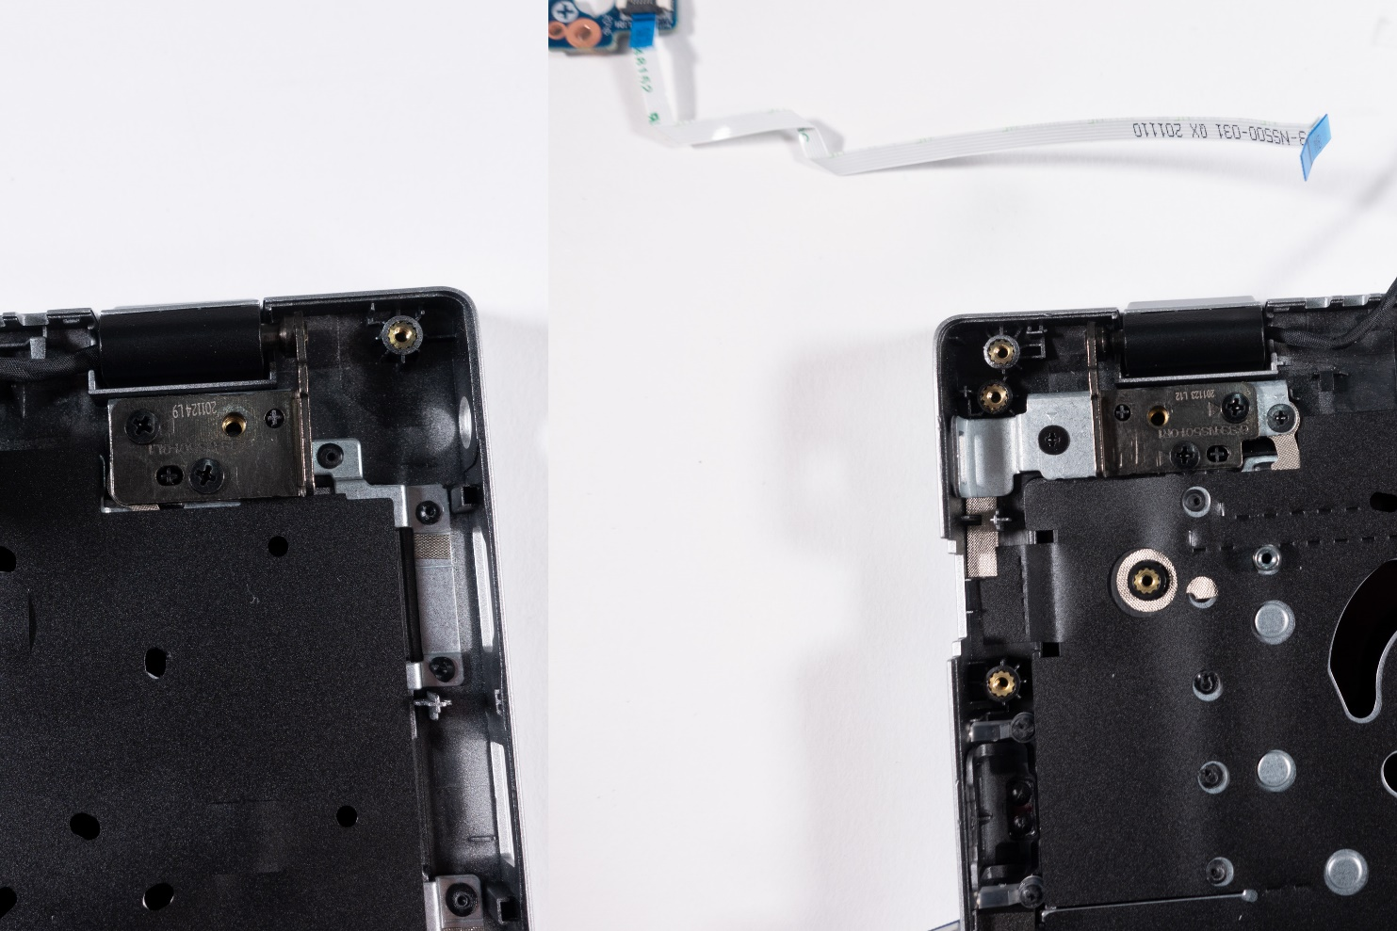
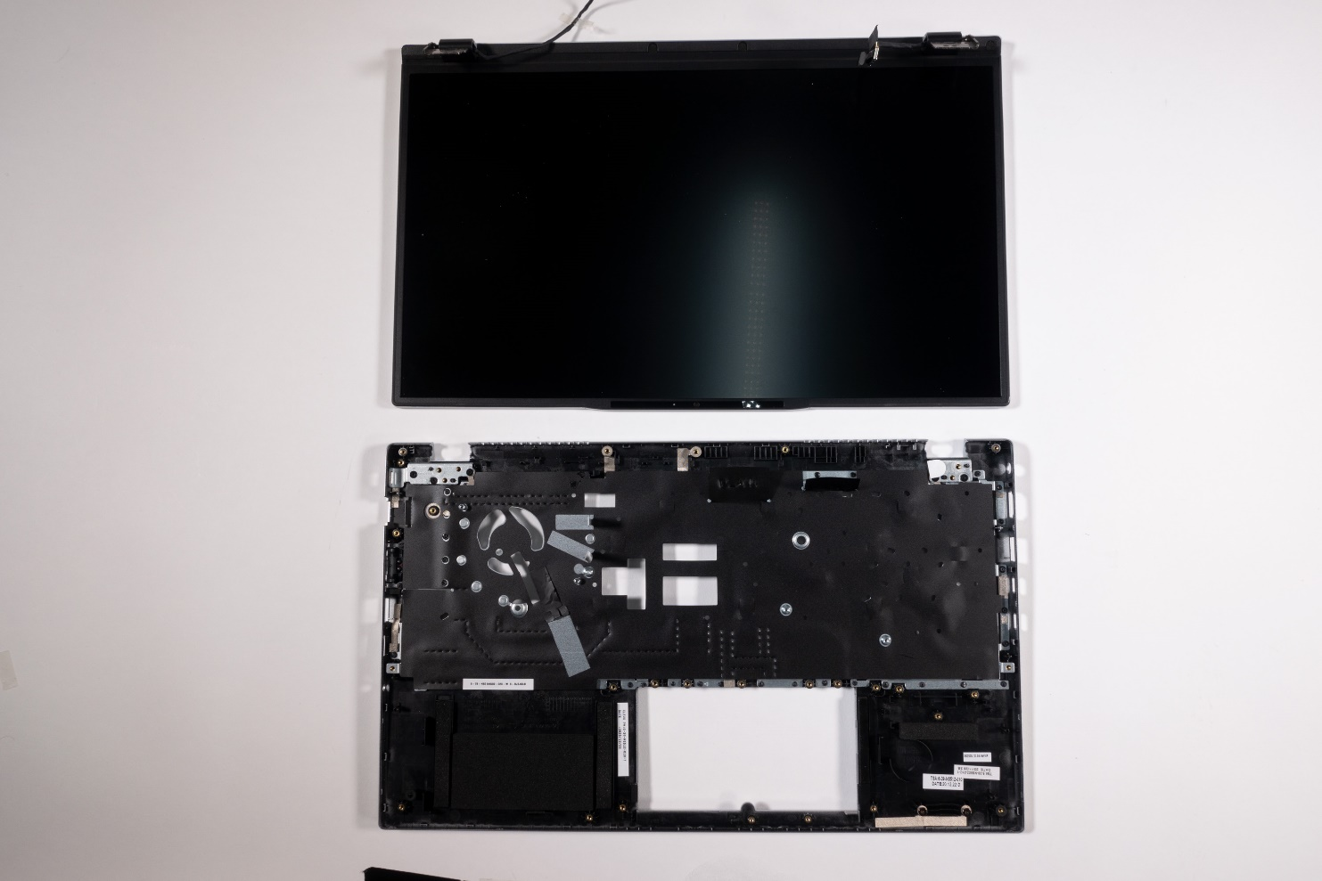
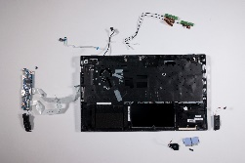
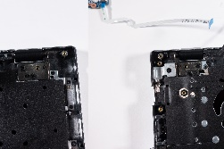

2. Step
Transfer both speakers, CMOS battery, cooling pads, audio/USB board (1x screw 2x cable), LID board (1x screw, 1x cable) (Fig.1).
Disconnect the WLAN antennas from the housing (Fig.2).
Remove two screws from each of the hinges (pay attention to the correct position when installing (Fig.3).
1
2
3
4

Slide 26
REMOVE THE CAMERA
TERRA MOBILE 1551
Difficulty: 

Slide 27
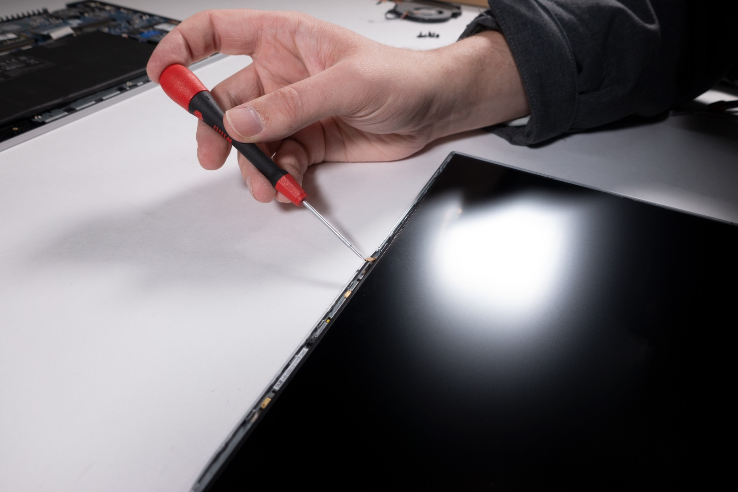
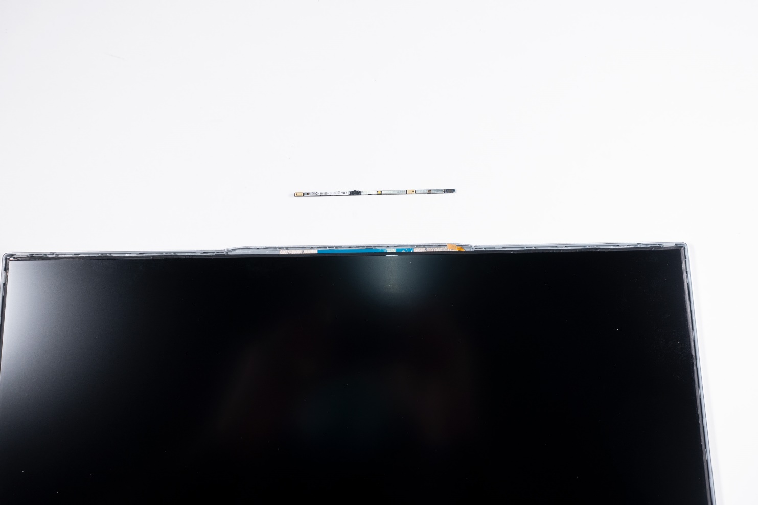
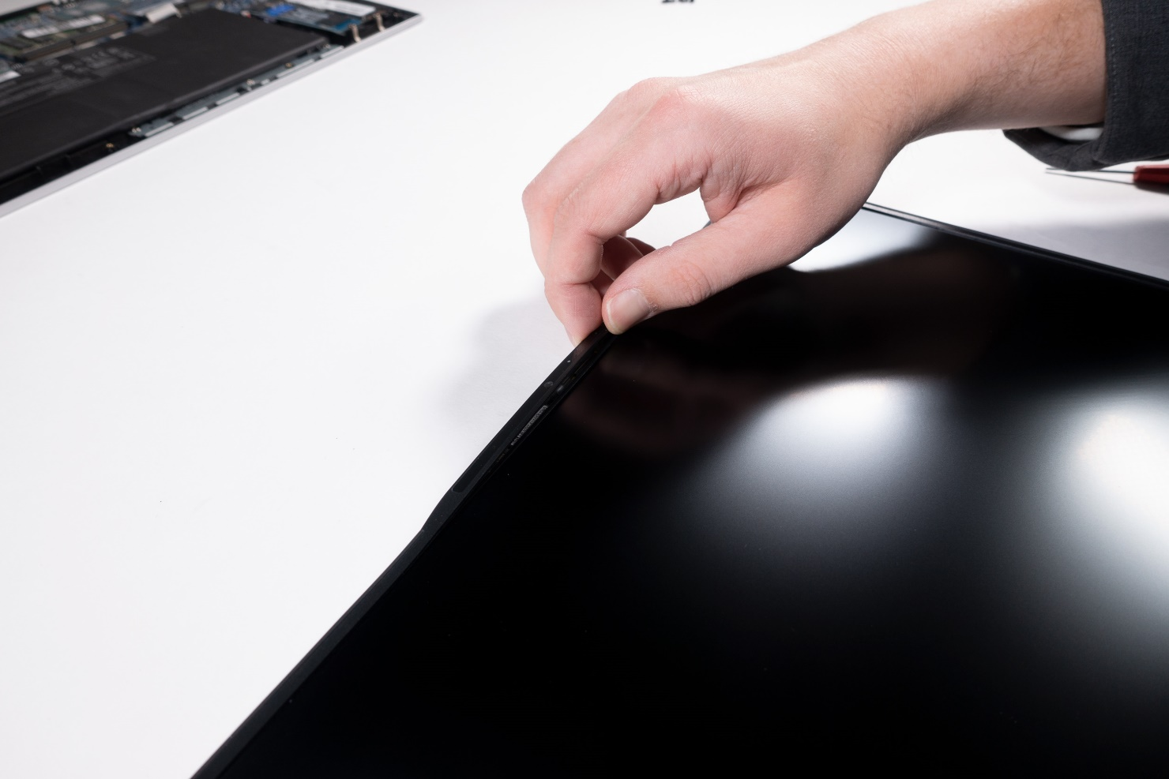


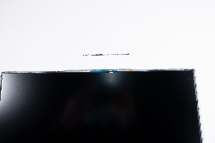
1. Step
Before you start,turn off the Notebook! and remove the power supply
The camera is stuck in place and connected with a flat ribbon cable
Loosen the front cover in the top area (Fig. 1).
Remove camera cable (Fig. 2).
Gently separate the camera from the housing (Fig. 3).
1
2
3
4

Slide 28
REMOVE THE LCD PANEL
TERRA MOBILE 1551
Difficulty: 

Slide 29
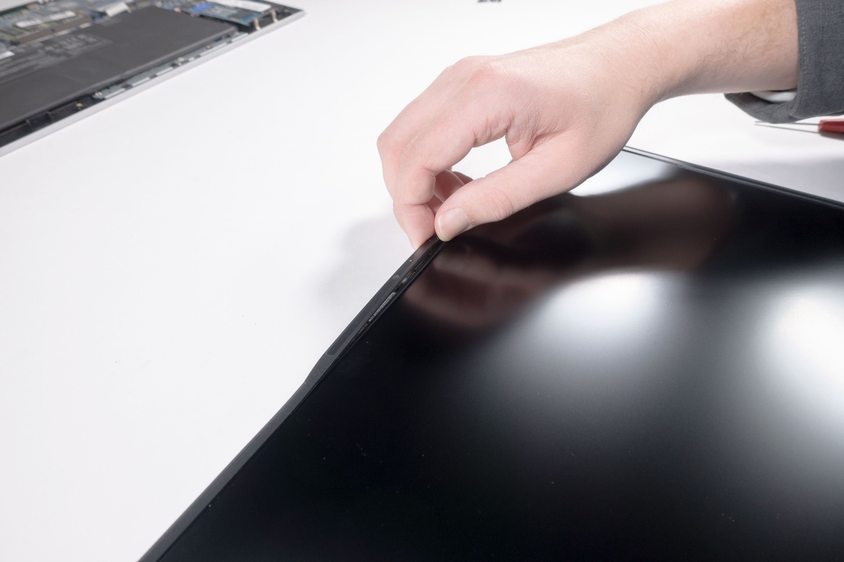
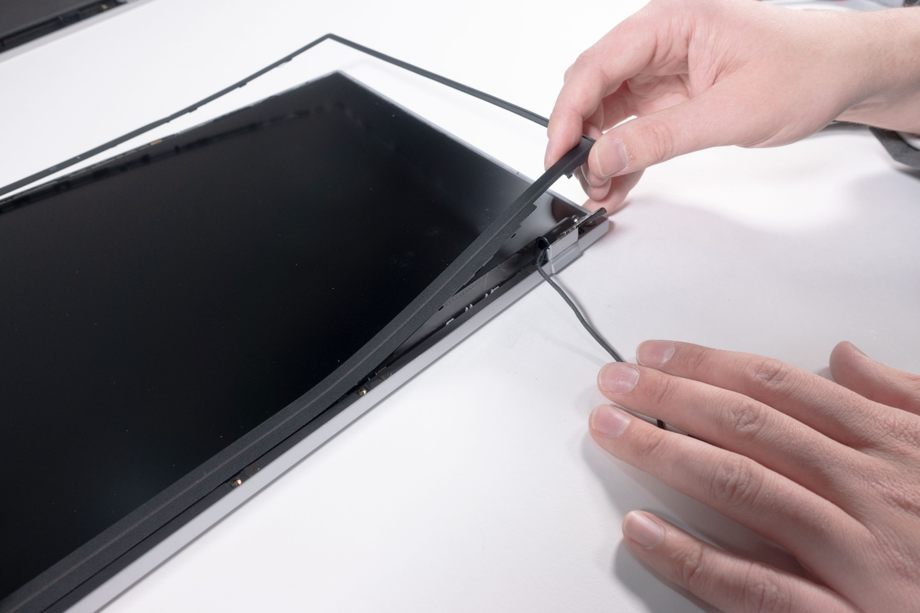
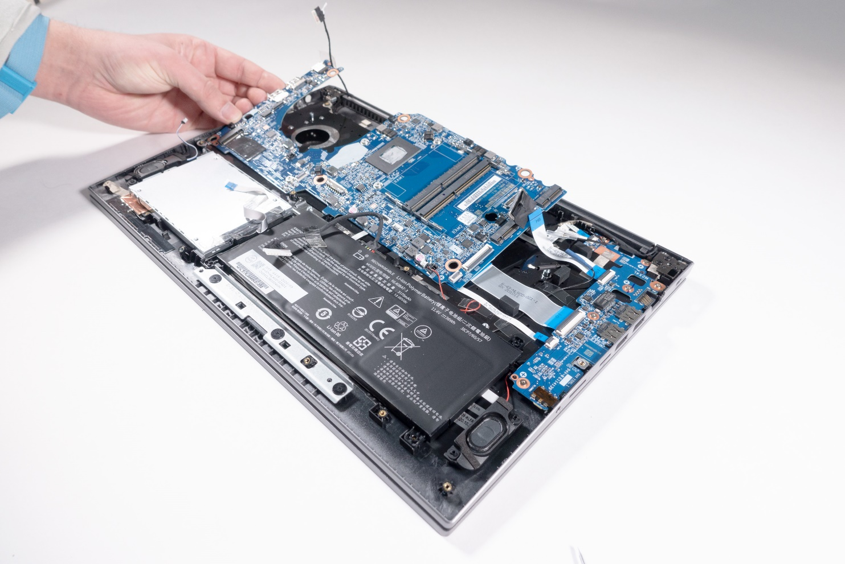
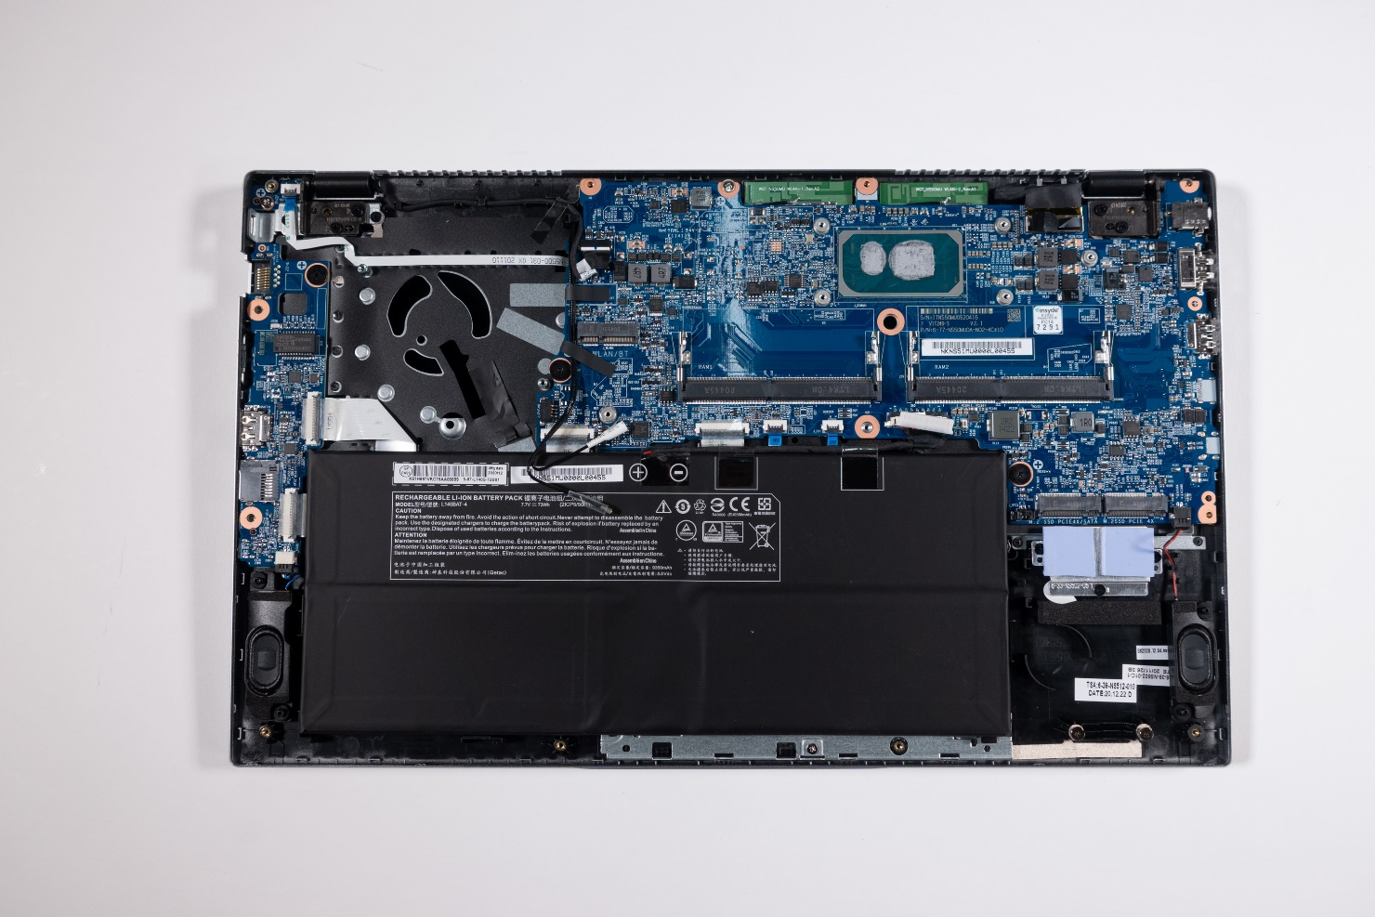
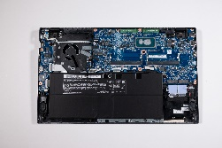



1. Step
Note: Disconnect the battery connection to prevent accidental power-up
First of all,remove the cooling unit
2 cables and the 4 hinge screws (M2.5x6/PH1) must be removed. The position of the screws is marked by triangles. (Fig.1).
The base and display are now separated
Lay the LCD display down flat on a clean surface.
Disconnect the front cover. Start at the top, then the sides and finally the bottom area. (Fig. 2 & 3).
Note: The cover is partially glued. The double-sided adhesive tape must be renewed during installation.
1
2
3
4

Slide 30








2. Step
The screw covers on the display housing must be removed. (Fig.1).
Remove the 7 screws (M2.5x4.5). (Fig.2).
Remove the cover. (Fig.3).
Remove 2 screws (M2x3) from both hinges.(Fig.4).
1
2
3
4

Slide 31








3. Step
Use pliers to remove the two adhesive strips.(Fig.1).
The display cable must be released from the cable guide (Fig. 2).
The webcam cable is only removed when replacing the back cover.(Fig. 3).
The display can now be removed. (Fig.4).
1
2
3
4

Slide 32
Spare Parts
TERRA MOBILE 1551

Slide 33
Spare Parts TERRA MOBILE 1551
Artikelnummer | Beschreibung
1480486 | AC-Adapter 65W EU
1480195 | Battery 73Wh
E1080589 | Battery Double Side Tape (46x5mm)
E1080590 | Battery Double Side Tape (57x8mm)
E1080574 | Bottom Case (Cover D)
E1080579 | CCD Lens
E1080314 | CMOS Battery
E1080573 | CPU fan with heatsink
E1080578 | Hall Sensor Board
E1080585 | Hinge (L)
E1080586 | Hinge (R)
E1080587 | Hinge Cover
E1080584 | LCD Back Cover (Cover A)
E1080582 | LCD Cable
E1080581 | LCD Display 15.6" FHD (eDP)
E1080588 | LCD Double Side Tape
E1080580 | LCD Front Cover (Cover B)
Artikelnummer | Beschreibung
E1080571 | Mainboard (i5-1135G7)
E1080572 | Mainboard (i7-1165G7)
E1080516 | Screw M2x5mm Nylok for Bottom Case
E1080576 | Speaker (L)
E1080577 | Speaker (R)
1480235 | Keyboard Multi-Color light [BE]
1480227 | Keyboard Multi-Color light [CH]
1480225 | Keyboard Multi-Color light [DE]
1480137 | Keyboard Multi-Color light [ES]
1480226 | Keyboard Multi-Color light [FR]
1480229 | Keyboard Multi-Color light [UK]
1480228 | Keyboard Multi-Color light [US]
E1080575 | Top Case (Cover C)
E1080595 | Touchpad
E1080622 | Multi I/O Board Realtek Card R.
E1080624 | Multi I/O Board O²Micro Card R.
E1080583 | Webcam

Slide 34
Spare Parts TERRA MOBILE 1551P
Artikelnummer | Beschreibung
1480278 | AC-Adapter 90W EU
1480195 | Battery 73Wh
E1080589 | Battery Double Side Tape (46x5mm)
E1080590 | Battery Double Side Tape (57x8mm)
E1080574 | Bottom Case (Cover D)
E1080579 | CCD Lens
E1080314 | CMOS Battery
E1080695 | CPU fan with heatsink
E1080578 | Hall Sensor Board
E1080585 | Hinge (L)
E1080586 | Hinge (R)
E1080587 | Hinge Cover
E1080584 | LCD Back Cover (Cover A)
E1080582 | LCD Cable
E1080684 | LCD Display 15.6" FHD (eDP)
E1080588 | LCD Double Side Tape
E1080580 | LCD Front Cover (Cover B)
Artikelnummer | Beschreibung
E1080682 | Mainboard (i5-1240P)
E1080683 | Mainboard (i7-1260P)
E1080516 | Screw M2x5mm Nylok for Bottom Case
E1080576 | Speaker (L)
E1080577 | Speaker (R)
1480235 | Keyboard Multi-Color light [BE]
1480227 | KeyboardMulti-Color light [CH]
1480225 | Keyboard Multi-Color light [DE]
1480137 | Keyboard Multi-Color light [ES]
1480226 | Keyboard Multi-Color light [FR]
1480229 | Keyboard Multi-Color light [UK]
1480228 | Keyboard Multi-Color light [US]
E1080681 | Top Case (Cover C)
E1080595 | Touchpad
E1080622 | Multi I/O Board Realtek Card R.
E1080624 | Multi I/O Board O²Micro Card R.
E1080583 | Webcam

