Slide 1
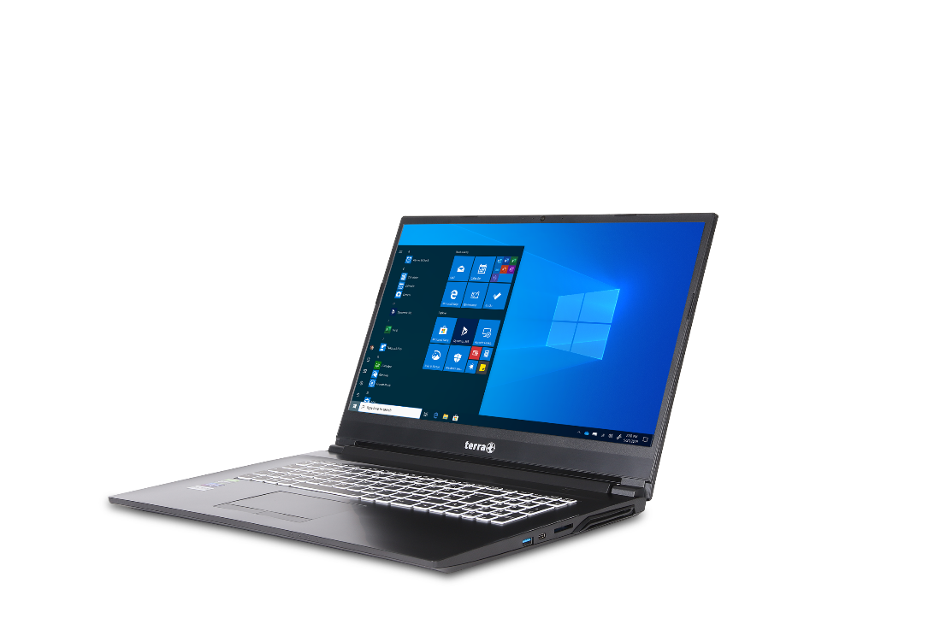
Service Manual
TERRA MOBILE 1577
TERRA MOBILE 1777
TERRA MOBILE 1777T

Slide 2


Contents
Remove the Battery
Remove the Keyboard
Remove the Bottom Case
Remove the RAM
Remove the HDD
Remove the M.2 SSD
Remove the WLAN Module
Remove the CMOS Battery
Remove the GPU Fan
Remove the CPU Fan / Heatsink
Remove the Mainboard
Remove the Top Case
Remove the LCD Display
Remove the LCD Back Cover
Spare parts List 1577
Spare parts List 1777
Spare parts List 1777T

Slide 3
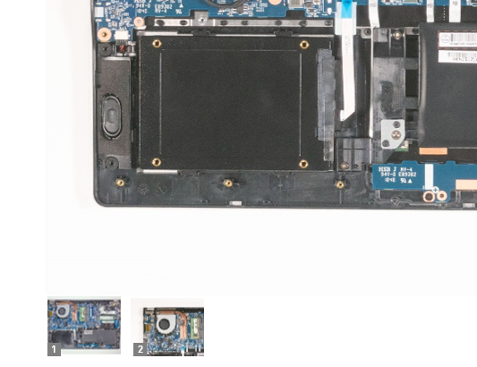

SERVICE NOTES
Safety instructions
Work on a clean surface. Make sure that the housing can not be scratched.
Sort the screws and make sure that they are in the right place when reinstalling. Wrongly inserted screws can cause irreparable damage.
For all service work. Always disconnect the power supply and the battery connection to the mainboard.
Ensure you have sufficient ESD protection.
The WORTMANN AG accepts no liability for any damage caused when using this service manual.
Tools
Phillips screwdriver PH0
Phillips screwdriver PH1
Slotted screwdriver 2 mm
Plastic Slotted screwdriver 3mm
Duct tape
The photos in this repair manual show the TERRA MOBILE 1777. Deviations in the construction of the MOBILE 1577 are shown separately....
Note
Click on the thumbnails to
view the pictures in full size.

Slide 4
REMOVE THE BATTERY
TERRA MOBILE 1577/1777
Difficulty: 

Slide 5
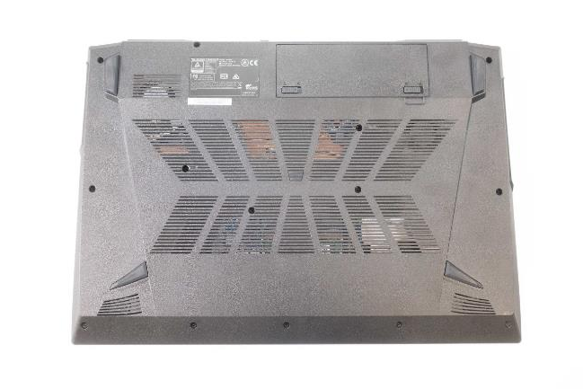
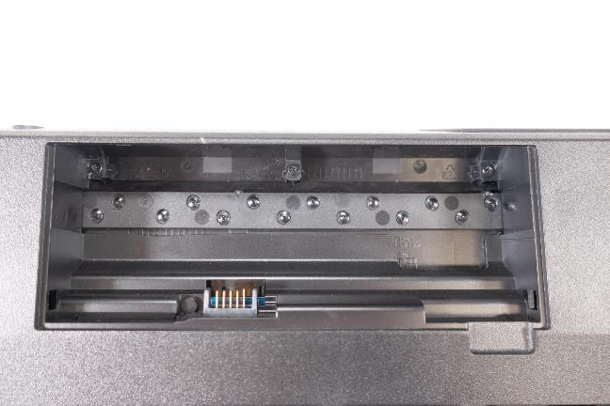
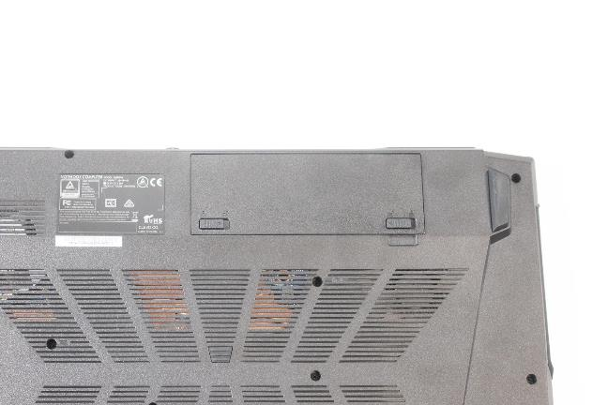
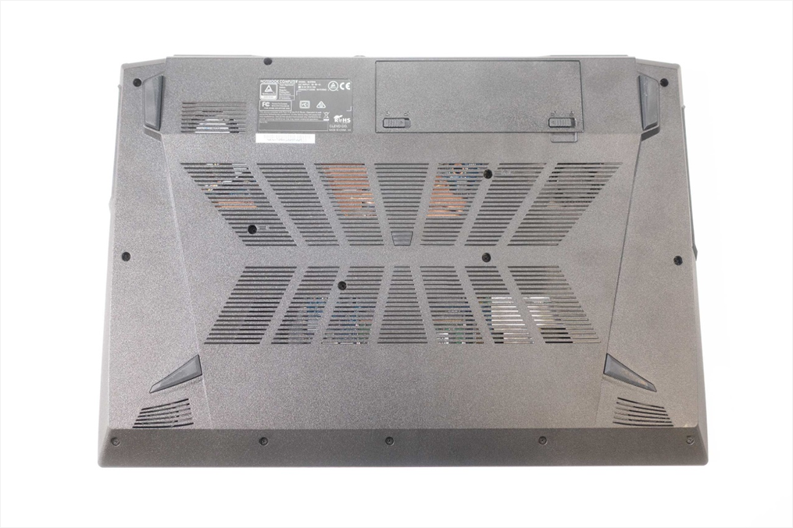
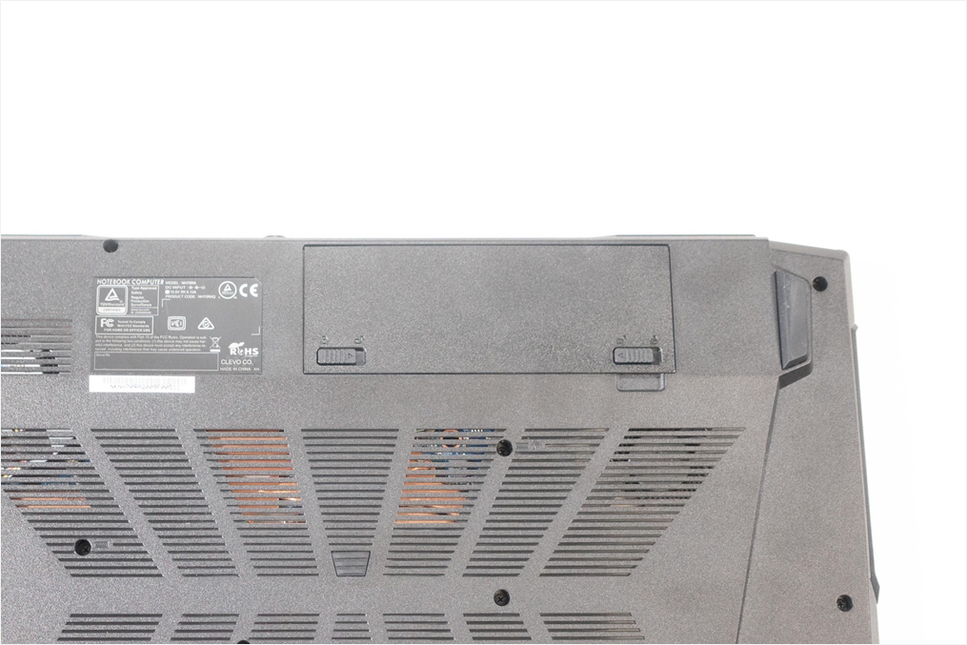
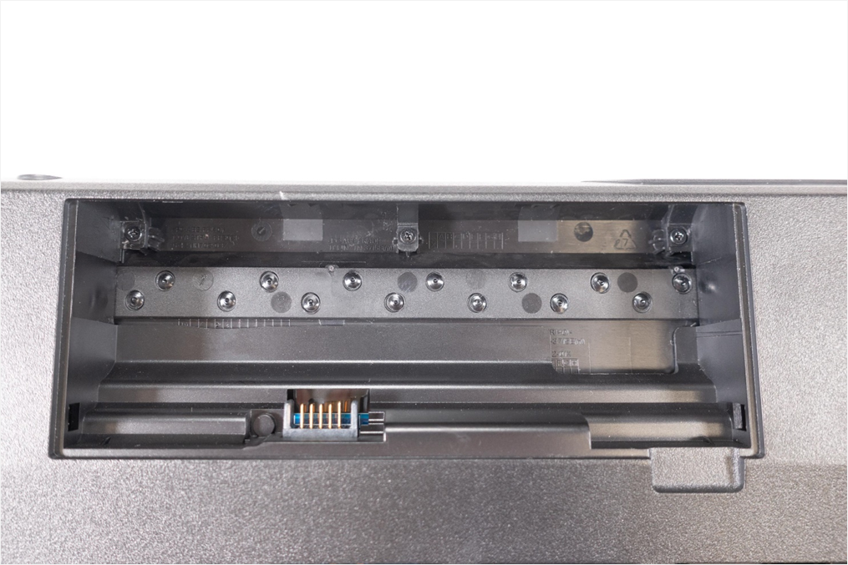
1. Step
Place the unit down as shown in (Fig.1), with the battery in the marked position.
Slide the latches inwards.(Fig.2).
Now you can remove the battery by lifting it upwards.(Fig. 3).
1
1
2
2
3
3
4
5

Slide 6
REMOVE THE KEYBOARD
TERRA MOBILE 1577/1777
Difficulty: 

Slide 7
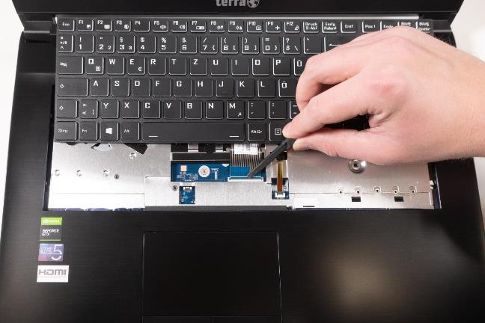
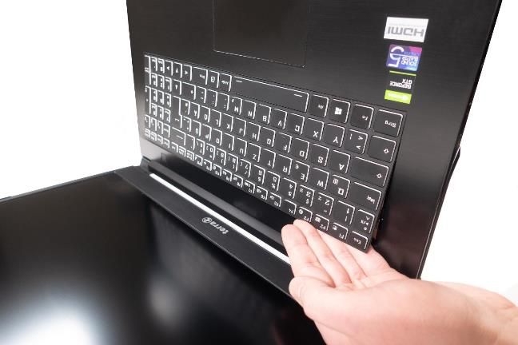
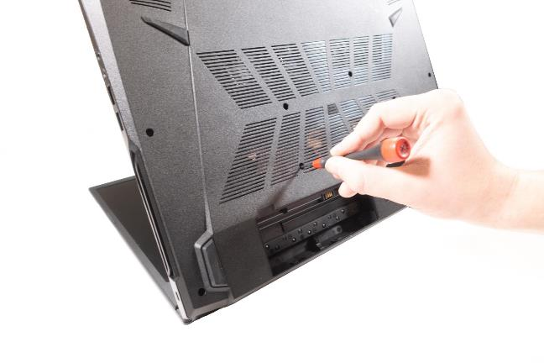
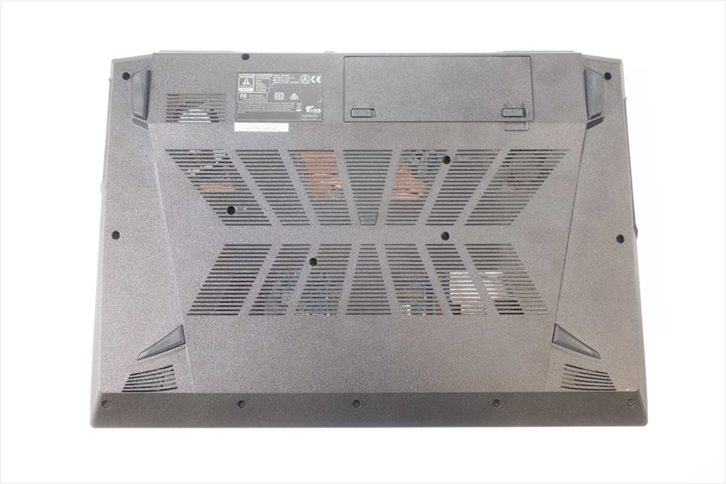
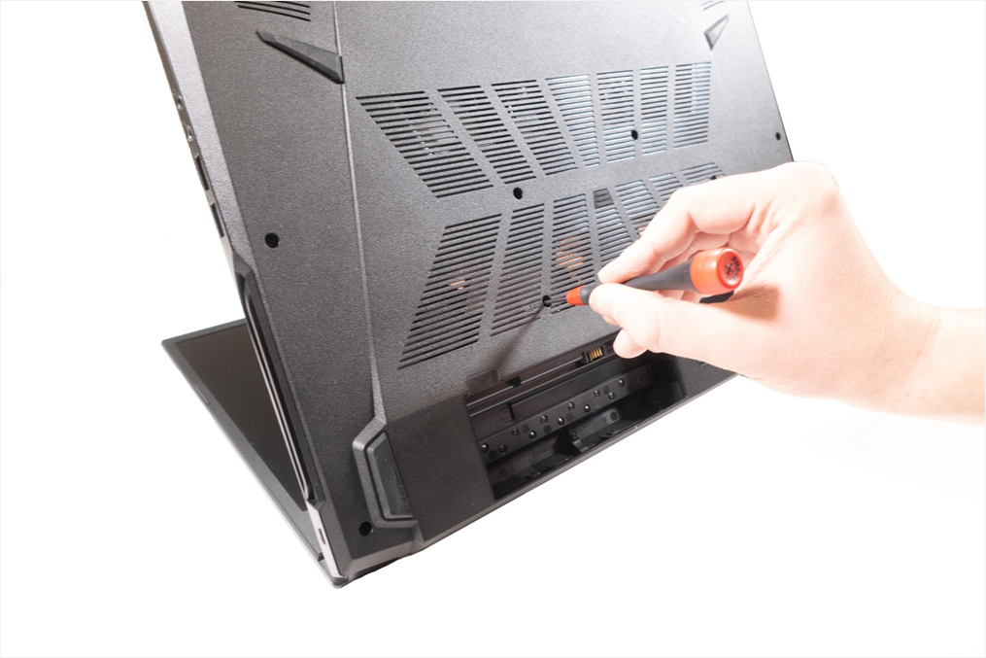
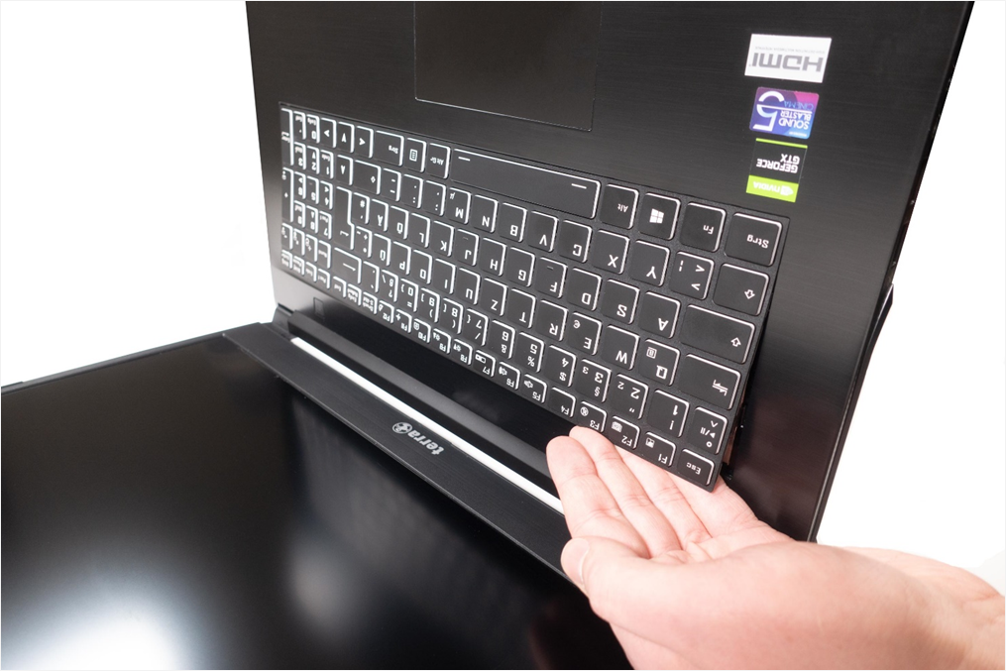
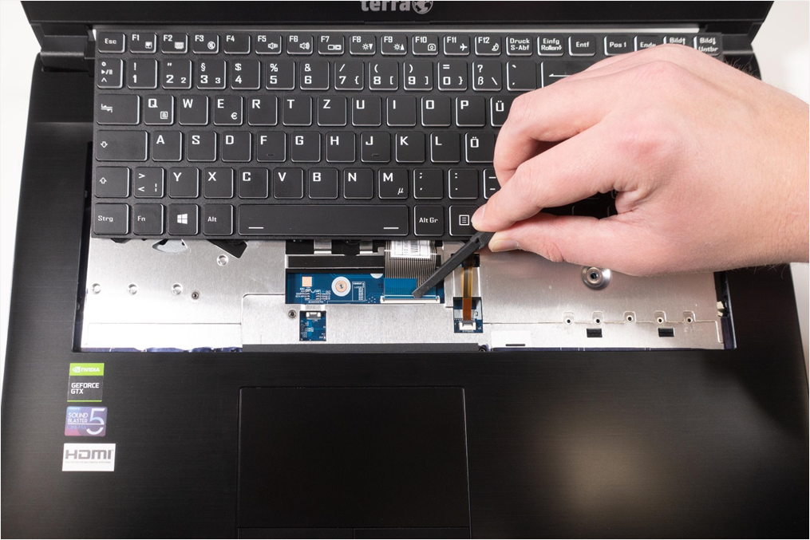
1. Step
Remove battery
Loosen the 2 screws. (Fig.1).
Now press the PH0 screwdriver into a screw hole and push the keypad out, holding the keypad firmly.(Fig. 2 & 3).
Disconnect the two flat ribbon cables.(Fig. 4).
1
2
3
4

Slide 8
REMOVE THE BOTTOM CASE
TERRA MOBILE 1577/1777
Difficulty: 

Slide 9
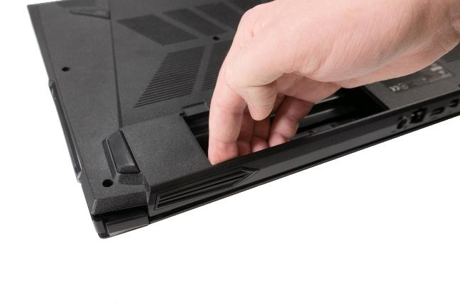
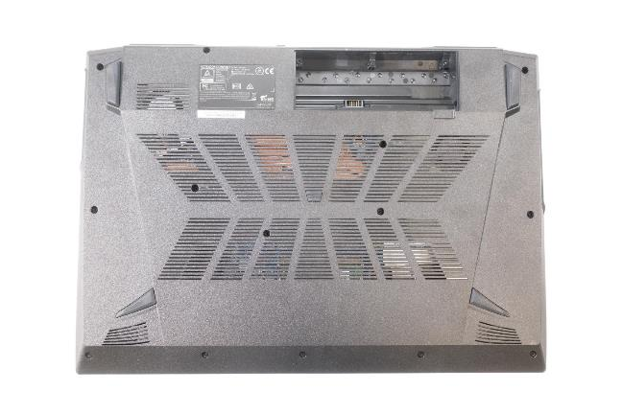
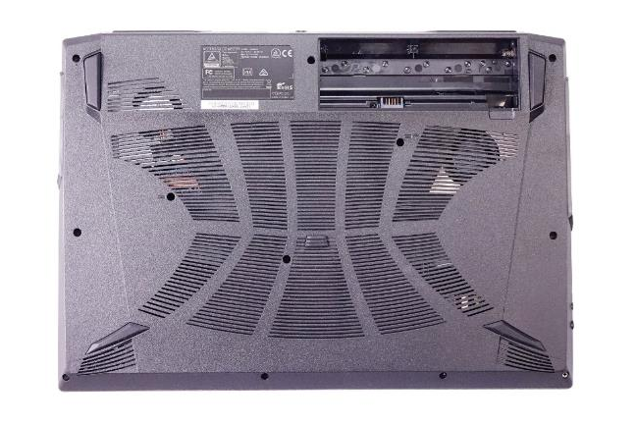
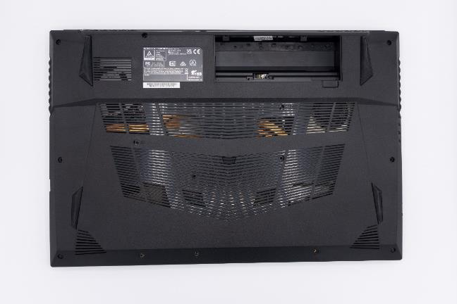



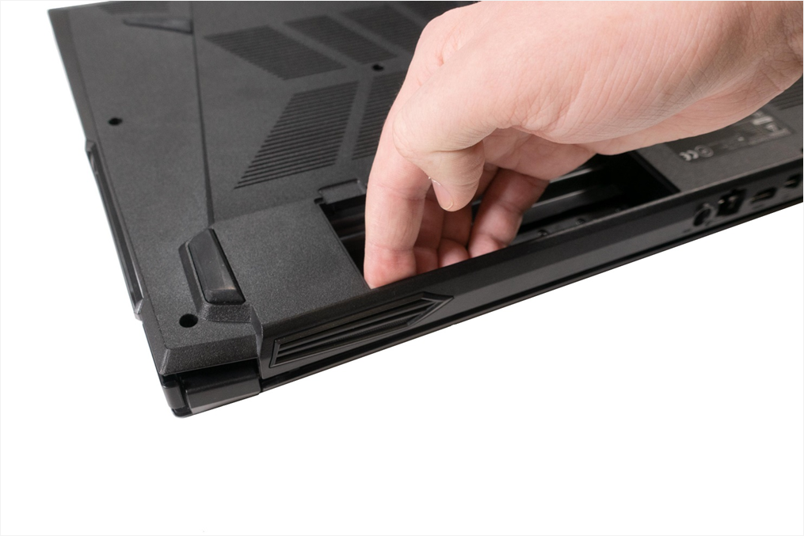
1. Step
Remove battery
1777: Loosen 14 long screws (Fig.1) + 3 short ones in the battery compartment.( Fig.2).
1577: Undo 2 long hinge screws + 13 screws.(Fig.3).
1777T: The 3 screws in the battery compartment are in a different place than on the 1777 (Fig. 4)
Starting at the battery compartment, carefully loosen the bottom case by pulling it upwards.(Fig. 5).
1
1
2
2
3
3
4
4
4
5

Slide 10
REMOVE THE RAM
TERRA MOBILE 1577/1777
Difficulty: 

Slide 11
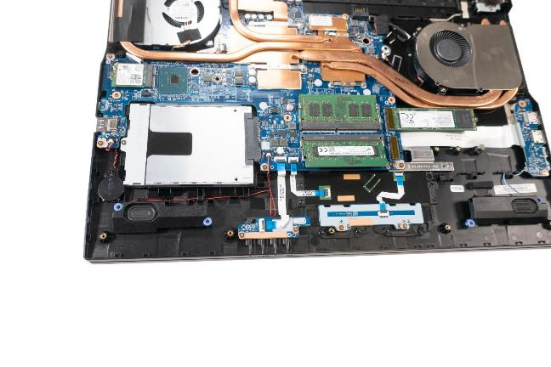
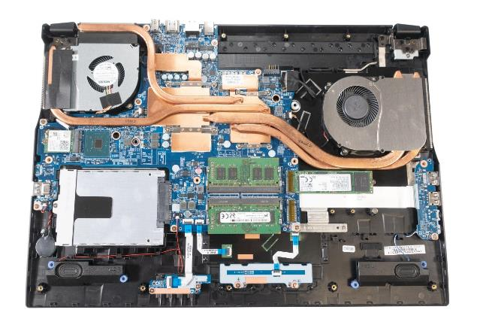
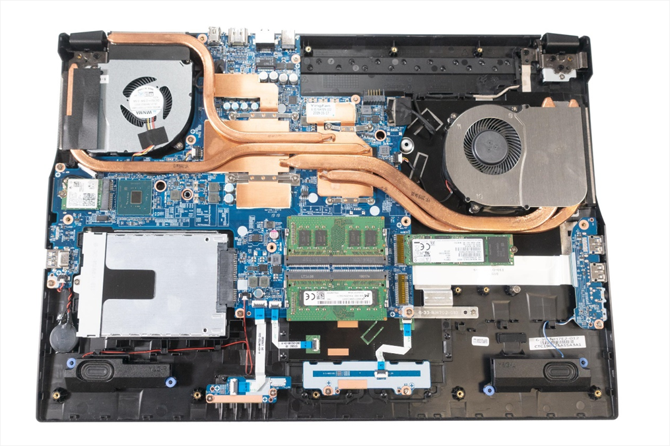
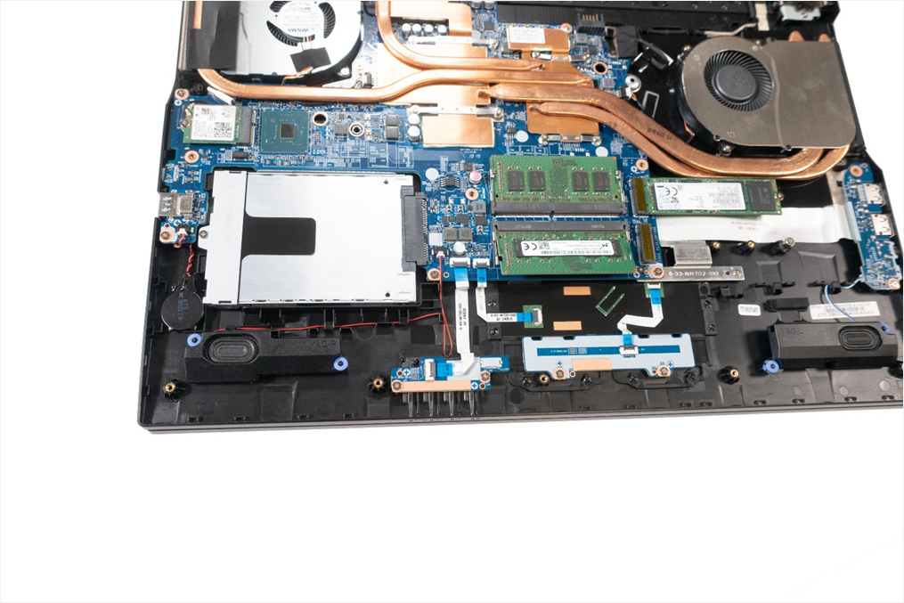
1. Step
Remove the Bottom Case
Push the metal retaining clips outwards at the same time to release the RAM. (Fig.1).
Now you can easily remove the RAM. (Fig.2).
Repeat the process for the other module if necessary.
1
1
2
2

Slide 12
REMOVE THE HDD
TERRA MOBILE 1577/1777
Difficulty: 

Slide 13
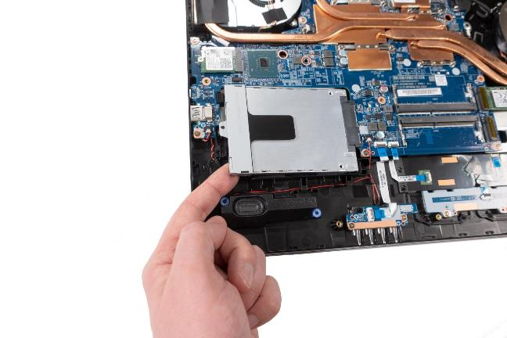
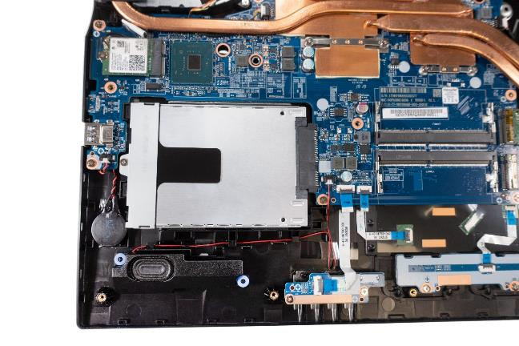
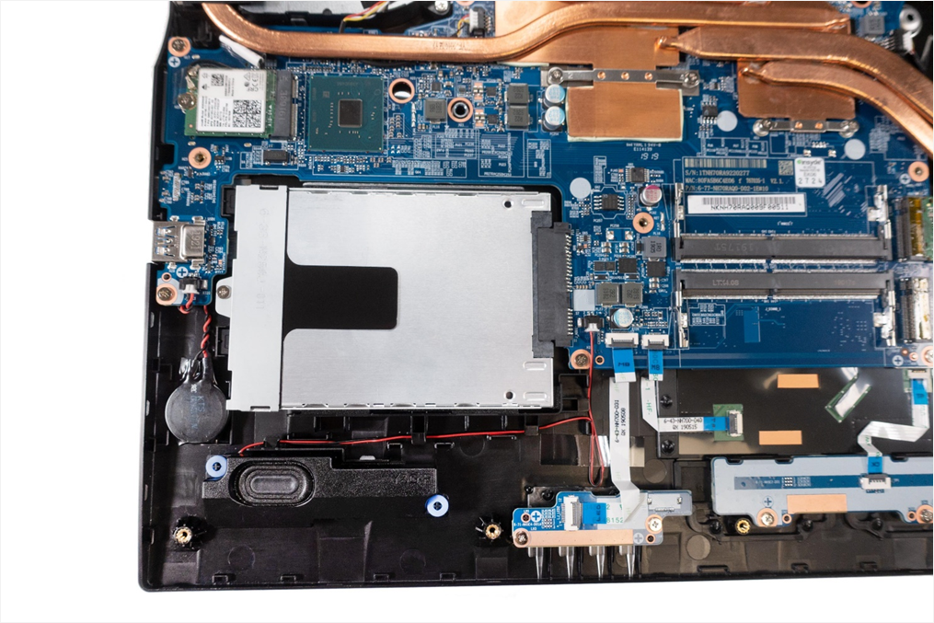
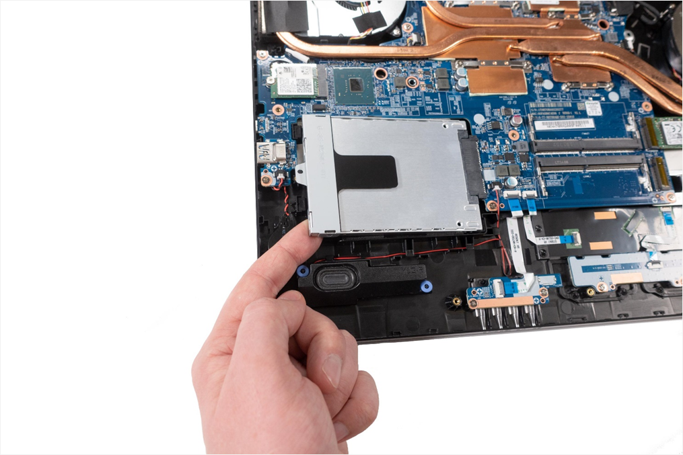
1. Step
Remove the Bottom Case
Loosen the screw.(Fig.1).
Now you can remove the HDD. (Fig. 2).
1
2

Slide 14
REMOVE THE M.2 SSD
TERRA MOBILE 1577/1777
Difficulty: 

Slide 15
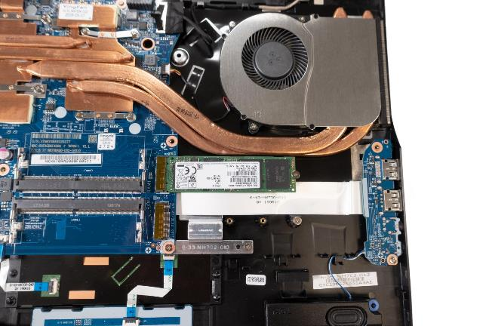
1. Step
Remove the Bottom Case
Loosen the screw. (Fig.1).
Now you can remove the M.2 SSD

Slide 16
REMOVE THE WLAN MODULE
TERRA MOBILE 1577/1777
Difficulty: 

Slide 17
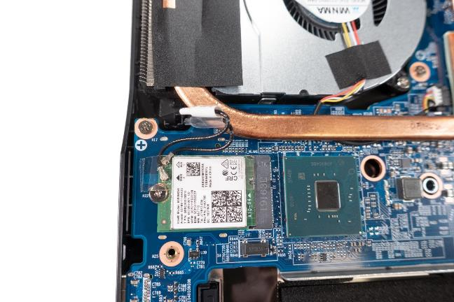
1. Step
Remove the Bottom Case
First remove the adhesive strips
Carefully remove the two antenna plugs.
Loosen the screw, now the module can be removed
The transparent cable is AUX, the white cable is MAIN.
If necessary, renew the adhesive strip.
The antenna connectors do not have to be disconnected for mainboard replacement.

Slide 18
REMOVE THE CMOS BATTERY
TERRA MOBILE 1577/1777
Difficulty: 

Slide 19
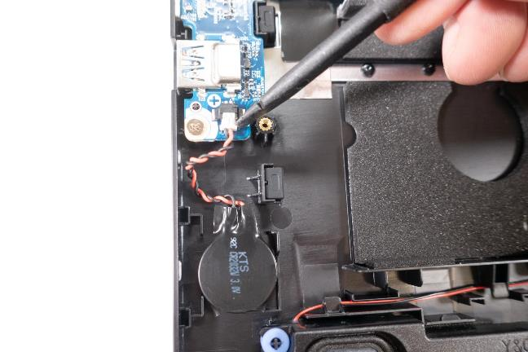
1. Step
Remove the Bottom Case
Carefully unplug the connector
Now you can remove the battery
The new CMOS battery must be fixed in position with an adhesive strip.
When starting up, the notebook switches off twice by itself,(this is normal )
Confirm the "CMOS Message when the system restarts. Make sure you reset your BIOS/UEFI Settings,

Slide 20
REMOVE THE GPU FAN
TERRA MOBILE 1577/1777
Difficulty: 

Slide 21
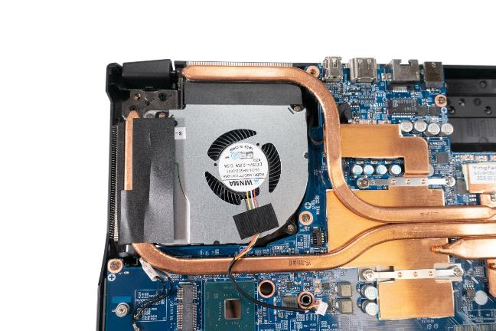
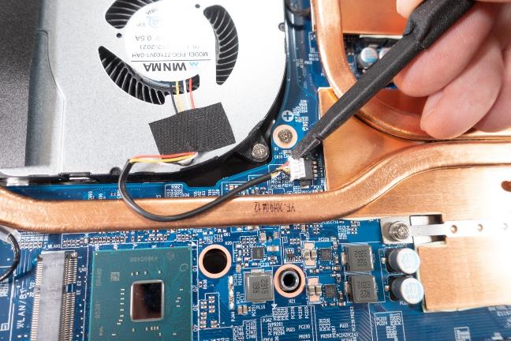
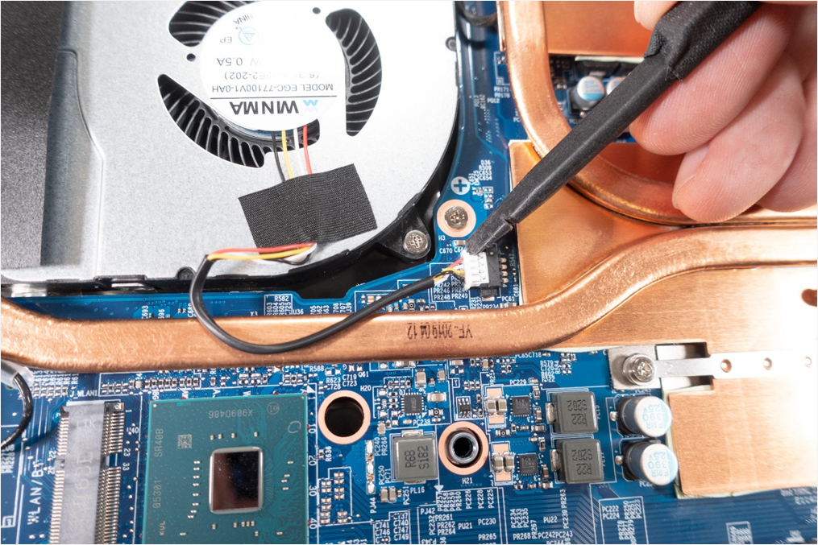
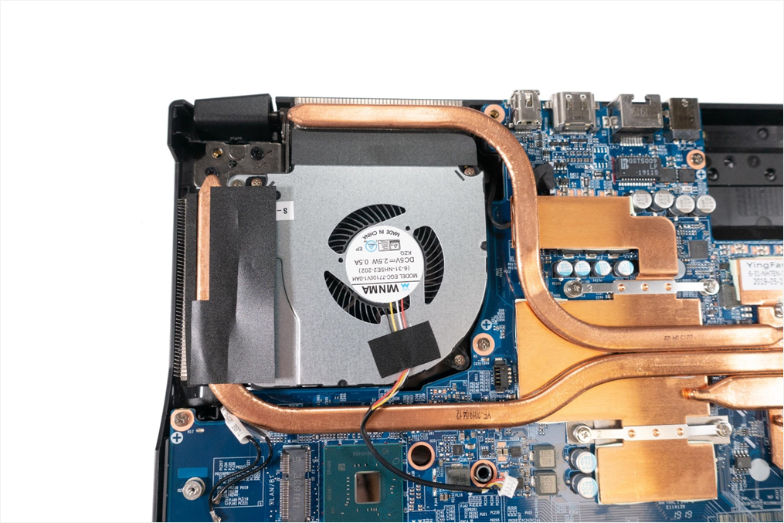
1. Step
Remove the Bottom Case
Carefully loosen the cable.(Fig.1).
Remove the 3 screws.(Fig. 2).
1
2

Slide 22
REMOVE THE CPU
FAN / HEATSINK
TERRA MOBILE 1577/1777
Difficulty: 

Slide 23
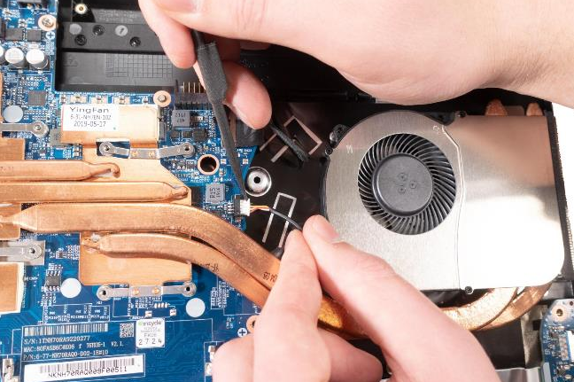
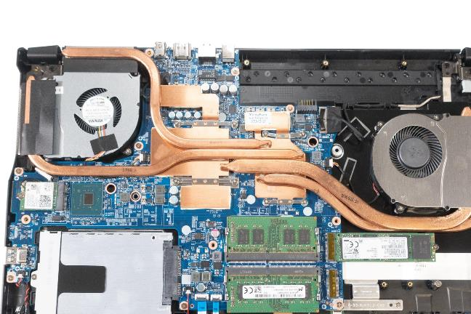
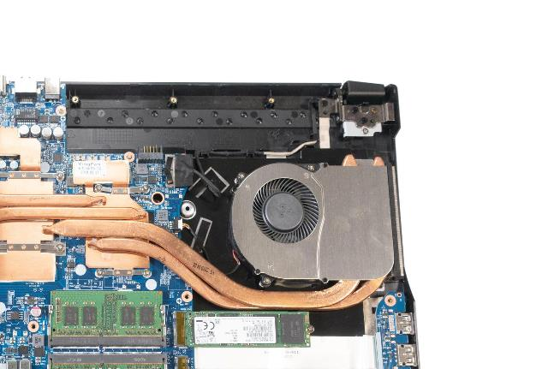

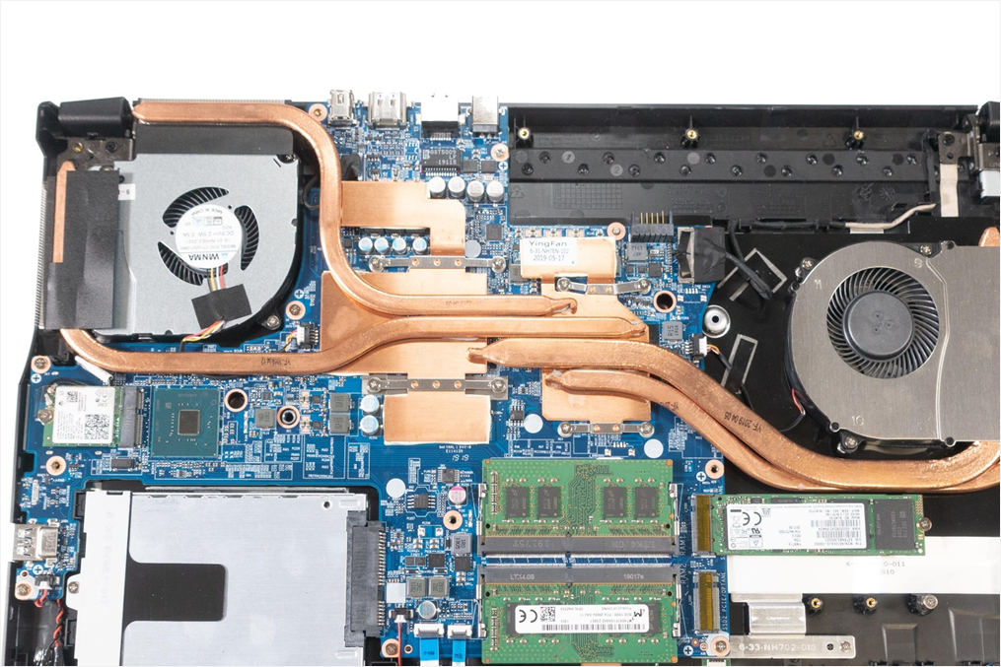
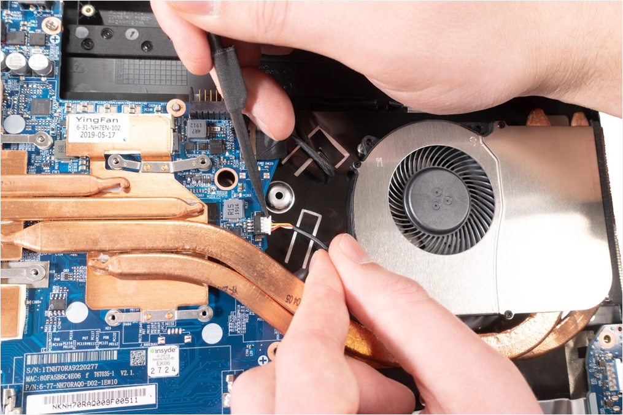
1. Step
Remove the Bottom Case
Loosen the 3 screws from the fan. (Fig.1)
Loosen the 8 screws on the mainboard. (Fig. 2).
Disconnect the cable. (Fig.3).
Remove the protective film from the new heatsink.
1
2
3

Slide 24
REMOVE THE MAINBOARD
TERRA MOBILE 1577/1777
Difficulty: 

Slide 25
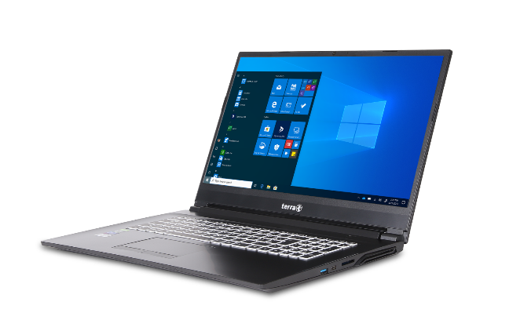
1. Step
Remove the Keyboard
Remove the Bottom Case
Remove the RAM
Remove the HDD
Remove the M.2 SSD
Remove the WLAN Module
Remove the CMOS Battery
Remove the GPU Fan
Remove the CPU Fan / Heatsink

Slide 26
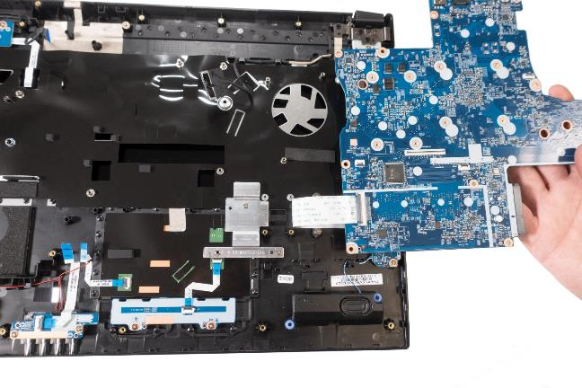
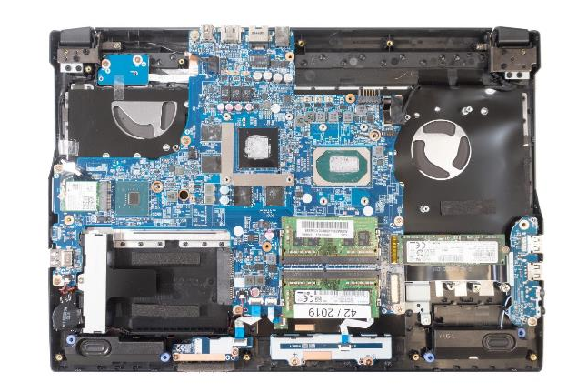
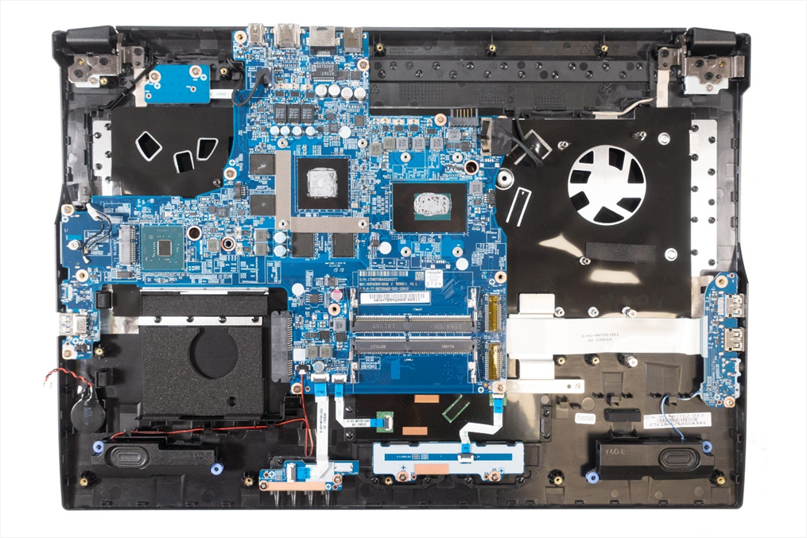
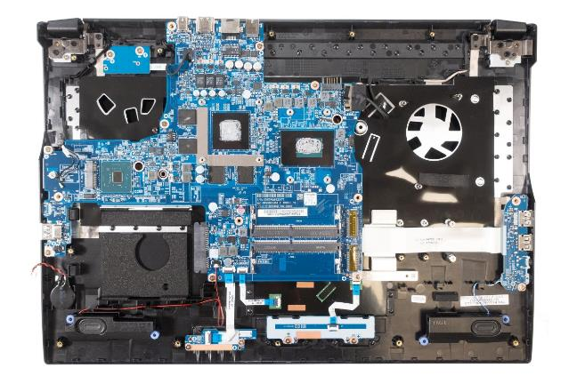
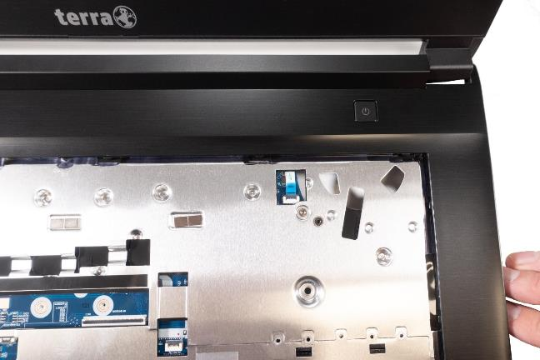
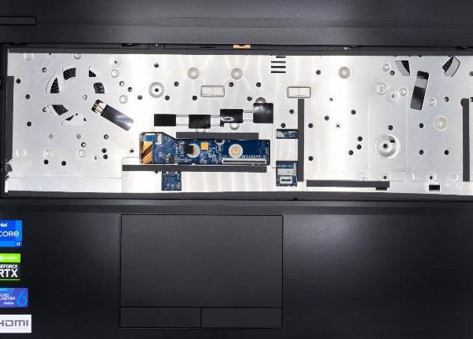
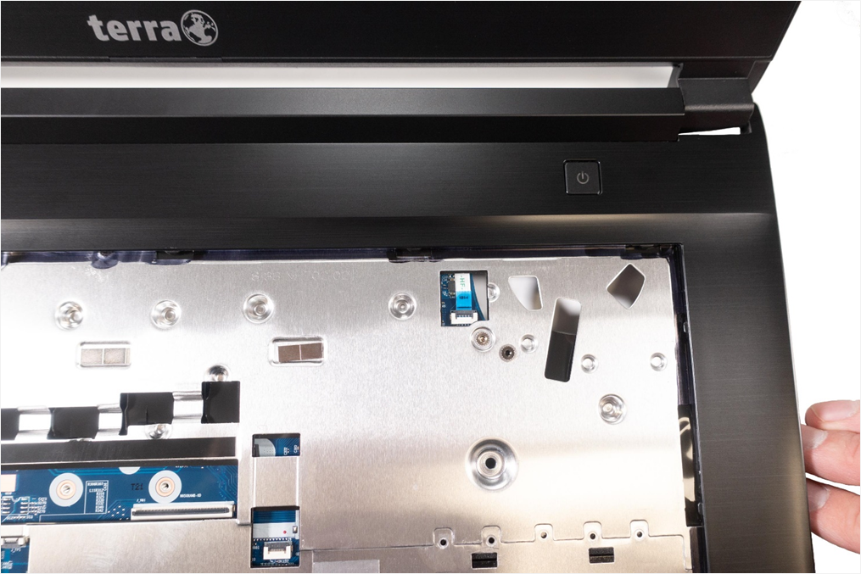

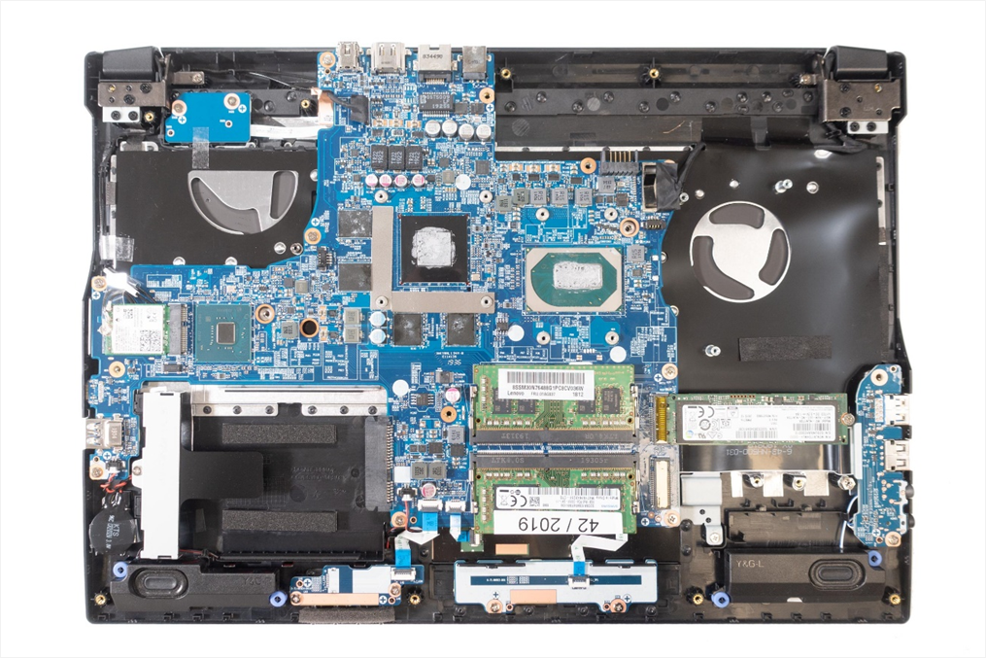
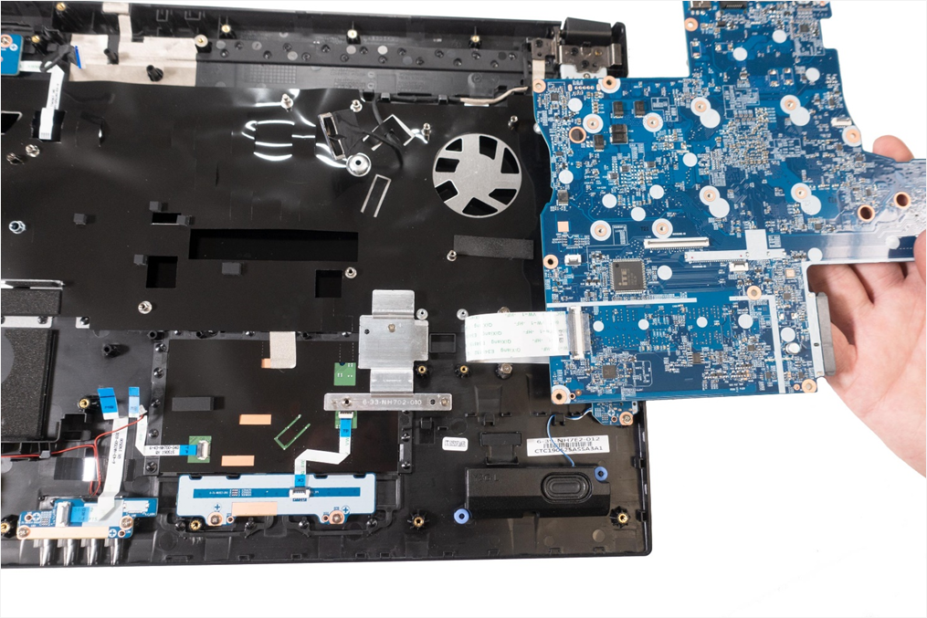

2. Schritt
Disconnect the cable under the keyboard (Fig.1).
Disconnect the 5 cables. (Fig.2).
1777: Remove 7 screws from the mainboard .(Fig.3).
1577: Remove 8 screws from the mainboard. (Fig.4).
Now carefully lift up the mainboard and disconnect the flat ribbon cable.(Fig.5).
1777T: The cable under the keyboard is on the left-hand side (Fig. 6), otherwise like 1777
1
2
3
4
5

Slide 27
REMOVE THE TOP CASE
TERRA MOBILE 1577/1777
Difficulty: 

Slide 28

1. Step
Remove the Keyboard
Remove the Bottom Case
Remove the HDD
Remove the M.2 SSD
Remove the CMOS Battery
Remove the GPU Fan
Remove the CPU Fan / Heatsink
Remove the Mainboard

Slide 29









1. Step
The marked components have to be removed and transferred to the new housing.(Fig.1).
Loosen 2x3 screws on the hinges. (Fig.2 & 3).
Disconnect the 2 antenna cables, the LCD cable and the webcam cable. (Fig.4).
Lift up the hinges, now you can remove the top case. (Fig.5).
Note on assembly:
The hinge screws are marked!
Pay attention to the cable routing it´s very important!
|
1
2
3
4
5

Slide 30
REMOVE THE LCD DISPLAY
TERRA MOBILE 1577/1777
Difficulty: 

Slide 31






1. Step
Remove the Battery
Loosen the front cover by placing your fingernail behind the LCD bezel. Start with the sides and then loosen the top. (Fig.1 & 2).
Note: The front cover is connected to the back cover by small hooks. It is additionally glued in the lower area
Now carefully remove the adhesive between the LCD bezel and the LCD display. The adhesive strip has to be replaced afterwards.(Fig.3).
Now you can remove the LCD display bezel.
1
2
3

Slide 32




2. Step
Place a protective cloth on the keyboard
Carefully remove the display from the housing. The display is attached with 4 adhesive strips.(Fig.1).
Place the display on the notebook. (Fig.2).
To remove the display cable, the adhesive strip has to be removed. It must be replaced.
Replace the 4 adhesive strips before installing the new display.
1
2

Slide 33
REMOVE THE LCD
BACK COVER
TERRA MOBILE 1577/1777
Difficulty: 

Slide 34



1. Step
Remove the LCD Display
Carefully detach the webcam including the cable. Remove the display cable from the guide and detach the WLAN antennas. (Fig.1).
Loosen 2x3 screws on the hinges, as well as the 2 screws at the top (Fig.2).
Also remove the protective adhesive strips from the new cover.
1
2

Slide 35
Spare Parts TERRA MOBILE 1577
Article number | Description
1480170 | Battery 48,96Wh
E1080369 | Audio Board
E1080411 | Bottom Case (Cover D)
E1080402 | Cable for Webcam
E1080370 | Click Board
E1081834 | CMOS Battery
E1080409 | CPU Fan
E1080373 | GPU Fan
E1080415 | Hinge ( R)
E1080414 | Hinge (L)
E1080412 | LCD Back Cover (Cover A)
E1080417 | LCD Cable
E1080436 | LCD Display 15.6" FHD (eDP)
E1080327 | LCD Double Side Tape for Display
E1080413 | LCD Front Cover (Cover B)
E1080410 | Mainboard Mobile 1577 (i5-9300H)
1481236 | Power supply 120W
Article number | Description
E1080371 | Power Switch Board
E1080365 | Speaker (L)
E1080366 | Speaker (R)
1480164 | Keyboard Multi-Colour [CH]
1480163 | Keyboard Multi-Colour [DE]
1480165 | Keyboard Multi-Colour [FR]
1480167 | Keyboard Multi-Colour [UK]
1480166 | Keyboard Multi-Colour [US]
E1080408 | Top Case (Cover C)
E1080367 | Touchpad
E1080368 | Touchpad Mylar
E1080416 | Webcam

Slide 36
Spare Parts TERRA MOBILE 1777
Article number | Description
1480170 | Battery 48,96Wh
E1080369 | Audio Board
E1080375 | Bottom Case (Cover D)
E1080381 | Cable for Webcam
E1080370 | Click Board
E1081834 | CMOS Battery
E1080374 | CPU Fan
E1080373 | GPU Fan
E1080379 | Hinge (R)
E1080378 | Hinge (L)
E1080377 | LCD Back Cover (Cover A)
E1080383 | LCD Cable
E1080382 | LCD Display 17.3" FHD (eDP)
E1080327 | LCD Double Side Tape for Display
E1080376 | LCD Front Cover (Cover B)
E1080372 | Mainboard Mobile 1777 (i7-9750H)
1481236 | Power supply 120W
Article number | Description
E1080371 | Power Switch Board
E1080365 | Speaker (L)
E1080366 | Speaker (R)
1480164 | Keyboard Multi-Colour [CH]
1480163 | Keyboard Multi-Colour [DE]
1480165 | Keyboard Multi-Colour [FR]
1480167 | Keyboard Multi-Colour [UK]
1480166 | Keyboard Multi-Colour [US]
E1080364 | Top Case (Cover C)
E1080367 | Touchpad
E1080368 | Touchpad Mylar
E1080380 | Webcam

Slide 37
Spare Parts TERRA MOBILE 1777T
Artikelnummer | Beschreibung
1480170 | Battery 48,96Wh
E1080614 | Audio Board
E1080612 | Bottom Case (Cover D)
E1080381 | Cable for Webcam
E1080646 | Click Board
E1081834 | CMOS Battery
E1080611 | CPU & GPU Lüfter
E1080619 | Hinge Cover
E1080620 | Hinge (R)
E1080621 | Hinge (L)
E1080617 | LCD Back Cover (Cover A)
E1080626 | LCD Cable
E1080382 | LCD Display 17.3" FHD (eDP)
E1080327 | LCD Double Side Tape for Display
E1080618 | LCD Front Cover (Cover B)
E1080610 | Mainboard Mobile 1777T (i7-11800H)
1481238 | AC-Adapter 150W
Artikelnummer | Beschreibung
E1080645 | Power Switch Board
E1080365 | Speaker (L)
E1080366 | Speaker (R)
1480164 | Keyboard Multi-Color [CH]
1480163 | Keyboard Multi-Color [DE]
1480165 | Keyboard Multi-Color [FR]
1480167 | Keyboard Multi-Color [UK]
1480166 | Keyboard Multi-Color [US]
E1080613 | Top Case (Cover C)
E1080615 | Touchpad
E1080616 | Touchpad Mylar
E1080644 | Webcam

